Slide 1
Favorable Findings For Dependency
Compensation Service
January 2019

Slide 2
Lesson Objectives
Define favorable findings
Explain when to use and input favorable findings
Overturning favorable findings

Slide 3
References
Public Law 115-55, Veterans Appeals Improvement and Modernization Act 2017
38 CFR 3.103(f), Decision Notices
M21-1, Part III, Subpart v, 2. B, Decision Notices

Slide 4
Define Favorable Finding
A favorable finding is a determination of fact, based on applicable laws and regulations, made by the adjudicator on an issue under review. Favorable findings should relate to a material element that would be required to grant the benefit sought.

Slide 5
AMA Notice Requirements
IMPORTANT – AMA notice requirements do not apply to award adjustments (such as drill pay, military retired pay adjustments, incarceration, return to active duty, etc.)

Slide 6
Required Elements of a Decision Notice
Each decision notice (rating and non-rating issues) must:
inform the claimant of the issues adjudicated
summarize the
  − evidence VA considered
  − laws and regulations applicable to the claim, and
  − applicable review options the claimant may use to seek further review
  of the decision
explain how to obtain or access evidence used in making the decision
identify, if applicable, the criteria required to grant SC or the next-higher level of compensation, and/or
identify
  − for denied claims, the element(s) required to grant the claim that were
  not met, and
  − a listing of findings that are favorable to the claimant under 38 CFR
  3.104(c), if any

Slide 7
Favorable Findings Requirement
Each notice of a decision affecting benefits must address any findings made by the adjudicator that are favorable to the claimant.
  Not all claims will have favorable findings
  Element selection generates favorable finding language
  Elements specific to dependent type...for example:
    Spouse
    Minor Child
    Foster child
    School child

Slide 8
Favorable Findings Requirement
For example: If we denied a claim to add a dependent spouse the decision notice would identify the element(s) not met with a summary of applicable laws and regulations. Then list the element(s) met that are favorable to the veteran. The decision notice will state:
“We couldn’t pay for <Dependent’s Name> as a dependent, because not all required elements were met. The following list contains an explanation of the elements required to establish entitlement to additional compensation for your dependent:”
“You failed to provide the date and place of the marriage. (38 CFR 3.204).”

Slide 9
Favorable Findings: Examples
“Even though we aren’t able to pay additional compensation for your dependent, the following findings were favorable to your claim:”
You are rated 30% or greater service connected
You provided < Dependent’s Name>’s social security number.
Your relationship with < Dependent’s Name> has been established.
You provided your spouse's name.
You provided < Dependent’s Name>’s social security number.
You provided marital history, as requested.
You provided your spouse’s date of birth.

Slide 10
Inputting Favorable Findings
Automatically included in the decision notice
  Based upon VSR selecting required decision elements.
Proper selection of decision elements as “met” or “not met”
  Determines favorable finding text listed in decision notice.

Slide 11
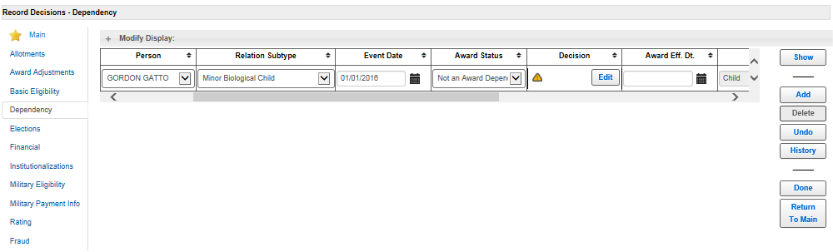
Inputting Favorable Findings (Cont...)

Slide 12
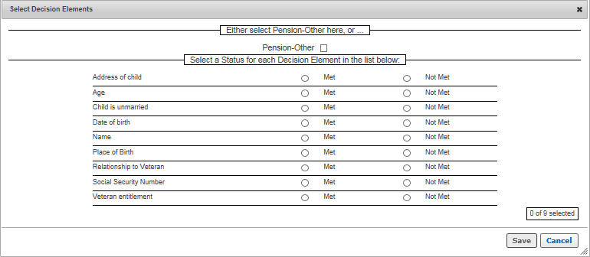
Inputting Favorable Findings (Cont...)

Slide 13
Dependency Denial Example
John Smith a service connected veteran submits a VA Form 21-686c wishing to add minor child Larry Smith to his award. A review of the file show’s he is rated at 30% for sleep apnea. All information to add the minor child is present on the 686c except the minor child’s social security number.
All attempts to contact the veteran by phone have been unsuccessful. The veteran fails to respond within 30-days with requested information.

Slide 14
Dependency Denial Example (Cont...)

Slide 15
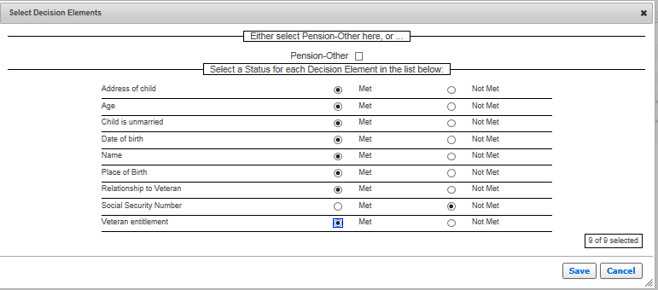
Dependency Denial Example (Cont...)

Slide 16
Dependency Denial Example (Cont...)

Slide 17
Generated Favorable Finding Text
"The following text displays in the letter:
Even though we aren’t able to pay additional compensation for your dependent, the following findings were favorable to your claim:
  You are rated 30% or greater service connected.
  You provided < Dependent’s Name>’s age.
  Your relationship with < Dependent’s Name> has been established.
  You provided your child’s name.

Slide 18
Generated Favorable Finding Text (Cont...)
  You provided < Dependent’s Name's> place of birth.
  < Dependent’s Name> is unmarried.
  You provided <Dependent> address.
  You provided < Dependent’s Name>’s date of birth.

Slide 19
Generated Favorable Finding Text (Cont...)

Slide 20
Overturning Favorable Findings
The veteran may file a new claim to add a previously denied dependent that calls into question a prior favorable finding.
Once it is determined that a prior favorable finding is no longer favorable we must overturn that favorable finding and notify the veteran of the reason why the prior finding was overturned.
We take the same approach as inputting favorable findings to overturn a favorable finding. The only difference is we now take the “met” element that was previously favorable and change to “not met”.
Once you change the element you will be prompted with the following message:
"You are electing to overturn a prior favorable finding. Please provide a justification that meets the clear and unmistakable evidence standard necessary to overturn a favorable finding.”

Slide 21
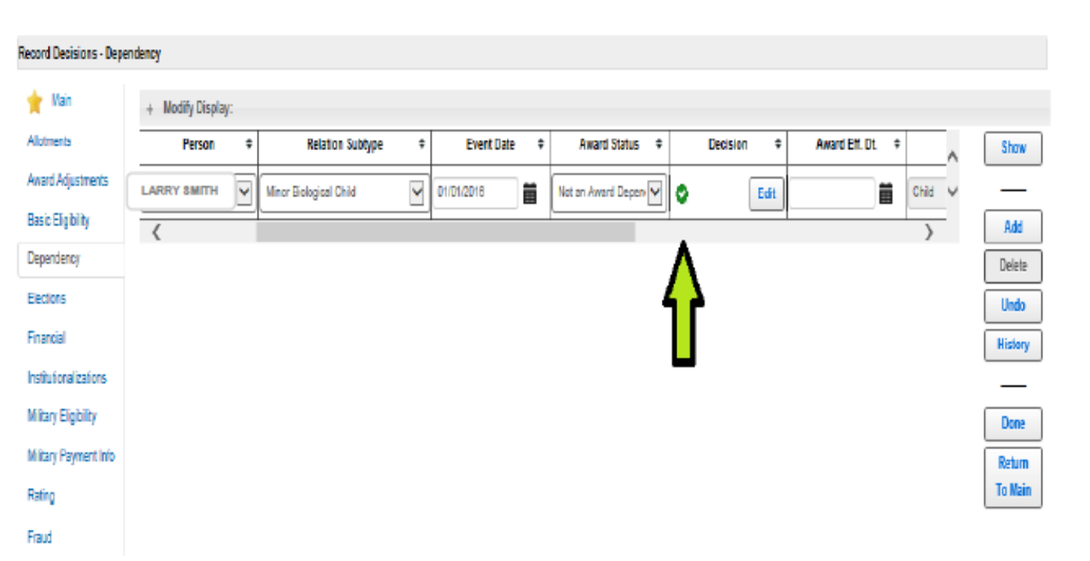
Overturning Favorable Findings (Cont...)

Slide 22
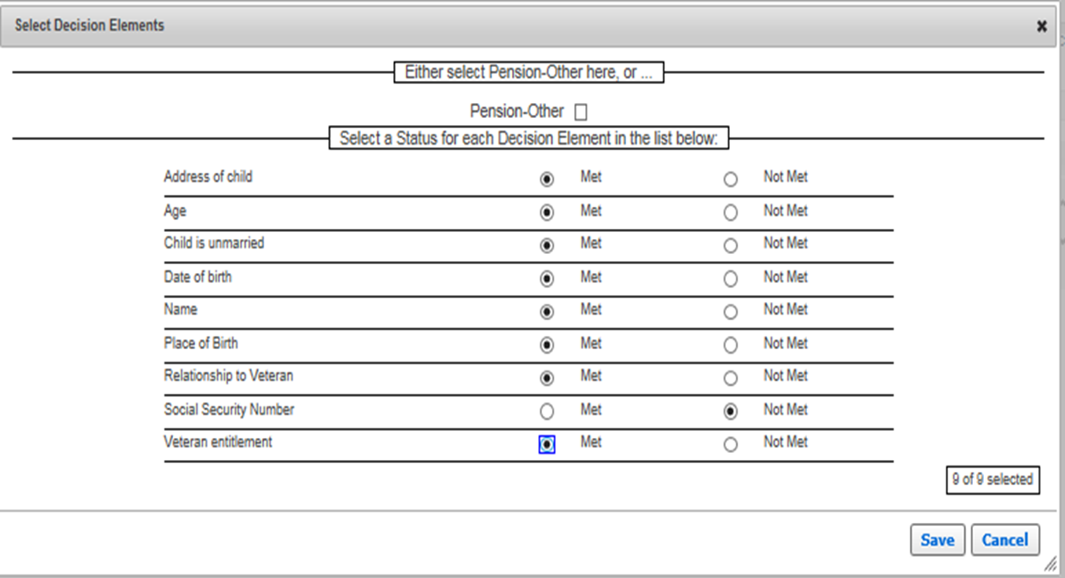
Overturning Favorable Findings (Cont...)

Slide 23
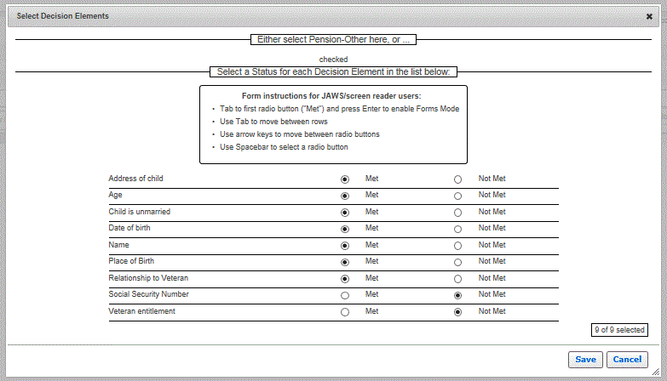
Overturning Favorable Findings (Cont...)

Slide 24
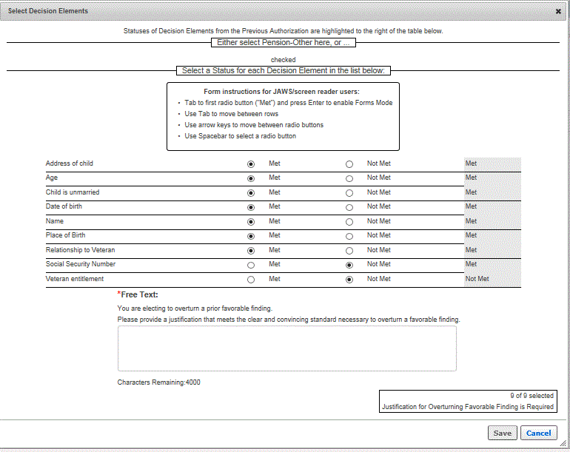
Overturning Favorable Findings (Cont...)
Please provide a justification that meets the clear and unmistakable evidence standard necessary to overturn a favorable finding.

Slide 25
Overturned Favorable Finding Generated Text
“The following text displays in the letter:
Favorable Findings Overturned (Header)
“Based on evidence of record, we have overturned the following finding(s) that we had originally decided in favor of your claim:
In the text box you will list the prior favorable finding that is being overturned and then provide justification for overturning.
<You are rated 30% or greater service connected.>”
“The overturned issue's explanation appears in the letter:
“The rating decision dated 2/1/2019 reduced your service connection percentage from 30% to 20% therefore you are no longer eligible for the benefit sought. (38 CFR 3.4)”

Slide 26
Overturned Favorable Finding Generated Text

Slide 27
Review
Questions?

