Slide 1
VRE Shipping Exceptions Training
Vocational Rehabilitation & Employment Service
Briefed by:
VR&E Service
Updated: February 6, 2019
Notes:
Hello and welcome to the training on resolving shipping exceptions within the ddTracker. My name is ________________ and I will be presenting.
A few housekeeping items before we begin:
This training is being recorded, so we have muted the audience. We will have a Q&A at the end of the training.
During the Q&A, please keep your questions relevant to the topics in the interest of time. We ask that you type your questions into the chat, and at the end of this training, we will unmute the audience for questions.
We also ask that you please keep sidebar conversations out of the Skype chat as it is distracting to the presenters as well as to the audience.
So let’s begin.

Slide 2
Purpose
The purpose of this training is to provide instructions to the VR&E Offices on the process of identifying and resolving shipping exceptions for inactive and active files.
Notes:
The purpose of this training is to provide step-by-step instructions for the VR&E offices, (and to CMAs on how to conduct the training in support of the ROs), on the process of identifying and resolving various types of shipping exceptions for inactive, and eventually active files.

Slide 3
Acronyms & Definitions
DCS ID (Document Control Sheet ID): Identifies a Veteran’s file generated within VBMS. DCS ID is required to allow scanning and uploading into efolders
ddTracker (Data Dimensions Tracker): Shipping portal for entering shipping information for the vendor. *This is the tracker needed for all shipments going to SMS in Janesville, WI
Manifest: Includes Shipping list used to identify files within box and UPS tracking number (i.e., DCS IDs)
RMN (Record Management Number): Identifies the shipments created by each station (i.e., 306VB0126195009b)
SMS (Systems Made Simple): Scanning Vendor
Notes:
We’ve provided a lit of acronyms and definitions, most of which you might already be familiar with from the inactive folder shipping training:
DCS ID (Document Control Sheet ID): Identifies a Veteran’s file generated within VBMS. DCS ID is required to allow scanning and uploading into efolders
ddTracker (Data Dimensions Tracker): Shipping portal for entering shipping information for the vendor. *This is the tracker needed for all shipments going to SMS in Janesville, WI
Manifest: Includes Shipping list used to identify files within box and UPS tracking number (i.e., DCS IDs)
RMN (Record Management Number): List of DCS IDs that were created on a specific day 306 Station, VB – Veterans Benefits, 01/26/19 - date the shipment was created in VBMS, 5009 – box number and last four digits of UPS tracking, B – Intake Site)
SMS (Systems Made System): Scanning Vendor

Slide 4
Training Topics
How to Locate Shipping Exceptions and Update the ddTracker Shipping Manifest Web Portal
How to Resolve Shipping Exceptions for:
  RMN/UPS Tracking Number Missing from Vendor Portal
  Missing DCS ID(s) from Manifest (extra file(s) in the box)
  Extra DCS ID(s) on Manifest (missing file(s) from the box)
  Missing or Incorrect Shipping Manifest
How to Create Document Control Sheet (DCS ID)
How to Generate VR&E Shipping Manifest
Technical Support
Notes:
How to Locate Shipping Exceptions in the ddTracker Shipping Manifest Web Portal
How to Resolve Shipping Exceptions for:
RMN/UPS Tracking Number Missing from Vendor Portal
Missing DCS ID(s) from Manifest (extra file(s) in the box)
Extra DCS ID(s) on Manifest (missing file(s) from the box)
Missing or Incorrect Shipping Manifest
How to Create Document Control Sheet (DCS ID)
How to Generate VR&E Shipping Manifest
Technical Support

Slide 5
Locating Shipping Exceptions
and
Updating ddTracker
Notes:
We will begin our training by discussing how to locate shipping exceptions and updating the ddTracker. Note that these next few steps will need to be followed to locate each exception.

Slide 6
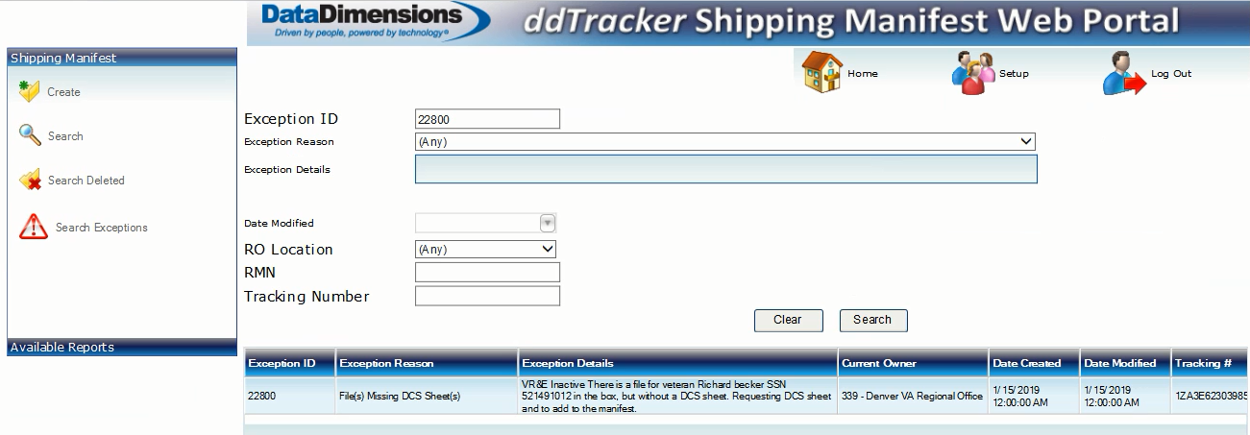
Locating Shipping Exceptions and Updating ddTracker
Launch ddTracker Shipping Manifest Web Portal to locate shipping exceptions
From the Home page select Search Exceptions
In the Exception ID page select the Search button
ddTracker will display unresolved shipping exceptions at the bottom of your screen
Double-click on the Exception ID you wish to resolve
Notes:
Launch ddTracker Shipping Manifest Web Portal to locate shipping exceptions
From the Home page select Search Exceptions
In the Exception ID page select the Search button
ddTracker will display unresolved shipping exceptions at the bottom of your screen
Double-click on the Exception ID you wish to resolve
Users who are identified POCs will be notified of any shipping exceptions via email.

Slide 7
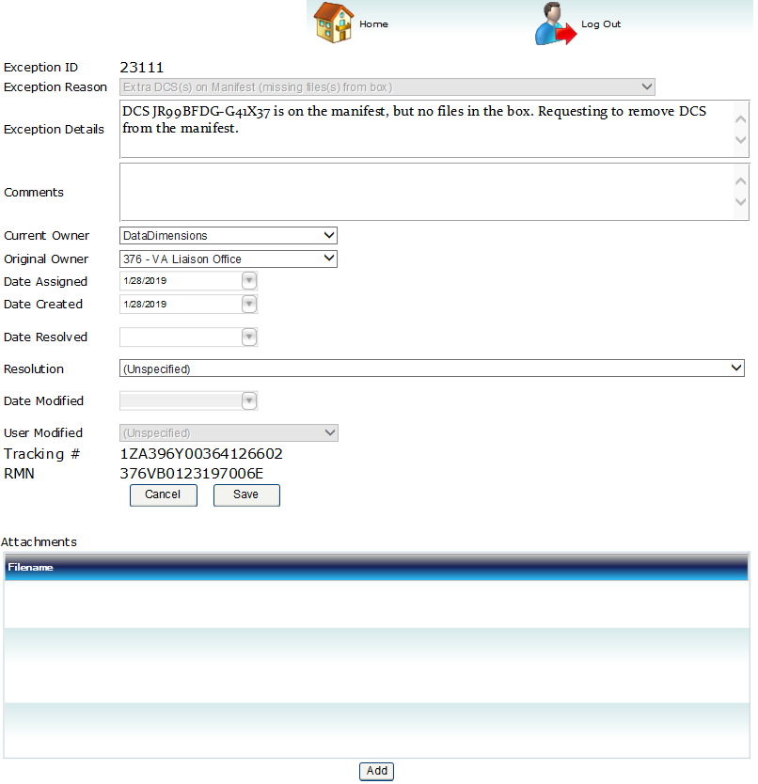
Locating Shipping Exceptions and Updating ddTracker
ddTracker will display a detailed view of the shipping exception
Additional information and resolution instructions can be found in the Exception Details box
Notes:
ddTracker will display a detailed view of the shipping exception
Additional information and resolution instructions can be found in the Exception Details box
Now that we’ve located the shipping exception, we will now proceed with updating the ddTracker

Slide 8
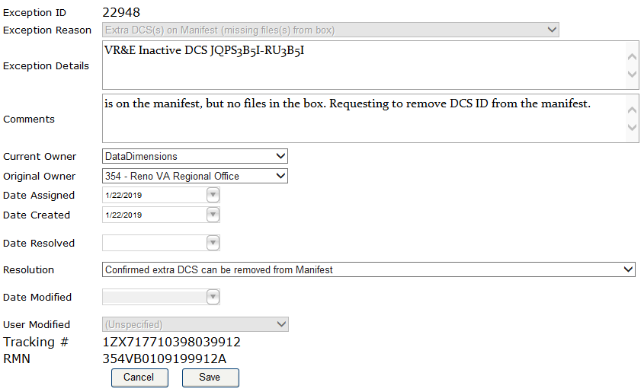
Locating Shipping Exceptions and Updating ddTracker
After completing the steps to resolve pending shipping exceptions, the next step is to update the ddTracker:
Select DataDimensions from the Current Owner drop-down list
Select the applicable resolution statement from the Resolution drop-down list
Click Save
Notes:
After completing the steps to resolve pending shipping exceptions, the next step is to update the ddTracker:
Select DataDimensions from the Current Owner drop-down list
Select the applicable resolution statement from the Resolution drop-down list
Click Save
Now that we have updated the ddTracker, we will move on to discuss how to resolve our shipping exceptions.

Slide 9
RMN/UPS Tracking Missing from Vendor Portal
(Shipping information was not added to the ddTracker Portal)
Notes:
This type of shipping exception involves a missing RMN or UPS tracking number from the vendor portal. In other words, the individual neglected to add the shipping information into the portal. This is a required and necessary step.

Slide 10
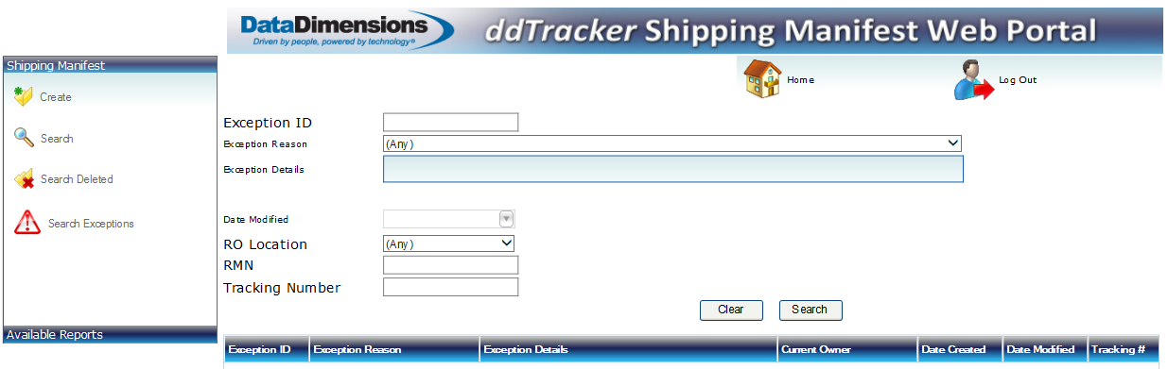
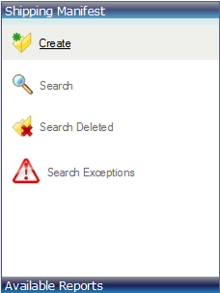
RMN/UPS Tracking Number Missing from Vendor Portal
This shipping exception occurs when the RO does not add the shipping information into the ddTracker portal prior to shipping a box.
To resolve shipping exceptions with a missing RMN and/or UPS Tracking number, sign into the ddTracker Shipping Manifest Web Portal
From the Home page select Create
Notes:
This shipping exception occurs when the RO does not add the shipping information into the ddTracker portal prior to shipping a box.
To resolve shipping exceptions with a missing RMN and/or UPS Tracking number, sign into the ddTracker Shipping Manifest Web Portal
From the Home page select Create

Slide 11
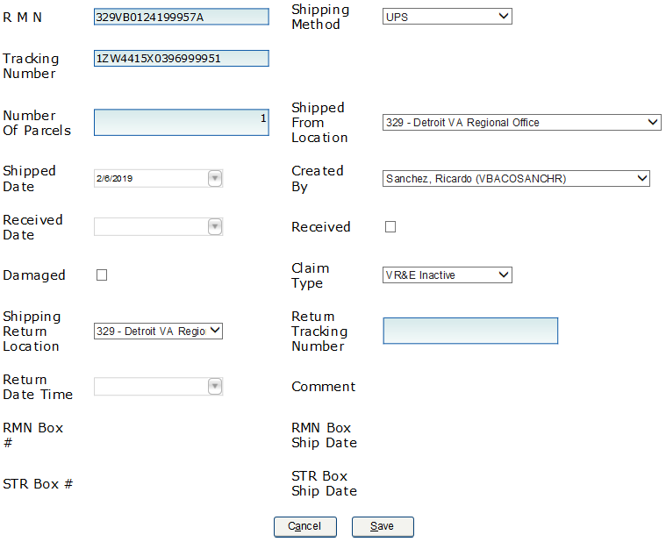
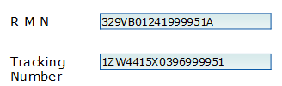

RMN/UPS Tracking Number Missing from Vendor Portal
Enter or copy and paste the RMN and Tracking Number
Select UPS for Shipping Method
The Shipped from Location and Shipped Return Location should reflect the shipping station (your RO)
From the Claim Type drop-down list select VR&E Inactive
Click Save
To return to the Home page, select Home
Note: The shipping information is saved when the RMN … saved message appears at the bottom of your screen
Notes:
Enter or copy and paste the RMN and Tracking Number
Select UPS for Shipping Method
The Shipped from Location and Shipped Return Location should reflect the shipping station (your RO)
From the Claim Type drop-down list select VR&E Inactive
Click Save
To return to the Home page, select Home
Note: The shipping information is saved when the RMN … saved message appears at the bottom of your screen

Slide 12
RMN/UPS Tracking Number Missing from Vendor Portal
After the RMN/UPS tracking number were added to the ddTracker, update the shipping exception status. Begin from the ddTracker Home page:
Select Search Exceptions, then click the Search button on the Exception ID page
In the Exception ID page, ddTracker will display unresolved shipping exceptions at the bottom of your screen
Double-click on the Exception ID you wish to resolve
Notes:
After the RMN/UPS tracking number were added to the ddTracker, update the shipping exception status. Begin from the ddTracker Home page:
Select Search Exceptions, then click the Search button on the Exception ID page
In the Exception ID page, ddTracker will display unresolved shipping exceptions at the bottom of your screen
Double-click on the Exception ID you wish to resolve

Slide 13
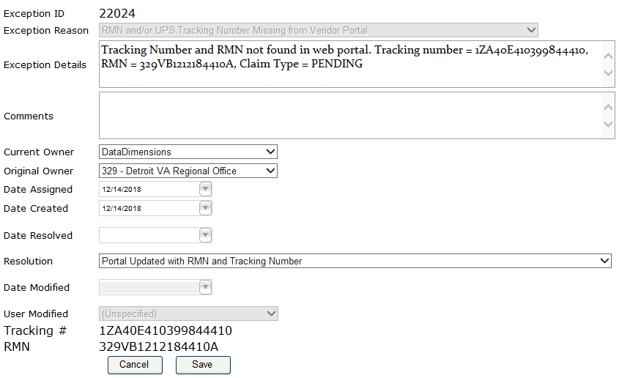
RMN/UPS Tracking Number Missing from Vendor Portal
  From the Current Owner drop-down list, select DataDimensions
  From the Resolution drop-down list, select Portal Updated with RMN and Tracking Number
  Click Save
Notes:
From the Current Owner drop-down list, select DataDimensions
From the Resolution drop-down list, select Portal Updated with RMN and Tracking Number
Click Save
Once you click Save, the system will process that action, but you will not receive a confirmation notification. Please be sure to click Save only once. Ok, let’s move on to the next topic of Missing DCS IDs from Manifest.

Slide 14
Missing DCS ID(s) from Manifest
(Extra files in the box)
Notes:
Now we will discuss how to resolve a shipping exception that involves missing DCS IDs from a manifest. This means that there are extra files found in a shipping box, but they are not listed on the manifest.

Slide 15
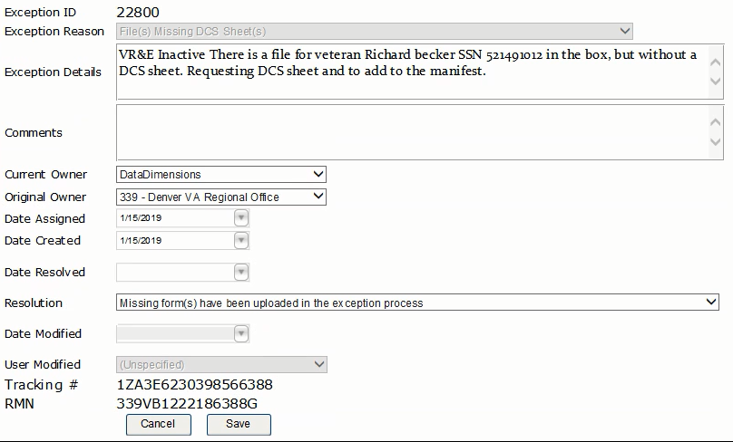
Missing DCS ID(s) from Manifest (extra file(s) in the box)
In the Exception Details box, the vendor will provide information about the files shipped without DCS IDs.
Update the Current Owner field to reflect DataDimensions
Select Missing form(s) have been uploaded in the exception process from the Resolution drop-down
Click Save
Notes:
In the Exception Details box, the vendor will provide information about the files shipped without DCS IDs.
Update the Current Owner field to reflect DataDimensions
Select Missing form(s) have been uploaded in the exception process from the Resolution drop-down
Click Save

Slide 16
Missing DCS ID(s) from Manifest (extra file(s) in the box)
If DCS ID was saved as a PDF:
Upload PDF into ddTracker
Update the Current Owner field to DataDimensions
From Resolution drop-down select: Missing Form(s) have been uploaded in the exception process
Click Save
Notes:
If DCS ID was saved as a PDF:
Upload PDF into ddTracker
Update the Current Owner field to DataDimensions
From Resolution drop-down select: Missing Form(s) have been uploaded in the exception process
Click Save

Slide 17
Missing DCS ID(s) from Manifest (extra file(s) in the box)
  If the missing DCS ID was not saved:
    Log into VBMS
    Create a new DCS ID
    Create a shipping manifest
    Attach the DCS ID PDF file
    Update the Current Owner drop-down list to DataDimensions
    Update Resolution drop-down list to Missing Form(s) have been uploaded in the exception process
  Click Save
  Note: Users must delete DCS IDs that were previously created in VBMS but not shipped. It's important to avoid Pending Scanning Banners (PSBs).
Notes:
If the missing DCS ID was not saved:
Log into VBMS
Create a new DCS ID
Create a shipping manifest
Attach the DCS ID PDF file
Update the Current Owner drop-down list to DataDimensions
Update Resolution drop-down list to Missing Form(s) have been uploaded in the exception process
Click Save
Note: Users must delete DCS IDs that were previously created in VBMS but not shipped. It's important to avoid Pending Scanning Banners (PSBs). It is important to note that if there is a PSB, no claims can be processed or closed.

Slide 18
Extra DCS ID(s) on Manifest
(File not in box)
Notes:
Now we will cover the topic on how to manage extra DCS IDs listed on the manifest. This means that a DCS ID was created in VBMS, but the file was not shipped.

Slide 19
Extra DCS ID(s) on Manifest (missing file from the box)
When a file is missing from the box, but is listed on the manifest, users must first sign into VBMS and delete the old DCS ID by doing the following:
Log in to VBMS and validate your PIV credentials
Select Intake from the upper ribbon
Search by RMN
Click on the Filter button
Notes:
When a file is missing from the box, but is listed on the manifest, users must first sign into VBMS and delete the old DCS ID by doing the following:
Log in to VBMS and validate your PIV credentials
Select Intake from the upper ribbon
Search by RMN
Click on the Filter button

Slide 20
Extra DCS ID(s) on Manifest (missing file from the box)
VBMS will display the search results
Click on Box Number to display a detailed view of the shipment
Notes:
VBMS will display the search results
Click on the hyperlinked Box Number to display a detailed view of the shipment

Slide 21
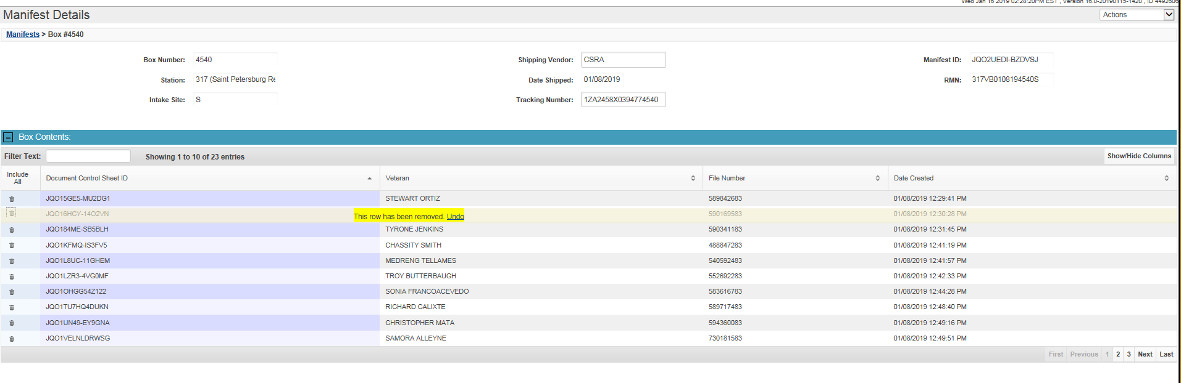
Extra DCS ID(s) on Manifest (missing file from the box)
Locate the DCS ID you wish to remove by clicking on the trash can image in the left column
Select Intake to return to the previous view
Notes:
Locate the DCS ID you wish to remove by clicking on the trash can image in the left column
Select Intake to return to the previous view
Now that you have deleted the old DCS ID, you will need to update the ddTracker portal.

Slide 22
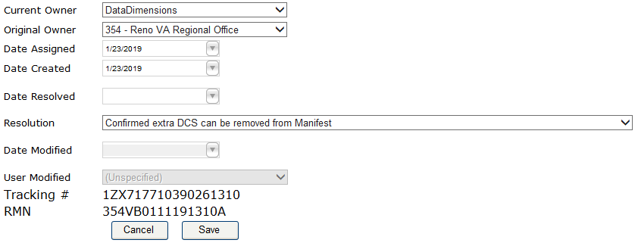
Extra DCS ID(s) on Manifest (missing file from the box)
Next, update the information in the ddTracker portal:
Sign into ddTracker and search for shipping exception
Update the Current Owner to DataDimensions
Update the Resolution to reflect Confirmed extra DCS can be removed from Manifest
Click Save
Notes:
Next, update the information in the ddTracker portal:
Sign into ddTracker and search for shipping exception
Update the Current Owner to DataDimensions
Update the Resolution to reflect Confirmed extra DCS can be removed from Manifest
Click Save

Slide 23
Missing or Incorrect Shipping Manifest
Notes:
Now we will cover the topic on how to resolve an exception involving a missing or incorrect shipping manifest.

Slide 24
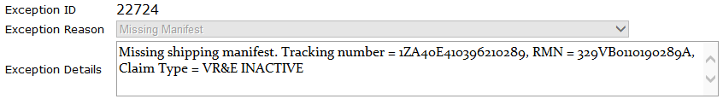
Missing or Incorrect Shipping Manifest
In the Exception Details box, the vendor will provide information about the missing Manifest
Notes:
In the Exception Details box the vendor will provide information about the missing Manifest

Slide 25
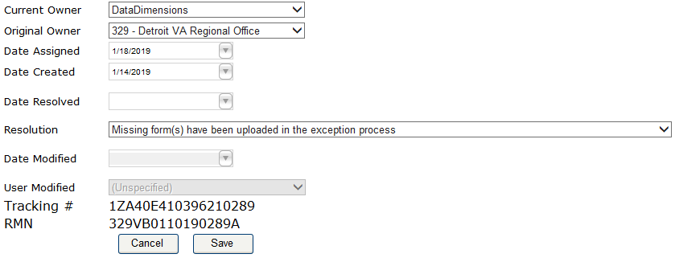
Missing or Incorrect Shipping Manifest
If a manifest is missing from the box:
Users should verify if original manifest was saved to the computer. If so, upload it to ddTracker
If Shipping Manifest was not saved, users must reprint it from VBMS
To update the shipping exception status, begin from ddTracker homepage
Update Current Owner field to DataDimensions
Update Resolution field to reflect Missing Form(s) have been uploaded in the exception process
Click Save
Notes:
If a manifest is missing from the box:
Users should verify if original manifest was saved to the computer. If so, upload it to ddTracker
If Shipping Manifest was not saved, users must reprint it from VBMS
To update the shipping exception status, begin from ddTracker homepage
Update Current Owner field to DataDimensions
Update Resolution field to reflect Missing Form(s) have been uploaded in the exception process
Click Save

Slide 26
How to Create Document Control Sheet (DCS ID)
Notes:
Because of the number of shipping exceptions we are seeing, we will provide instructions on how to create a DCS ID, followed by How to Generate VR&E Shipping Manifest, as a refresher from the Inactive Folder Shipping and Tracking training.

Slide 27
Create Document Control Sheet ID
Log into VBMS and validate your credentials.
Select the Search drop-down on the upper left corner of the screen.
Type the file number and/or SSN in the search field.
Select the Open Profile button.
VBMS will display the Veteran’s profile.
Notes:
Begin by logging into VBMS, entering your Station ID and validate your credentials with the PIV login.
Select the Search drop-down on the upper left corner of the toolbar
And a search box will appear. Type the file number or SSN in the search field
And click on the Open Profile button.
VBMS will display the Veteran’s profile.

Slide 28
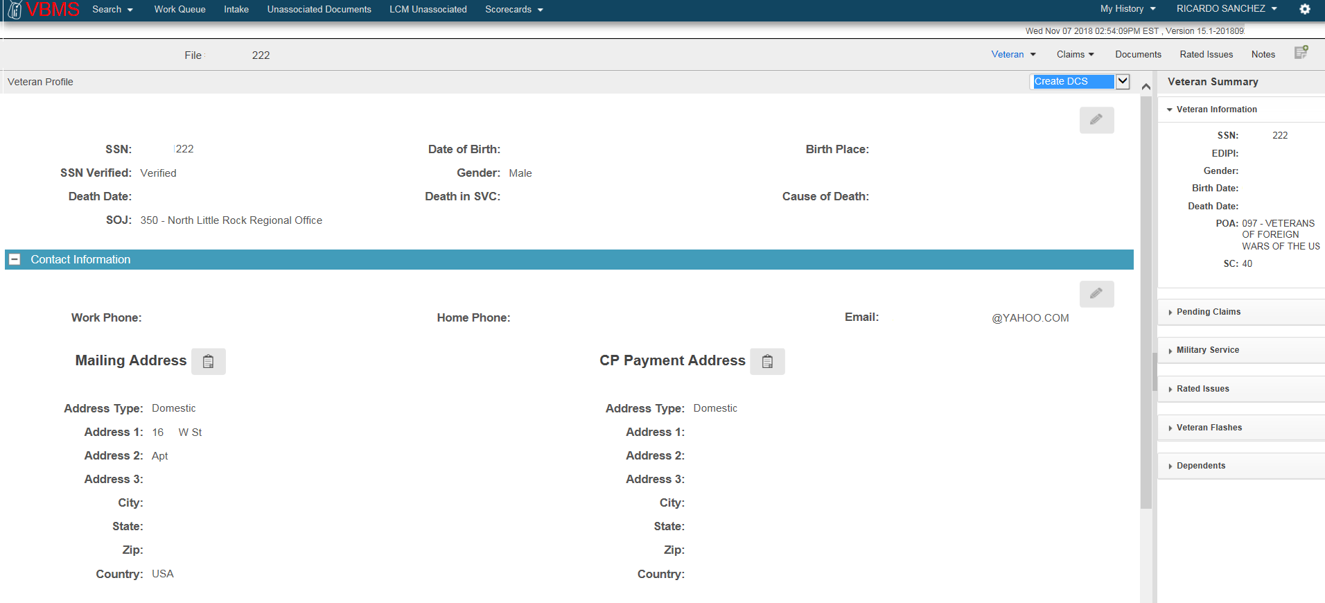
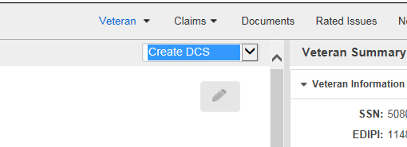
Create Document Control Sheet ID cont’d
5. From the Actions drop-down list, select Create DCS
Notes:
From the Actions drop-down menu in the upper right hand corner, select the Create DCS option.

Slide 29
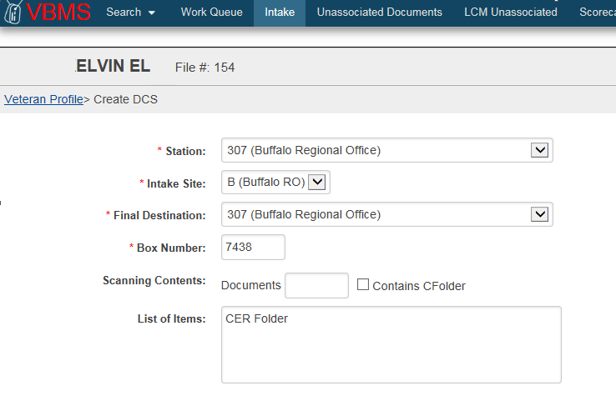

Create Document Control Sheet ID cont’d
From the Create DCS ID screen, select the following from the drop-down menus:
Station: Station from which files will be shipped
Intake Site: RO location
Final Destination: Same as Station
Box Number: Last four digits of UPS tracking number (i.e., UPS tracking number 1ZA410E40397487438)
Scanning Contents: Leave blank
List of Items: Enter “CER Folder” in text box
Click Submit button to generate the DCS ID – only one time
NOTE: Before creating UPS labels, place files inside box to be weighed. Boxes cannot exceed 50 pounds,
per M21-1, Part III, subpart ii, Chapter 1, Section F Preparing Source Materials for Shipping
Notes:
From the Create DCS ID screen, select the following from the drop-down menus:
Your station from which files will be shipped
Intake Site: RO location
Final Destination: Same as Station field
Box Number: Last four digits of UPS tracking number
Scanning Contents: We ask that you leave this area blank
List of Items: Type the words “CER Folder”
Click Submit button to generate the DCS ID – Please click Submit only ONCE.
NOTE: You will first create your UPS shipping label prior to this process of creating a DCS ID. Before creating UPS labels, place files inside box to be weighed, not to exceed 50 pounds, per the M21, Compensation & Pension manual, under the section: Preparing Source Materials for Shipping

Slide 30
Create Document Control Sheet ID cont’d
After clicking Submit, the message “Do you want to open or save?” will appear at the bottom of the screen
Select Open to display a PDF view of the DCS ID, or select Save As to store a copy to the desktop
Notes:
After clicking Submit, the message “Do you want to open or save?” will appear at the bottom of the screen
Again for the purpose of this training, we will select Open to display a PDF view of the DCS ID. You will select Save As to store a local copy to your computer.

Slide 31
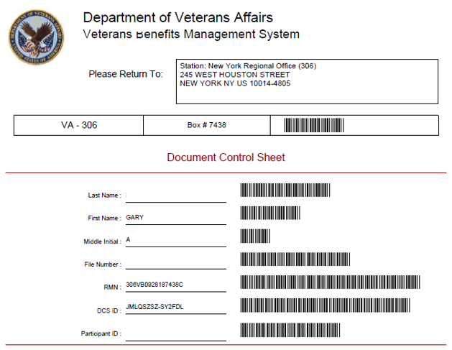
Create Document Control Sheet ID cont’d
Print the PDF file and attach it to the associated file
  To avoid Record Management Number (RMN) issues, all DCS IDs and shipping manifests must be created on the same day.
NOTE: DCS IDs CANNOT be reprinted from VBMS. Please ensure you print and save DCS IDs before shipping files to scanning.
Notes:
Once opened, you will see the PDF of the DCS ID.
Print the PDF file and place it on the outside front of the file, and secure using a rubber band. If there are multiple volumes, please ensure that they are all secured together.
There should be one DCS ID per file number.
After all DCS IDs have been created, generate and print the Shipping Manifest.
NOTE: DCS IDs cannot be reprinted from VBMS. Please ensure you print and save DCS IDs before shipping files to scanning.
For additional shipping instructions, refer to the M21 manual under the section (VCIP) Shipping.

Slide 32
How to Generate VR&E Shipping Manifest
Notes:
Next we will review the process of generating a VR&E shipping manifest.

Slide 33
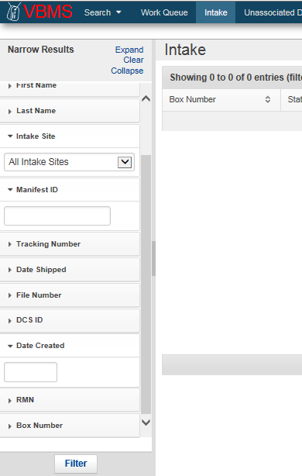
Generate VR&E Shipping Manifest
Log in to VBMS and validate your credentials
From the Home page, select Intake as shown in the figure above
On the Narrow Results menu option, click on Clear
Provide the RMN number found on the manifest, as shown in the figure to the right
Click the Filter button
Notes:
Log into VBMS and validate your credentials
From the Home page, select Intake
On the Narrow Results menu option, click on Clear
Provide the file number found on the manifest
Click the Filter button

Slide 34
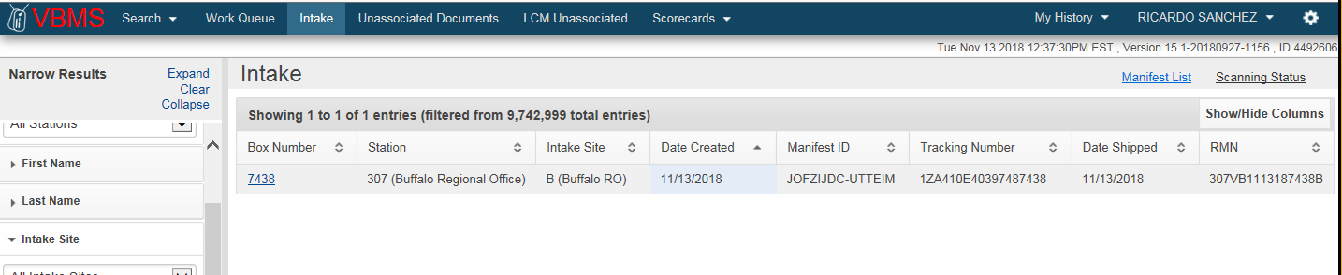
Generate VR&E Shipping Manifest
VBMS will display the shipment linked to the RMN
For a detailed view of the Manifest, select the Box Number link
Notes:
VBMS will display the shipment linked to the RMN
For a detailed view of the Manifest, select the Box Number link

Slide 35
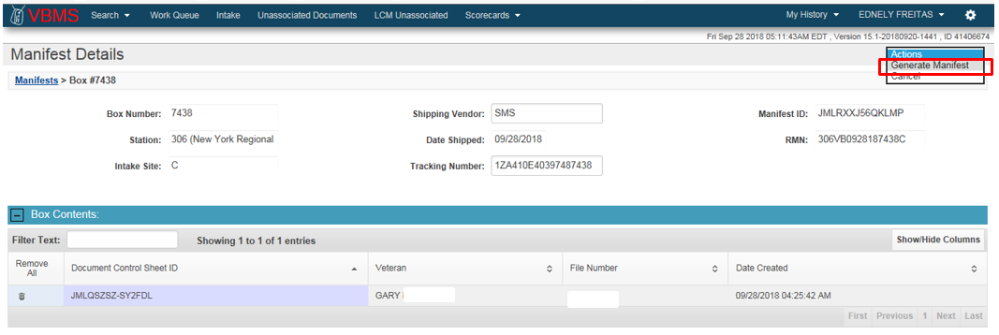

Generate VR&E Shipping Manifest
VBMS will display a detailed view of the Shipping Manifest listing all DCS IDs, names, and file numbers included in the shipment
From the Actions drop-down menu on the upper right corner of the screen, select Generate Manifest
At the bottom of the screen, VBMS will display the message: Do you want to open or save?
Select Open to display a PDF view of the Shipping Manifest or Save to store a copy to your desktop
Notes:
VBMS will display a detailed view of the Shipping Manifest listing all DCS IDs, names, and file numbers included in the shipment
From the Actions drop-down menu on the upper right corner of your screen, select Generate Manifest
“Do you want to open or save?” message will appear at the bottom of the screen
Again for the purpose of this training, we will select Open to display a PDF view of the Shipping Manifest. You will select Save As to store a local copy to your computer.

Slide 36
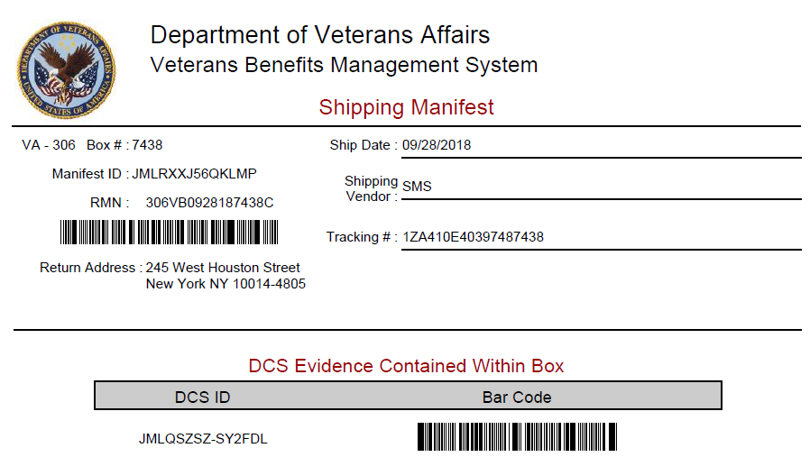
Generate VR&E Shipping Manifest
VBMS will display the Shipping Manifest
Print the Shipping Manifest and place it inside the box
IMPORTANT! Write your business line and VR&E Office Location (i.e., “306-VR&E New York”) and the RMN in permanent black ink on the outside front of the shipping box
Notes:
VBMS will display the Shipping Manifest
Print the Shipping Manifest and place it inside the box
Write your business line and VR&E Office Location (i.e. “306 VR&E New York”) and the RMN in permanent black ink on the outside front of the shipping box.
It is very important that the business line “VR&E” is written on the outside of each box. The scanning vendor deals with hundreds of boxes daily from other business lines and failing to label your boxes as instructed will incorrectly place your box in a Claims lane.

Slide 37

Questions?
For technical support please contact SMS DataDimensions:
ddhelpdesk@datadimensions.com
Help Desk @ 608-373-6255
Notes:
This concludes our training session for shipping exceptions.
Any VR&E questions may be directed to Ricardo Sanchez at ricardo.sanchez@va.gov
Scanning inquiries or Portal assistance can be sent to VCIP.VBACO@va.gov

