Slide 1
FOR TMS TRAINING CREDIT
To obtain training credit in TMS, there is no need to review these slides at this time – immediately close this box by using your mouse to select the “X” in the upper right-hand corner; select the “Return to Content Structure” button; and, select the next link (Video) to view the edited audio-video recording of the Quality Call along with the Call Bulletin
These slides are included here only in case you want to use them later for training purposes or reference
These are the same slides that are shown in the audio-video recording

Slide 2
February 13, 2019
Compensation Service
Quality Call

Slide 3
Welcome to the February 2019 Quality Call
Robert Johnson
Senior Quality Review Specialist
Quality Review Team
Quality Assurance

Slide 4
Agenda
January 2019 Quality Call Quiz
Common Site Visit Findings
Accepting Outdated Forms
Discontinuance of VA Pulse Monitoring
What’s New in the Manual
Mitchell Opinions in the post-Sharp World
Updates to Local Quality Review Checklists
Authorization Q-Tips (Over $25K Calculator & National Non-BE Error Citations)
When to Mark National Error Corrections as “Complete”
When & How to Update Service for COD
Poll Questions

Slide 5
QUIZ – January 2019 Topics – QUIZ

Slide 6
Quiz Question Guidance
Three (3) Quiz Questions will be shown on the following slides
Interactive Quiz Screen will be displayed after each question slide
Using your mouse , please select your response
Please do NOT type your answer into the Chat Box
Note: If you are in a group setting using only one computer, poll the group and have somebody use the mouse at the computer to select the group’s response
Quiz results will be discussed after everybody has responded

Slide 7
Quiz Question #1 – Use Mouse to Select Answer
When an Amyotrophic Lateral Sclerosis (ALS) case is routed to you in the National Work Queue (NWQ), it requires priority processing.
QUESTION: Is this True or False?
True
False

Slide 8
Quiz Answer # 1
True
ALS claims require priority processing. The manual reference noted below specifically tells us that ALS claims require priority processing.
M21-1 III.ii.1.D.1.a

Slide 9
Quiz Question #2 – Use Mouse to Select Answer
As a VSR, you are promulgating a rating decision granting service connection for ALS with an evaluation of 100% effective the date of claim; February 11, 2019. You look at the codesheet and notice that Specially Adapted Housing (SAH) was not granted.
QUESTION: What action should you take?
Promulgate the decision – SAH not warranted
Generate a deferral

Slide 10
Quiz Answer # 2
Generate a deferral
Rating Decision must be routed back to decision maker to correct because Specially Adapted Housing (SAH) must be granted per 38 CFR 3.809(d) – this was effective as of December 3, 2013.
M21-1 IX.i.3.1.b
M21-1 III.v.2.A.2.c

Slide 11
Quiz Question #3 – Use Mouse to Select Answer
Although the Effective Date Builder Tool does not replace a decision maker’s judgment of assigning the correct effective date, the tool should be used to double-check your decision to ensure no other laws or regulations allow for an alternate date.
QUESTION: Is this True or False?
True
False

Slide 12
Quiz Answer # 3
True
The Effective Date Builder Tool assists decision makers on how to calculate an effective date for Veterans and beneficiaries for their compensation. The use of this tool can assist with possibly avoiding effective date errors in rating decisions.
The Effective Date Builder Tool:
Handles Effective Date determinations for all rating issues
Incorporates changes in the law
Informs when Effective Dates under other methods of granting might be more advantageous
Is a standalone tool that can be updated and released quickly
Has been available since February 2017
DENTT mailbox – DENTT.VBAPHO@va.gov

Slide 13
Common Site Visit Findings
Daniel Buzhardt
Lead Operations Analyst
Program Operations Staff
Quality Assurance

Slide 14
Gulf War Rating Decision Narratives
Proper text is required in the Reason for Decision section of rating decisions when granting or denying SC under 38 CFR 3.317
M21-1 IV.ii.2.D.4 provides specific instructions on the proper text to include in rating decisions when awarding SC for qualifying disabilities under 38 CFR 3.317

Slide 15
Gulf War Rating Decision Narratives (Cont’d)
Denials of SC under 38 CFR 3.317 require adequate reasons to be included in the rating decision and decision notice letter
Must include discussion of specific provisions that were not met under the presumptive provisions of 38 CFR 3.317 and the direct SC provisions, to include any other avenue of SC raised by the claimant or the evidence
M21-1 IV.ii.2.D.5.b provides specific instructions on the general requirements that must be included in the rating decision narrative when denying SC under 38 CFR 3.317

Slide 16
Potential Under/Overpayment Special Issue Compliance
Potential Under/Overpayment special issue must be added to controlling EP(s) to monitor timeliness in completing actions until any and all actions involving under/overpayment are completed
Use of this special issue allows creation of priority routing rules on claims with potential under/overpayment
M21-1 III.ii.1.C.7 provides specific instructions for the use of the Potential Under/Overpayment special issue

Slide 17
Accepting Outdated Forms
Daniel Buzhardt

Slide 18
Accepting Outdated Forms
Outdated versions of forms may be accepted when generated through a VA electronic claims submission system, such as
eBenefits
SEP
D2D, or
other VA system that includes form-generation capacity
M21-1 III.ii.1.C.8.a
Claim labels and document properties in VBMS will clearly denote the source of the submission

Slide 19
Accepting Outdated Forms (Cont’d)
When accepting an outdated version of a form generated through a VA electronic claims submission system
Develop for any information required to process the claim that is requested on the current version of the form but not requested on the outdated version of the form
Note: If information collected on the current version of the form is not required to process the claim that was submitted on the outdated version of the form, additional development is not necessary, unless indicated in other policies or procedures

Slide 20
Discontinuance of VA Pulse Monitoring
Melvin Gerrets
Chief
Program Operations Staff
Quality Assurance

Slide 21
Discontinuance of VA Pulse Monitoring
Effective January 17, 2019, Compensation Service (CS) discontinued monitoring numerous VA Pulse sites and providing official answers/support via VA Pulse
All inquiries submitted prior to January 17, 2019, will continue to be addressed until resolved; however, new inquiries will not be monitored and will not receive official responses from CS
Questions related to CS policy, procedures, and/or programs must be submitted to the appropriate staff CS mailbox via the VSCM mailbox, an officially designated mission/program specific coordinator, or the VSCM and/or AVSCM

Slide 22
Discontinuance of VA Pulse Monitoring (Cont’d)
Effective January 17, 2019, the following VA Pulse sites are no longer being monitored by Compensation Service:
CS may continue to use VA Pulse to provide or collect information to/from claims processors, management, and other stakeholders
M21-1 Feedback
VASRD Implementation Feedback
Attorney Fee Coordinators
Centralized Mail
Fully Developed Claims
Standard Claims and Appeals Form Rule
Collaboration Strategies Team
AQRS Collaboration Network
RQRS Collaboration Network
QRT Coaches, and
VSCM Network

Slide 23
Discontinuance of VA Pulse Monitoring (Cont’d)
The M21-1 Feedback site will continue to be active and individuals are welcome to use the site for collaborative discussion with fellow claims processors
Each RO, through their designated leadership/coordinator, can submit M21-1 questions via the M21-1 mailbox – please use the following format and text for the body of an e-mail:
Citation: [List the citation(s) to which that the inquiry pertains]
Question or problem: [Briefly state the specific question or problem that need to be addressed]
Recommended solution: [Provide a recommended solution to address the issue – this may include re-phrasing the guidance, including additional sentences, or adding new notes or notations]

Slide 24
What’s New in the Manual
Dustin Williams & Angela Hiller
Manual Editors/Program Analysts
Procedures and Program Implementation Staff
Policy and Procedures

Slide 25
What’s New in the Manual
Dustin Williams
Manual Editor/Program Analyst
Procedures and Program Implementation Staff
Policy and Procedures

Slide 26
AMA and M21-1
February 19, 2019
Mass release of revised content in support of the Appeals Modernization Act of 2019 (AMA)
Highly important process-driven changes will be published immediately, while less substantive maintenance changes will continuing following the rule’s implementation

Slide 27
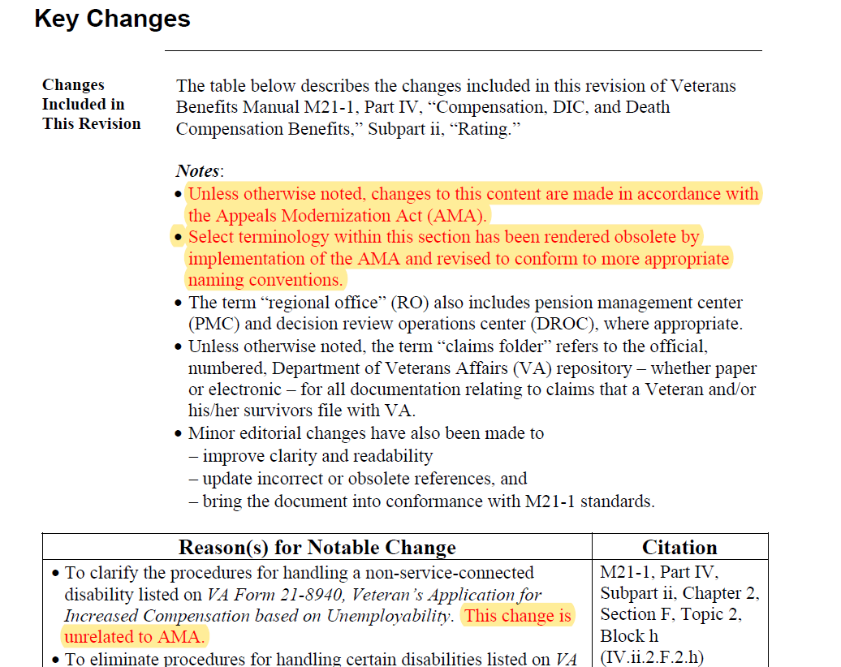
AMA and M21-1 (Cont’d)
Individual key change documents associated with AMA section updates will specifically
reference the law as the basis for the change, and
identify procedural items that have undergone changes unrelated to AMA

Slide 28
What’s New in the Manual
Angela Hiller
Manual Editor/Program Analyst
Procedures and Program Implementation Staff
Policy and Procedures

Slide 29
Proposed Rating Decision & Due Process Period
Update forthcoming to correct discrepancy between two sections
M21-1 III.iv.8.B.1.g
M21-1 III.iv.8.E.1.g
Correct guidance in M21-1 III.iv.8.B.1.g
When the reason for a reduction changes
Complete a new rating decision, and
Provide a new period of due process

Slide 30
Mitchell Opinions in the post-Sharp World
Andrew Latham
Training Consultant
Training Staff
Rating Instruction Staff (Denver)

Slide 31
Relevant Holdings
Mitchell v. Shinseki, 25 Vet.App. 32 (2011)
If pain is associated with movement, two opinions are required – one indicating an estimation of additional ROM loss after use over time, and one for the same during a flare-up
Jones (Michael H.) v. Shinseki, 23 Vet.App. 382 (2010)
If the opinions cannot be given without speculation, medical rationale is necessary
Sharp v. Shulkin, 29 Vet.App. 26 (2017)
Rationales based on a general lack of knowledge, aversion to opinion on matters beyond direct observation, or a lack of consideration for procurable evidence are not sufficient

Slide 32
Examples – Insufficient Rationales

Slide 33
Example – Sufficient Based on Estimation

Slide 34
Example – Sufficient Based on Rationale
The rationale is:
specific to the case,
based on the procurable evidence, and
does not imply or state an aversion to opining on matters beyond direct observation

Slide 35
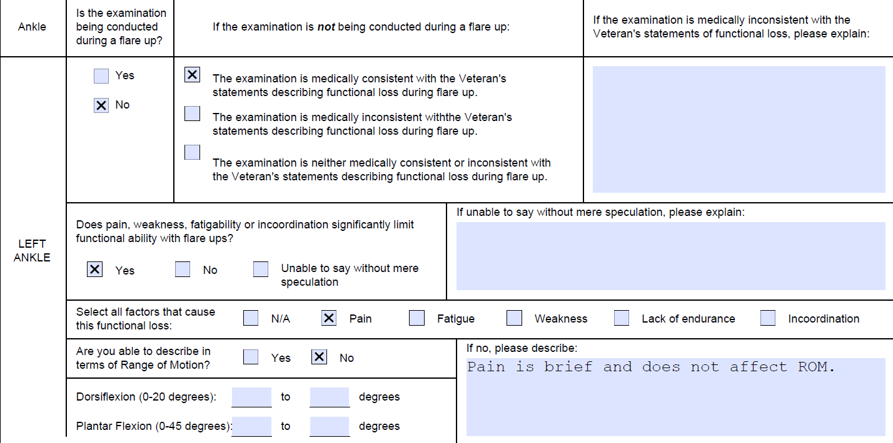
Example – Otherwise Apparent
Flare-ups occur, but the evidence indicates an estimation of loss of ROM would not be appropriate

Slide 36
AMA Changes – Local Quality Checklists
Ken Maurer
Consultant
Quality Review and Consistency
Quality Assurance

Slide 37
AMA Changes To Local Quality Checklists
Appeals Modernization Act (AMA)
Regulatory changes will take effect February 19, 2019
New VSR checklist to accommodate these changes
Task 10 has new descriptors
New rating checklist to accommodate these changes
Tasks 1, 3, 4, 5, 6 and 9 have new descriptors
Task 12 (Correctable Comments) has been added

Slide 38
Amendments To VSR Checklist By Task
Task 10 – Was the claimant properly notified?
Notification letter failed to explain how to obtain or access evidence used in making the decision
A summary of the applicable laws and regulations was not provided
Notification letter failed to provide review options to the claimant to seek review of the decision

Slide 39
Amendments To Rating Checklist By Task
Task 1 – Were all claimed issues addressed and decided?
The decision failed to address an issue requiring adjudication (specific to supplemental and/or HLR claims)
Task 3 – Was all necessary development to obtain all indicated evidence (excluding VA Examination) completed prior to deciding the claim?
New and relevant evidence was submitted necessitating development for other identified evidence prior to deciding the issue

Slide 40
Amendments To Rating Checklist By Task (Cont’d)
Task 4 – Were all necessary examinations and medical opinions requested and sufficient?
New and relevant evidence was submitted necessitating a VAE prior to deciding the issue
Task 5 – Was the grant of all issues correct?
Service connection was not warranted as there was “clear and unmistakable” evidence to overturn past favorable findings

Slide 41
Amendments To Rating Checklist By Task (Cont’d)
Task 6 – Was the denial of all issues correct?
New and relevant evidence was submitted which warrants a grant of the issue
Service connection was warranted as there was no “clear and unmistakable” evidence to overturn past favorable findings

Slide 42
Amendments To Rating Checklist By Task (Cont’d)
Task 9 – Was the decision free of other deficiencies?
A summary of the evidence considered was not provided
The laws and regulations applicable to the claim were not provided
For denied claim(s), identification of the missing element(s) which are required to grant the claim(s) was not provided
The decision did not identify the criteria required to grant the next higher level of compensation

Slide 43
Amendments To Rating Checklist By Task (Cont’d)
Task 12 – Is the C-file free from other defects requiring correction which are not considered “critical” to the item(s)/transaction currently under review?
New and relevant evidence was submitted but the claim was not decided based on the merits of the claim
The decision maker did not identify and properly document applicable favorable findings
Favorable findings were not overturned when “clear and unmistakable” evidence was present to rebut the findings, however the decision to grant or deny the issue(s) is correct

Slide 44
Reminder
As always, answer the main task question!
The main task question determines the existence of an error
Grace period applies
During this grace period, uncheck the critical error box when using one of the new error descriptors (not needed for Task 12)
M21-4 Chapter 6, Topic 4, Block d (M21-4 6.4.d)

Slide 45
Mandatory Use of Over $25K Calculator
Christine Alford
Chief
Program Review Staff - Authorization
Quality Assurance

Slide 46
New Over $25K Calculator
M21-1, lll.v.1.l.3.g was revised on 10/24/18 to require the use of the Administrative Error Paid/Due Calculator Over $25K for cases forwarded to Compensation Service (CS) for approval of administrative decisions involving an erroneous payment of $25,000 or greater due to administrative error
Per M21-1, lll.v.1.l.3.g, the Calculator results must be uploaded to the Veterans Benefits Management System (VBMS) eFolder prior to routing the request for administrative decision approval to CS via National Work Queue (NWQ) Station 388

Slide 47
New Over $25K Calculator (Cont’d)
A link is provided in M21-1 lll.v.1.l.3.g to access to the Calculator, which is also located on the CS Intranet, 214 Homepage, STAR Homepage, and Rating Job Aids
Please email questions to VAVBAWAS/CO/214B

Slide 48
Non-BE National Authorization Error Citations
Christine Alford

Slide 49
Non-BE National Authorization Error Citations
To assist ROs:
“Comment” now added after the Station Number on all non-BE error citations
“Benefit Entitlement” will continue to be added after the Station Number when citing errors under Questions 1 – 11 on National Compensation Authorization Quality Review Checklist to further assist in distinguishing between national BE and non-BE error citations
Please email questions to VAVBAWAS/CO/214B

Slide 50
STAR Quality Error Corrections – “Complete”
Christine Alford

Slide 51
STAR Quality Error Corrections
As delineated in M21-4 Chapter 3.05(f), the identified correcting Regional Office (RO) must take corrective action on all national error citations
QA has recently noted a number of cases containing errors cited over 30 days earlier, in which, although entries have been made on the Quality Management System’s (QMS) National Compensation Authorization Quality Review Error Correction screen to indicate completion of correction, action to correct the error has not been initiated

Slide 52
STAR Quality Error Corrections (Cont’d)
ROs are reminded to ensure that all actions to initiate the correction are done within 30 days of notification of the error
If multiple errors are cited on a case, all actions to initiate the correction of all errors must be executed
Error corrections are not to be marked as “Complete” in QMS until all corrective action has been initiated

Slide 53
When & How to Update Service for COD
Christine Alford

Slide 54
Updating the Record After a COD Determination
Unless the current entries in the Beneficiary Identification Records Locator Subsystem (BIRLS) are accurate, the corporate record must be updated accordingly after a COD determination
The authorization activity must update the Veteran Identification Data (VID) tab to reflect the Veteran’s
period of service
eligibility to health care for service connected (SC) disabilities
type(s) of discharge, and
separation reason(s)

Slide 55
Updating the Record – COD (Cont’d)
Please refer to the table shown under M21-1 III.v.1.B.1.k. for instructions on how to update the VID tab in BIRLS
Former service members who receive a bad conduct discharge (BCD) are not eligible for health care
ROs may update VID by entering 12C in the character of service field, which will indicate a bar to all benefits ...similar to the entry made when there is a bar under 38 CFR 3.12(c)

Slide 56
Poll Questions
Presented by:
Robert Johnson

Slide 57
Interactive Poll Question Guidance
Five (5) Poll Questions will be shown on the following slides
Interactive Quiz Screen will be displayed after each question slide
Using your mouse , please select your response
Please do NOT type your answer into the Chat Box
Note: If you are in a group setting using only one computer, poll the group and have somebody use the mouse at the computer to select the group’s response
Poll results will be discussed after everybody has responded

Slide 58
Poll Question # 1 – Use Mouse to Select Answer
An outdated VAF 21-526EZ form was received today through SEP, it is sufficient for rating, and does not violate any policy or procedure guidance. There is information on the current version of the form that is not included on the outdated form; however, the missing information is not required to process the claim.
Question: Does the VSR need to develop for the information that is on the current form, but not on the outdated form that was submitted?
Yes
No

Slide 59
Poll Question Answer # 1
No
Since the information collected on the current version of the form is not required to process the claim that was submitted on the outdated version of the form through SEP (a VA electronic claims submission system), additional development is not necessary, unless indicated in other policies or procedures.
M21-1 III.ii.1.C.8.a

Slide 60
Poll Question # 2 – Use Mouse to Select Answer
Veteran evaluated at 40% for Lumbar Strain FTR for a proper review exam
RVSR notes current evid of painful ROM in CAPRI & proposes to reduce to 10%
Proposal issued on 09-07-2018 noting FTR reduction in no fewer than 60 days
On 10-19-2018, the Veteran states willingness to report, and subsequent rescheduled examination results show 20% is warranted
On 11-12-2018, the RVSR adjudicates a final rating decision reducing the 40% evaluation to the more favorable 20% versus 10% evaluation effective 12-01-2018, the first day of the month following expiration of the adverse action proposal period
Question: Was correct rating action taken?
Yes
No

Slide 61
Poll Question Answer # 2
No
Although the final outcome of the evaluation issue was more favorable than initially proposed, the notice of proposed adverse action issued September 7, 2018, as well as the rating decision that preceded it, were premised on a regulatory principle [38 CFR 3.655(c) for failure to report for review examination] different than that ultimately used to reduce the evaluation [noted improvement under 38 CFR 3.105(e)].
M21-1 III.iv.8.B.1.g

Slide 62
Poll Question # 3 – Scenario
Claim for increase for right knee strain
Knee DBQ shows Veteran’s report of flare-ups of right knee pain occurring very often with complete inability to bend the knee lasting hours
Recent CAPRI records document several treatments for flare-ups of right knee pain with full ROM, normal gait, and no time lost from work due to the knee pain
Examiner declines to estimate additional loss of range of motion (ROM), stating that doing so cannot be done without resorting to speculation
Rationale: “The Veteran’s testimony during the examination directly contradicts the VA treatment records, and it would be speculation to attempt to reconcile the conflicting reports into an accurate estimation.”

Slide 63
Poll Question # 3 – Use Mouse to Select Answer
Is the examiner’s opinion appropriately justified? Why or why not?
No; the examiner’s rationale is predicated on an aversion to opining on matters beyond direct observation.
Yes; the examiner’s rationale is appropriate as it is clear from the Veteran’s testimony and the examination that ROM is unaffected during a flare-up.
No; the examiner’s rationale is predicated on a general lack of knowledge of the case.
Yes: the examiner’s rationale is appropriate as it is specific to the Veteran’s case, is based on a review of all procurable evidence, and does not imply or state an aversion to opining on matters beyond direct observation.

Slide 64
Poll Question Answer # 3
Yes: the examiner’s rationale is appropriate as it is specific to the Veteran’s case, is based on a review of all procurable evidence, and does not imply or state an aversion to opining on matters beyond direct observation.
The examiner has explained the basis for such an opinion, identifying what facts cannot be determined, and demonstrated consideration of all procurable and relevant information (to include medical treatment records and/or lay testimony).
M21-1 III.iv.3.D.2.r (Sharp v Shulkin)

Slide 65
Poll Question # 4 – Use Mouse to Select Answer
Use of the Administrative Error Paid/Due Calculator Over $25K for cases forwarded to Compensation Service for approval of administrative decisions involving an erroneous payment of $25,000 or greater due to administrative error is required only when the retroactive period of the overpayment is 5 or more years.
True
False

Slide 66
Poll Question Answer # 4
False
The manual was revised on 10/24/2018 to require the use of the Administrative Error Paid/Due Calculator Over $25K for all cases forwarded to Compensation Service for approval of administrative decisions involving an erroneous payment of $25,000 or greater due to administrative error regardless of the retroactive overpayment period.
M21-1 lll.v.1.l.3.g

Slide 67
Poll Question # 5 – Use Mouse to Select Answer
When accepting a National STAR error, ROs must first input “Complete” in QMS before initiating any corrective action.
True
False

Slide 68
Poll Question Answer # 5
False
Error corrections are not to be marked as “Complete” in QMS until all corrective action has been initiated.
M21-4 Chapter 3, Topic 5, Block f (M21-4 3.5.f)

Slide 69
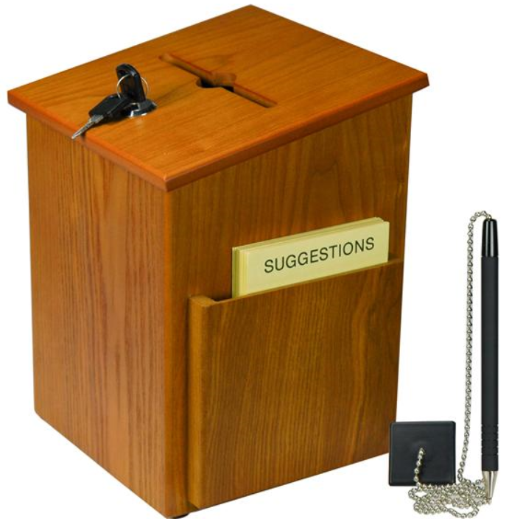
Questions – Suggestions – Next Quality Call
Presented by:
Robert Johnson

Slide 70
Questions Relating to Today’s QC Topics
Questions on topics presented must be emailed to the Compensation Service Quality Review Team at InternalQRS.VBAVACO@va.gov
Emails must include Cc to your Coach or other RO management
Emails must contain the name of the topic(s) with your question(s)
Questions must be submitted to the mailbox by COB Friday, February 15th
Questions submitted after COB Friday will not be accepted
Email questions are limited to those pertaining to only the topics presented, and responses will not be provided to any questions that are not related to the topics presented during today’s Quality Call
Official guidance to the questions will be posted later in the Call Bulletin

Slide 71
Do You Have Suggestions for Topics?
Please feel free to email your topic suggestions to the Compensation Service Quality Review Team at InternalQRS.VBAVACO@va.gov
In your email, be sure to include:
Cc to your Coach or other RO management
Name of the topic
Intended audience (VSR – SVSR – RVSR – DRO – AQRS – RQRS)
Applicable M21-1 and/or 38 CFR citations
Quality Call Bulletins can be found in the STAR Home Page on the Compensation Service Intranet site, TMS, and VBA Learning Catalog
Audio recordings of the Quality Calls with separate copies of the PowerPoint slides can be found in both TMS and VBA Learning Catalog

Slide 72
Next Quality Call
A Compensation Service Quality Call is usually presented each month
Next Quality Call will be conducted on March 13, 2019

