Slide 1
Sound Check
New Manager Training Skype Session Call will begin momentarily
A facilitator is currently talking. If you cannot hear, please place a ‘sad face’ emoticon in the chat box
Notes:
Narrator – Dale Sagotsky/Donna Robinson
(15 / 7 mins)
Slide Instructions –
Open Lync/slide 15 minutes before call begins
Start Video when call begins (office start time of call)
Place all participants microphones in lecture mode (mute)
Slide Notes – Copy text “A facilitator is currently talking. If you cannot hear, please place a ‘sad face’ emoticon in the chat box.”
Slide Narration –
Hello, Welcome to the New Manager Training Lync Session Call. The call will begin in (15 /7 start time) minutes.
Please remember to mute your microphones when you are not speaking.
If you are calling in by phone, please ensure your microphone and speaker on your computer is muted. This will prevent feedback
Please do not use the Instant Message window for general discussion or commentary as it can be distracting to the audience and presenter.
(omit at start time) Please stand by until the call begins.

Slide 2
Developing Effective Training Plans
VR&E New Manager Training
Briefed by:
NMT Subject Matter Expert Facilitators
Updated: May 21, 2019

Slide 3
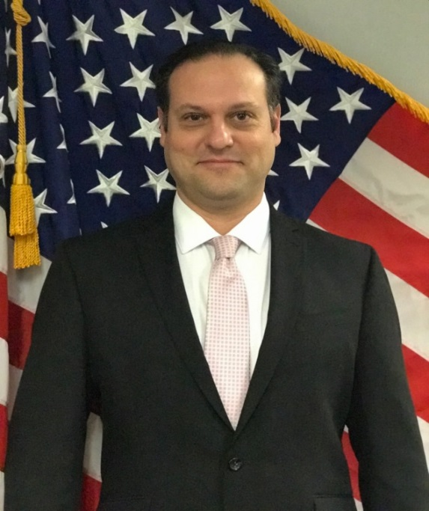
Presenters
Lamoyd Figures VR&E Training Specialist Orlando, FL
Dale Sagotsky VR&E Training Specialist Orlando, FL
Notes:
Lamoyd Figures

Slide 4
Learning Objectives
Upon completion of instruction, you will be able to:
Define performance and performance improvement
Identify the Scope of Training and VREO Responsibilities
Identify the Systematic Technical Accuracy Review (STAR)/Quality Assurance (QA) Team training requirements during site visits
Identify the components of an annual training plan
Notes:
After this session, you will be able to:
Define performance and performance improvement
Identify the Scope of Training and VREO Responsibilities
Identify the Systematic Technical Accuracy Review (STAR)/Quality Assurance (QA) Team training requirements during site visits
Identify the components of an annual training plan

Slide 5
Defining Performance
What is meant by performance and performance improvement?
Performance is measured in terms of progress toward specific business goals
Performance improvement is when there must be a measureable change
Notes:
Defining Performance
Performance is the most critical issue in training and development today.
Performance is about a number of factors like workflow, culture, goals, etc. All of these factors must work together to produce something of value to the customer. In our case, the customer is the Veteran. In a nutshell, regardless of the organization, performance is all about outputs or results.
So who wants to take a stab, what is it meant by performance and performance improvement?
Performance is measured in terms of progress toward specific business goals.
Performance improvement is when there must be a measureable change.
Due to the complexities of our jobs, training events that can include: attending a workshop, seminar, or meeting; reading a book, listening to an audiocassette; watching a videotape and more-are not sufficient to meet the performance improvement needs of employees. In order to track measureable change we use performance standards and Local and National STAR Quality Reviews.

Slide 6
Defining Performance
So, what are the performance problems in your division?
Which of the following do you think will solve your division’s problem:
More or better information
Additional resources
More motivated employees
Better incentives and rewards
Notes:
So, what are the performance problems in your division?
To identify staff development needs, the VREO may perform the following
functions:
• Conduct regular technical supervision and quality reviews with the staff
• Review individual VRC’s counseling techniques during counseling sessions
• Conduct group discussions with the staff to identify pertinent needs and
determine the priorities to be assigned to them
• Hold conferences with individual staff members to identify particular
professional development needs
• Prepare, review, and update VRC Staff Development Inventories
Which of the following do you think will solve your division’s problem:
More or better information
Research TMS, EPSS, inquire materials from Training Team and/or other offices, institutions of higher learning such as colleges/universities.
Additional resources
Research TMS, EPSS, inquire materials from Training Team and/or other offices, institutions of higher learning such as colleges/universities.
More motivated employees
Training on recruitment/hiring strategies (HR), consultation with staff members
Better incentives
Training on strategies to reward employees via VRE, HR, TMS.
The purpose of asking this types of questions is to get each of you all to ponder about how can you make sure that training is
Needed or warranted
And that you select training for yourself and staff that is beneficial to meeting your local goals and the organizational goals.

Slide 7
Scope of Training
Identify staff development needs,
Fulfill VBA core annual technical training requirements,
Plan and implement an appropriate staff development program to meet those needs,
Guide development of Individual Development Plans (IDP), and
Provide periodic in-service training.
Notes:
The scope of training at each VR&E Division is to supplement training provided by VR&E Service, and to adequately prepare local staff to
successfully carry out their daily tasks.
VR&E Divisions should
identify staff development needs,
fulfill VBA core annual technical training requirements,
plan and implement an appropriate staff development program to meet those needs,
guide development of Individual Development Plans (IDP), and
provide periodic in-service training.
Note: all of these tasks require an investment of time with the team individually and as a whole.

Slide 8
Staff Development and Training
VREOs Responsibilities
1. Monitoring and reporting training and staff development activities
2. Reviewing local performance data
3. Identifying performance gaps
4. Identifying local training needed to improve performance
5. Identifying available training resources
6. Developing training plans
7. Requesting assistance to obtain or develop training material
Notes:
Per 38 CFR 21.382 and M28R, Part II, Section A, Chapter 3, the VR&E Officer is responsible for preparing a training plan for the development of staff as part of the station’s training plan at the beginning of each fiscal year.
1. Monitoring and reporting training and staff development activities
2. Reviewing local performance data
3. Identifying performance gaps
4. Identifying local training needed to improve performance
5. Identifying available training resources
6. Developing training plans
7. Requesting assistance to obtain or develop training material

Slide 9
Staff Development and Training
8. Notifying VR&E Service of major training needs
9. Requesting CRC credit from VR&E Service on behalf of staff members
10.Promoting mentor relationships with less experienced VRCs and ECs
11.Providing new staff comprehensive training in a timely manner
12.Providing frequent refresher training to experienced staff
13.Allowing opportunities for staff members to attend professional training outside of the RO
Notes:
8. Notifying VR&E Service of major training needs
9. Requesting CRC credit from VR&E Service on behalf of staff members
10.Promoting mentor relationships with less experienced VRCs and ECs
11.Providing new staff comprehensive training in a timely manner
12.Providing frequent refresher training to experienced staff
13.Allowing opportunities for staff members to attend professional training outside of the RO

Slide 10
Developing Training Plans & CRCC Requests
VREOs Responsibilities
5. Identifying available training resources
6. Developing training plans
7. Requesting assistance to obtain or develop training material
8. Notifying VR&E Service of major training needs
9. Requesting CRC credit from VR&E Service on behalf of staff members
Notes:
So today we are going to focus on Developing Local Training Plans and later requesting CRC continuing education units for staff members.

Slide 11
Systematic Technical Accuracy Review (STAR)/Quality Assurance (QA) Team Site Visit
Action Item #?: Develop and implement a formal training plan for VR&E staff.
Although training sessions are currently being conducted and the division is working toward completion of the national core training curriculum, this office does not have a formal training plan for the VR&E Division for FYxx. Also, a formal training plan was not developed for FYxx. Per 38 CFR 21.382 and M28R.II.3.07.i, the VR&E Officer is responsible for preparing a training plan for the development of staff as part of the station’s training plan at the beginning of each fiscal year.
Notes:
This is an example of the most common citation that is noted as an Action Item during a STAR/QA local site visit review. As mentioned in this slide and the previous slides, it is the VR&EOs responsibility to prepare a training plan for the development of staff as part of the stations training plan at the beginning of each fiscal year.

Slide 12
VR&E Training Plan
Must include:
Training for each of the core areas and core technical training requirements
At least seven of the identified areas of training and development
Means through which training and development activities will be accomplished
A review, at least yearly, of the training needs of each employee in the Division
The frequency of in-service training meetings
The estimated costs for travel related to training
Notes:
Now, what should a VR&E Training Plan include. This slide lists the components of a VR&E Training Plan
The VREO prepares the VR&E training plan at the beginning of each fiscal year for concurrence by the RO Director. The plan must include training for each of the core areas and core technical training requirements (see Core Annual Technical Training Requirements 3.09.h), and at least seven of the identified areas of training and development listed in 3.08.b. It also must include the means through which training and development activities will be accomplished, such as in-service training, training in conjunction with other VA elements, or with other state and federal agencies. It also must include:
• A review, at least yearly, of the training needs of each employee in the Division
• Development of the means through which such training will be provided
• The frequency of in-service training meetings
• The estimated costs for travel related to training

Slide 13
VR&E Training Plan - Core Technical Training Requirements
FY19 Core Requirements
VR&E Officers and Asst. VR&E
Officers (New 68.40 hrs , Experienced 23 hrs)
Supervisory VRCs (New 68.40 hrs, Experienced 23 hrs)
VRCs (New 79.50 hrs, Experienced 40 hrs)
IDES (New 79.50 hrs, Experienced 40 hrs)
VSOC (New 79.50 hrs, Experienced 40 hrs)
ECs (New 42.50 hrs, Experienced 28 hrs)
Admin. Support Professional (New 22 hrs, Experienced 18 hrs)
CBTS Participants-All Experienced VRCs (20-40 hrs)
Incorporate the station determined hours & personal/professional development hours
Notes:
Review the attached NTC Checklist. Most of these hourly requirements were mandated by VBA Letter 20-06-68 and these hourly requirements have been reported to be mutually agreed upon by VR&E Service, OFO, and the various Union representatives.
Please note: ED&T and VR&E Service are collaborating to develop a new ………

Slide 14
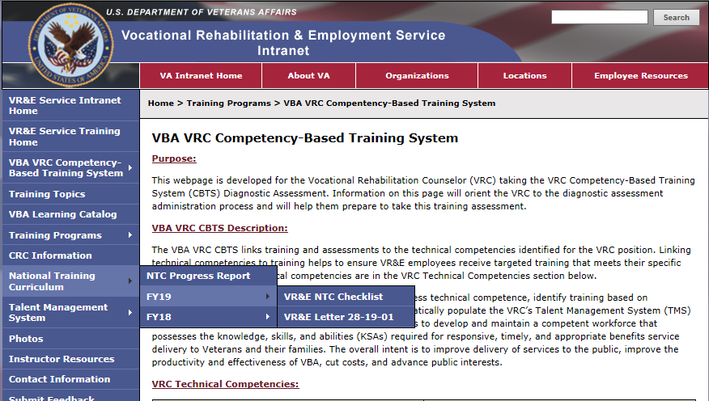
National Training Curriculum Checklist & VR&E Training Website
Notes:
The National Training Curriculum Checklist and Announcement Letter are housed on the VR&E Training Website (http://vretraining.vba.va.gov/Index.htm) and are also dispersed nationally via the VRE Corporate Mailbox. These items are usually posted within the first 15 days of the new FY.
These are tools to be used by VR&E Officers/Assistant VR&E Officers and Local Training Managers to aid in the development of local training plans.

Slide 15
VR&E Training Plan - Areas of Training and Development
1. Evaluation and assessment
2. Medical aspects of disability
3. Psychological aspects of disability
4. Counseling theory and techniques
5. Personal and vocational adjustment
6. Occupational information
7. Placement processes and job development
8. Independent Living (IL) services
9. Special considerations in rehabilitation for people with severe disabilities
10. Resources for training and rehabilitation
11. Utilization of research findings and professional publications
12. Administration of rehabilitation and counseling services
13. Professional ethics
14. Rehabilitation philosophy and history
Notes:
The areas in which training and development activities may be provided to enhance staff skills include, but are not limited to the following:
1. Evaluation and assessment
2. Medical aspects of disability
3. Psychological aspects of disability
4. Counseling theory and techniques
5. Personal and vocational adjustment
6. Occupational information
7. Placement processes and job development
8. Special considerations in rehabilitation for people with severe disabilities
9. Independent Living (IL) services
10. Resources for training and rehabilitation
11. Utilization of research findings and professional publications
12. Administration of rehabilitation and counseling services
13. Professional ethics
14. Rehabilitation philosophy and history
Note: All the training areas/topics that are underlined in green align with the Commission of Rehabilitation Counselors Certification (CRCC) General Content Focus Domain. The training area of “professional ethics” aligns with CRCC’s Ethical Standards and Decision Making Models for Rehabilitation Counselors Focus Domain Area.

Slide 16
VR&E Training Plan – Means
Means through which training and development activities will be accomplished
Local in-service program or other on-site training
Employ the services of consultants
Write grants or make contracts with public and private agencies, including institutions of higher learning to conduct workshops and training activities
Authorize individual training at institutions of higher learning and appropriate facilities
Notes:
Means through which training and development activities will be accomplished. This basically means: Which method or how will the training be delivered.
Training can be delivered by the following:
Local in-service program or other on-site training
Employ the services of consultants
Write grants or make contracts with public and private agencies, including institutions of higher learning to conduct workshops and training activities
Authorize individual training at institutions of higher learning and appropriate facilities
For example, many stations do the following:
work with DOL to provide training on state employment trends
Work with local colleges and universities to hear graduate presentations on multicultural counseling
Work with local SBA affiliates to learn about local business resources that can assist Veterans/Servicemembers
Please note: Most of the VR&E Service training is provided via TMS, EPSS, TPSS., Lync Meeting and Conference Calls.

Slide 17
Annual Review of Training Needs/ Frequency of In-Service/ Estimated Cost
A review, at least yearly, of the training needs of each employee in the Division
Frequency of in-service training meetings
Estimated costs for travel related to training
Notes:
A review, at least yearly, of the training needs of each employee in the Division
We have already discussed methods to identify training needs, so use your results to identify performance gaps; then procure, develop, and/or assign training to meet your staffs needs.
Frequency of in-service training meetings
There have been several policy letters released in the last couple of months requiring local station training such as…………. This training assignment can be conducting locally during an in-service training meeting. These training can be conducted by you or a designated person whom is qualified to deliver the training. You can coordinate this training with the local TMS Admin and have it recorded in TMS.
Estimated costs for travel related to training
Most VREOs/AVREOs request travel dollars to bring in outbased staff to the RO to conduct quarterly or annual training on various topics for 2-5 days. Some stations make sure they complete or view various VR&E Service deployed training and/or locally developed training to address station specific needs.

Slide 18
Questions/Discussion
TMS # 4492146
Effective Training Plans
Next NMT Skype Sessions:
Local QA Review and Trends
Tuesday, June 4, 2019 @ 11-12:30 PM ET
Preparing for Site Visits
Tuesday, June 11, 2019 @ 11-12:30 PM ET
Human Resources
Tuesday, July 9, 2019 @ 11-12:30 PM ET
Capstone Review Session 2
Tuesday, July 16, 2019 @ 11-12:30 PM ET
Notes:
Any questions.
TMS Info: Please complete the feedback survey.

