Slide 1
Performance Management
THIS EVENT IS BEING RECORDED
Briefed by:
NDLT Subject Matter Expert
VR&E New Division Leaders Training

Slide 2
Facilitators
Dale Sagotsky VR&E Training Specialist Orlando, FL
Tanya Lunn VR&E Training Specialist Orlando, FL
Notes:
Welcome to NDLT Session 1 for FY 22. We are your facilitators with the VR&E Central Office Training Team.

Slide 3
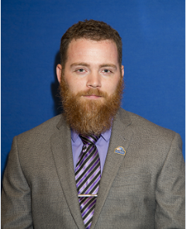
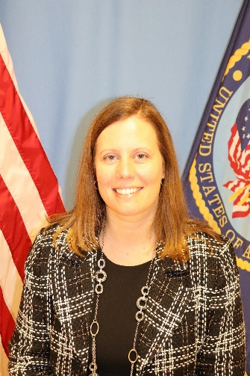
Subject Matter Experts
James Lester
Columbia VREO
Linda Steffensmeier
Los Angeles VREO
Heather Becker
Buffalo AVREO
Rodney Hackney Oakland VREO
Corliss De La Garza
Albuquerque VREO
Chloe Freeman
Waco VREO
Kenneth Fisher
Muskogee AVREO

Slide 4
Objectives
Upon completion of this instruction, you will be able to:
Identify 5 aspects of performance management
Have knowledge of performance plans
Plan, Monitor, Develop, Appraise and Reward performance

Slide 5
Good vs Bad Performance Management
https://youtu.be/oy-UZYDPvSs

Slide 6
Performance Management
What is performance management?
Performance management is a management function which includes the processes of planning performance, monitoring performance, developing performance, appraising performance, and rewarding performance
Notes:
Question:
What is Performance Management?
Answer: For today’s lesson we will use the following definition.
Performance management is a management function which includes the processes of planning performance, monitoring performance, developing performance, appraising performance, and rewarding performance
Now lets look at the following words in this definition:
Planning
Monitoring
Developing
Appraising and
Rewarding

Slide 7
Performance Management
Planning
Monitoring
Developing
Appraising
Rewarding
Notes:
Planning - Establishing elements and standards, and setting goals and expectations for individuals and groups
Monitoring - Measuring performance and providing feedback to employees on their performance
Developing - Increasing the capacity of employees to perform, i.e., through formal training, on-the-job training, details, work process improvement, competency development, and/or other methods
Appraising - Evaluating employee performance against elements and standards in an employee’s performance plan and providing a rating of record
Rewarding – recognizing and awarding someone for their work
These five processes are equally important and must be completed by managers and supervisors if organizational objectives are to be accomplished

Slide 8
The Title 5: Performance Appraisal Program
An Overview
Notes:
In supporting a results-based and customer-oriented environment, managers and employees, at all levels, must be held accountable for achieving desired outcomes. The performance appraisal provides an ideal mechanism for communicating and clarifying organizational goals to employees and linking individual appraisal and performance to achievement of those goals.

Slide 9
Purpose
The program is designed to:
Link employee performance to the achievement of VA’s organizational goals and objectives
Encourage employee and employee representative participation in the development and operation of the program
Ensure the inclusion of customer service goals and standards in all individual performance plans
Notes:
The program is designed to:
Link employee performance to the achievement of VA’s organizational goals and objectives
Encourage employee and employee representative participation in the development and operation of the program
Ensure the inclusion of customer service goals and standards in all individual performance plans

Slide 10
Purpose
The program is designed to:
Provide for continuous performance improvement of the organization and its employees and assistance to employees in improving unacceptable performance
Recognize and reward organizational/team and individual performance accomplishments
Notes:
Provide for continuous performance improvement of the organization and its employees and assistance to employees in improving unacceptable performance
Recognize and reward organizational/team and individual performance accomplishments

Slide 11
Coverage
All General Schedule employees
Notes:
Performance Plans must be written for all employees who are paid on a GS Scale

Slide 12
Performance Appraisal Period
Appraisal period is the fiscal year, 10/1 to 9/30 of the following year
For new employees, the rating period will start the date the employee receives the plan
A progress review should still be completed
Minimum appraisal period is 90 calendar days
Notes:
The Appraisal period is the fiscal year. The fiscal year begins October 1st and ends on September 30th of the following year (10/1 to 9/30).
For new employees, the rating period will be the date the employee receives the plan
Please note that a progress review should still be completed for the new employee.
Minimum appraisal period is 90 calendar days

Slide 13
Performance Appraisal Form
VA Form 0750, Performance Appraisal Program
http://vaww.va.gov/vaforms/va/pdf/VA0750(ES)(10%20pages).pdf
Notes:
This slide has the link to VA Form 0750, the Performance Appraisal Program Form. This is the form that you will use to complete your performance appraisal. You will complete this form and review it with the employee. You and the employee will complete the form by signatures.
Now let’s review the steps of preparing and completing this form.

Slide 14
Planning Performance
Performance plans
Must be written
Employees and their representatives should be involved in developing and revising performance plans
AFGE shall be given a reasonable written advance notice (no less than 15 calendar days) when Rater changes, adds to, or establishes new elements and performance standards
AFGE may provide input
Notes:
Performance plans
Must be written
Employees and their representatives should be involved in developing and revising performance plans
AFGE shall be given a reasonable written advance notice (no less than 15 calendar days) when Rater changes, adds to, or establishes new elements and performance standards (for NFFE it’s 10 working days)
AFGE may provide input (so may NFFE)

Slide 15
Planning Performance
Performance plans
Must support organizational goals and objectives and be linked to overall program results
Will contain at least one critical element (CE) and one noncritical element (NCE)
Must include standard(s) that addresses customer service
Must be written at least at the “Fully Successful” (FS) achievement level
Notes:
Performance plans
must support organizational goals and objectives and be linked to overall program results – look at the big picture
will contain at least one critical and one noncritical element
must include standard(s) that addresses customer service
must be written at least at the “Fully Successful” achievement level

Slide 16
Planning Performance
Performance plans
Employee must be adequately informed of what is necessary to reach an “Exceptional” achievement level on each element
Do not require higher level approval
Must be communicated in writing as soon as possible but no later than 60 calendar days (normally 30 calendar days for AFGE bargaining unit employees)
Notes:
Performance plans
Employee must be adequately informed of what is necessary to reach an “Exceptional” achievement level on each element.
Do not require higher level approval
Must be communicated in writing as soon as possible but no later than 60 calendar days (normally 30 calendar days for AFGE bargaining unit employees) (NFFE is as soon as possible but normally no later than 30 days after starting the position)

Slide 17
Planning Performance
Employee must sign for receipt of plan on VAF 0750
Changes or other developments that necessitate changes to the plan will be documented in writing on VAF 0750 and communicated to the employee
Notes:
Employee must sign for receipt of plan on VAF 0750
Changes or other developments that necessitate changes to the plan will be documented in writing on VAF 0750 and communicated to the employee
Employee must sign VAF 0750
Normally, plans will not be changed within 90 calendar days of the end of the appraisal period

Slide 18
Monitoring Performance
Raters and employees mutually share responsibility for initiating communications about actual performance
Raters must hold at least one progress review during the appraisal period and document the review on VAF 0750
When Rater determines an employee is not meeting the standards of one or more of his/ her critical elements, HR should be consulted
Notes:
Raters and employees mutually share responsibility for initiating communications about actual performance – employees should understand where their performance is, this can be done monthly, quarterly, etc.
Raters must hold at least one progress review during the appraisal period and document the review on VAF 0750
When Rater determines an employee is not meeting the standards of one or more of his/ her critical elements, HR should be consulted

Slide 19
Appraising Performance
Performance ratings must be completed and communicated within 60 calendar days after the end of the appraisal period
Employees may submit to Rater a self-assessment within 10 workdays after the end of the appraisal period
Notes:
Performance ratings must be completed and communicated within 60 calendar days after the end of the appraisal period
Employees may submit to Rater a self-assessment within 10 workdays after the end of the appraisal period – this is optional, however can help you with tracking employee performance.

Slide 20
Appraising Performance
Raters may consider feedback from multiple sources, including customers, peers or other appropriate sources
Raters may consider improvements in efficiency, productivity, timeliness, quality of work or service, accomplishment of goals, as well as any other relevant information in appraising performance
Raters may take into consideration any summary ratings completed during the appraisal period
Notes:
Raters may consider feedback from multiple sources, including customers, peers or other appropriate sources – stakeholders, workgroup leaders,
Raters may consider improvements in efficiency, productivity, timeliness, quality of work or service, accomplishment of goals, as well as any other relevant information in appraising performance
Raters may take into consideration any summary ratings completed during the appraisal period

Slide 21
Appraising Performance
Elements will be rated at three achievement levels:
Exceptional (E)
Fully Successful (FS)
Less Than Fully Successful (LFS)
Notes:
Exceptional – All performance standards for the element are significantly surpassed. This level is reserved for employees whose performance in the element far exceeds normal expectations and results in significant contributions to the organization.
Fully Successful – Performance standards when taken as a whole are being met. This level is a positive indication of employee performance and means the employee is effectively meeting performance expectations for this component of the job.
Less Than Fully Successful – Performance standards are not being met. Assignment of this level means that performance in not acceptable in this component of the job.

Slide 22
Appraising Performance
If an achievement level of other than Fully Successful is assigned, information on the achievements/performance deficiencies supporting the level assigned must be documented on VAF 0750
Notes:
If an achievement level of other than Fully Successful is assigned, information on the achievements/performance deficiencies supporting the level assigned must be documented on VAF 0750

Slide 23
Appraising Performance
After assigning a level of achievement for each Element of the Plan, the rater will assign a rating of record based on one of five adjective descriptions:
Outstanding - Achievement levels for all elements are designated as Exceptional
Excellent - Achievement levels for all critical elements are designated as Exceptional. Achievement levels for noncritical elements are designated as at least Fully Successful. Some, but not all, noncritical elements may be designated as Exceptional
Notes:
After assigning a level of achievement for each Element of the Plan, the rater will assign a rating of record based on one of five adjective descriptions:
Outstanding - Achievement levels for all elements (critical and non-critical) are designated as Exceptional.
Excellent - Achievement levels for all critical elements are designated as Exceptional. Achievement levels for noncritical elements are designated as at least Fully Successful. Some, but not all, noncritical elements may be designated as Exceptional. (i.e. at least one non-critical element is designated as fully successful, while all other elements are designated as exceptional.)

Slide 24
Appraising Performance
Fully Successful - The achievement level for at least one critical element is designated as Fully Successful. Achievement levels for other critical and noncritical elements are designated as at least Fully Successful or higher
Minimally Satisfactory - Achievement levels for all critical elements are designated as at least Fully Successful. Achievement levels for one or more noncritical elements is designated Less Than Fully Successful
Unsatisfactory - The achievement level(s) of one (or more) critical elements(s) is (are) designated as Less Than Fully Successful
Notes:
Fully Successful - The achievement level for at least one critical element is designated as Fully Successful. Achievement levels for other critical and noncritical elements are designated as at least Fully Successful or higher.
Minimally Satisfactory - Achievement levels for all critical elements are designated as at least Fully Successful. Achievement levels for one or more noncritical elements is designated Less Than Fully Successful
Unsatisfactory - The achievement level(s) of one (or more) critical elements(s) is (are) designated as Less Than Fully Successful.

Slide 25
Appraising Performance
Fully Successful and Excellent performance ratings do not require higher level approval
Unsatisfactory, Minimally Satisfactory and Outstanding performance ratings do require higher level approval
Unsatisfactory performance ratings require higher level approval as well as remedial action prior to the rating
Notes:
Fully Successful and Excellent performance ratings do not require higher level approval
Unsatisfactory, Minimally Satisfactory and Outstanding performance ratings do require higher level approval
Unsatisfactory performance ratings require higher level approval as well as remedial action prior to the rating

Slide 26
Appraising Performance
Employees dissatisfied with their ratings may informally discuss with raters and/or approving officials;
If unresolved, employees may grieve under the applicable grievance procedure
Notes:
Employees dissatisfied with their ratings may informally discuss with raters and/or approving officials;
if unresolved, employees may grieve under the applicable grievance procedure

Slide 27
Details and Transfers
Employees detailed or temporarily promoted should be provided a performance plan for the new position; if the detail or temporary promotion lasts for at least 90 days, a performance rating should be completed at the end of the detail or temporary promotion
If the employee leaves or changes positions, the rater must prepare a summary rating on the original VAF 0750
Notes:
Employees detailed or temporarily promoted should be provided a performance plan for the new position; if the detail or temporary promotion lasts for at least 90 days, a performance rating should be completed at the end of the detail or temporary promotion
If the employee leaves or changes positions, the rater must prepare a summary rating on the original VAF 0750

Slide 28
Details and Transfers
If the rater leaves or changes positions or the employee changes raters, the rater must prepare a summary rating, using a copy of the original VAF 0750
The new rater may utilize any summary performance rating prepared by a previous rater as the rating of record by concurring in it
Notes:
If the rater leaves or changes positions or the employee changes raters, the rater must prepare a summary rating, using a copy of the original VAF 0750
The new rater may utilize any summary performance rating prepared by a previous rater as the rating of record by concurring in it

Slide 29
Poll Questions

Slide 30
True or False
The minimum appraisal period is 60 calendar days.

Slide 31
True or False
Performance ratings must be completed and communicated within 60 calendar days after the end of the appraisal period.

Slide 32
True or False
If the employee leaves or changes positions, the rater must prepare a summary rating on the original VAF 0750.

Slide 33
Impact of Ratings
Generally, employees must be rated Fully Successful or higher to receive within grade increases and career ladder promotions
Employees rated Fully Successful or higher are eligible for Performance Awards (FS with at least 1 CE rated as Exceptional)
Unless reassigned, employees rated Unsatisfactory must be demoted or removed from Federal service. Can provide “Informal Assistance.”
Notes:
Generally, employees must be rated Fully Successful or higher to receive within grade increases and career ladder promotions
Employees rated Fully Successful or higher are eligible for Performance Awards (FS with at least 1 CE rated as Exceptional). However, how monetary awards are actually distributed may vary by office.
Unless reassigned, employees rated Unsatisfactory must be demoted or removed from Federal service. Need to provide a Performance Improvement Plan (PIP) first.

Slide 34
Performance Management: The Process
Notes:
During this section of the presentation, we will discuss the process of delivering the information to the employee. What information should we discuss with the employee, as well as the timeline for the performance management process.

Slide 35
Performance Management: The Process
Present Performance Plan to employee each year
Review plan
Discuss expectations
Stress definition: fully successful as expected level of achievement
Have employee sign the plan and provide a copy
Be prepared to advise what is expected to be rated as Exceptional in each element and for the Plan as a whole
Notes:
Present Performance Plan to employee each year.
Review plan
Discuss expectations
Stress definition: fully successful as expected level of achievement
Have employee sign the plan and provide a copy
Be prepared to advise what is expected to be rated as Exceptional in each element and for the Plan as a whole.

Slide 36
Performance Management: The Process
Conduct Mid-year Review in April each year
You may describe actual performance in summary, but it is not required. (Caution: Do not use terms such as Outstanding or Exceptional)
Simply state that the employee is performing acceptably or not (Fully Successful or Needs Improvement to be Fully Successful)
If not performing acceptably, describe and annotate what areas need improvement
Notes:
Conduct Mid-year Review in April each year (October through March performance data)
You may describe actual performance in summary, but it is not required. (Caution: Do not use terms such as Outstanding or Exceptional)
Simply state that the employee is performing acceptably or not
If not performing acceptably, describe and annotate what areas need improvement
Provide employees with honest feedback on both positive and negative performance points in a manner that encourages them to strive for improvement.

Slide 37
Performance Management: The Process
At end of Performance Appraisal Year: Prepare to assign rating
Receive schedule from HR and issue employee notice of self-assessment opportunity
Await completion of self-assessment period
Consider your information and employee input
Complete appraisal and communicate to employee
Notes:
At end of Performance Appraisal Year: Prepare to assign rating
– Receive schedule from HR and issue employee notice of self-assessment opportunity
– Await completion of self-assessment period
– Consider your information and employee input
Complete appraisal and communicate to employee
Can accept the Self Assessment if it was done by Element and addresses how the standard(s) were met, exceeded.
Even at the Fully Successful Level . . .
You may find that encouragement to improve some aspect will be necessary. Provide employees with honest feedback on both positive and negative performance points in a manner that encourages them to strive for improvement.
As well, there may be an accolade that can be given for extra effort during the performance year even if the performance does not warrant assigning the Exceptional achievement level at the end of the year evaluation.

Slide 38
Performance Management: The Process
A word about assigning the “Exceptional” level...
Must meet the criteria you defined at the start of the Performance Appraisal year.
For example, if Customer Service allows 3 valid complaints in describing the FS level, is the absence of any complaints really “exceptional”?
Or is 3 the threshold before any official performance action will be initiated?
Definition must be clear at beginning so if Fully Successful is assigned, it will be understood and accepted.
Notes:
A word about assigning the “Exceptional” level...
Must meet the criteria you defined at the start of the PA year.
For example, if Customer Service allows 3 valid complaints in describing the Fully Successful (FS) level, is the absence of any complaints really “exceptional”?
Or is 3 the threshold before any official performance action will be initiated?
Definition must be clear at beginning so if the FS is assigned, it will be understood and accepted.

Slide 39
Performance Management: The Process
Timeline for the process:
April: Mid-Year Performance review
10/01-10/15: Notice to employee for Self-Evaluation
10/16-11/01: Appraise performance considering employee input and your data
11/03-11/10: Consideration of all ratings and begin awards assessment process (FS can get award consideration if at least one critical element is E)
Notes:
11/1 to 11/7: include ratings at Minimally Satisfactory or Unsatisfactory (maybe Outstanding) that require higher level sign off.
When communicating at end provide new Performance Appraisal get signature/date
Performance Awards are determined based upon employee ratings.
As long as employee is rated Fully Successful or better, with at least one critical element rated as excellent, they may be eligible for a performance award. Actual distribution of awards may vary based on office protocol, union agreements, etc.

Slide 40
Performance Management: The Process
11/10-11/30: Communicating rating and awards info to employees (get signature/date and provide copy to employee); New performance plan distributed
(All of above can be extended by business needs)
HRCs will provide a due date for all performance reviews to be submitted and all performance awards to be entered
Notes:
11/10-11/30: Communicating rating and awards info to employees (get signature/date and provide copy to employee); New appraisal
All of above can be extended by business needs. Usually HRCs will provide a “drop dead” date for awards to be paid out by the end of the calendar year.
HRCs will provide a due date for all performance reviews to be submitted and all performance awards to be entered. Typically the due dates will be given so that HRCs can process performance awards so they can pay out around the holidays, or at least by the end of the calendar year.

Slide 41
Performance Management: The Process
HR has a role in your completed process (performance management and awards processing)
SSNs on awards (if incorrect; slows down coding process)
Position title and series (if not accurate; problem if used for promotion opportunity)
Notes:
Attention to detail is important during the performance management process. This is also important because…..
HR has a role in your completed process
SSNs (if incorrect; slows down coding process)
Position title (if not accurate; problem if used for promotion opportunity)

Slide 42
Performance Management: The Process
Grade (if not accurate also can be a problem if used in applying for promotion);
Can also raise an issue as to the validity of the appraisal
Was the person rated against the wrong standards
Credibility of rater could be called into question
Deficient narrative for the Exceptional level of achievement
Notes:
Grade (if not accurate also can be a problem if used in applying for promotion);
Can also raise an issue as to the validity of the appraisal
Was the person rated against the wrong standards
Credibility of rater could be called into question
Deficient narrative for the E level of achievement – Exceptional areas should be explained.
What happens if in February the employee went from a GS-9 Employment Specialist to a GS-11 Employment Specialist? Who can describe process?
Summary rating at GS-9. New Performance Plan communicated for GS-11.
Can use GS-9 Summary along with GS-11 to perhaps enhance a rating of record at end of Performance Appraisal year.

Slide 43
Performance Management: The Challenges
Notes:
Now lets talk about some of the performance management difficulties or challenges to be aware of…….hopefully we can also discuss some best practices when these issues arise.

Slide 44
Performance Management: The Challenges
Minimally Satisfactory
The achievement levels for all critical elements are designated as at least Fully Successful, however,
The achievement level(s) for one (or more) non critical element(s) is designated as Less than Fully Successful
This rating must be signed by an approving official in addition to the rater.
Employee should have been counseled prior to issuance of such a rating. Not eligible for WIG.
Notes:
Lets start off by discussing the minimally satisfactory rating:
Minimally Satisfactory
The achievement levels for all critical elements are designated as at least Fully Successful, however,
The achievement level(s) for one (or more) non critical element(s) is designated as Less than Fully Successful
This rating must be signed by an approving official in addition to the rater.
Employee should have been counseled prior to issuance of such a rating. Not eligible for WIG.

Slide 45
Performance Management: The Challenges
At first sign of deficiency, discuss with employee (informal)
Document that discussion, even if verbal, with an e-mail at the minimum
Union obligations?
Follow your Regional Office process about when to consult with your Human Resource department and Director’s office.”
Notes:
Now what should you do at the first sign of a deficient performance issue:
At first sign of deficiency, discuss with employee (informal) – make sure they understand how to get to fully successful. Discuss what resources they might need in order to help them become successful and follow up to provided them whenever possible (training, mentoring, overtime, etc.)
Document that discussion even if verbal with an e-mail at the minimum – it will help if you need to look back at this and help the employee to understand.
Union obligations? – be sure to include them if need be.

Slide 46
Performance Management: The Challenges
No or little improvement . . .
You may wish to issue a written performance counseling memo with the specifics of the issues (make reference to earlier verbal conversation)
OR
Follow the 714 Accountability Act guidance
Notes:
No improvement . . .
You may wish to issue a written counseling with the specifics of the issues (make reference to earlier verbal conversation)
OR
Follow the 714 Accountability Act guidance

Slide 47
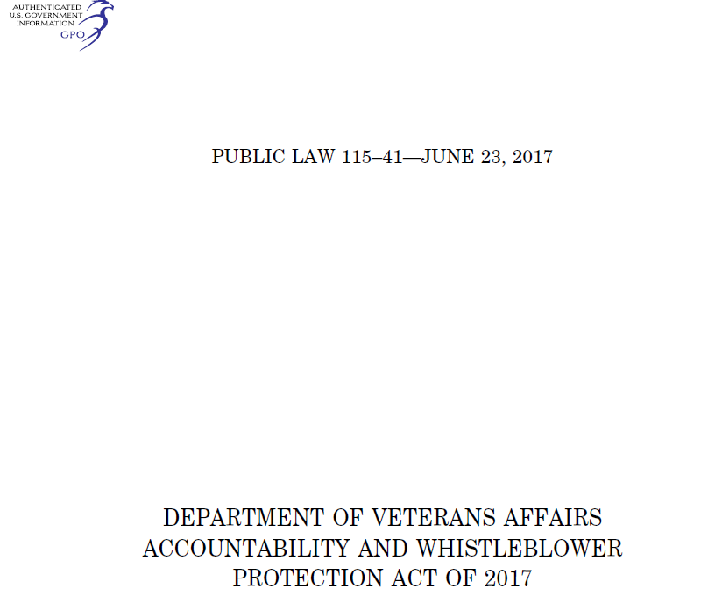
714 Accountability Act
https://www.congress.gov/115/plaws/publ41/PLAW-115publ41.pdf
Notes:
Click on the link – pages 9 through 13 cover Section 714: Employees: removal, demotion, or suspension based on performance or misconduct.

Slide 48
Performance Management: The Challenges
In the Letter of Concern:
State what assistance you will provide
State how often you will meet (A26, Section 10C)
Advise of other actions that will/may be affected—WIG, Career Ladder Promotions
Deliver (on your assistance and meeting statements)
Document all assistance provided and each meeting held
Union Obligations?
Notes:
In the Letter of Concern:
State what assistance you will provide
State how often you will meet (A26, Section 10C)
Advise of other actions that will/may be affected—WIG, Career Ladder Promotions
Deliver (on your assistance and meeting statements)
Document all assistance provided and each meeting held
Union Obligations? (AFGE A26, Section 10A) (NFFE Article 16)
For other positions in RO also eligibility for Certification may be affected.

Slide 49
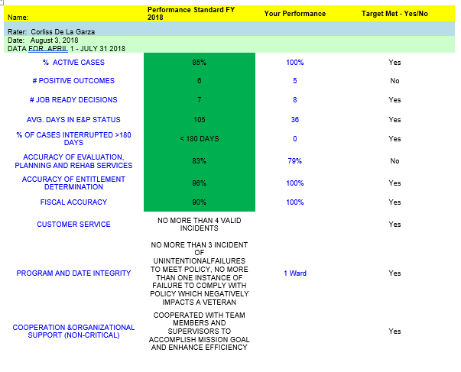
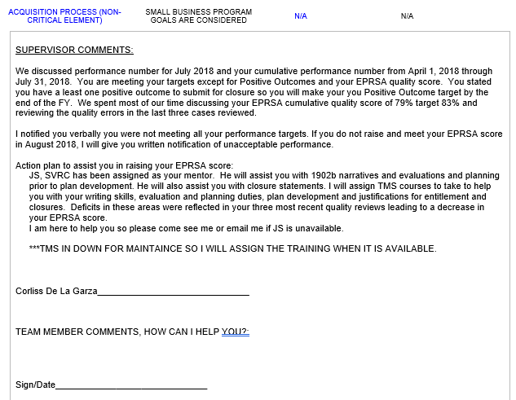
Sample Performance Document

Slide 50
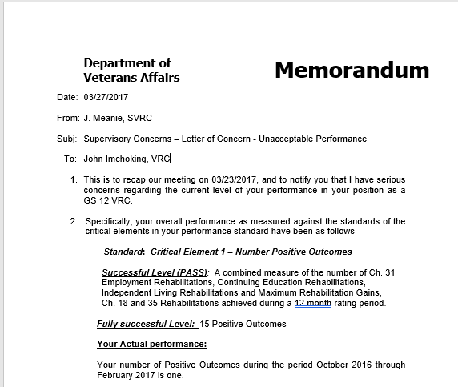
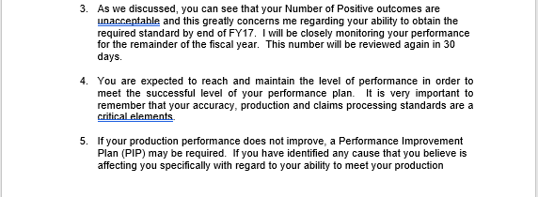
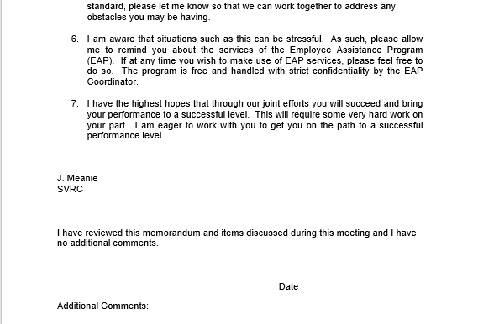
Sample Performance Memorandum

Slide 51
Performance Management: The Challenges
Employee brings up deficiency
Meet to advise and provide written outcome
Must then maintain for 1 year
Employee is close, and positive trends are present. . . Extend
Notes:
Employee brings up deficiency
Meet to advise and provide written outcome
Must then maintain at least fully successful performance in all elements of the performance plan for a minimum of 1 year. Failure to do so is equivalent to failing the PIP and follow up actions are required.
Employee is close . . . Extend
The length of the extension should be based on the elements the employee is working to improve, the progress they have been making, and consideration of a reasonable timeline to be able to show sufficient improvement to meet the standard(s).

Slide 52
Performance Management: The Challenges
Employee not close/not improving . . .
Meet to let the employee know he/she did not bring performance up to standard. Have documentation for reference
Advise that you must now make recommendation to the Director to reassign, demote, or remove
Notes:
Employee not close and/or not improving. . .
Meet to let the employee know he/she did not bring performance up to standard
Advise that you must now make recommendation to the Director to reassign, demote, or remove
HR and your Director’s office should already have been kept update of the progress prior to this time. Don’t blindside them with an Unsuccessful performance review.

Slide 53
Performance Management: The Challenges
If decision is to demote or remove—Adverse Action
Issue Unsatisfactory Performance Rating of Record
The achievement level(s) for one (or more) critical elements is designated as Less Than Fully Successful
This rating must be signed by an approving official in addition to the rater
Notes:
If decision is to demote or remove—Adverse Action. This means the employee has more rights to appeal (i.e. MSPB) and gets a notification and a chance to respond before any action is taken.
Issue Unsatisfactory Performance Rating of Record
The achievement level(s) for one (or more) critical elements is designated as Less Than Fully Successful
This rating must be signed by an approving official in addition to the rater

Slide 54
Performance Management: The Challenges
Proposed Demotion/Removal
5 USC 4303(c)(2)(A):
In case of reduction in grade or removal, may be based only on those instances of unacceptable performance by employee which occurred during the 1 year period ending on the date of the 30 day advance written notice.
Notes:
Proposed Demotion/Removal
5 USC 4303(c)(2)(A):
In case of reduction in grade or removal, may be based only on those instances of unacceptable performance by employee which occurred during the 1 year period ending on the date of the 30 day advance written notice.
This means, you can not take into consideration performance issues that were noted more than 1 year prior to the date of the prosed demotion or removal. This is particularly important when considering our Quality Assurance processes. This is also particularly important in cases where extensions have been provided during the PIP. Documentation is imperative to strongly support the decision and justify the action was within the scope the law allows.

Slide 55
Performance Management: The Challenges
VR&E Quality Review Process – 1 year look back
Notes:
VR&E Quality Review Process – 1 year look back (from date of review, or from date of case closure)

Slide 56
Performance Management: The Challenges
On appeal, Merit System Protection Board, (MSPB) cannot mitigate your penalty as in a Conduct Action
May only sustain or reverse your action
First thing the Administrative Judge (AJ) will do is assure that each element of the law has been met
You must dot your “I”s and cross your “T”s
Following notice period, the Director will issue a decision on the action you proposed (demote/remove)
Notes:
Reasonable standards
PIP at least 90 days
Assistance Provided
Meetings Held
Advance Notice of Adverse Action
Performance outside the 1 year period not considered

Slide 57
Questions

Slide 58
True or False
Management should conduct a Mid-year Review every April

Slide 59
True or False
It is a best practice at first sign of deficiency to discuss with employee (informal)

Slide 60
True or False
You should consult with your local HR department during performance management

Slide 61
References
VA Directive 5013
VA Handbook 5013 https://vaww.va.gov/OHRM/Directives-Handbooks/Documents/5013.pdf
VA - AFGE Master Agreement https://www.va.gov/LMR/docs/Agreements/AFGE/Master_Agreement_between_DVA_and_AFGE-fin_March_2011.pdf
VA - NFFE Master Agreement https://www.va.gov/LMR/docs/Agreements/NFFE/NFFE_VA_Master_Agreement_July2012.pdf
Notes:
References:
VA Directive 5013
VA Handbook 5013
http://vbaw.vba.va.gov/bl/edt/acad_hrm_guide.htm
Revised Article 26, Master Agreement Between VA and AFGE
VA-NFFE master agreement

Slide 62
Additional Information
HR Directives and Handbooks Web Site https://vaww.va.gov/OHRM/HRLibrary/Dir-Policy.htm
For information on developing performance plans, sample standards, etc. http://vaww1.va.gov/ohrm/EmployeeRelations/Performance.htm
Notes:
Additional Information:
HR Directives and Handbooks Web Site http://vaww1.va.gov/ohrm/Directives-Handbooks/Direct_Hand
For information on developing performance plans, sample standards, etc. http://vaww.va.gov/title5performance/

Slide 63
Questions/Discussion
Next NDLT Teams Sessions:
Systematic Analysis of Operations Part 1
Tuesday, March 8, 2022 @ 11-12:30 PM ET
Systematic Analysis of Operations Part 2
Tuesday, March 15, 2022 @ 11-12:30 PM ET
Global Perspective: VBA Education Service
Tuesday, March 22, 2022 @ 11-12:30 PM ET
TMS # 4492144
Preparing for Midyear Performance
Notes:
Any questions.
TMS Info: Please complete the feedback survey.

