Slide 1

VA Appeals Modernization Act
Improved Decision Notices -
Rating Decisions
January 2021
Notes:
Instructor Notes:
This course provides an overview of the Appeals Modernization Act (AMA) decision notice requirements. The course provides students with an understanding of favorable findings and how those should be documented in a rating decision.

Slide 2
Improved Decision Notices
References
Objectives
Identify the six Appeals Modernization Act (AMA) improved rating decision notice requirements
Define favorable findings and document those findings in a rating decision
Complete a rating decision in VBMS-Rating (VBMS-R) that meets the AMA improved notice requirements
Notes:
Instructor Notes:
At the end of this lesson, you will be able to:
Identify the six Appeals Modernization Act (AMA) improved rating decision notice requirements
Define favorable findings and document those findings in a rating decision
Complete a rating decision in VBMS-Rating (VBMS-R) that meets the AMA improved notice requirements

Slide 3

Improved Decision Notices
References
AMA Notice Requirements
To ensure claimants receive adequate notices, AMA requires VA to issue improved decision notifications. There are 8 elements VA must include in all decision notices.
This training will focus on the first 6 elements and how to address them using VBMS-R.
For information on the new notification letter requirements (Elements 7-8),
see the training handouts.
Notes:
TELL the students there are 8 elements VA must include in all decision notices, and this training focuses on the first 6 elements.

Slide 4
Improved Decision Notices
References
Rating Decision Elements
Identification of the issues adjudicated
A summary of the evidence considered
A summary of the laws and regulations applicable to the claim
A listing of any findings made by the adjudicator that are favorable to the claimant
For denied claims, identification of the element(s) required to grant the claim(s) that were not met
If applicable, identification of the criteria required to grant the next higher level of compensation
Notes:
REVIEW the available handouts for detailed information on the rating decision elements.

Slide 5
Improved Decision Notices
References
Rating Decision Elements 1-3
Elements 1 and 2 require no change to VA rating decision processes. Decisionmakers will continue to list the issues adjudicated and provide a summary of the evidence considered within the body of the rating decision narrative.
Element 3 requires decisionmakers to identify laws and regulations applicable to each issue within the claim. Decisionmakers must use the system generated text (issue management screen and glossary) which summarizes the laws and regulations and provides citations.
To assist in identification of applicable laws and regulations, decisionmakers should refer to the Common Laws and Regulations for Completing Decisions handout.
Notes:
REVIEW the available handouts for detailed information on the rating decision elements.
TELL the students they should also refer to the Common Laws and Regulations for Completing Decisions handout.

Slide 6
Improved Decision Notices
References
VBMS-R: Laws and Regulations
VBMS-R will continue to automatically generate parenthetical references. However, if an applicable reference does not generate, users must:
  Select the Reference Laws tab under the Issue Management tab.
  Click the applicable Code of Federal Regulations (CFR) Part radio button.
Notes:
REVIEW the VBMS-Rating: Reference Laws and Regulations Job Aid.

Slide 7
Improved Decision Notices
References
VBMS-R: Laws and Regulations (cont.)
Users can search for and add any applicable reference law or regulation for any issue under a claim.
Notes:
REVIEW the VBMS-Rating: Reference Laws and Regulations Job Aid

Slide 8
Knowledge Check #1
True or False:
The Appeals Modernization Act now requires that VA provide notification of the elements required to grant a claim for service connection and inform the Veteran of any elements that were not met, when denying a claim.
Notes:
REVIEW the knowledge check with the students.
True or False:
The Appeals Modernization Act now requires that VA provide notification of the elements required to grant a claim for service connection and inform the Veteran of any elements that were not met, when denying a claim.
The answer is True.

Slide 9
Element 4:
What is a Favorable Finding?

Slide 10
Improved Decision Notices
References
Element 4: Favorable Findings
38 CFR 3.104(c) defines Favorable Findings:
A finding means a conclusion either on a question of fact or on an application of law to facts made by an adjudicator concerning the issue(s) under review.
Any finding favorable to the claimant made by either a VA adjudicator or by the Board of Veterans’ Appeals (Board) is binding on all subsequent VA and Board adjudicators, unless rebutted by evidence that identifies a clear and unmistakable error in the favorable finding.
Favorable findings relate to a material element that would be required to grant the benefit sought and should be specific.
Notes:
TELL the students favorable findings should be specific enough that a claimant, upon reading the notification and rating decision, will be able to determine what evidence was used to make the finding.

Slide 11
Improved Decision Notices
References
Documenting Favorable Findings
Decisionmakers must address any favorable findings in rating decisions based on the decision rendered as shown below:
Issues Granted
  There is no requirement to separately list favorable findings.
Issues Denied/Confirmed Denials
  If elements are met, use the VBMS-R Favorable Findings Tab to separately identify and save any favorable findings.
Increase Granted/Confirmed Evaluations
  Rely on system generated language from the Evaluation Builder (separate favorable findings list is not required).
Notes:
EMPHASIZE to the students there is no requirement to list favorable findings for issues granted.

Slide 12
Improved Decision Notices
References
Documenting Favorable Findings
When documenting Favorable Findings,
  Clearly identify the material element found to be met such as
    Incurrence
    Nexus
    Diagnosis
    Presumptions (i.e. exposure to herbicides, chemical, radiation, etc.)
  Briefly state the evidence used to support the finding (only include the most relevant and recent evidence of record)
A list of pre-approved text is available for use in documenting the material element for favorable findings. (see Favorable Findings Approved Text handout)
Notes:
REVIEW the Favorable Findings Approved Text for the list of pre-approved text for documenting the material element for favorable findings.

Slide 13
Improved Decision Notices
References
Good Examples of Favorable Findings
Element Met | Material Element Approved Text (Select from list, copy verbatim) | Supporting Evidence (Free text /use claim specific information)
Incurrence | The evidence shows that a qualifying event, injury, or disease had its onset during your service. | “Service treatment records from service period January 2016 to March 2018 show treatment for a right knee injury.”
Nexus | A nexus, or link, has been established between your claimed issue and an in-service event or injury. | “VAMC Houston examination dated March 17, 2017established a relationship between your right knee injury in service and your currently diagnosed right knee arthritis.”
Diagnosis | You have been diagnosed with a disability. | “VAMC Houston examination dated March 17, 2017 confirms a current diagnosis of right knee arthritis.”
Notes:
REVIEW the below good examples of favorable findings. Good examples are specific and document supporting evidence.
An in-service injury is confirmed based on a right knee strain shown in service treatment records dated January 3, 1956.
A direct causal relationship between your right knee injury in service and your currently diagnosed right knee arthritis is established on VAMC Houston examination dated March 17, 2017.
Agent orange herbicide exposure is presumed based on confirmed service in Vietnam on DD 214 for service period April 1966 to April 1972.
Your left shoulder arthritis meets the requirement for a chronic condition at a compensable degree within one year of discharge based on VAMC Bay Pines treatment reports dated January 1, 2013.
Entitlement to an earlier effective date is shown based on a diagnosis of diabetes mellitus prior to May 2001 shown in private treatment records from Dr. Smith dated January 1999.

Slide 14
Improved Decision Notices
References
Improper Examples of Favorable Findings
Improper Examples | Good Examples (material element + evidence)
Service connection is warranted. | The evidence shows that a qualifying event, injury, or disease had its onset during your service. Service treatment records from service period January 2016 to March 2018 show treatment for a right knee injury.
Private treatment records dated January 1, 2012, February 5, 2015, March 19, 2018, December 21, 2018, and January 1, 2019 show a diagnosis. | You have been diagnosed with a disability. Private treatment records from Dr. John Smith dated January 1, 2019 show a diagnosis of right knee arthritis.
There is a current diagnosis. | You have been diagnosed with a disability. “VAMC Houston examination dated March 17, 2017 confirms a diagnosis of right knee arthritis.”
Service treatment records dated January 1, 1955 show a right knee injury. Records dated March 1956, June 1956, and July 1957 show treatment for the right knee. Records from April 1958 show right knee pain. Therefore, an in-service event is conceded. | The evidence shows that a qualifying event, injury, or disease had its onset during your service. Service treatment records from January 1955 to April 1958 show treatment for a right knee injury.
Vietnam service is confirmed. | Exposure to herbicide agents is presumed. You served in the Republic of Vietnam as noted on your DD 214 for service period January 1966 to March 1966.
Notes:
TELL the students favorable findings should be specific enough that a claimant, upon reading the notification and rating decision, will be able to determine what evidence was used to make the finding.
Improper examples are general and lack supporting evidence.
Service connection warranted.
Current diagnosis.
Diagnosis in service treatment records.
Private treatment records show a current diagnosis.
VA Houston examination report dated March 9, 2018.
Vietnam service confirmed.

Slide 15
Improved Decision Notices
References
Rating Decision Elements 5-6
Element 5 requires identification of the element(s) required to grant the claim(s) that were not met for denied issues.
  Elements vary according to the claimed condition/benefit.
  Elements not met should be clearly stated and concise.
Element 6 requires identification of the criteria required to grant the next higher level of compensation if applicable. Decisionmakers will follow existing practices when evaluating a condition. The Evaluation Builder should be used for evaluating a condition and documenting it within the rating narrative.
Notes:
TELL the students elements not met should be clearly stated and concise.
TELL the students they should follow existing practices when evaluating a condition.

Slide 16
Documenting Decisions in
VBMS-R

Slide 17
VBMS-R Functionality
  VBA made updates to VBMS-R to ensure VBA rating decisions meet the new AMA notice requirements. These updates include:
  generated language changes,
  updated glossary fragments, and
  the addition of favorable finding functionality.
  Decisionmakers will cover all essential notice requirements (1-6) through use of the items noted above and existing functionality to include:
  calculators,
  the evaluation builder, and
  limited free text.
Notes:
TELL the students updates were made to VBMS-R to include generated language changes, updated glossary fragments and the addition of favorable finding functionality.

Slide 18
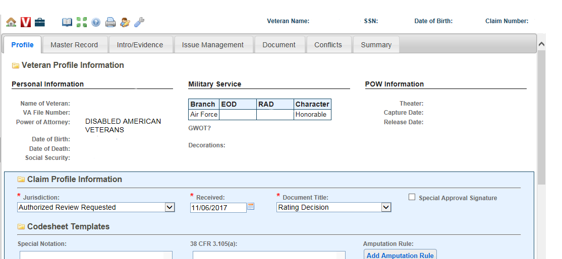
Improved Decision Notices
References
VBMS-R Profile Screen
Until “Supplemental Claim Received” and “HLR Received” are available for selection in VBMS-R, use “Authorized Review Requested” as the “Jurisdiction” type. Decisionmakers should modify the rating introduction narrative assistance text to ensure the correct language is displayed.
Jurisdiction
Notes:
TELL the students they should modify the rating introduction narrative assistance text to ensure the correct language is displayed in the rating decision.

Slide 19
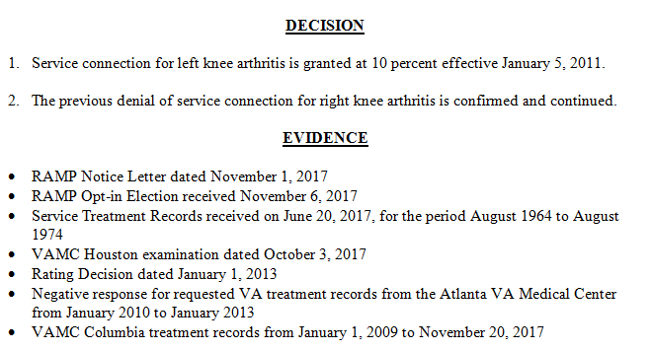
Improved Decision Notices
References
VBMS-R: Issues and Evidence
Decisionmakers will follow existing guidance on listing the issues adjudicated and the evidence considered as shown below.
Notes:
TELL the students they will follow existing guidance on listing the issues adjudicated and the evidence considered.

Slide 20
Improved Decision Notices
References
VBMS-R: Decision Narrative
Decision narratives for each issue must include the following components and users must use system generated text when available:
Text explaining the decision
All elements met and not met for denied claims
Evaluation builder text explaining evaluation assigned and next higher criteria (grants and increases only)
SMC calculator text, when applicable
Effective date explanation (grants or effective date claims only)
Favorable findings, if applicable
Applicable laws and regulations
Notes:
TELL the students decision narratives for each issue must include the following components, and they must use system generated text when available.

Slide 21
Improved Decision Notices
References
VBMS-R: Favorable Findings
When present, use the Favorable Findings tab in VBMS-R to separately list all favorable findings.
Select the Favorable Findings tab under the Issue Management tab.
Users can add, edit, and delete favorable findings, to include free text information.
Notes:
REVIEW the VBMS-Rating: Favorable Findings Job Aid.

Slide 22
Improved Decision Notices
References
VBMS-R: Favorable Findings (cont.)
VBMS-R allows for a user to overturn a favorable finding previously established by a prior rating decision.
Notes:
REVIEW the VBMS-Rating: Favorable Findings Job Aid.

Slide 23
Improved Decision Notices
References
VBMS-R: Favorable Findings (cont.)
Favorable findings are binding on all subsequent adjudicators. Decisionmakers may overturn a prior favorable finding when clear and unmistakable evidence is present to refute the finding.
Users must provide a justification in VBMS-R when overturning a prior favorable finding. VBMS-R will require users to overturn a previously documented favorable finding to remove it.
Users must select the
Overturn Finding button and
provide a justification.
Notes:
EMPHASIZE to the students favorable findings are binding on all subsequent adjudicators. However, Decisionmakers may overturn a prior favorable finding when clear and unmistakable evidence is present to refute the finding.

Slide 24
Improved Decision Notices
References
VBMS-R: Laws and Regulations
Compensation Service provided an extensive list of over 8,400 changes to update VBMS-R generated text.
These changes include updates to Analysis, Evaluation Builder, Secondary, and Tool text fragments.
The primary goal of these changes was to update/add regulation citations for these text fragments to provide a summary of applicable laws and regulations.
Decisionmakers must use the VBMS-R system generated text to provide notice to the claimant of the applicable laws and regulations.
To assist in identification of applicable laws and regulations, decisionmakers should refer to the Common Laws and Regulations for Completing Decisions handout.
Notes:
TELL the students they must use the VBMS-R generated text to provide notice to the claimant of the applicable laws and regulations.
TELL the students they should review the Common Laws and Regulations for Completing Decisions handout.

Slide 25
Improved Decision Notices
References
AMA Issue Tracking
Decisionmakers will be required to map contentions and provide issue-based dispositions when working any AMA claims (i.e. 030/040 EP series).
This functionality supports tracking and reporting requirements for Congress as required under the Appeals Modernization Act.
For detailed information on Contention Mapping, review the existing VBMS-R Contention Mapping Job Aid.
Issue Based Dispositions is addressed in this training. (For additional information, review the VBMS-R Dispositions Job Aids)
Notes:
REVIEW the associated Job Aids for VBMS-R Contention Mapping and Contention Dispositions.

Slide 26
VBMS-R: AMA Issue-Based Dispositions
A decisionmaker may identify a duty to assist (DTA) error or require additional development based on a difference of opinion. Impacted issues must be returned for corrective action.
Additionally, to comply with reporting requirements under the Appeals Modernization Act, decisionmakers must document the disposition for each issue adjudicated under the Supplemental Claim process.
26

Slide 27
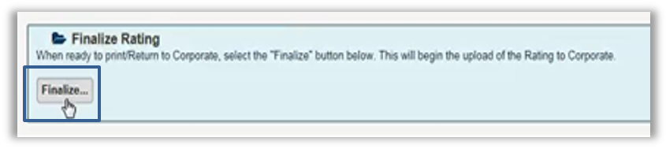
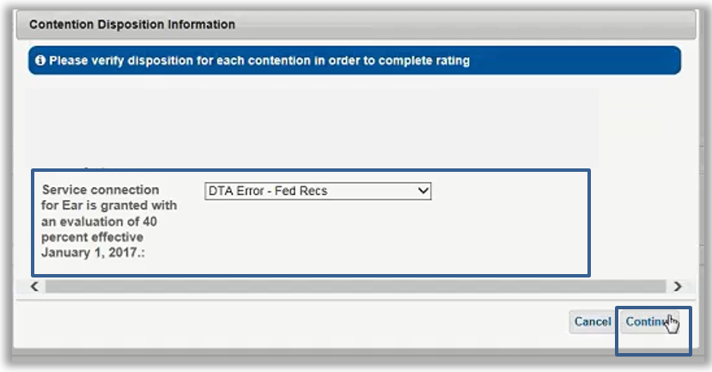
Improved Decision Notices
References
VBMS-R: AMA Issue-Based Dispositions
From the Documents tab, preview the Narrative and Codesheet and select Finalize.
Select the disposition from the Contention Disposition Information drop-down menu and complete the rating by selecting Continue.
Available options include:
Granted
Denied
DTA Error – Fed Recs (HLR only)
DTA Error – PMRs (HLR only)
DTA Error – Exam/MO (HLR only)
DTA Error – Other (HLR only)
Deferral (Supplemental Claims only)
Notes:
REVIEW the actions needed for selecting the disposition from the Contention Disposition Information drop-down menu within VBMS-R.

Slide 28
Knowledge Check #2 - Scenario
G.I. Jones served honorably in the U.S. Army from 1992-1998. On March 15, 2019, he submitted a substantially complete application for service connection for asthma and submitted current records from his doctor in support of his claim. The Veteran did not provide any information on when his asthma began or how the condition is related to his military service. The treatment records from Dr. Smith show a current diagnosis and treatment for asthma from 2015 to the present. STRs were negative for treatment or diagnosis of asthma or any complaints of difficulty breathing during the Veteran’s service. The claim was determined to be ready to rate without the need for a VA examination.
28

Slide 29
Knowledge Check Scenario (cont.)
Which of the following must be addressed in your rating decision? (identify all that apply)
A duty to assist error was identified based on the need for a VA examination.
Notation of a favorable finding regarding a current diagnosis of asthma as documented in the records from Dr. Smith.
Service connection for asthma is denied.
The required elements for service connection for asthma.
Evaluation builder text explaining the evaluation assigned and the next higher evaluation criteria.
*** Element 1 requires identification of the issue(s) being adjudicated. Element 4 requires listing of any findings made by the adjudicator that are favorable to the claimant. Element 5 requires identification of the element(s) required to grant the claim(s) that were not met for denied issues. Element 6 only requires identification of the criteria required to grant the next higher level of compensation when applicable, such as when an evaluation is being provided or confirmed and continued.
29
Notes:
Correct answer:
Notation of a favorable finding regarding a current diagnosis of asthma as documented in the records from Dr. Smith.
Service connection for asthma is denied.
The required elements for service connection for asthma.

Slide 30

Improved Decision Notices
References
Questions?
AMA Notice Requirements
Rating Decision Elements
Documenting Favorable Findings
Completing a Rating Decision in VBMS-R
Notes:
Instructor Notes:
As stated in the beginning of the training, the lesson objectives were to:
Identify the 6 Appeals Modernization Act (AMA) improved rating decision notice requirements
Define favorable findings and document those findings in a rating decision
Complete a rating decision in VBMS-Rating (VBMS-R) that meets the AMA improved notice requirements
We discussed each of these objectives through the following topics in each slide today:
AMA Notice Requirements
Rating Decision Elements
Documenting Favorable Findings
Completing a Rating Decision in VBMS-R
Are there any additional questions?

Slide 31
Improved Decision Notices
References
Next Steps
A satisfaction survey has been assigned to you in TMS
Be sure to complete the survey to receive credit for this training
Notes:
Instructor Notes:
A satisfaction survey has been assigned to you in TMS. Completing it will allow you to receive credit for this training.

