Slide 1
(VSR Challenge) DPRIS and PIES
Compensation Service
May 2019
Notes:
Welcome to the Introduction to Medical Electronic Performance Support System (E P S S) course. To advance each slide, click anywhere on the screen.

Slide 2
Lesson Objectives
Identify the purpose and functionality of the Defense Personnel Records Information Retrieval System (DPRIS) and Personnel Information Exchange System (PIES)
Identify what records are available through DPRIS Web and PIES
Demonstrate how to create a request and navigate the functions within DPRIS Web and PIES
Notes:
Lesson Objectives
Upon completion of this lesson, you will be able to:
Identify how to access Medical EPSS
Identify how to access the Help Menu
Determine how to access the menu tabs at the top of the Medical EPSS
Determine how to utilize the Search function box on the main menu
Identify other reference tools
Locate elements within the Medical EPSS in a practical activity

Slide 3
References
M21-1, Part III, Subpart iii, 2.A, General Information on Service Records
M21-1, Part III, Subpart iii, 2.D, Requesting Information and Records Through the Personnel Information Exchange System (PIES)
M21-1, Part III, Subpart iii, 2.I.4, Requests for Records Through the Defense Personnel Records Information Retrieval System (DPRIS)
DPRIS Website and PIES User Guides
DPRIS Web to PIES Cross Reference Guide
Notes:
Reference
The references for this course are listed on the screen. You may click any hyperlinked references for further details.
Compensation Service Intranet Home Page
Rating Job Aids
http://epss.vba.va.gov/Medical EPSS

Slide 4
Defense Personnel Records Information Retrieval System (DPRIS)
An electronic gateway used to request digital copies of Official Military Personnel File (OMPF) documents and to submit request to the Joint Services Records Research Center (JSRRC).
Primarily personnel records and copies of DD-214s, but will also provide some medical and physical examination results
The secure website allows access to the Services' records management systems and is maintained by Defense Manpower Data Center (DMDC).
Notes:
What is the Medical E P S S?
Tutorial information related to medical terminology and issues, using graphics and visual aids to illustrate various medical definitions and concepts
Information regarding the function of the body system and common conditions
Links to obtain more information on specific diseases, body parts, and medical terms

Slide 5
DPRIS Advantages
Provides standard index of all images contained in each branch’s OMPF systems (except Coast Guard)
Includes follow-up message capability
Single-source repository for most branches
On average, images are received in less than 48 hours
Notes:
What is the Medical E P S S?
Tutorial information related to medical terminology and issues, using graphics and visual aids to illustrate various medical definitions and concepts
Information regarding the function of the body system and common conditions
Links to obtain more information on specific diseases, body parts, and medical terms

Slide 6
VSR Roles and Responsibilities
Initiate requests for OMPF information
Upload the request and any available records into eFolder
Initiate and manage secure follow-up messages
Submit any questions or suggestions using the Assistance Form

Slide 7
Records Availability

Slide 8
Using DPRIS Web
DPRIS Website: https://www.dpris.dod.mil
All VARO users shall use their Personal Identity Verification (PIV) badge and PIN to log in
Prospective users should contact their DPRIS super user or manager to become authorized users

Slide 9
DPRIS Website

Slide 10
Home Screen

Slide 11
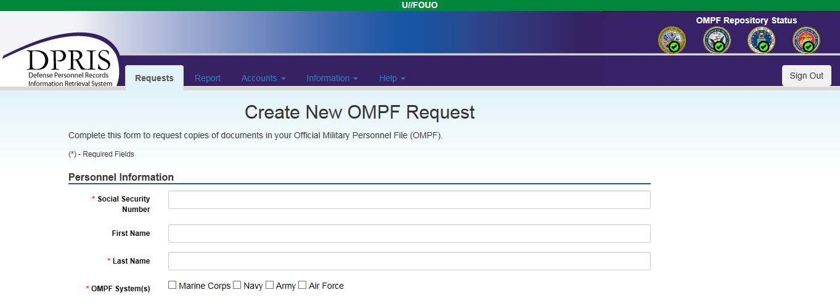
OMPF Request Form

Slide 12
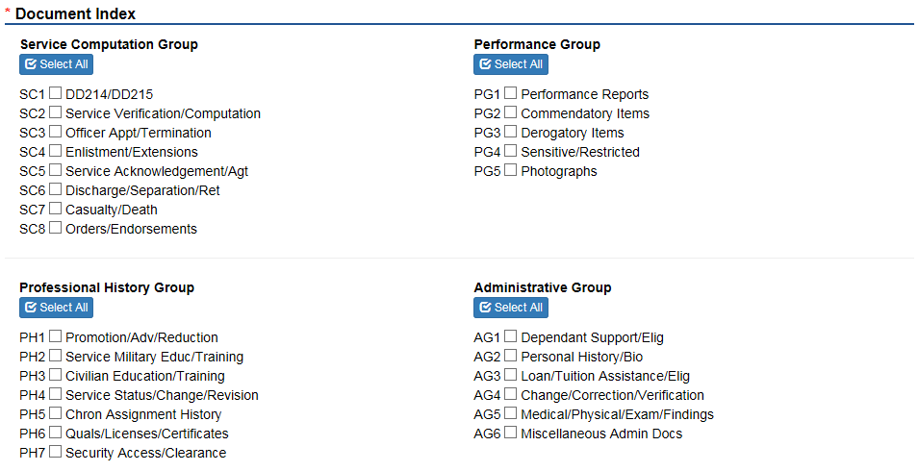
Document Index
*Remember to take a screenshot of this request page to upload into the eFolder*

Slide 13
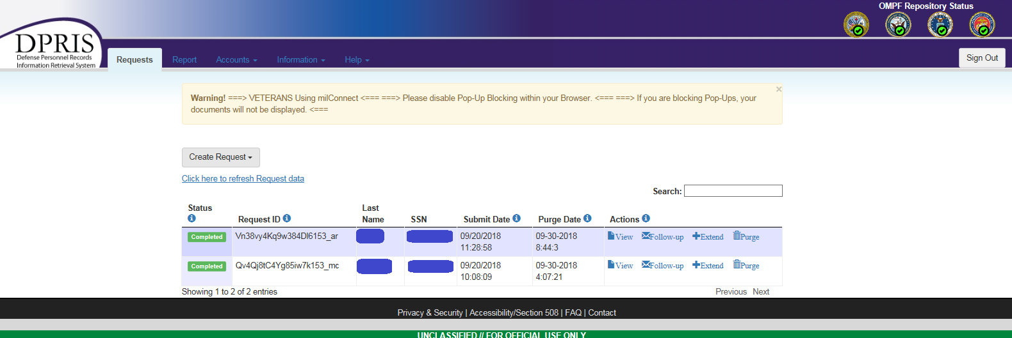
Requests Screen

Slide 14
Response

Slide 15
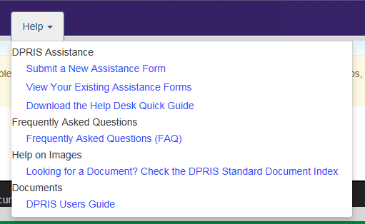
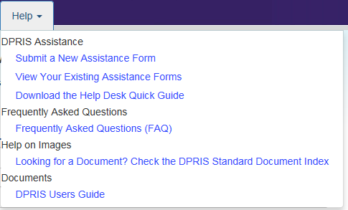
DPRIS Help

Slide 16
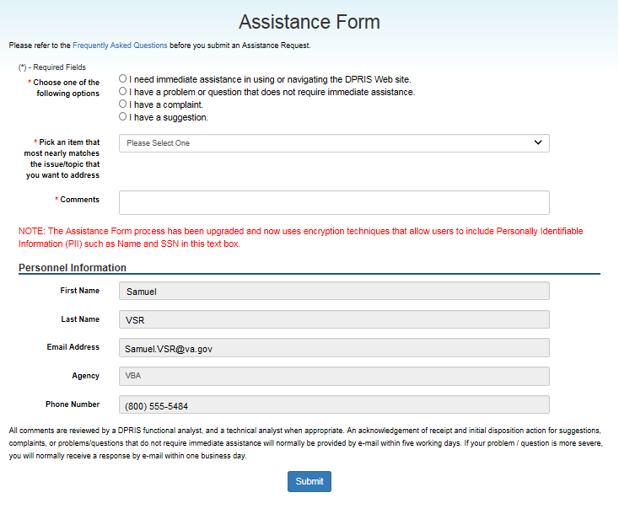
Assistance Form

Slide 17
Personnel Information Exchange System (PIES)
VA application used to request Service Treatment Records (STRs) and Personnel Records from the National Personnel Records Center (NPRC) and individual branches of service.

Slide 18
NPRC STRs

Slide 19
NPRC Personnel Records
If the veteran last served in the… | and had no service on or after…
Army | October 1, 1994
Navy | January 1, 1995
Air Force | October 1, 2004
Marine Corps | January 1, 1999

Slide 20
PIES Home Screen

Slide 21
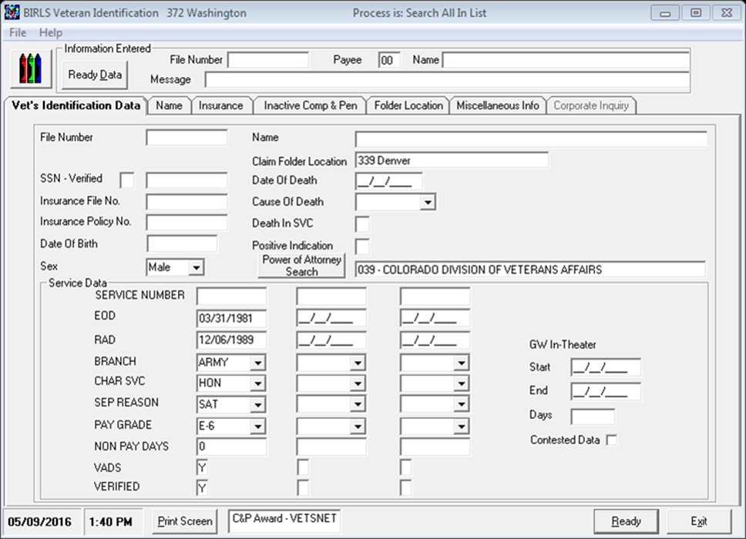
SHARE: BIRLS – VID
BIRLS Inquiry: Vet’s
Identification Data (VID)
Screen Information is transferred to PIES

Slide 22
Using PIES

Slide 23
Using PIES (cont.)

Slide 24
DPRIS to PIES Cross Reference Guide
DPRIS Web to PIES Cross Reference Guide is available on the Compensation Service Intranet Home Page under:
Procedures (212)
PIES/DPRIS

Slide 25
Review
Questions?
Notes:
Questions?

