Slide 1

Compensation Service Benefits Delivery at Discharge (BDD) and Integrated Disability Evaluation System (IDES) Conference Call
Briefed by: 212A
Name/Title: 212A Staff
Date: November 13, 2018

Slide 2
Agenda (1 of 3)
Introduction
Topics for Discussion
  MSC Top 6 Error Categories from Quality Reviews
  BDD and IDES MSC Information on MSC SharePoint Site
IDES Specific Topics
  Holiday Leave and Servicemember Availability
  VA Form 21-0819 Date Stamp & EP 689 Date of Claim
  DRAS’ Providing Rating Information Directly to SMs
  Notification to DRAS of SI/VSI IDES Participants

Slide 3
Agenda (2 of 3)
VTA Reminders
  MSC Pending Reports
  Exit Interview Data Fields in VTA
  Number of Claimed Conditions in VTA
  VTA v.2.4.1
  VTA Training
BDD Specific Topics
  BDD Manual Reference Updates
  Discontinuation of the DoD POC List
  BDD In-Service Rating Refresher Training
  Current Program Timeliness
  From the Pre-Discharge BDD Mailbox

Slide 4
Agenda (3 of 3)
Open Floor
Next Tele-Conference
TMS #

Slide 5
Reminder: Slides are used to show the Topic, and start discussion, however, slides do not show all the information associated with the topic. The Read Ahead is the official document.

Slide 6
BDD and IDES Topics for Discussion

Slide 7
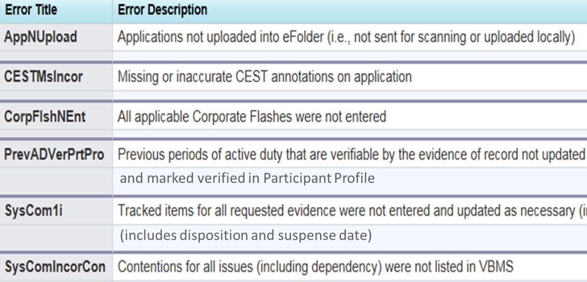
MSC Top 6 Error Categories from Quality Reviews

Slide 8
BDD and IDES MSC Information on MSC SharePoint Site
MSC Coaches/Supervisors are requested to keep their ROs BDD MSC List and IDES MSC List updated on the MSC SP Site. For questions/assistance contact andew.reese@va.gov

Slide 9
IDES Specific Topics

Slide 10
Holiday Leave and SM Availability
As we approach the holidays, MSCs should inquire about approved leave (non-emergency) during the initial interview that could interfere with the IDES process
If the participant indicates he or she has approved leave that would prevent the timely completion of exams, the MSC should return the referral to the PEBLO as an improper referral
Do not accept a case or submit exam requests if you know the participant will not be available to report for exams

Slide 11
VA Form 21-0819 Date Stamp and EP 689 Date of Claim (DoC)
The date stamp on the VA Form 21-0819 should be the date the form comes into the possession of the VA and the EP 689 DoC should be the same date

Slide 12
DRAS’ Providing Rating Info Directly to SMs
DRAS’/VSRs are reminded that they will not provide rating information directly to SMs
We received info from an MSC that an VSR called a SM to confirm/collect some information, and the VSR discussed the rating with the SM
It is the PEBLOs responsibility to provide the rating info to the SM, and if there are questions/concerns, the SM should see the MSC, and the MSC will contact the DRAS, if needed

Slide 13
Notification to DRAS of SI/VSI IDES Participants
DRAS’ have requested that MSCs notify the DRAS when potential SI/VSI participants are referred into IDES to ensure the case is handled with appropriate attention
MSCs should direct this notice to the applicable DRAS Mailbox indicated below
AF Cases: desaf.vbapro@va.gov
Navy/USMC Cases: des.vbapro@va.gov
Army Cases dras.vbasea@va.gov

Slide 14
VTA Reminders

Slide 15
MSC Pending Reports
With the new IDES goals/stage times, Coaches and MSCs are reminded of the importance of running Pending Reports, some at least twice a week
The Pending CD Report: The CD goal is 5 days for AD and 11 days for NAD. This report should be run twice, once by RO and once by MEB Location. Running the report by MEB Location will show cases that have a Prepare Claim Start Date, but may not have an MSC Assigned/RO. These cases need to be assigned to an MSC and/or the MEB MTF contacted about the referral
The Pending Medical Evaluation Stage Report: We are seeing an uptick in cases that are not being updated with exam returned and end dates

Slide 16
Exit Interview Data Fields in VTA
MSCs are reminded that the Exit Interview data fields in VTA will not allow entry until the Final Disposition Date is entered by the PEBLO
The date of entry will show in the Exit Interview Start Date on the MSC Tab

Slide 17
Number of Claimed Conditions in VTA
MSCs must enter the number of claimed conditions from the 526 into the Total Claimed Conditions field on the MSC Tab
Some MSCs are entering one (1) when there are multiple claimed conditions
Accurate data is important as it affects claim assignments and the analysis of the average number of contentions on IDES claims

Slide 18
VTA v.2.4.1 and VTA Training
VTA v.2.4.1 will be released November 18, 2018. The release information is in Appendix A of the Read Ahead
VTA Training is November 27 (9:00 AM EDT) and 28, 2018 (1:00 PM EDT). Information is listed on the VTA Homepage under Calendar of Events

Slide 19
BDD Topics for Discussion

Slide 20
BDD Manual Reference Updates
Updates to the BDD section of the manual were published on Oct. 24. Many of these were discussed on previous calls; however, we encourage all users to review the updates. Some of the major updates include:
Discontinuation of Rating Activity Site (RAS) language
Responsibilities of the BDD Coordinator
Requirements for paper document handling
Several other changes were also included in the recent update and should be reviewed by supervisors and processors to ensure compliance and accurate processing
See updates (M21-1, Part III, Subpart i, Chapter 2, Section A, B, and C)

Slide 21
Discontinuation of the DoD POC List
Updated functionality to VBMS has automated the delivery of contract SHA examination results to DoD
Users no longer need to create a customized tracked item in VBMS and list a DoD POC when requesting contract examinations
As a result of the recent update, the DoD POC list will be removed from the Pre-Discharge website
Please direct all DoD SHA POCs to the SM electronic health record for contract exam results and JLV for VHA exam results

Slide 22
BDD In-Service Rating Refresher Training
An update to the TMS BDD training is forthcoming
These updates will include the recent changes to the BDD procedures along with relevant case scenarios
This training will be instructor lead and should be provided to all VSRs and RVSRs

Slide 23
Current Program Timeliness
As outreach specialists and VA’s frontline contact with SMs and
Veterans, it is vital that we are realistic in our communications regarding claims processing times. Below is the current program timeliness data as of November 6, 2018
November 6, 2018 | BDD
Completed FYTD | 4,743
Receipts FYTD | 5,757
Pending | 6,433
% Pending >125 Days | 17.9%
# Pending >125 Days | 1,149
Average Days Pending | 73.2
Avg. Days to Complete FYTD | 47.2

Slide 24
Questions from the Pre-D/BDD Mailbox
Question: The recent update of M21-1,III.i.2.B.2.a and h specifically states that when establishing a BDD claim the segmented lane should be BDD National. What lane should be selected when establishing a BDD Excluded claim?
Answer: For BDD Excluded claims, you should select Core (National) per M21-1, III.ii.3.D.2.d. Note that lane assignment will not affect claims routing in the National Work Queue (NWQ).

Slide 25
Misc and Open Floor
TMS #: VA 4486875
Open Floor/Questions
Next Teleconference: December 11, 2018

