Slide 1
Promulgating In-Service Rating
Compensation Service
November 2018

Slide 2
Objectives
Understand the Pre-discharge Benefits Delivery at Discharge (BDD) in-service rating
Comprehend how to process a pre-discharge in-service rating for a Veteran in receipt of military retired pay (MRP)

Slide 3
References
38 CFR Part 4 – Schedule for Rating Disabilities
M21-1, Part III, Subpart i, 2, A - General Information on Pre-Discharge Claims
M21-1, Part III, Subpart i, 2, B - Division of Responsibilities for Processing Benefits Delivery at Discharge (BDD) and BDD Excluded Claims
M21-1, Part III, Subpart i, 2, C - Ancillary Benefits and Other Issues Involving Pre-Discharge Claims
M21-1, Part III, Subpart v, 2, A - Decision Authorization
M21-1, Part III, Subpart v, 4, A - General Information on Elections
M21-1, Part III, Subpart v, 5, B - Preparing and Adjusting Awards in Military Retired Pay (MRP) Cases

Slide 4
In-Service Rating
Pre-discharge BDD claims shifted from completing the rating decision after the service members’ (SM) discharge from active duty to requiring that the rating decision be completed while the SM is still on active duty.
The purpose of this training is to inform the audience of the current BDD in-service rating award generation, and authorization process after discharge.

Slide 5
In-Service Rating
The BDD rating decision will be completed while the SM is still on active duty.
This will allow for:
completion of all necessary development required to rate a claim prior to discharge
service verification, award generation/authorization, and decision notification to begin the day after discharge
the SM to receive a decision on their claim as close to discharge as possible
Greatly decrease the overall average number of days pending for the pre-discharge claim inventory

Slide 6
BDD vs. BDD Excluded
Claims received on or after October 1, 2017, within 180 days prior to discharge are identified as Benefits Delivery at Discharge (BDD) claims or BDD excluded claims.
Days prior to separation claim is submitted | 90-180 days | 1-89 days
Claim identity | BDD | BDD Excluded

Slide 7
National Work Queue (NWQ)
Following the actions taken at the BDD intake site, the National Work Queue (NWQ) will route the BDD claim to regional offices nationally for review for ready for decision (RFD) status as soon as all examinations have been completed or all tracked items have expired.
NOTE: This will occur while the SM is still on active duty, therefore deferral for service verification should not occur. Service verification for BDD claims does not occur until after the completion of the in-service rating decision and the SM’s discharge from active duty.

Slide 8
Jurisdiction
BDD claims that are made ready for decision are routed for rating action to regional offices nationally based on capacity
BDD excluded claims will be rated at the Regional Office of Jurisdiction (ROJ).
If an intake site receives a BDD-excluded claim 10 or fewer days before the discharge date that cannot be processed in VBMS, follow instructions in M21-1III.i.2.B.3.g

Slide 9
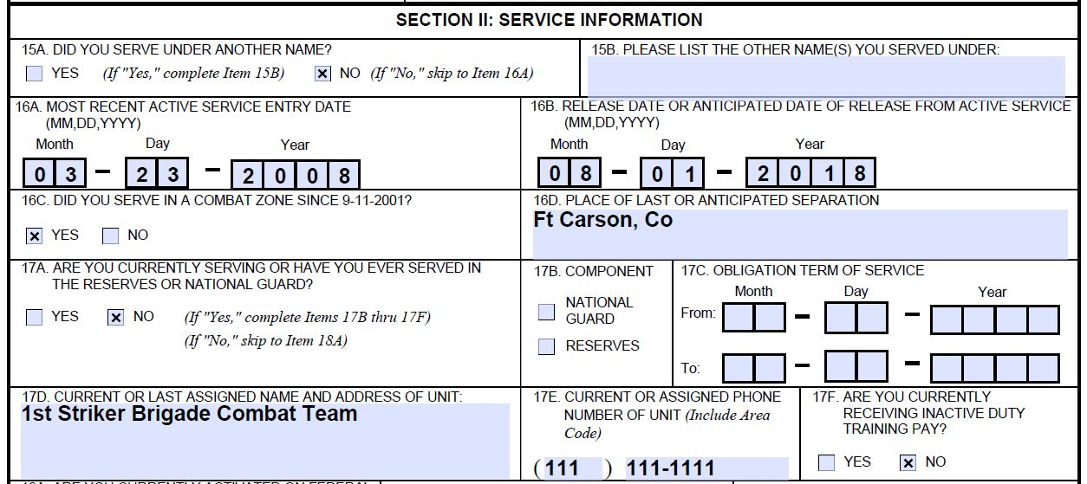
In-Service Rating Guidance
The BDD rating decision will be completed while the SM is still on active duty
The RVSR will utilize a future effective date for the grant of benefits
All current rating requirements will remain the same except that partial rating decisions will not be allowed for the In-Service Ratings.

Slide 10
In-Service Rating Guidance (Cont.)
RVSR must:
ensure the SMs reported separation date is still accurate
Remember the effective date entered into VBMS-R will be a future effective date.
Do not defer the claim for service verification prior to the SM’s discharge from active duty and completing the in-service draft rating!
take into account that an examination was conducted in-service
This can have an effect on the evidence required for service-connection (SC).
A diagnosis of a chronic disability on an in-service VA examination is a diagnosed disability while on active duty.
A Pre-discharge claim is filed by the claimant while still on active duty; therefore, inherently has in-service symptoms/complaints.

Slide 11
Promulgation
The day following the SM’s discharge from active duty, NWQ will route the BDD claim for promulgation. Before promulgation, the VSR must verify the Veteran’s
discharge date, and
character of discharge (COD) (must be other than dishonorable).
If a COD determination is needed, then the claim is excluded from the BDD program. The claim label must be adjusted to the appropriate non-BDD claim label and the SM notified following the steps in M21-1, III.i.2.B.3.a.
If the SM’s reported release from active duty (RAD) date has changed, and/or additional evidence has been received since rating completion, follow the instructions in M21-1.III.i.2.B.4.i.

Slide 12
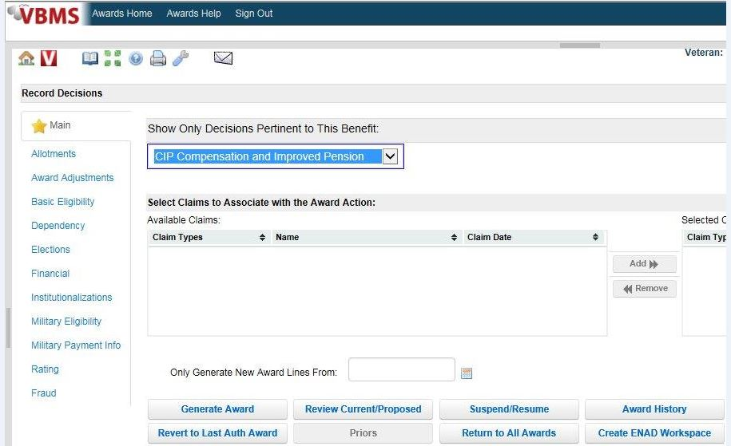
Award Generation and Authorization
If no change to RAD and no additional evidence received since rating completion, remove the bookmark “DRAFT: Rating document should not be released until after the award is authorized.”
If no separation or retired pay involved, generate the award

Slide 13
Award Generation and Authorization (cont.)
For claims involving military retired pay (MRP), refer to M21-1 III.v.5.B prior to generating the award
For claims involving separation pay, see M21-1.III.v.4.B prior to generating the award

Slide 14
Retired?
Check DD Form 214 to determine if Veteran separated based on a retirement.
The Veteran will be eligible for retired pay if retired upon separation from active duty.
Retired pay may or may not be figured by DFAS or Coast Guard when compensation claim is ready to work.

Slide 15
DFAS RCPS
VIS may take more than 30 days to update once retired pay is figured. Therefore, data from the DFAS Retired and Casualty pay Subsystem (RCPS) must be used to determine the amount of compensation to withhold based on receipt of retired pay for retirees of the Army, Navy, Air Force, and Marine Corps.
For retired pay information for Coast Guard, Public Health Service, and National Oceanic and Atmospheric Administration retirees, retired pay information may be obtained by contacting the Coast Guard Retiree and Annuitant Service Branch.

Slide 16
Establishing the “Retired Pay Case” Indicator
A proper “Retired Pay Case” indicator must be established prior to authorization; see M21-1 III.v.5.B.1 for additional information.
If the monthly retired pay amount is known, use the amount and the retirement date to set the indicator.
A “blank” amount is used to set the indicator when the monthly retired pay amount has yet to be determined.

Slide 17
Working Retired Pay Cases
For cases in which the monthly retired pay amount has been figured, follow the procedures in M21-1 III.v.5.B, topics 1 and 2.
For cases in which the monthly retired pay amount has not been figured, follow the procedures in M21-1 III.v.5.B.3.

Slide 18
Questions

