Slide 1
VR&E Transition to eFolder Effective December 17, 2018
Vocational Rehabilitation
and Employment (VR&E) Service
Briefed by:
Change Management Agent
Version: 11-15-2018
Notes:
Today we will be training on VR&E’s Transition to the eFolder. This training is being provided in support of the major Vocational Rehabilitation and Employment (VR&E) transformation that is taking place throughout our business line. This is one of a suite of trainings that will provide instructions to support the incremental transformation to a digital and paperless environment. The required prerequisite for staff to be able to comply with and implement this training is for employees to have a VBMS account with the appropriate user role. Employees without the required access should direct this request through their local regional office. Today’s training is intended for VR&E staff to ensure there is a seamless transition and clear understanding of the procedures being put forth.

Slide 2
Agenda
Training objectives
Background
Setting up internal electronic concurrence
Managing electronic concurrence process
Frequently asked questions
Notes:
Training will focus on the initial transition to the eFolder. VR&E field staff are already comfortable with many electronic tools such as VBMS, CAPRI, and CWINRS. Initiating the utilization of the eFolder is one step towards our transition to the digital and paperless environment. To ease this transition, the requirement will be effective only for new Chapter 31 Veterans whose applications are received after December 17, 2018. This training will focus on the following areas:
Training Objectives
Background information to explain where we came from and where we are going
Procedures for setting up an internal, completely paperless, concurrence workflow
Managing an electronic concurrence process
FAQs

Slide 3
Training Objectives
Upon completion of today’s training, you will:
Understand this step toward transition to digital and paperless environment
Know how VR&E will utilize the eFolder for storing electronic documentation for new applicants
Be able to use the process for electronic concurrence
Notes:
At the completion of this training, you will:
Understand this step toward transition to digital and paperless environment
Know how VR&E will utilize the eFolder for storing electronic documentation for new applicants
Be able to use the process for electronic concurrence

Slide 4
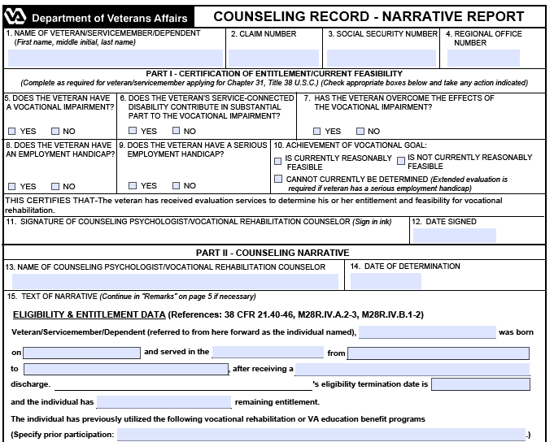
Background
eFolder
No New Paper
Applicable to New Cases/Applications received after
December 17, 2018
Notes:
Today, VR&E operates in a paper-driven environment. Although we use CWINRS case management system to access and generate shells of Word versions of letters and forms, often with merged fields, we handle these word docs as if they were paper and print paper versions to store in the CER folder. Today we also have to print documents to acquire Veterans signatures. In this initiative, it will change.
We are initiating a transition to the digital and paperless environment. This initiative is to begin utilizing the eFolder while stopping the creation of new paper to be stored in CER folders. In other words, anything received or created electronically will not be printed and stored as a paper document in the CER folder. The CER folder will continue to be created and maintained for any physical paper records or documents received at a Regional Office (RO).
The immediate transition will only be applicable for new Chapter 31 cases with applications received after December 17, 2018.
The rule of thumb for documents that should be stored in the eFolder is quite simple. For New Applicants received after 12/17/2018, if a document is created or received electronically and is currently, per the M28R manual, required to be stored in the CER Folder, then that document must be uploaded into the eFolder.
This initiative will assist VR&E in the transition to the digital and paperless environment by:
Beginning the practice of uploading to the eFolder by document type
Using the filters and keyword search to find documents in the eFolder
Leveraging the PIV Signature and Signature Pads
Minimizing unnecessary printing
During the transition to fully digital and paperless environment, new applicant Veteran folders will be comprised of both a CER and an eFolder repository. Once all active folders are scanned, all CERs will be scanned by document type into the eFolder which will serve as the Veterans’ complete record.
VR&E Service has developed a basic framework for the electronic concurrence process which can be adjusted to meet the needs of the local office and followed until the deployment of a comprehensive electronic case management solution that we expect will include many workflows including this approval process.

Slide 5
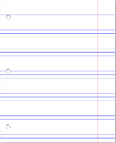
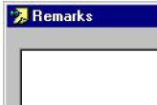
Process for Applications Received after December 17, 2018
Regional Office
Continue to Process Applications
All documents created electronically should be stored in eFolder by doc type
In CWINRS “Remarks Box,” annotate “…documentation stored in eFolder…”
Annotate the tab of the CER Folder with a “red star”
Notes:
Now we are going to review the steps for handling electronically created and received documents for new applicants received after December 17, 2018. Regardless of how the application is received, either as a hard copy VA Form 28-1900 or through eBenefits, VR&E staff should process the application for eligibility just as they do today. The only change is that any documents received or created electronically in this eligibility processing step should be uploaded to the Veteran’s eFolder. VR&E Staff will also continue to create CER folders for these new applicants so there is a place to store physical documents received at the RO (i.e., in person, fax, mail).
An example is, a Veteran comes in for their case management appointment. Just like you asked the Veteran to do, the Veteran brings in a copy of grades from the prior semester. This grade document will need to be filed in the CER.
All other documents, letters, and forms that are created electronically should be uploaded and stored in the applicable eFolder by document type. For instance, instead of the Veteran bringing in a paper copy of the grades, the grade report is emailed to you. In this case, you must upload this document into the eFolder.
Local scanning of paper is not permitted because we do not have the capability within VR&E divisions nor Regional Offices to manage the storage of the paper that we upload. In the future, we will utilize the centralized mail vendor and a VR&E specific portal to scan and upload this paper and manage long term storage.
VR&E Staff will document in the new applicants’ CWINRS Remarks Box New Application Received on XX/XX/XXXX, appropriate documentation will be stored in the eFolder effective this date.
Additionally, VR&E Staff will annotate the tab of the CER Folder with a red star in order to signify that documents have been uploaded to the eFolder. These may seem like unnecessary additional steps, however they serve multiple purposes including 1) if another VRC is covering for you when are not available, he or she will need to know where to find the most current information on a Veteran’s case and 2) for QA reviews either locally or Nationally, to ensure all required documentation has been completed and is available

Slide 6
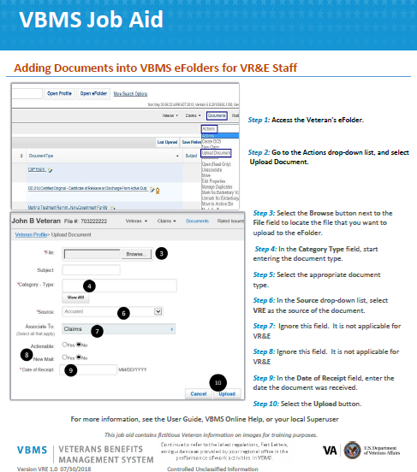
VBMS Job Aid
Notes:
As I mentioned, all electronically received and created documents, letters, and forms should be uploaded and stored in the applicable eFolder by document type. Here is a screenshot of a job aid that will walk you through the process of uploading a document into the eFolder. You can select either of the images in the slide to open an electronic copy of this job aid, or you can go to KMP and find it in the training folder. We have also attached a copy in TMS where you will self-certify completion of this training.

Slide 7
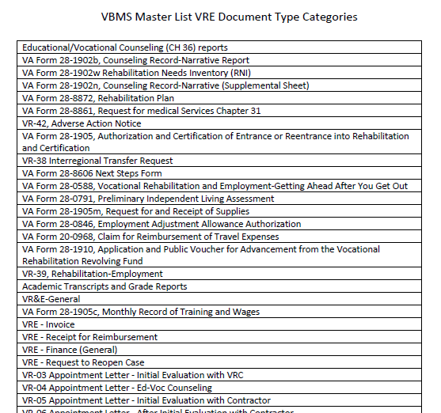
VBMS Master List VRE Documents
Notes:
This is a screen shot of the master list of VRE Document Type Categories which can be referenced for uploading and labeling all electronically received and created documents, letters, and forms by document type. We typically refer to these as “doc type”.
But don’t worry, you do not have to reference this list. When you go to upload your document and start typing a form name, or form number or letter name, the best matched document types will appear and you will just click and select.
You can select either of the images in the slide to open an electronic copy of this job aid, or you can go to KMP and find it in the training folder. This will also be available in TMS.

Slide 8
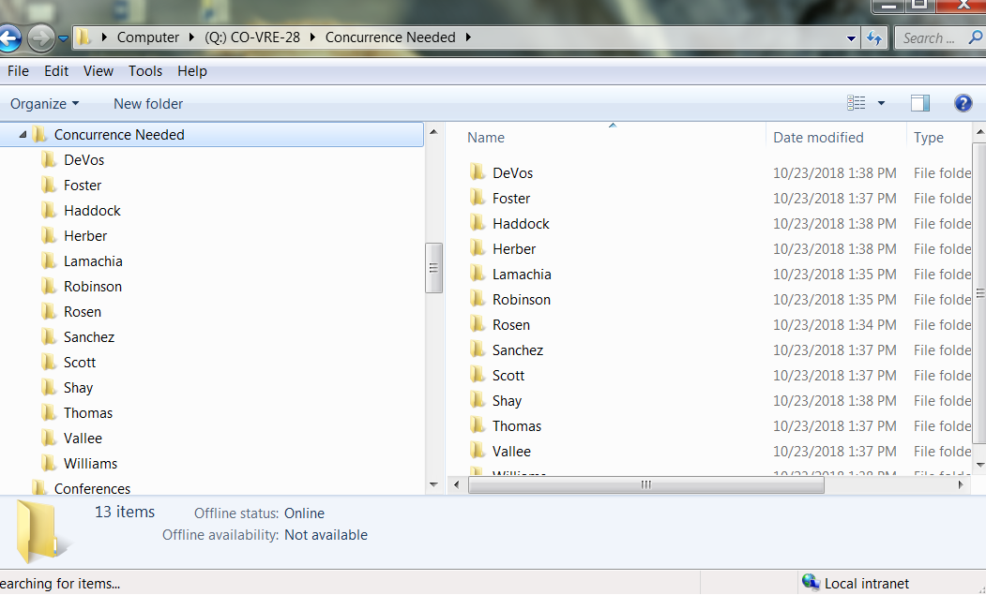
Setting Up Internal Electronic Concurrence
Notes:
Not all electronic documents can be immediately uploaded into the eFolder. Some of the documents will need to be concurred upon first, just as today they are concurred upon prior to storing in the CER. Therefore, there is standard procedure being put in place for local offices that will allow for electronic concurrence, and prevent the need for printing documents.
Each Regional Office will establish a locally based, collaborative platform on either SharePoint or a shared network drive for electronic concurrence and label it as “Concurrence Needed.” Local offices will need to determine and use whichever option works best for their office and local IT infrastructure.
All VR&E staff will need access to the folder. At the same electronic location, create a subfolder for each VR&E employee. Doing this will help with the workflow process and keep the main folder as clean and uncluttered as possible. This is a screenshot example of what the folder hierarchy should look like. In the example we created a “Concurrence Needed” folder on the “Q” Drive and then we listed subfolders for counselors by last name.
I will now walk you through the steps for managing this electronic concurrence workflow.

Slide 9
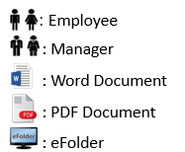
Managing Electronic Concurrence Process
Employee
Creates MSWord Doc
Employee
Saves Doc as PDF (using naming convention)
Employee
Moves signed PDF to “Concurrence Needed” folder
Employee
eNotifies VREO of documents in Concurrence Folder
VREO
Reviews document, moves document to the VRC’s folder with PIV signature or return to VRC for further action
VREO
Deletes original request from Concurrence Folder
Employee
Uploads approved document by doc type to eFolder
Employee
Deletes temporary document from their subfolder
Notes:
This flow chart will walk you through the steps for concurrence. Remember, not all documents will require concurrence before uploading to the eFolder, but for those that do, these are the steps and procedures you will follow. You are going to find on this flow chart different images that have specific meanings. On the bottom right of the diagrams you can see there is an image for employee, manager (e.g., VR&E Officer, designee), word document, PDF document and eFolder. As I progress through this chart, the image will signify which individual or action the step is intended for. You will notice too that whichever step we are on the box will be illuminated with a white box.
The first step in the concurrence process is for the employee to create and edit the document needing approval in Microsoft Word. However, the document will not remain in this format for the entire process. The word document allows an employee to enter information about the Veteran and edit it as needed. Once editing the document is complete, move onto the next step.

Slide 10
Managing Electronic Concurrence Process
Employee
Creates MSWord Doc
Employee
Saves Doc as PDF (using naming convention)
Employee
Moves signed PDF to “Concurrence Needed” folder
Employee
eNotifies VREO of documents in Concurrence Folder
VREO
Reviews document, moves document to the VRC’s folder with PIV signature or return to VRC for further action
VREO
Deletes original request from Concurrence Folder
Employee
Uploads approved document by doc type to eFolder
Employee
Deletes temporary document from their subfolder
Notes:
After an employee creates the document in Word and it is ready for submission to the VR&E Officer for concurrence, it will need to be saved as a PDF on the employee’s desktop. Saving the document as a PDF prevents the document from being further edited and allows for digital signatures. The employee saves the document as a PDF using prescribed naming convention which will be shared on the next slide and when applicable, signs with the PIV Enabled Signature.

Slide 11
How to Name Documents Consistently
Naming Conventions
Veterans/Servicemembers with eFolders:
Last Name First Initial Middle Initial (FIMI) letter number or form number MMDDYY.pdf
Sample: Smith JD 28-1905 092518.pdf
NOTES:
The eFolder document upload will not accept the following characters within a document name: \ / :* ? " < > | % , !
Documents must be saved as PDFs or the upload to the eFolder will fail
Notes:
We are outlining a specific naming convention for documents that you save to your temporary location so that when you gain final approval you will have an easier time uploading them to the correct Veterans eFolder with the Correct Document Type. I will explain to you how the documents need to be saved in the concurrence folder.
As a sidenote, these instructions were a product of the Paperless Transition Workgroup which was composed of various VR&E Officers and Assistant VR&E Officers from across the nation
Chapter 31 Veterans or Servicemembers with eFolders will have documents saved with the following title in place, Last Name First Initial Middle Initial (FIMI), letter number or form number and date the document is created, or saved for concurrence. For example, there is John Douglas Smith’s plan needing approval for Chapter 33 Retroactive Reimbursement. Staff would complete the required appendix, save it as a PDF, digitally sign it, and save it to the desktop as “Smith JD Appendix AV 092518.pdf”. Keep in mind, there are some forms and letters that do not have a form or letter number and you may have to save it as it is named, for example, high cost memo.
The eFolder will not accept special characters within a document name. Avoid using special characters when saving documents. Documents must be saved as PDFs or the upload to the eFolder will fail

Slide 12
Managing Electronic Concurrence Process
Employee
Creates MSWord Doc
Employee
Saves Doc as PDF (using naming convention)
Employee
Moves signed PDF to “Concurrence Needed” folder
Employee
eNotifies VREO of documents in Concurrence Folder
VREO
Reviews document, moves document to the VRC’s folder with PIV signature or return to VRC for further action
VREO
Deletes original request from Concurrence Folder
Employee
Uploads approved document by doc type to eFolder
Employee
Deletes temporary document from their subfolder
Notes:
This document will then be saved directly to the “Concurrence Needed” folder in the shared location. Locate the file of the document that you saved on your desktop and transfer the PDF version to the “Concurrence Needed” folder.

Slide 13
Managing Electronic Concurrence Process
Employee
Creates MSWord Doc
Employee
Saves Doc as PDF (using naming convention)
Employee
Moves signed PDF to “Concurrence Needed” folder
Employee
eNotifies VREO of documents in Concurrence Folder
VREO
Reviews document, moves document to the VRC’s folder with PIV signature or return to VRC for further action
VREO
Deletes original request from Concurrence Folder
Employee
Uploads approved document by doc type to eFolder
Employee
Deletes temporary document from their subfolder
Notes:
After the PDF document is saved to the “Concurrence Needed” notify the VR&E Officer electronically by IM or email, which ever your VR&E Officer prefers, that the concurrence document was placed in the “Concurrence Needed” folder. Veteran’s name, File number, reason for the request for concurrence, and any relevant documents already stored in the eFolder should also be provided for reference.

Slide 14
Managing Electronic Concurrence Process
Employee
Creates MSWord Doc
Employee
Saves Doc as PDF (using naming convention)
Employee
Moves signed PDF to “Concurrence Needed” folder
Employee
eNotifies VREO of documents in Concurrence Folder
VREO
Reviews document, moves document to the VRC’s folder with PIV signature or return to VRC for further action
VREO
Deletes original request from Concurrence Folder
Employee
Uploads approved document by doc type to eFolder
Employee
Deletes temporary document from their subfolder
Notes:
After reviewing the document and relevant material, the VR&E Officer will either move the document to the employee’s subfolder on the shared location with their PIV enabled signature denoting approval; or return to the employee for further action. The VR&E Officer will notify staff if the document has been approved and moved to their subfolder.

Slide 15
Managing Electronic Concurrence Process
Employee
Creates MSWord Doc
Employee
Saves Doc as PDF (using naming convention)
Employee
Moves signed PDF to “Concurrence Needed” folder
Employee
eNotifies VREO of documents in Concurrence Folder
VREO
Reviews document, moves document to the VRC’s folder with PIV signature or return to VRC for further action
VREO
Deletes original request from Concurrence Folder
Employee
Uploads approved document by doc type to eFolder
Employee
Deletes temporary document from their subfolder
Notes:
After moving the document the VR&E Officer deletes the original request from “Concurrence Needed” folder.

Slide 16
Managing Electronic Concurrence Process
Employee
Creates MSWord Doc
Employee
Saves Doc as PDF (using naming convention)
Employee
Moves signed PDF to “Concurrence Needed” folder
Employee
eNotifies VREO of documents in Concurrence Folder
VREO
Reviews document, moves document to the VRC’s folder with PIV signature or return to VRC for further action
VREO
Deletes original request from Concurrence Folder
Employee
Uploads approved document by doc type to eFolder
Employee
Deletes temporary document from their subfolder
Notes:
The concurrence process is complete at this point. The employee must upload the approved document by doc type to the appropriate eFolder. Earlier I shared with you an eFolder job aid that walks you through the steps for uploading to the eFolder. It might make sense to keep this handy so that you can use it until you are experienced in uploading documents.

Slide 17
Managing Electronic Concurrence Process
Employee
Creates MSWord Doc
Employee
Saves Doc as PDF (using naming convention)
Employee
Moves signed PDF to “Concurrence Needed” folder
Employee
eNotifies VREO of documents in Concurrence Folder
VREO
Reviews document, moves document to the VRC’s folder with PIV signature or return to VRC for further action
VREO
Deletes original request from Concurrence Folder
Employee
Uploads approved document by doc type to eFolder
Employee
Deletes temporary document from their subfolder
Notes:
Once the VR&E employee confirms the document was uploaded successfully, the employee should delete this temporary document from their subfolder inside of the “Concurrence Needed” folder and any other location where it may have been temporarily stored.

Slide 18
Frequently Asked Questions
Q1. Remind me again—when does the change to using eFolder for new applicants and marking in CWINRS that documents are in the eFolder go into effect?
The change goes into effect after December 17, 2018.
Q2. Why are we doing it this way, I thought we were going to pilot active folder scan, centralized mail, and working within the eFolder for all cases this fall?
You are correct, we were going to pilot and roll-out nationally Active Folder Scan/Centralized Mail and working within the eFolder all at once. However, as we got into the details we learned there were many barriers created by moving forward with these initiatives without other infrastructure in place. VR&E Service assessed that these barriers would add an unreasonable increase to administrative burden on field staff—which was in direct conflict with the goals of the transition.
Q3. Why can’t I just scan and upload my own documents at the RO?
The prohibition to scan documents locally is consistent with the guidance that Compensation Service has issued for their staff. The problem is, once paper is scanned, VA still has a responsibility for keeping and storing the paper documents per the Records Schedule. Currently, the responsibility to ensure that all documents have been properly scanned and stored in a manner that they can be retrieved later if needed falls under the responsibility of the Centralized Mail contractor. We do not have the infrastructure in place for local scanning, nor do we want to have to take on this additional administrative burden. Q4. Why are we only uploading documents for newly received applications?
The decision to stop creating new paper and start using the eFolder with newly received applications was made to ensure that VR&E field staff, local management and the National QA team can quickly determine where to look for the most current information on a Veteran and to streamline the review process for open cases. This requirement, along with the requirement to capture in the CWINRS Remarks field and on the CER folder that documents are now in the eFolder, should facilitate this goal.
Notes:
Here are some questions you might have about the eFolder.
Q1. Remind me again—when does the change to using eFolder for new applicants and marking in CWINRS that documents are in the eFolder go into effect?
The change goes into effect after December 17, 2018.
Q2. Why are we doing it this way, I thought we were going to pilot active folder scan, centralized mail, and working within the eFolder for all cases this fall?
You are correct, we were going to pilot and roll-out nationally Active Folder Scan/Centralized Mail and working within the eFolder all at once. However, as we got into the details we learned there were many barriers created by moving forward with these initiatives without other infrastructure in place. VR&E Service assessed that these barriers would add an unreasonable increase to administrative burden on field staff—which was in direct conflict with the goals of the transition.
Q3. Why can’t I just scan and upload my own documents at the RO?
The prohibition to scan documents locally is consistent with the guidance that Compensation Service has issued for their staff. The problem is, once paper is scanned, VA still has a responsibility for keeping and storing the paper documents per the Records Schedule. Currently, the responsibility to ensure that all documents have been properly scanned and stored in a manner that they can be retrieved later if needed falls under the responsibility of the Centralized Mail contractor. We do not have the infrastructure in place for local scanning, nor do we want to have to take on this additional administrative burden. Q4. Why are we only uploading documents for newly received applications?
The decision to stop creating new paper and start using the eFolder with newly received applications was made to ensure that VR&E field staff, local management and the National QA team can quickly determine where to look for the most current information on a Veteran and to streamline the review process for open cases. This requirement, along with the requirement to capture in the CWINRS Remarks field and on the CER folder that documents are now in the eFolder, should facilitate this goal.

Slide 19
Frequently Asked Questions
Q5. What if the Veteran is a re-applicant? Do these instructions still apply?
Yes. After December 17, 2018, for the purpose of initiating the use of the eFolder and stopping the creation of new paper, you should treat a re-applicant as if the person is a new applicant and follow the prescribed instructions. Q6. What if the CER for Veteran who is a re-applicant was already scanned as an inactive folder?
You should treat a re-applicant whose CER was already scanned in as an inactive folder as if the person is a new applicant and follow the prescribed instructions. Q7. Instead of uploading to the eFolder, can I just copy the text of my letters and paste in a CWINRS casenote?
No. The eFolder is an official document repository. The practice of copying letters and other text directly into casenotes was a work-around because we did not have another way to store them electronically. This is no longer an acceptable practice. Q8. How do I handle loose documents for Veterans whose CER was previously scanned as an inactive file?
The following instructions ONLY apply if the entire CER folder has been previously scanned as an inactive folder. Loose documents which must be added to the eFolder for CERs which were previously scanned as inactive files must be shipped to the scanning vendor in the same method as an inactive case. You must place the documents in a folder, create a Data Control Sheet (DCS) and Records Management Number (RMN), create a shipping manifest, and ship to the scanning vendor in the same way as an inactive file.
Q9. What about cases that we are continuing to manage in the paper CER folder—can I store those documents and emails in CWINRS casenotes?
While you are not required to upload and store documents to the eFolder for active cases, if you choose to do so, please follow the instructions about adding a statement in the CWINRS Remarks field that you have done so in order to help facilitate coverage for you when you are unavailable and for case reviews.
Notes:
Q5. What if the Veteran is a re-applicant? Do these instructions still apply?
Yes. After December 17, 2018, for the purpose of initiating the use of the eFolder and stopping the creation of new paper, you should treat a re-applicant as if the person is a new applicant and follow the prescribed instructions. Q6. What if the CER for Veteran who is a re-applicant was already scanned as an inactive folder?
You should treat a re-applicant whose CER was already scanned in as an inactive folder as if the person is a new applicant and follow the prescribed instructions. Q7. Instead of uploading to the eFolder, can I just copy the text of my letters and paste in a CWINRS casenote?
No. The eFolder is an official document repository. The practice of copying letters and other text directly into casenotes was a work-around because we did not have another way to store them electronically. This is no longer an acceptable practice. Q8. How do I handle loose documents for Veterans whose CER was previously scanned as an inactive file?
The following instructions ONLY apply if the entire CER folder has been previously scanned as an inactive folder. Loose documents which must be added to the eFolder for CERs which were previously scanned as inactive files must be shipped to the scanning vendor in the same method as an inactive case. You must place the documents in a folder, create a Data Control Sheet (DCS) and Records Management Number (RMN), create a shipping manifest, and ship to the scanning vendor in the same way as an inactive file. Q9. What about cases that we are continuing to manage in the paper CER folder—can I store those documents and emails in CWINRS casenotes?
While you are not required to upload and store documents to the eFolder for active cases, if you choose to do so, please follow the instructions about adding a statement in the CWINRS Remarks field that you have done so in order to help facilitate coverage for you when you are unavailable and for case reviews.

Slide 20
Frequently Asked Questions
Q10. I don’t see a document type for emails. What should I use?
Use the VRE Correspondence document type when uploading emails to the Veteran’s eFolder. This document type should also be used for incoming correspondence. The scanning vendor will use this document type for emails, as well. Q11. Can we use manila folders in lieu of “CER” folders to store paper documents for applicants after the December 17th cutoff date?
Yes, you can use a manila folder. Please just make sure you label as you do for CER folders today and you annotate the CER folder with the red star, as explained in the instructions. Q12.What documents should be stored in the eFolder?
Any documents currently required by the M28R to be stored in the CER and are created electronically should be stored in the eFolder. Q13. Normally we aren’t told exactly how to save documents, why is the process so prescriptive now?
We worked with a team of VR&E Officers to establish a standardized naming convention in order to help VR&E field staff locate documents off their desktops and upload them to the eFolder with the correct document type. This is a tool to help staff in the transition. Q14. What do I do if I run into a problem and need IT support?
Since the eFolder is a functionality within the VBA VBMS suite of tools, any IT issues should be submitted through a “Your IT” ticket.
Notes:
Q10. I don’t see a document type for emails. What should I use?
Use the VRE Correspondence document type when uploading emails to the Veteran’s eFolder. This document type should also be used for incoming correspondence. The scanning vendor will use this document type for emails, as well. Q11. Can we use manila folders in lieu of “CER” folders to store paper documents for applicants after the December 17th cutoff date?
Yes, you can use a manila folder. Please just make sure you label as you do for CER folders today and you annotate the CER folder with the red star, as explained in the instructions. Q12.What documents should be stored in the eFolder?
Any documents currently required by the M28R to be stored in the CER and are created electronically should be stored in the eFolder. Q13. Normally we aren’t told exactly how to save documents, why is the process so prescriptive now?
We worked with a team of VR&E Officers to establish a standardized naming convention in order to help VR&E field staff locate documents off their desktops and upload them to the eFolder with the correct document type. This is a tool to help staff in the transition. Q14. What do I do if I run into a problem and need IT support?
Since the eFolder is a functionality within the VBA VBMS suite of tools, any IT issues should be submitted through a “Your IT” ticket.

Slide 21
Questions

Slide 22
Resources and Job Aids
TITLE | LOCATION
Veterans Affairs VBMS Intranet Resource Page | https://vbaw.vba.va.gov/VBMS/resources.asp
Clear Browser Cache | https://vbaw.vba.va.gov/VBMS/docs/VBMS_Job_Aid_Clear_Browser_Cache_20131001.pdf
Internet Explorer Compatibility Instructions | https://vbaw.vba.va.gov/VBMS/docs/Compatibility_View_Job_Aid_20140710_FINAL.PDF
Adding Documents into VBMS eFolder for VR&E Staff (Step-by-Step) | https://vaww.vashare.vba.va.gov/sites/VRWKM/Training/2018%20VRE%20Officer's%20Training%20Symposium/Technology%20Bar/VBMS_Job_Aid_Adding_Documents_to_the_eFolder_Job_Aid_VRE_20180730.pdf
VBMS Master List VRE Document Type Categories | https://vaww.vashare.vba.va.gov/sites/VRWKM/Training/2018%20VRE%20Officer's%20Training%20Symposium/Technology%20Bar/VBMS%20Master%20List%20VRE%20Document%20Type%20Categories%202018%2008%2009.pdf
CMA Modernization Toolkit | https://vaww.vashare.vba.va.gov/sites/VRWKM/Change%20Management%20Agent%20Documents/Forms/AllItems.aspx?RootFolder=%2Fsites%2FVRWKM%2FChange%20Management%20Agent%20Documents%2FCMA%20Modernization%20Toolkit&FolderCTID=0x0120000E285A3382BF994DBC71AEED172310C2&View=%7BADB6D3D3%2D24B8%2D4186%2DA122%2DA1302E39AD2E%7D
Notes:
Here is a list of resources and job aids that will assist with this process and with VBMS.

Slide 23
Conclusion
eFolder
Notes:
Congratulations, you are on your way to being part of VR&E’s transformation and no longer using paper files and folders. VR&E personnel will need to complete the assessment and evaluation in TMS to receive full credit for this course.

Slide 24
Client Relations Team
District | E-mail
North Atlantic | VAVBAWAS/CO/VRE/NA
Southeast | VAVBAWAS/CO/VRE/SE
Midwest | VAVBAWAS/CO/VRE/MW
Continental | VAVBAWAS/CO/VRE/CONT
Pacific | VAVBAWAS/CO/VRE/PA
Notes:
For questions that cannot be answered by your Regional Office, or for feedback about the eFolder, please route through your Client Relations Team mailbox.

