Slide 1
Compensation Service Benefits Delivery at Discharge (BDD) and Integrated Disability Evaluation System (IDES) Conference Call
Briefed by: 212A
Name/Title: 212A Staff
Date: October 9, 2018

Slide 2
Agenda (1 of 3)
Introduction
IDES and BDD Topics for Discussion
EMS Job Aid Update
Missing Entrance Physicals and Final Attempt Letter
VA Form 21-0845 vs VA Form 5571
TMS Course for MSC Rebuttal’s on Errors

Slide 3
Agenda (2 of 3)
IDES Specific Topics
IDES Checklist Update
Acceptable Diagnostic Language on VA Rating Code Sheets
Handling an IDES Participant’s Request to Reschedule a
Pending VA Exam
Brokering IDES Claims
VTA Reminders
Improper Use of Other Exam Fields
Timely Input of Exam Returned Dates
VTA Training

Slide 4
Agenda (3 of 3)
BDD Topics for Discussion
Electronic Transfer of STRs
BDD Claims in Centralized Mail Portal
Intake Sites in VBMS
Exam Availability for BDD Claimants
Current Program Timeliness
From the Pre-Discharge Mailbox
Open Floor
Next Tele-Conference

Slide 5
BDD and IDES Topics for Discussion

Slide 6
EMS Job Aid Update
OFO released the Job Aid regarding Exam Management Issues (EMS) on September 25, 2018
OFO in partnership with Comp Service, OBPI, and the EMS developers continue to make improvements to address all EMS issues impacting the field
The updated version added or changed the following guidance to the topics in the job aid released, September 11, 2018: Missing Exam results, Rework Requests, clarification requests requiring DBQ changes, exam scheduling requests with 11 contentions, and possible scenario requiring trouble tickets

Slide 7
Missing Entrance Physicals and Final Attempt Letter in IDES and BDD Claims (1 of 2)
IDES and BDD claims are subject to the same requirement for final attempt letters as all other Veteran’s claims. The are no program-specific or special requirements for final attempt requirement in IDES and BDD claims above those specified in M21-1 for general VA claims
In IDES cases, the entrance physical is a required part of the referral package and must be provided by the PEBLO, or have been deemed unavailable and noted as such on the PEBLO’s STR memo. However, if the entrance physical is noted as unavailable on the STR memo, but the rest of the STR was provided, the MSC/DRAS does not need to complete a final notification letter. DRAS should not delay decisions or initiate development for missing entrance physicals when the STR memo states the entrance physical is unavailable

Slide 8
Missing Entrance Physicals and Final Attempt Letter in IDES and BDD Claims (2 of 2)
Similarly, If the STRs provided in BDD cases do not include the entrance physical, but are otherwise complete, it is not necessary to complete a final notification letter
However, a final notification letter is required when the STRs for an entire POS are missing (or when the available STRs are inconsistent with the circumstances of the Veteran’s service—e.g., lacking records over an extended period). In these circumstances, MSCs processing IDES cases must prepare the final notification letter before transferring the claim to DRAS

Slide 9
VA Form 21-0845 vs VA Form 5571
We have received several questions regarding the use of VA Form 5571 during interviews
VA Form 5571 is not required for interviews. MSCs should use VA Form 21-0845 which allows the National Call Centers (NCCs) and regional offices (ROs) to release specified information normally protected under privacy provisions to family members or other designated persons who are not POAs, agents, or fiduciaries (III.ii.3.C.3.a., use of VA Form 21-0845)

Slide 10
TMS Course for MSC Rebuttal’s on Errors
TMS course VA 4450993 (QMS Error Corrections for Floor Employee and Coaches) covers how to use the system for the non-QRT user and provides information on notification of errors, accepting errors, rebuttals, etc.

Slide 11
IDES Specific Topics

Slide 12
IDES Checklist Update
The IDES checklist was updated September 2018. You can find the September 2018 version on the IDES Homepage. As changes in the manual occur, Compensation Service will continue to update the IDES Checklist

Slide 13
Acceptable Diagnostic Language on VA Code Sheet
M21-1 III.iv.6.C.3 permits only the VA-recognized diagnostic language to appear on VA rating code-sheets. Any indication of different diagnostic language (such as the terminology used by the Veteran on the application, typically indicated as “claimed as…”) may be shown on the rating narrative, to help explain the decision to the claimant; however, this language must not be entered on the code-sheet
The purpose of this restriction is to standardize the information in VA’s corporate record. The information on the code-sheet populates VA record and should indicate only the specific issues/diagnoses decided by VA
There is one allowable exception in IDES cases: When a discrepancy exists between the VA diagnosis of a referred condition and the DoD diagnosis indicated on the referral, it would be acceptable to indicate “referred as…” on the code-sheet of the proposed rating

Slide 14
Handling an IDES Participant’s Request to Reschedule a Pending VA Examination
IDES participants with pending appointments for VA examinations are expected to report for appointments as scheduled; these appointments cannot be changed unless the participant’s PEBLO determines that it is necessary to reschedule
As such, MSCs must advise participants who wish to reschedule VA examinations to first consult with their PEBLO. MSCs may take action to reschedule IDES examinations only after receiving a request (or approval) from the participant’s PEBLO. MSCs must ensure that the PEBLOs request/approval is noted in VTA

Slide 15
Brokering IDES Claims
MSCs are reminded of the requirement in III.i.2.D.7.d. (Actions MSCs Must Take Once All Examination Reports Are Deemed Complete) to broker the EP 689 to the DRAS. We have recently seen an increase of EP689’s not being brokered timely which leads to delays in the case
Two ROs alone had over 300 cases that had not been brokered timely
To broker a claim, a VBMS user must have the Intake Analyst role

Slide 16
VTA Reminders

Slide 17
Timely Input of Exam Returned Dates
MSCs are reminded of the importance of entering the SHA Exam Returned Date and the Other Exam Returned Date (if applicable) when exams are complete
In cases where SHA and Other exams are requested, MSCs should not wait for both providers to complete the exams before updating VTA
Ex: Exams are split and being performed by VHA and QTC. VHA has completed the SHA exams on the 22nd, but the other QTC exams are still pending. MSCs must update the VHA (SHA Exam Returned Date) in VTA upon notification that VHA exams are complete. Once the QTC exams are complete the Other Exam Returned Date must be entered

Slide 18
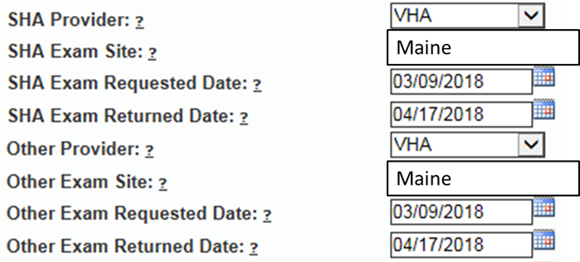
Improper Use of Other Exam Fields (1 of 2)
The Other Exam fields are used when the SHA Examiner is not performing all exams. We are seeing numerous cases in which the MSC is incorrectly populating the Other Exam Fields
The same provider and dates should not be in the SHA and Other Exam fields

Slide 19
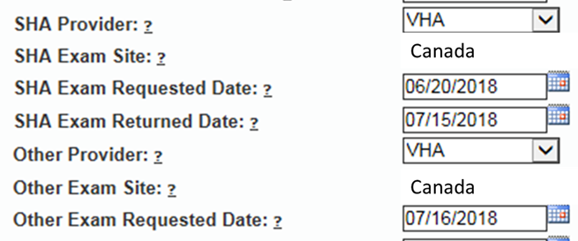
Improper Use of Other Exam Fields (2 of 2)
The Other Exam fields will not be used when the MSC must re-order exams from the SHA Provider

Slide 20
BDD Topics for Discussion

Slide 21
Electronic Transfer of STRs
Over the last several years we have been working with DoD and IT to develop a method to transfer STRs electronically for BDD claimants
Functionality was released to VBMS in March 2018. DoD is moving closer towards implementing the electronic transfer of the STRs for BDD cases
BDD claims processors should be aware that, as a result of this testing, you may see STR records electronically transferred into the VBMS eFolder along with the STRs provided by the SM that were scanned by the scanning vendor
BDD claims processors must continue to require STRs to be submitted when filing a BDD claim until official notice is provided that the requirement has been removed. If you notice any issues with the electronic transfer of the STRs (such as duplicate or missing records) please let us know through the Pre-Discharge mailbox, along with the information on the claim

Slide 22
BDD Claims in the Centralized Mail Portal
Since implementing the revised BDD program last year, ROs nationwide have been processing BDD claims to include establishment/development, in-service ratings and authorization
Intake sites and ROs are responsible for completing all initial development for BDD claims received at their locations; however, it was recently noted that some ROs are receiving BDD claims from intake sites outside of their jurisdiction through redistribution of mail in the CM Portal
BDD claims received from other ROs/intake sites through the CM portal should have the 336 – BDD EP established (be sure to select the appropriate intake site where the claim was received during establishment), and that EP should be brokered back to the RO with jurisdiction over that intake site for initial development
As a reminder, ROs and intake sites should not be sending hardcopy BDD claims to the CM portal

Slide 23
Intake Sites in VBMS
A new default intake site functionality has been added to VBMS for Pre-Discharge claims received externally (eBenefits)
“Other – Not On List” will automatically populate as the intake site in VBMS for Pre-Discharge claims received electronically when a location is not available. This new feature will allow end users to successfully request examinations for Pre-Discharge claims in EMS without receiving an error message
End users are reminded that this selection is only for claims that are received externally and should not be used when manually establishing a Pre-Discharge claim in VBMS. Users must continue to include the intake site for manually established Pre-Discharge claims to prevent error messages when requesting examinations
If your intake site location is not listed in VBMS, use your Regional Office as the intake site and send a request to our Pre-Discharge mailbox to have your intake site added to VBMS

Slide 24
Examination Availability for BDD Claimants
It is important to remind BDD claimants, as part of the criteria for participating in the BDD program, they must be available for examinations for 45 days following the date of claim submission
If the SM is not available during this time, be sure to advise them of their exclusion from the BDD program and answer any questions regarding processing
In rare circumstances, if a SM is excluded from the BDD program and later becomes available for exams and still meets all other BDD criteria (including still having 90 or more days remaining on active duty), update the claim type to BDD and process accordingly

Slide 25
Current Program Timeliness
As outreach specialists and VA’s frontline contact with SMs and
Veterans, it is vital that we are realistic in our communications regarding claims processing times. Below is the current program timeliness data as of September 30, 2018
September 30, 2018 | BDD
Completed FYTD | 36,281
Receipts FYTD | 36,184
Pending | 5,367
% Pending >125 Days | 17.7%
# Pending >125 Days | 949
Average Days Pending | 82.2
Avg. Days to Complete FYTD | 64.5

Slide 26
Questions from the Pre-D/BDD Mailbox
Question and Answer

Slide 27
Misc and Open Floor
TMS #: VA
Open Floor/Questions
Next Teleconference: November 13, 2018

