Slide 1
(VSR VIP Pre-D) Introduction to Reviewing Service Treatment Records (STRs)
Compensation Service
September 2020
Notes:
Welcome to Introduction to Reviewing Service Treatment Records (STRs) course. To advance each slide, click anywhere on the screen.

Slide 2
Lesson Objectives
Define Service Treatment Records (STRs)
Explain the organization of STRs
Know how to locate x-rays, medical history forms, and other parts of STRs
Identify the entrance and separation physical examinations and annotate/bookmark them for future reference
Review STRs efficiently to establish if the claimed condition or symptoms occurred during service
Describe the Subjective Objective Assessment Plan (SOAP) format
Notes:
Lesson Objectives
Upon completion of this lesson, you will be able to:
Define STRs
Explain the organization of STRs
Know how to locate x-rays, medical history forms, and other parts of STRs
Identify the entrance and separation physical examinations and tab/annotate them for future reference
Review STRs efficiently to establish that the claimed condition/symptoms did/did not occur during service
Understand the Subjective Objective Assessment Plan (SOAP) format

Slide 3
References
M21-1, Part III, Subpart iii, 2.A, General Information on Service Records
M21-1, Part III, Subpart iii, 2.B, Migration of Service Records and the Procedures for Obtaining Them
M21-1, Part IV, Subpart ii, 2.A, Deciding Claims for Disability Compensation
M21-1, Part III, Subpart iv, 3.A.8.d, Requirement to Identify Relevant Evidence for the Examiner’s Review
M21-1, Part III, Subpart iv, 3.A.8.e, Bookmarking Documents for Examiner Review
M21-1 Part III. Subpart iv, 3.A.8.f, Annotating Documents for Examiner Review
Notes:
References
The references for this course are listed on the screen.

Slide 4
Definition
Service Treatment Records (STRs) are the chronological records (electronic or paper) documenting the medical and/or dental care and treatment received primarily outside of a hospital (i.e. – outpatient) during service for each service member. For many years, they were referred to as Service Medical Records (SMRs).
Notes:
Definition
STRs are the in-service health records that service departments collect for each service member. For many years, they were referred to as Service Medical Records (SMRs).

Slide 5
Obtaining STRs
STRs are uploaded into Veteran Benefits Management System (VBMS) from:
National Personnel Records Center (NPRC) via Personnel Information Exchange System (PIES)
Records Management Center (RMC) – RMC Source Material Tracking System (SMTS) Portal
Healthcare Artifact and Image Management Solution (HAIMS)
Notes:
Obtaining STRs
STRs will be uploaded into VBMS from:
National Personnel Records Center (NPRC) via Personnel Information Exchange System (PIES)
Records Management Center (RMC)
Healthcare Artifact and Image Management Solution (HAIMS)

Slide 6
General Information Found in STRs
Physical examination reports, including reports from entrance and discharge physical examinations, if performed
Service member’s medical history and dental records
Clinical record cover sheets and summaries
Physical profiles and Medical board proceedings
On January 1, 2013 individual service departments included a letter of certification of completeness of a member’s STRs
Note: See handout for complete list
Notes:
General Information Found in STRs
Physical examination reports, including reports from entrance and discharge physical examinations, if performed
Service member’s medical history and dental records
Clinical record cover sheets and summaries
Physical profiles and Medical board proceedings
On January 1, 2013 individual service departments included a letter of certification of completeness of a member’s STRs
Note:
See handout for complete list

Slide 7
General Information Not Found in STRs
Inpatient treatment records (clinical records)
Finance records
Mental health records, or
The Military Personnel Record Jacket (MPRJ), which may contain physical profiles and medical board proceedings
Notes:
General Information Not Found in STRs
Inpatient treatment records (clinical records)
Finance records
Mental health records, or
The Military Personnel Record Jacket (MPRJ), which may contain physical profiles and medical board proceedings

Slide 8
General Information Not Found in STRs (cont.)
If a Service member obtains treatment at an "off-base" civilian facility on their own, medical or mental health records created during the course of treatment are not automatically associated with the STRs.
These records are never forwarded for long-term storage to the NPRC, they are destroyed after a period of inactivity (five years for mental health records).
Notes:
General Information Not Found in STRs (continued)
If a Service member obtains treatment at an "off-base" civilian facility on their own, medical or mental health records created during the course of treatment are not automatically associated with the STRs.
These records are never forwarded for long-term storage to the NPRC, they are destroyed after a period of inactivity (five years for mental health records).

Slide 9
Reviewing STRs
Review the STRs only for claimed conditions
Annotate/bookmark the entrance and separation physical exams in the STRs
SF 88 or DD Form 2808, depending on Veteran’s service period
Annotate/bookmark where the claimed condition was diagnosed or noted in the STRs
STRs received from HAIMS are often typed and contain a Table of Contents to make STR review easier
Note: annotating and bookmarking STRs in VBMS are required actions which will help expedite the claim. M21-1 III.iv.3.A.8.d.
Notes:
Reviewing STRs
Review the STRs only for claimed conditions
Tab/annotate the entrance and separation physical exams in the STRs
Tabbing/annotating only necessary for one or two instances where the claimed condition was diagnosed or noted in the STRs

Slide 10
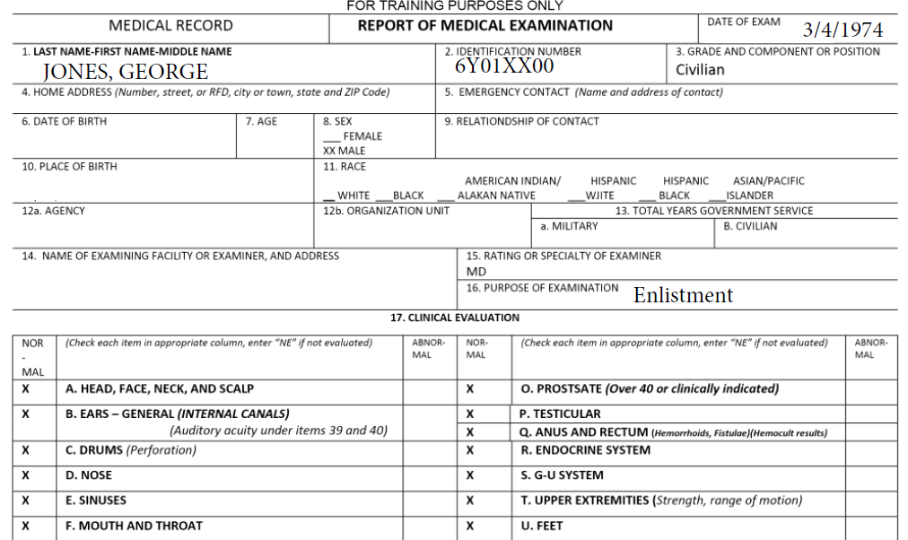
Enlistment Exam – SF 88
Notes:
Enlistment Exam

Slide 11
Enlistment Exam – DD Form 2808
While reviewing the STRs you will find that the form is now changed from a SF 88 to a DD Form 2808, depending on the period that the veteran served. These forms are very similar.

Slide 12
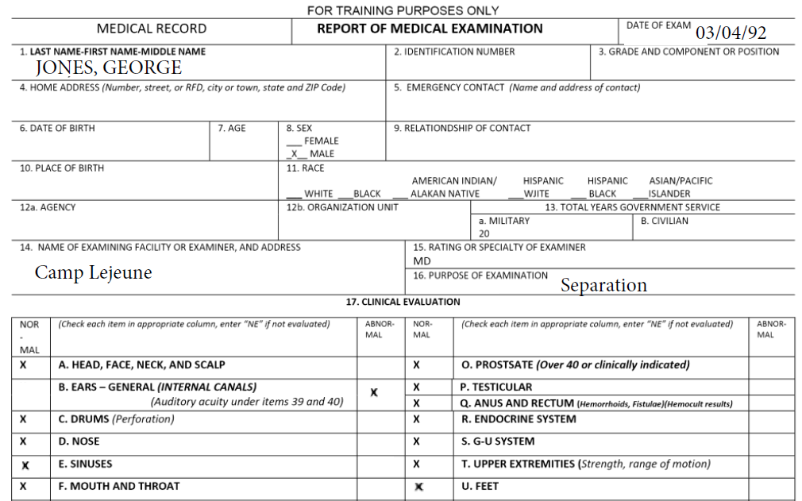
Separation Exam – SF 88
Notes:
Separation Exam

Slide 13
Separation Exam – DD Form 2808

Slide 14
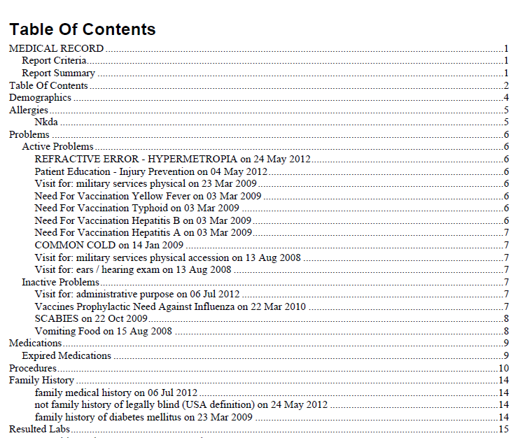
HAIMS – Table of Contents

Slide 15
SOAP
Subjective, Objective, Assessment, Plan (SOAP)
The SOAP format is used by many medical professionals, not just military medical professionals
Many treatment records will use different abbreviations, or possibly none at all, to signify each section
Notes:
SOAP
Subjective, Objective, Assessment, Plan (SOAP)
The SOAP format is used by many medical professionals, not just military medical professionals.
Many treatment records will use different abbreviations, or possibly none at all, to signify each section

Slide 16
Examples of SOAP
Notes:
Examples of SOAP

Slide 17
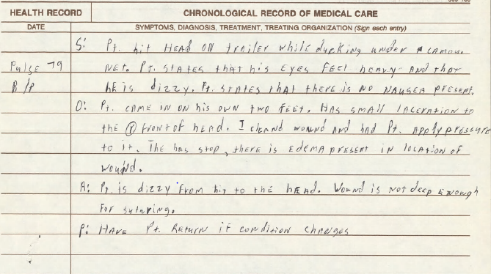
Examples of SOAP SF 600

Slide 18
Examples of SOAP SF 600 (cont.)

Slide 19
Questions

