Slide 1
Codesheet Compliance
Compensation Service
September 2018
Notes:
Welcome to Introduction to Ratings course. To advance each slide, click anywhere on the screen.

Slide 2
Lesson Objectives
Understand the anatomy of a rating codesheet.
Identify the required elements of a rating codesheet.
Notes:
Lesson Objectives
Upon completion of this lesson, you will be able to:
Recognize issues that require a Rating Decision
Identify the anatomy of a Rating Decision
Define terms associated with Rating Decisions

Slide 3
References
38 CFR Part 4 – Schedule for Rating Disabilities
M21-1, Part III, Subpart iv, Chapter 6, D – Codesheet Section
M21-1, Part III, Subpart iv, Chapter 6, E – Coded Conclusion
M21-1, Part III, Subpart iv, Chapter 6, Section A - Partial Rating Decisions and Deferred Issues
Notes:
References
The references for this course are listed on the screen. You may click any hyperlinked references for further details.
38 CFR Part 4 – Schedule for Rating Disabilities
M21 dash 1 (Archive), Part One, Appendix A - Rating Codes
M21 dash 1, Part Three, Subpart four - General Rating Process
VBMS Job Aid, Partial Rating with Deferral for Exam/Clarification and Additional Development Actions

Slide 4
Anatomy of a Rating Codesheet
The rating codesheet includes:
Data table
Jurisdiction
Associated claim(s)
Coded conclusions
Special notations and template fields
Signature(s)
Notes:
VA Adjudicative Decision
An entitlement decision is a decision made by a Veterans Service Representative (VSR)
A Rating Decision is a decision made by a Rating Veterans Service Representative (RVSR)

Slide 5
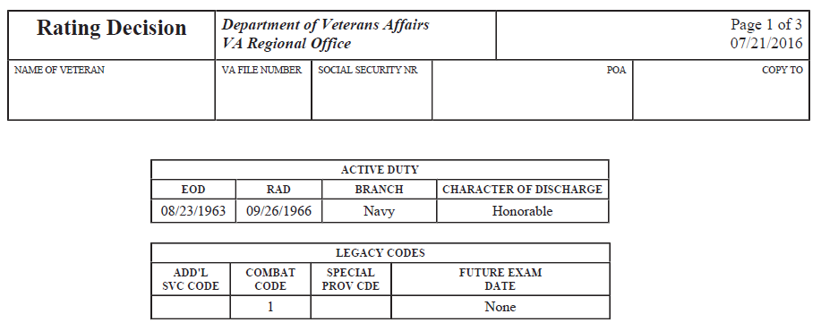
Data Table
The Data Table includes:
Personal Identifying Information such as name, Social Security Number, POS, POA, file number, and date of Rating
Any future exam date(s)
SMC Code(s)
Combat Status Code
Additional Service Code
Notes:
The VSR’s Role
VSRs have a responsibility to review cases to determine whether there is a proper claim and an issue within the jurisdiction of the rating activity.

Slide 6
Power of Attorney
Important that the POA in VA systems indicate the most recent POA election. Prior to drafting the Rating Decision, the decision maker must update VA systems with the correct POA if it has not already been updated. A POA must be updated using SHARE. The steps on how to are located in M21-1, III.ii.3.C.5.b.
Notes:
The VSR’s Role (continued)
A VSR has authority to make entitlement decisions, and when supported by evidence, deny benefits if an issue involves basic eligibility determination
A VSR may deny a claim for service-connected (SC) compensation without a Rating Decision if:
there is a legal bar to entitlement, and or
any necessary development has been completed and time limitations have expired

Slide 7
Period of Service
Extremely important that the POS(s) is correct and updated in VA systems. Although all verified and pertinent periods of service should be in the system before a claim is made ready for decision, the individual drafting the Rating needs to verify this information prior to drafting the Rating. The decision maker has the ability to update military service in SHARE and/or Participant Profile and verify service.
Exception: RVSR may determine an injury incurred during ADT so that period of service will not be updated in SHARE prior to the rating being completed - this action is completed after the rating is finalized per M21-1 III.ii.6.A.2.k
Notes:
Authorization Authority
Other issues a VSR may make decisions about include:
Change in number of dependents
Adjustment in income
Aid and Attendance (A & A) due to nursing home status (after SMC has been granted)

Slide 8
Jurisdiction
The Jurisdiction of the codesheet
appears below the data table
explains why the case is before the rating activity
refers to the claim at issue, and
cites the pertinent jurisdictional date.
Notes:
Authorization Authority (continued)
VSRs do not have the authority to:
Determine if service medical records support a disability claim, and or
Deny a specific claim for SC death benefits without a Rating Decision

Slide 9
Associated Claim(s)
The associated claim(s) section
appears below the jurisdiction
includes all end product(s) (EP) associated with the contentions/claims be processed along with the DOC(s) of the claim(s)
cites the type of claim(s)
Notes:
RVSR’s Role
RVSRs are vested with authority to make decisions and take other actions on claims requiring a Rating Decision
RVSRs apply provisions of all pertinent laws and regulations governing VA

Slide 10
Coded Conclusions
The coded conclusions section provides the list of conditions that are service connected, not service connected, or for pension purposes only. This section must include all rated conditions both past and present.
38 CFR Part 4, Rating Schedule for Disabilities, is used to determine disability codes and percentages of evaluation.
Notes:
Rating Decision Evidence
Prior to making a decision, the RVSR must review all evidence of record to ensure completeness and adequacy
The RVSR is prohibited from denying a claim before all efforts to obtain evidence have been exhausted
The RVSR must list all relevant evidence in the “Evidence” portion of the rating, including any evidence not obtainable

Slide 11
Coded Conclusion (Cont.)
If a condition is service connected, it must include
the current percentage evaluation,
the effective date of the grant (for each assigned evaluation for that condition),
basis for a decision (i.e. aggravated, presumptive, direct)
special issue (Agent Orange, Asbestos)
the era in which the disability was incurred,
whether the condition is a disability severance condition (extremely important),
whether the disability is static or not, and
any future exam(s) that may be warranted for that particular condition.
Notes:
Anatomy of Rating Decision
A Rating Decision has two sections:
Narrative
Codesheet

Slide 12
Coded Conclusion (Cont.)
At the end of the service connected conditions must be the
combined evaluation
historical combined evaluation, and
the effective date(s) for each combined evaluation.
All denials for service connection must include the date of the original denial along with the reason and era.
If the Veteran has ever claimed pension, each non-service connected condition must include a disability percentage for pension purposes. Furthermore, the codesheet must include the combined evaluation of all service connected and non-service connected conditions for pension purposes.
Notes:
Anatomy of Rating Decision
A Rating Decision has two sections:
Narrative
Codesheet

Slide 13
Coded Conclusion (Cont.)
All service connected conditions that a Veteran received disability severance pay for must be identified as such.
In order to identify a condition that received disability severance pay, you must select the “Disability Severance” option from the “Withholding Information” drop down which is under the “Diagnosis Information” chevron under the “Disability Decisions” tab in VBMS-R.
Notes:
Anatomy of Rating Decision
A Rating Decision has two sections:
Narrative
Codesheet

Slide 14
Coded Conclusions (Cont.)
Conditions that need further development before a proper decision can be made will be listed under the subsection “Deferred Issues.” It is extremely important that when a final decision for a deferred issue is made that the condition is removed from the “Deferred Issues” subsection. (There may be an instance in which the condition is deferred for an evaluation only. If that is the case, then the condition will be listed under the “service connected” and the deferral sections.)
Additionally, a condition cannot be listed simultaneously under the Service Connected subsection and the Not Service Connected subsection. This is duplicate and non-compliant with properly updated VA systems.
Notes:
The Codesheet (continued)
Combined Evaluation for Compensation:
Each disability’s assigned percentage is combined together to give a total combined disability percentage and an associated effective date.
“Not Service Connected” or denied conditions:
All contentions that have ever been denied will be listed in this section of the Codesheet.

Slide 15
Special Notations & Template Fields
The primary purposes of notations made in the special notation and the notification template fields on the codesheet are to
record special remarks or approvals applicable to the rating decision, and
communicate an instruction or administrative message to the authorization activity.
For instance, for any proposal to reduce and/or sever a service connected condition, the proposed combined evaluation needs to be provided by the Rating Activity. The proposed combined evaluation will be included in this section.
Notes:
Rating Schedule and Diagnostic Codes
38 CFR Part 4, Rating Schedule for Disabilities, is used by the RVSR to determine disability codes and percentages of evaluation
The 4 digit numbers on left column of the rating schedule represent diagnostic codes for rating disabilities
These diagnostic codes are reflected on the Codesheet of the Rating Decision

Slide 16
Special Notations & Template Fields (Cont.)
All special notations and templates are generated through input in the ISSUE MANAGEMENT tab of VBMS-R.
Use the SPECIAL NOTATION field, accessible from VBMS-R's PROFILE tab, to communicate an instruction or administrative message to the VSR. Clarify if the message is solely administrative (for example, Cancel the erroneously established EP 930) or to be shared with the Veteran (for example, Tell the Veteran that the evaluation of his nephrolithiasis is currently under appeal and will be addressed in a future decision).
Notes:
Rating Schedule and Diagnostic Codes
38 CFR Part 4, Rating Schedule for Disabilities, is used by the RVSR to determine disability codes and percentages of evaluation
The 4 digit numbers on left column of the rating schedule represent diagnostic codes for rating disabilities
These diagnostic codes are reflected on the Codesheet of the Rating Decision

Slide 17
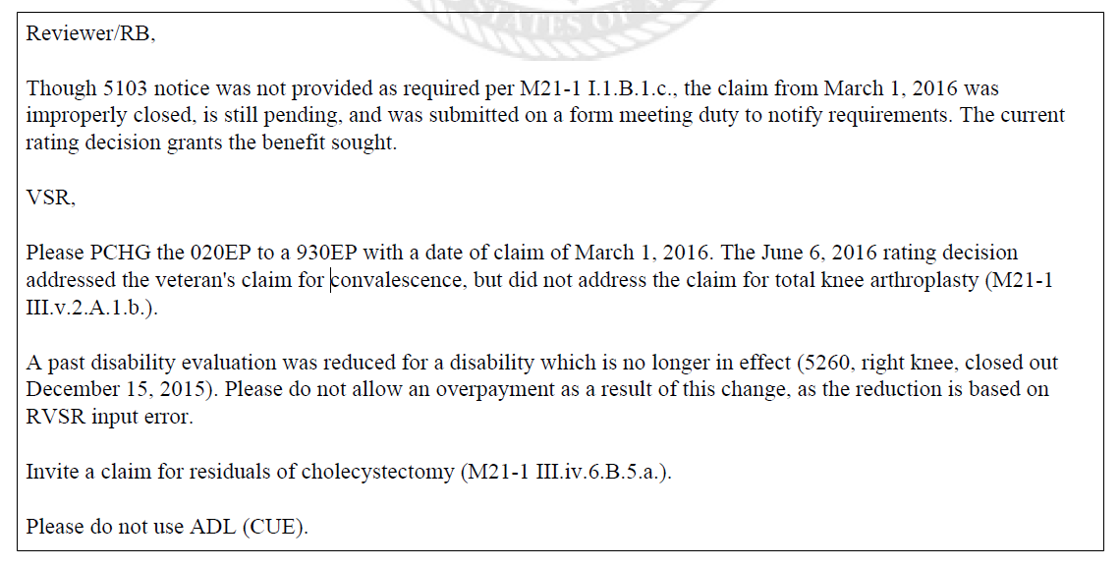
Special Notations & Template Fields (Cont.)
The special notation text appears at the bottom of the codesheet above the signature(s).
For further information on the ISSUE MANAGEMENT tab or SPECIAL NOTATION field, see the VBMS-R User Guide.
Notes:
Rating Schedule and Diagnostic Codes
38 CFR Part 4, Rating Schedule for Disabilities, is used by the RVSR to determine disability codes and percentages of evaluation
The 4 digit numbers on left column of the rating schedule represent diagnostic codes for rating disabilities
These diagnostic codes are reflected on the Codesheet of the Rating Decision

Slide 18
Signature
Rating decisions must contain the decision maker’s standard digital signature on the bottom of the last page of the codesheet. “wet signatures” are no longer required.
A rating decision signature is defined as
an electronic signature certification statement, and
the user’s
o Local Area Network identification (LAN ID), and
o job title.
Notes:
Special Monthly Compensation (SMC)
SMC is a benefit in addition to the basic rate of compensation
Entitlement to SMC is always the RVSR’s determination and will be clearly coded on the Rating Decision

Slide 19
Signature (Cont.)
To establish the standardized digital signature, users should navigate to the SIGNATURE/DOCUMENT TITLE tab, and populate the AUTHOR SIGNATURE LINE field as follows:
eSign: certified by [decision maker’s LAN ID, job title]
Example: eSign: certified by VSCJSMIT, RVSR
Notes:
Special Monthly Compensation (SMC)
SMC is a benefit in addition to the basic rate of compensation
Entitlement to SMC is always the RVSR’s determination and will be clearly coded on the Rating Decision

Slide 20
Signature (Cont.)
Exception: If a rating decision requires more than one signature, the rating decision codesheet must display the required additional signature fields, but the digital signatures of the additional reviewers must be documented on VA Form 21-0961, Electronic Signatures.
Important: The signature of the decision maker(s) certifies that the claims folder was reviewed and all phases of the claims process leading to the decision were correctly handled.
Notes:
Special Monthly Compensation (SMC)
SMC is a benefit in addition to the basic rate of compensation
Entitlement to SMC is always the RVSR’s determination and will be clearly coded on the Rating Decision

Slide 21
Single or Multiple Signatures
Single-signature authority is restricted to RVSRs whose ability to produce quality work independently without additional oversight has been demonstrated by review.
All rating decisions require the signatures of two decision makers, unless approved as single-signature ratings by the VSCM or PMCM.
Exception: The VSCM/PMCM does not have authority to grant single-signature authority in all cases. Please refer to the table in M21-1, Part III, Subpart iv, 6.D.7.d for information on when second signatures are warranted.
Notes:
SMC (continued)
Examples of SMC include: anatomical loss or loss of use of one or both hands, one or both feet, creative organs, blindness, deafness, etc.
SMC is also granted to a beneficiary who is housebound or in need of aid and attendance based on a service-connected disability

Slide 22
Review
Questions
Notes:
Questions?

