Slide 1
Compensation Service
August 2018
Systems Compliance Training

Slide 2
Objectives
Review the history of System Compliance errors
Identify the different System Compliance errors
List different ways to prevent a System Compliance error
Summarize the importance of proper systems compliance
Properly identify if an System Compliance error exists

Slide 3
References
M21-1, Part I, Chapter 3 - Power of Attorney
M21-1, Part III, Subpart ii, Chapter 2, D through F - Reopen, Claims for Increase, Reconsideration
M21-1, Part III, Subpart ii, Chapter 3, Section C - Systems Updates
M21-1, Part III, Subpart iii, Chapter 1, Section F - Record Maintenance During the Development Process
M21-4, Appendix A - Regional Office Station Numbers and Payee Codes
M21-4, Appendix B - End Product Codes and Work-Rate Standards for Quantitative Measurements
M21-4, Appendix C - Index of Claim Attributes
M21-4, Appendix D - Index of Claim Stage Indicators
M21-4, Chapter 6, Appendix A, B, and C - Task Based Quality Review Checklists

Slide 4
Development of VETSNET Business Rules
VETSNET Business Rules were originally developed April 3, 2003 under Fast Letter (FL) 03-10
FL 03-10 distributed standardized data input rules for MAP-D.
FL 06-11 provided updated standardized rules and claim cycles for MAP-D enhanced functionality.
FL 12-03 better defined the standardized rules and enhanced the business requirements
February 2014 CS Bulletin stated QRSs and STAR are required to cite System Compliance Errors

Slide 5
M21-4 Chapter 6
M21-4 Chapter 6 was created in December 2015 to assist QRSs improve quality and timeliness of claims processing. QRSs must call System Compliance errors for the following:
Is the date of claim and end product correct?
Are all the payees’ address (including direct deposit) correct?
Are all periods of service for the Veteran verified and updated in all systems?
Was the Power of Attorney (POA) information/access updated in all systems and correspondence?

Slide 6
M21-4 Chapter 6
(Continued from prior page)
Were special issues and flashes entered correctly?
Were contentions and classifications entered correctly?
Were tracked items entered and updated as necessary?
Was the claim (Ready for Decision (RFD), Rating Decision Complete (RDC), Open updated appropriately?
Were the suspense dates (tracked item or claim level) updated and correct?

Slide 7
System Compliance Checklist
M21-4 Chapter 6, Appendices A & B provide the VSR & RVSR Quality Review Checklists. Section 11 of each checklist covers System Compliance Specific Questions to include:
Date of claim incorrect
End product correct
Payees’ address (including direct deposit information) incorrect
All periods of active duty or other service related to claimed issues not verified and updated in all systems (BIRLs/Participant Profile) (EOD, RAD, Branch, Char SVC, Sep Reason VADS and/or VERIFIED)

Slide 8
Date of Claim (DOC)
DOC is the earliest date any VA facility received the claim except when the claim is received before release from active duty – in these cases, DOC is the first day following release from active duty.

Slide 9
End Product (EP)
EP is the primary workload monitoring & management tool for the Veterans Service Center (VSC)/Pension Management Center (PMC). It is imperative that the correct EP is associated with the claim.
Correct use of the EP system facilitates proper control of pending workloads and appropriate work measurement credit.
Correct work measurement is essential to substantiate proper staffing requirements and determine productive capacity.

Slide 10
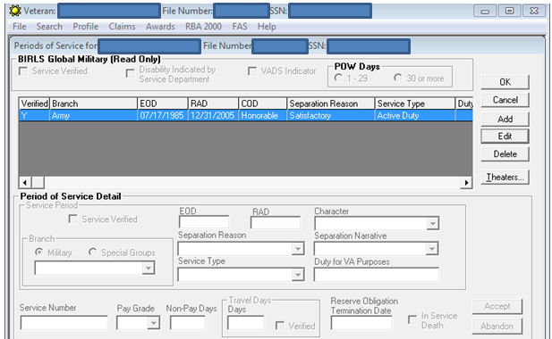
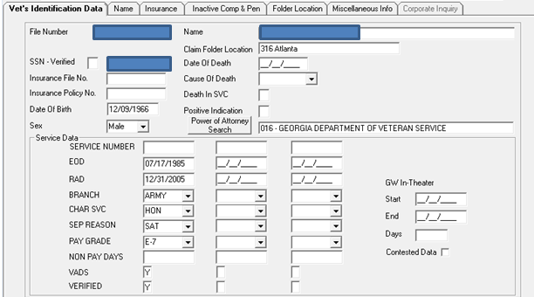
Period(s) of Service (POS)
Regional Offices are responsible for ensuring service is updated in both BIRLS and the Veteran’s corporate record through Participant Profile.

Slide 11
Period(s) of Service (POS)
The only POS(s) that must be inputted into the system is/are active duty period(s). Do not input and verify active duty for training (ADT) and inactive duty for training (IADT) periods unless service connection (SC) is awarded for an injury that occurred during such a period.
If SC for a disability of death is established based on a single day of ADT or IADT, the RVSR must provide VA Form 21-6789 and the authorization activity will update BIRLS & Participant Profile.

Slide 12
Payee(s) Address(es)
Correct and current contact information in the system is imperative.
Address(es) and other contact information can be added/updated using VBMS or SHARE.
VBMS preferred system to update address and other contact information.
Direct Deposit information can only be updated in SHARE or VBMS-A.
Follow USPS Business Mail instructions.

Slide 13
Power of Attorney (POA)
Claimants have the right to representation.
VA Forms 21-22 and/or 21-22a are declarations of representation by the claimant.
Make sure VA form is complete – signatures and dates.
Use M21-1 III.ii.1.C.8.a. to determine if form is acceptable.
Use M21-1 III.ii.3.C.4.g. to obtain a valid form if necessary.

Slide 14
Power of Attorney (POA)
Declarations of representation must comply with 38 U.S.C. 7332 to prevent inadvertent disclosure of protected records.
If form does no permit release, then send claimant the “Failure to Elect 38 U.S.C. 7332 letter using letter creator.
You must update the systems when there is a change in POAs or revocation of a POA.

Slide 15
Verify POA Access
M21-1, III.ii.3.C.5.b provides the steps on how to update SHARE with the POA information.
Make sure that systems are updated to allow a POA access to the claimant’s folder and ability to update the claimant’s address if the claimant authorized the representative these privileges.

Slide 16
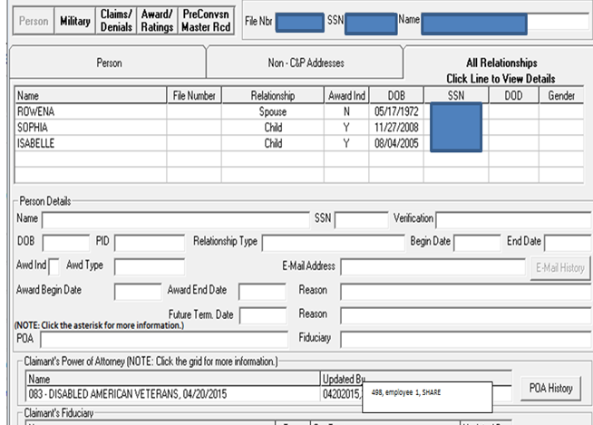
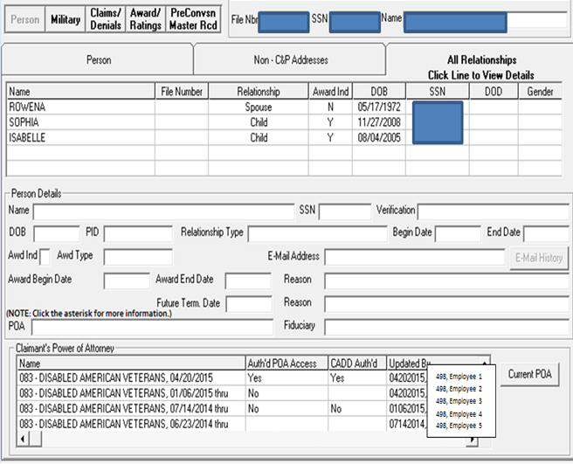
Verify POA Access (Cont.)
To verify if POA has access to VA systems and to CADD Auth’d
Step 1
Step 2
Step 3
Step 4

Slide 17
Special Issue and Corporate Flashes
M21-4, Appendix C provides the lists of Corporate Flashes and Special Issues.
Special Issues and Corporate Flashes help track pending work and resolve claims as quickly and efficiently as possible.

Slide 18
Contentions
Use of contentions for each claim is mandatory and should be entered as soon as they are identified.
Each contention must be entered separately and easy to understand.
Contentions should be in the claimant’s own words, as appropriate.
Correct any misspellings.
Only need to list the claimed condition(s).

Slide 19
Tracked Items
Purpose of tracked items is to control receipt or non-receipt of information requested from claimant, beneficiary, or other information provider.
Visible through eBenefits
Responsibility of the claims processor reviewing or taking action on a claim to ensure that
The necessary tracked item(s) have been generated
All suspense dates are accurate, and
Dispositions of all tracked items have been accurately managed
Note: Custom tracked item should not be used if a standard tracked item exists.

Slide 20
Importance of System Compliance
The Department of Veterans Affairs has worked tirelessly over the past few years to reduce the number of pending compensation claims.
Every claim you work impacts a Veteran!

Slide 21
Creating a Better Veteran’s Experience
President’s Commission on Care for America’s Returning Wounded Warriors established by Executive Order 13426 in March 2007
April 5, 2010 eBenefits launched version 2.3 which allowed service members and Veterans to check the status of C&P claims
Various data points are exchanged with eBenefits and directly impact the information the Veteran is able to view through eBenefits

Slide 22
Creating a Better Work Experience
Proper systems compliance eliminates extra workload. Here are some examples:
Manually reassigning claims occurs because proper flashes or special issues are not initially added correctly.
Prevents missed development.
Eliminates misrouting of claims.

Slide 23
National Impacts throughout VA
Systems Compliance impacts the National Work Queue’s(NWQ) ability to properly disseminate workload to employees for processing based on special issues and flashes.
Incorrect tracked items added to a claim or not closing out track items could cause delays in claims processing timeliness.
Incorrect address could implicate a Personally Identifiable Information (PII) violation.
Wrong date of claim could lead to a wrong effective date applied.
Incorrect contentions entered could confuse the Veteran and the next employee who processes the claim.

Slide 24
Recommendations to Avoid System Compliance Errors
Create a routine of verifying accuracy of system compliance while working a claim.
Post the systems compliance checklist in a visible sight within your work area.
Double, triple check and proofread your work.
Learn from errors or recommendations provided to you from the Quality Review Team
Keep in mind you are influencing a Veteran’s eBenefits record

Slide 25
Recommendations to Avoid System Compliance Errors
Keep in mind your co-workers – the better system compliance each individual satisfies, the higher the quality and lower average days pending for each claim.
Tracked items are designed for employees to quickly identify which life cycle the claim is currently in and assists in determining what next action is required.
The CFR and Manual are your best resources to avoiding system compliance oversights.
Additional resources are the VBA Learning Catalog and VSR/RVSR Assistant

Slide 26
Questions?

