Slide 1
Compensation Service
June 2018
Intent to File (CA)

Slide 2
Objectives
Understand the importance of March 24, 2015, as it relates to the communication of an ITF
Recognize what kind of claims ITFs apply to and how they can be communicated
Know required elements of an ITF and development actions needed for an inadequate communication of an ITF
Locate list of ITFs in VBMS and determine their status
Identify possible duplicate ITFs

Slide 3
References
38 CFR 3.155(b), Intent to file a claim
M21-1, Part III, Subpart ii, 2.C, Informal Claims Received Prior to March 24, 2015, Communication of an Intent to File (ITF), and Requests for Application

Slide 4
Before March 24, 2015
Prior to this date VA would accept “informal claims”. The standards for informal claims were much less restrictive.
Informal claims were important because they served as an effective date placeholder, if VA received a substantially complete claim within one year of the date we notified the claimant one was needed.

Slide 5
March 24, 2015
VA stopped accepting informal claims on March 24, 2015.
Claimants desiring an effective date placeholder must now communicate to VA a formal “intent to file” a claim.

Slide 6
Expiration of ITFs
An ITF is considered “Active” as an effective date placeholder until:
VA receives a substantially complete claim for the same benefit on a prescribed form; or
One year passes since VA received the ITF
Only one ITF can be active at a time. If another ITF is received while an active ITF exists, it is a “Duplicate” ITF.

Slide 7
Status of ITFs
Active – only one ITF can be active at a time
Duplicate – an ITF received while an active one exists
Incomplete – requires development
Expired – did not receive claim within one year of ITF
Claim Received – claim received within one year of ITF
Canceled – created erroneously

Slide 8
Benefits ITF Applies To
Compensation
Pension
Survivor’s Pension, and
DIC
An ITF is specific to the benefit sought. When the claim received is not for the same type of benefit identified on the ITF, the ITF may not be applied to the claim for purposes of effective date assignment.

Slide 9
Benefits ITF Does Not Apply To
Examples of claims ITF does not apply to (not a complete list):
Dependency
Ancillary benefits
Requests for Reconsideration
Duplicate claims
Requests for review based on a clear and unmistakable error

Slide 10
Required Elements of an ITF
A claimant’s communication of an ITF is adequate if the claimant:
provides VA with enough information to identify the Veteran (and themselves if they are not the Veteran), and
specifies the general benefit they are seeking (compensation and/or pension, or Survivors Pension and/or Dependency and Indemnity Compensation (DIC))

Slide 11
Ways to Communicate an ITF
When an ITF is submitted in writing, it must be submitted on VA Form 21-0966. VA Form 21-0966 must be signed by
The claimant
The claimant’s VSO, or
A VA-recognized power of attorney (POA)
As long as VA can identify the claimant via information included on VA Form 21-0966 or other information submitted with the form, the only sections of VA Form 21-0966 a claimant must complete are the sections titled General Benefit Election and Declaration of Intent (Sections II and III on the July 2015 version of the form). Assume the claimant is the Veteran if he/she leaves the Claimant/Veteran Identification (Section I) of the form blank.

Slide 12
Ways to Communicate an ITF (cont.)
The initiation of an application for benefits via eBenefits/VDC or SEP constitutes an acceptable communication of an ITF.
If a claimant communicates his/her ITF by contacting a VA call center, and the claimant does not have a corporate record, a call center employee must complete, sign, and submit VA Form 21-0966 on the claimant's behalf.
A claimant may communicate his or her ITF to a Field Examiner as directed in the Fiduciary Program Manual (FPM) 2.D.3.r.

Slide 13
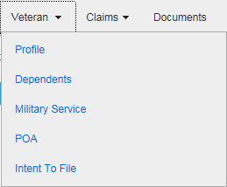
ITFs in VBMS
ITF information can be found on the “Intent To File” screen under the “Veteran” tab in VBMS.

Slide 14
Select a Status
Default will be “Active”
Select “All”

Slide 15
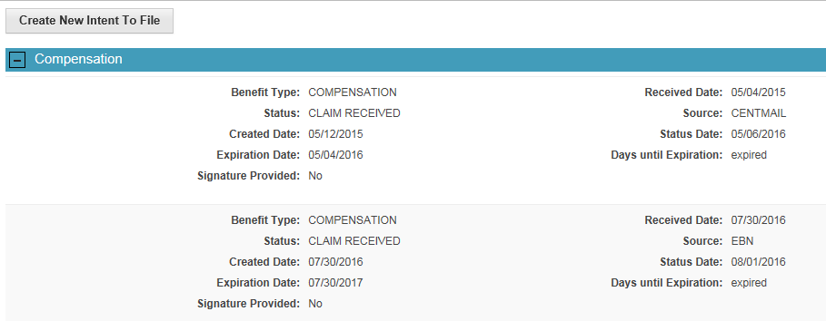
Entering an ITF in VBMS
ITFs can be manually entered on the “Intent To File” screen using the “Create New Intent To File” button.

Slide 16
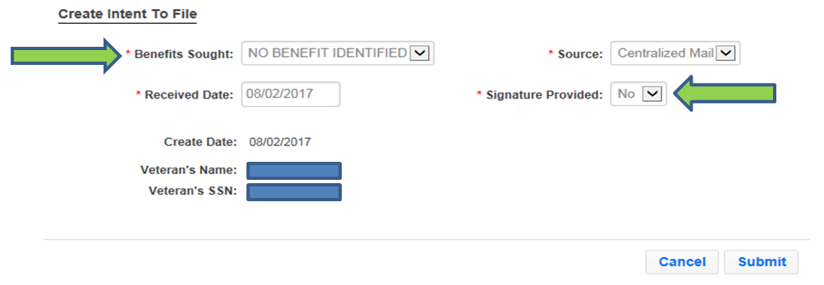
Incomplete ITF Letter
An “Incomplete ITF” letter is automatically generated by entering an ITF in VBMS and selecting the benefit is unidentified and/or the signature is missing.

Slide 17
ITF Acknowledgement Letter
When a valid ITF is communicated online or entered in VBMS, and a substantially complete claim is NOT submitted online the same day, an automatically generated letter is sent to the claimant acknowledging receipt of the ITF.
Historically a copy of this letter was placed into the “Legacy Content Manager Documents” in VBMS. Currently the letter is placed into the eFolder.

Slide 18
Incomplete VA Form 21-0966
If VA Form 21-0966 is missing a required element, and VA has not received a subsequent claim, telephone development should be attempted to obtain the missing information. If telephone development is unsuccessful, an “Incomplete ITF” letter must be sent to the claimant. This letter is sent automatically when an incomplete ITF is entered in VBMS.
If a subsequent claim has been received an “Incomplete ITF – Claim Received” letter should be sent using the Letter Creator program, so that the automatic VBMS letter is not sent.

Slide 19
VA Form 21-0966 in VBMS?
A VA Form 21-0966 will NOT appear in the Documents list if the ITF was communicated by initiating an application online, calling the NCC or NPCC, or spoken to a VSC or PMC employee who has immediate access to VBMS (to enter the ITF).
Note: If a claimant does not have a corporate record, a call center employee must complete, sign, and submit VA Form 21-0966 on the claimant's behalf.

Slide 20
Request for Application
Any communication received after March 24, 2015 that indicates the desire to submit a claim that is not an ITF (or on a prescribed form) is a “Request for Application.”
A Request for Application (RFA) letter should be sent to the claimant informing them what they need to do to submit an ITF and/or formal claim. It should be generated in VBMS using the process described in the handout.

Slide 21
Duplicate ITFs
An ITF remains active for one year or until a claim is received, whichever occurs earlier. Any subsequent duplicate ITF submitted for the same benefit during the active period will have no effect on benefit entitlement.
•Only one ITF can be active at a time. If another ITF is received while an active ITF exists, it is a “Duplicate” ITF.
•Search the Documents in VBMS for current “active” ITF.
•If there is a current ITF, mark the subsequent ITF as “Duplicate”.

Slide 22
ITF VBMS Video
Please watch the ITF VBMS Video.
http://media.ttande.org/video/Comp_Svc/4203116.html

Slide 23
Questions?

