Slide 1
Compensation Service
June 2018
Complete Application and
Payee Codes

Slide 2
Objectives
Identify a substantially complete application.
Identify an incomplete application.
Select proper actions when an incomplete application is received.
Select proper actions when a claim is based on allegation of exposure.
Identify when a Payee Code is required.
Determine the correct Payee Code to apply during Claims Establishment.

Slide 3
References
M21-1, Part I, Chapter 1, Section B, Criteria for Substantially Complete Applications
M21-1, Part III, Subpart ii, Chapter 2, Section B, What Constitues a Substantially Complete Application
38 CFR 3.160 (a)
38 CFR 3.159(a)(3)
M21-4, Appendix A, Section II, Payee Codes
M21-4, Appendix B, Section I, End Products

Slide 4
Criteria for Substantially Complete Applications
A substantially complete application must include the following:
claimant’s name and relationship to the Veteran, if applicable
sufficient service information for the VA to verify the Veteran’s service, if applicable
benefit claimed
disability(ies) on which the claim for benefits is based
signature of the claimant or another legally authorized individual, and
statement of income for Veterans pension, Survivors pension, or Parents' Dependency and Indemnity Compensation (DIC), if claimed.

Slide 5
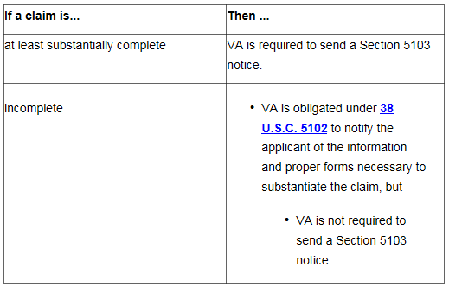
Criteria for Substantially Complete Applications
Upon receipt of an application for benefits, VA must determine the claim is substantially complete.
Note: If the claim was received on an EZ form, then in most instances the requirements regarding Section 5103 notice has been fulfilled.

Slide 6
Acceptable Signature
Faxed or photocopied versions of original wet signatures are acceptable for VA purposes.
Accept any electronic or digital signature or other image of a signature on a claim or appeal for benefits, or associated form, unless there are clear indications of fraud.
Accept signatures by X mark or thumbprint only if any one of the following individuals (or group of individuals) witness the mark or thumbprint:
two persons who give their addresses
a VA employee
a Veterans service organization (VSO) representative
an attorney
an accredited agent
a notary public, or
a person having the authority to administer oaths for general purposes.

Slide 7
Incomplete Application
In absence of any of the required information, the application is considered incomplete.
Step | Action
1 | Whenever possible, contact the claimant first by telephone to obtain the information needed to complete the application
2 | If the information cannot be obtained by telephone: -establish an EP 400, or -change the erroneously established EP to an EP 400 -with an Incomplete Application claim label, and -use the date the application was received as the control date.

Slide 8
Incomplete Application
Step | Action
3 | Cancel any other erroneously established EP associated with the incomplete claim
4 | Notate the incomplete application in the claims folder by changing the document’s subject to Incomplete Application.
5 | Print a copy of the incomplete application.
6 | Mark the blocks on the application in red that require the claimant’s attention

Slide 9
Incomplete Application
Step | Action
7 | Use the Incomplete Application letter included in the Letter Creator tool or equivalent letter from Personal Computer Generated Letters (PCGL) to return the incomplete application to the claimant and claimant’s representative, if any. Include notice -of the information VA needs to consider the application complete, and -that failure to submit a substantially complete application within one year will result in no benefit being paid or furnished by reason of that application.
8 | Add a copy of the Incomplete Application letter to the claims folder
9 | Clear the EP 400

Slide 10
Incomplete Application
Note: If a complete claim is submitted within one year of the date of receipt of an incomplete application,
consider the complete application filed as of the date the incomplete application form was received, but
use the date of receipt of the complete claim as the date of claim.

Slide 11
Incomplete Application
Example: The Veteran submits a VA Form 21-526EZ, Application for Disability Compensation Benefits, which includes the following:
Veteran’s name - Signature
Social Security number - Disability listed: right leg condition
Multiple searches were completed with the information provided but no record was able to be retrieved via SHARE, VBMS, or CAPRI.
What is the next step with this claim?
(Answer purposely not provide; instructor address.)

Slide 12
Incomplete Application Based on Exposure Allegation
An allegation of exposure to a potentially hazardous substance during service without an associated claim for SC for a specific disability resulting from the exposure is not a substantially complete claim. In these cases, follow the incomplete application procedures. In the notification letter, also:
inform the Veteran that exposure, in and of itself, is not a disability, and
ask the Veteran to identify the disability(ies) that resulted from exposure during service.

Slide 13
Incomplete Application Based on Exposure Allegation
Important: Do not
Process the claim as a denial, or
Establish EP control for the incomplete claim unless there are other complete claims also submitted.
Examples:
Radiation - Herbicides
Agent Orange - Asbestos
Mustard Gas - Other hazards
Environmental hazards during service in Southwest Asia
Note: These allegations can be in conjunction with a named disability but these cannot be proven as a disability.

Slide 14
Practical Exercise
Please refer to the Student Handout for Practical Exercise Questions.
Four VA Form 21-526EZs will be located within lesson materials.

Slide 15
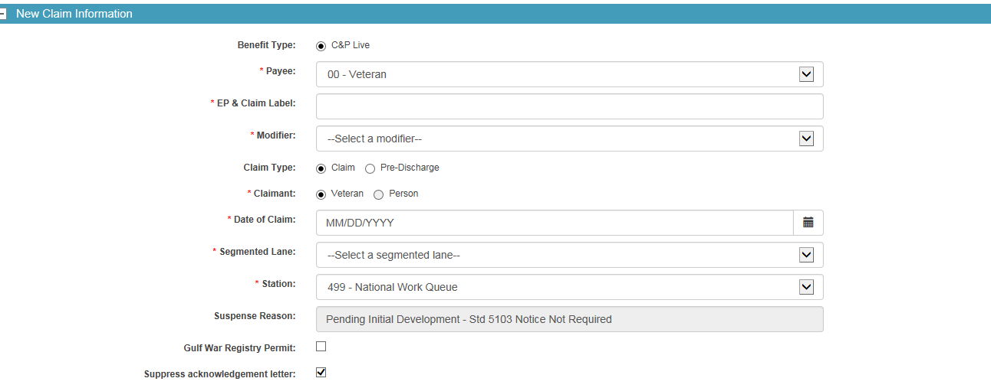
Payee Code
Payee code is a mandatory field needed during the claims establishment process. VBMS will provide a list of options from a drop down menu.

Slide 16
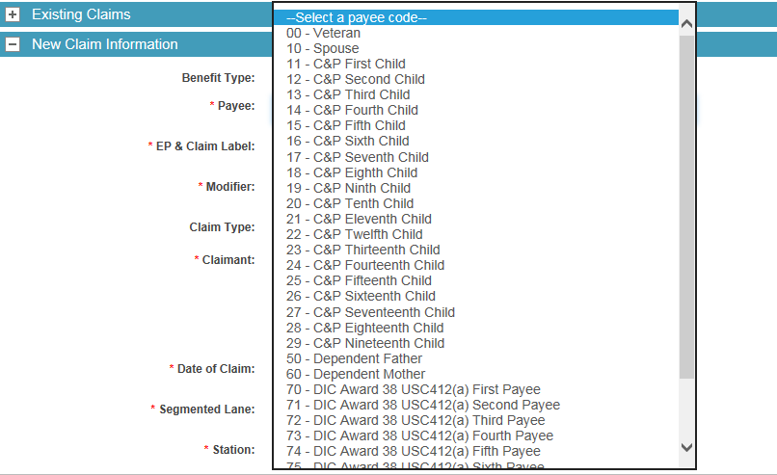
Payee Code

Slide 17
Payee Code
The appropriate payee code is assigned by the user during claims establishment:
Payee | Payee Code
Veteran | 00
First Payee Recipient | 01
Second Payee Recipient | 02
Third Payee Recipient | 03
Fourth Payee Recipient | 04
Fifth Payee Recipient | 05
Sixth Payee Recipient | 06
Seventh Payee Recipient | 07
Eighth Payee Recipient | 08
Ninth Payee Recipient | 09
Payee | Payee Code
Spouse | 10
C&P First Child | 11
C&P Second Child | 12
C&P Third Child | 13
C&P Fourth Child | 14
C&P Fifth Child | 15
C&P Sixth Child | 16
C&P Seventh Child | 17
C&P Eighth Child | 18
C&P Ninth Child | 19

Slide 18
Payee Code
The appropriate payee code is assigned by the user during claims establishment:
Payee | Payee Code
C&P Tenth Child | 20
C&P Eleventh Child | 21
C&P Twelfth Child | 22
C&P Thirteenth Child | 23
C&P Fourteenth Child | 24
C&P Fifteenth Child | 25
C&P Sixteenth Child | 26
C&P Seventeenth Child | 27
C&P Eighteenth Child | 28
C&P Nineteenth Child | 29
Payee | Code
Vendor | 30
Consolidated Payee 1st group of children | 31
Consolidated Payee 2nd group of children | 32
Consolidated Payee 3rd group of children | 33
Consolidated Payee 4th group of children | 34
Consolidated Payee 5th group of children | 35
Consolidated Payee 6th group of children | 36
Consolidated Payee 7th group of children | 37
Consolidated Payee 8th group of children | 38
Consolidated Payee 9th group of children | 39

Slide 19
Payee Code
The appropriate payee code is assigned by the user during claims establishment:
Payee | Payee Code
CH35 First Child | 41
CH35 Second Child | 42
CH35 Third Child | 43
CH35 Fourth Child | 44
CH35 Fifth Child | 45
CH35 Sixth Child | 46
CH35 Seventh Child | 47
CH35 Eighth Child | 48
CH35 Ninth Child | 49
Dependent Father | 50
Payee | Code
Dependent Mother | 60
DIC Award 38 USC412(a) First Payee | 70
DIC Award 38 USC412(a) Second Payee | 71
DIC Award 38 USC412(a) Third Payee | 72
DIC Award 38 USC412(a) Fourth Payee | 73
DIC Award 38 USC412(a) Fifth Payee | 74
DIC Award 38 USC412(a) Sixth Payee | 75
DIC Award 38 USC412(a) Seventh Payee | 76
DIC Award 38 USC412(a) Eighth Payee | 77
DIC Award 38 USC412(a) Ninth Payee | 78

Slide 20
Payee Code
The appropriate payee code is assigned by the user during claims establishment:
Payee | Code
First Claimant Burial/Accrued | 80
Second Claimant Burial/Accrued | 81
Third Claimant Burial/Accrued | 82
Fourth Claimant Burial/Accrued | 83
Fifth Claimant Burial/Accrued | 84
Sixth Claimant Burial/Accrued | 85
Seventh Claimant Burial/Accrued | 86
Eighth Claimant Burial/Accrued | 87
Ninth Claimant Burial/Accrued | 88
Tenth Claimant Burial/Accrued | 89
Payee | Code
Institutional Veteran CFR3.852 | 99

Slide 21
Payee Code – Practice Exercise
Example 1: Veteran submits a VA Form 21P-527EZ, Application for Pension, on January 26, 2018. Which payee code would be utilized in this situation?
(Answer purposely not provide; instructor address.)
Example 2: Surviving spouse submits a VA Form 21P-534EZ, Application for DIC, Death Pension and/or Accrued Benefits, on December 14, 2017. Which payee code would be utilized in this situation?
(Answer purposely not provide; instructor address.)

Slide 22
Payee Code – Practice Exercise
Example 3: Veteran’s name is Michelle. Veteran’s spouse, Roger, submits a claim for apportionment for daughter, Clara. Which payee code would be utilized in this situation?
(Answer purposely not provide; instructor address.)
Example 4: Veteran’s name is Samuel. Veteran’s daughter, Emily, submits a claim for apportionment. Which payee code would be utilized in this situation?
(Answer purposely not provide; instructor address.)

Slide 23
Payee Code – Practice Exercise
Example 5: Veteran’s name is Lauren. Veteran submits a VA Form 21-526, Veterans Application for Compensation and/or Pension. Which payee code would be utilized in this situation?
(Answer purposely not provide; instructor address.)
Example 6: Veteran’s name is Eric. Veteran submits a VA Form 21-526EZ, Application for Disability Compensation and Related Compensation Benefits. Which payee code would be utilized in this situation?
(Answer purposely not provide; instructor address.)
Note: Example 6 is the most common form received when Veteran’s apply for Compensation.

Slide 24
Questions?

