Slide 1
Compensation Service
June 2018
Letter Creator

Slide 2
Objectives
Locate the Letter Creator program and initial setup
Demonstrate how to create a letter using Letter Creator
Know how to Print VA Forms in Letter Creator
Recognize what types of letters are used in IPC

Slide 3
References
Letter Creator User Guide
M21-1, Part I, Chapter 1, Section B, Notification Requirements for an Incomplete Application
M21-1, Part III, Subpart ii, Chapter 3, Section E, Handling a Disagreement with a Decision Not Submitted on VA Form 21-0958, When Required
M21-1, Part I, Chapter 3, Section B, Notification Requirement Where Appointment Forms Lack 38 USC 7332 Election
M21-1, Part III, Subpart ii, Chapter 1, Section C, Handling a Form or Application With an Alternate Signature
M21-1, Part III, Subpart ii, Chapter 1, Section C, Rejecting an Outdated Version of VA Form
M21-1, Part III, Subpart ii, Chapter 1, Section B, Processing Unidentifiable Mail in CM
M21-1, Part III, Subpart ii, Chapter 1, Section B, Final Attempt to Obtain an Updated Address for Undeliverable Claimant Notification and Essential Mail

Slide 4
Letter Creator
Veterans Benefits Management System (VBMS) is the primary system for eFolder storage, strongly utilized for workload management, and the development process.
Letter Creator is an additional system utilized for letters to the Veteran which are not available within VBMS.

Slide 5
Locating Letter Creator
Go to the Compensation Services Intranet site:
Compensation Service Intranet
Click on Rating Job Aides
Locate and select Letter Creator
Complete Initial Setup

Slide 6
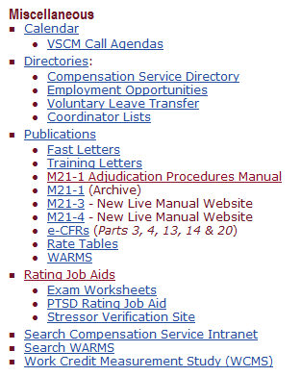
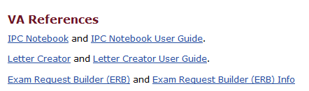
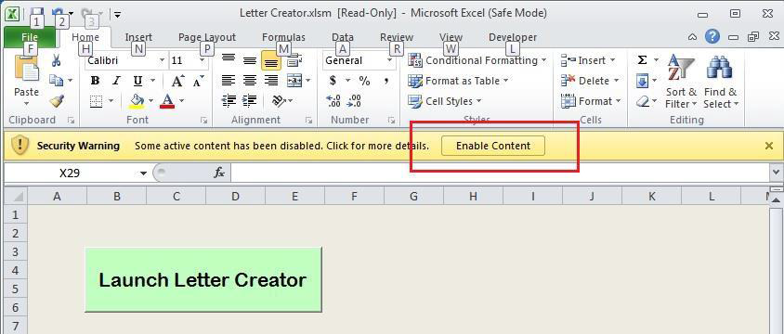
Locating Letter Creator
Open the excel document from your desktop and be sure to click the yellow banner option that says “Enable Content.”
Then click the Launch Letter Creator button.

Slide 7
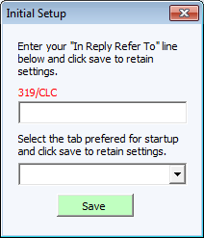
Locating Letter Creator
The first time the tool is opened, the above screen should appear. Please enter your station ID/your department code (if applicable)/your Initials.
For example, the “In Reply Refer To:” line should appear like this: 319/CLC.
The drop down menu allows for the user to set a default tab in which the tool will start each time it is opened.

Slide 8
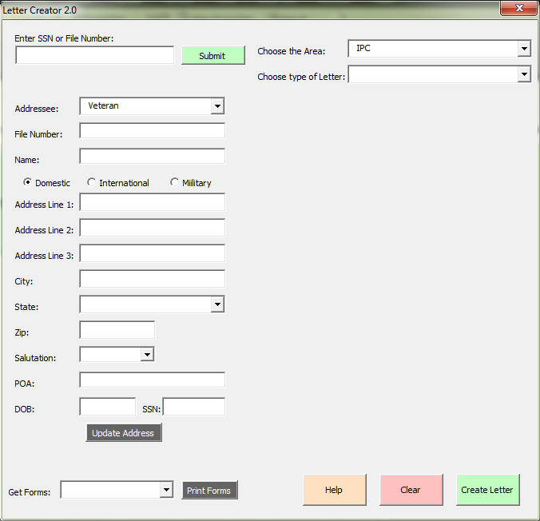
Creating a Letter
First, ensure VBMS is open to the proper Veteran.
Enter the Veteran's Social Security number or File number into the field and click the green Submit button. Letter Creator will populate the name, address, salutation, and POA (if one is of record) from VBMS.
It will also extract other points of data not seen on the screen above that is stored in the tool for use in certain letters.
-This data includes DOD and Periods of Service.

Slide 9
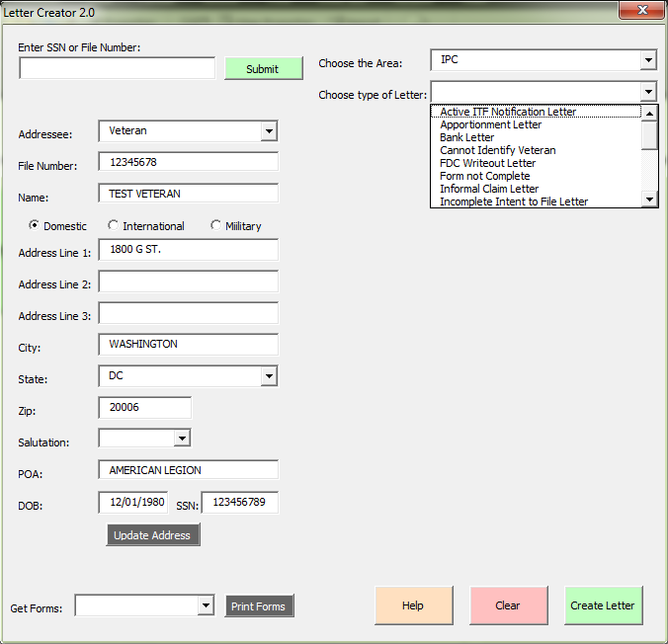
Creating a Letter
If a letter is needed where there is no Veteran record or address then the address can be manually entered into the tool.
If an address is entered manually where a Veteran record does exist, the tool can be used to update the Veteran record with the address entered into the tool.

Slide 10
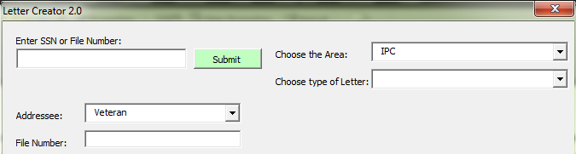
Creating a Letter
To begin, enter the Veteran’s file number in the SSN or File Number Field as shown below:

Slide 11
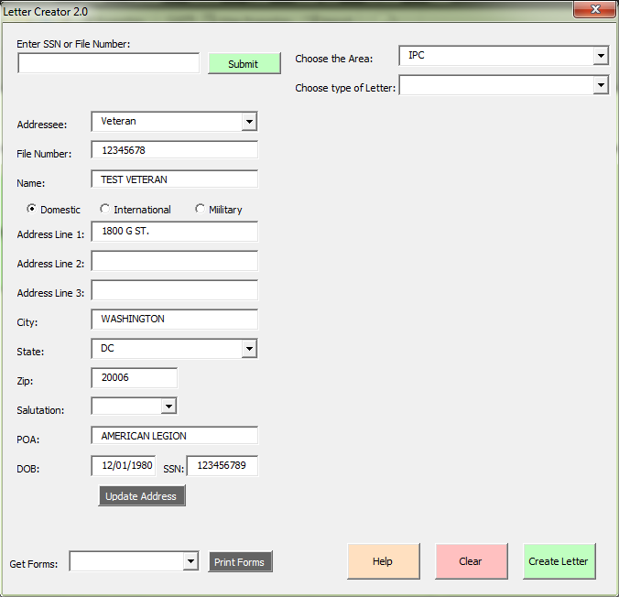
Creating a Letter
Once the “Submit” button is clicked this will pull the Veteran’s profile information from VBMS and populate it into the tool as shown below. A loading screen will appear and will go away once the tool is finished loading.

Slide 12
Creating a Letter
1
Select the appropriate drop down from “Choose the Area”.
Then, select the type of letter which needs to be sent to the Veteran/claimant.
2

Slide 13
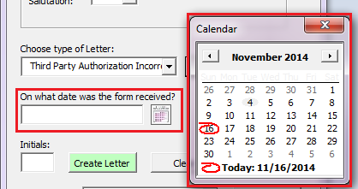
Creating a Letter
As shown below there is a field for a date. Throughout the tool there are various areas where a date needs to be entered. Where a date should be entered, there will be a little calendar next to the field. Clicking the picture of the calendar will bring up a full calendar where the date can be selected by clicking on the date.

Slide 14
Creating a Letter
When all options and entries are made, click the “Create Letter” button. This will create the letter in a word document that may not appear instantly on screen but will be running on the desktop. Find it on the taskbar and click on the letter to maximize it.

Slide 15
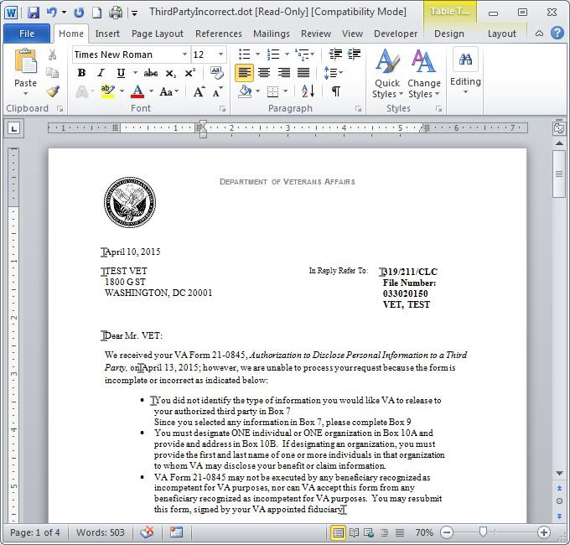
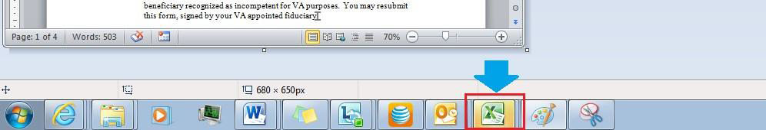
Creating a Letter
The letter should appear as shown and be complete.
Do not save the letter at this point.
Do not close the letter.
After reviewing the letter and making any necessary changes, go back to the tool in excel. It should be blinking on the taskbar in Windows.

Slide 16
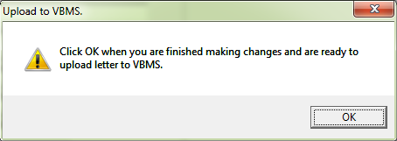
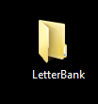
Creating a Letter
Once back in the tool, a popup message will appear that says, “Click OK when you are finished making changes and are ready to upload the letter to VBMS.” Click OK
Note: At this point the tool will save the letter as a PDF to a specific location. The tool will save the letter to your desktop in a folder called “LetterBank”. The tool will create the folder automatically if it does not already exist.

Slide 17
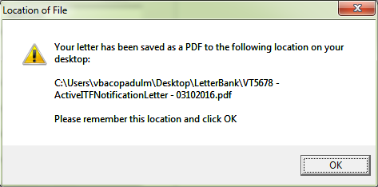
Creating a Letter
A pop up will appear that will notify you of the location to which the PDF was saved.

Slide 18
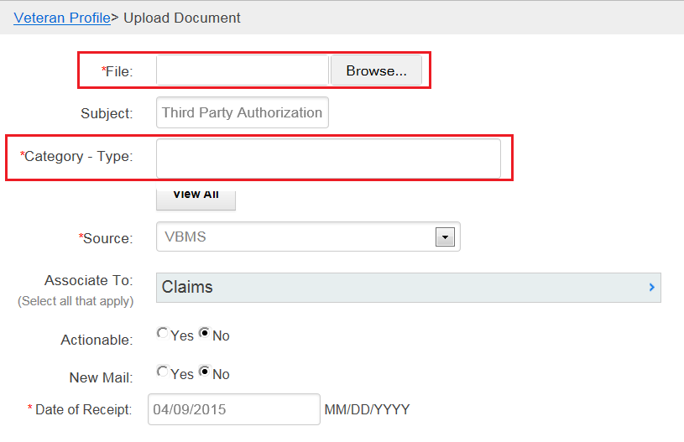
Uploading a Letter
Once the “OK” button is clicked the tool will cause VBMS to navigate to the Upload Document screen. The tool will also fill out everything on that screen except for the File Location. The file field will need to be manually completed by the user.
The Letter Creator will automatically update the “Category – Type” field to “Correspondence: Correspondence”.
The user can manually edit this field if necessary.

Slide 19
Uploading a Letter
Please watch the following demonstration video:
            Uploading a Document

Slide 20
Type of Letters
Letters available in Letter Creator IPC section.
Letter Name | Letter Name | Letter Name
Active ITF Notification Letter | Informal Claim Letter | Return Mail
Apportionment Letter | ITF Cancellation Letter | Return of Documents
Bank Letter | Outdated Form - Non-Claim Letter | Return of X-rays
Cannot Identify Veteran | POA Not of Record Letter | Special Media Return Letter
Claim Already on Appeal | Receipt of Unsolicited Evidence | Third Party Authorization Incorrect
Claims Acknowledgement Letter | Recently Employed IU Recipient Letter | Untimely Claim Withdrawal Letter
FDC Writeout Letter | Recognition of Custodian | Withdrawal of Claim Letter
Form not Complete | Request for Application Apportionment
Incomplete Application Letter | Request for Application for Compensation, Pension, or DIC
Incomplete Intent to File Letter | Request for Application for Dependency
Incomplete ITF – Claim Received Letter | Request for Application for NOD
Incomplete NOD | Request for Application Helpless Child

Slide 21
Instructor Demonstration

Slide 22
Questions?

