Slide 1
Section 202 of PL 115-48 Survivors’ and Dependents’ Educational Assistance Program (CH35) Months of Entitlement
Harry W. Colmery Veterans Educational Assistance Act

Slide 2
Lesson Objectives
At the end of this lesson, you will be able to:
Identify when a claimant is eligible for 36 months vs 45 months of entitlement
Determine if any adjustments should be made in the Benefits Delivery Network (BDN) and create (or adjust) as needed
Modify the Certificates of Eligibility (COEs) or send additional letters
Notes:
At the end of this lesson, you will be able to:
Identify when a claimant is eligible for 36 months vs 45 months of entitlement
Determine if any adjustments should be made in the Benefits Delivery Network (BDN) and create (or adjust) as needed
Modify the Certificates of Eligibility (COEs) or send additional letters

Slide 3
Legislation Verbiage
SEC. 202. DURATION OF EDUCATIONAL ASSISTANCE UNDER SURVIVORS' AND DEPENDENTS' EDUCATIONAL ASSISTANCE PROGRAM.
Section 3511(a)(1) is amended-
(1) by striking ``chapter for'' and all that follows through the period and inserting ``chapter--''; and
(2) by adding at the end the following new subparagraphs:
``(A) in the case of a person who first enrolls in a program of education using such entitlement before August 1, 2018, for an aggregate period not in excess of 45 months (or to the equivalent thereof in part-time training); or
``(B) in the case of a person who first enrolls in a program of education using such entitlement on or after August 1, 2018, for an aggregate period not in excess of 36 months (or to the equivalent thereof in part-time training).''.
Notes:
The Legislation as “Section 202 of the Colmery Act, changes the current amount of original entitlement received under CH35 from 45 months to 36 months for those 1st enrolling after August 1, 2018.”

Slide 4
Summary of Legislation-Entitlement
Original entitlement under CH35 will be 36 months for those who first enter a program on or after August 1, 2018.
Original entitlement under CH35 will be 45 months for those who began a program prior to August 1, 2018.
When entitlement exhausts, no extensions are granted.
Used entitlement before 8/1
No used entitlement before 8/1
Notes:
If the claimant has used entitlement before 8/1/18, then the claimant’s entitlement remains unchanged. If they have not used even 1 day, the claimant is now eligible for 36 months.

Slide 5
Combined Entitlement “81/48 Month Rules”
Two or more benefit programs used [excluding Chapter 35 and Chapter 31] may not exceed 48 months.
The aggregate of Chapter 35 used with other programs not including Chapter 31 may not exceed 81 months as long as the previous condition is met.
Chapter 31 combined with any benefit program [includes Chapter 35] is limited to 48 months, except that Chapter 31 may provide additional months if determined necessary to complete a rehabilitation program.
Notes:
The 81- Month Rule allows the CH 35 claimant to use an aggregate of entitlement in combination with other benefits (excluding Chapter 31) up to 81 months.

Slide 6
81 Month Rule
The 81 Month Rule Job Aid is used to calculate entitlement to enter into BDN.
Does not apply to claimants who have exhausted 48 months of entitlement prior to October 1, 2013.
- If the BDN No Pay Date (NPD) is prior to 10-2-13, or the Long Term Solution (LTS) Exhaust Date is prior to 10-1-13.
Does NOT apply to Vocational Employment and Rehabilitation (CH31).
Do not enter any entitlement transferred in through Transfer of Eligibility (TOE)
Notes:
STRESS the items that do NOT apply to the 81 month rule.

Slide 7
Restoration of Entitlement
Chapter 35 recipients may be eligible for entitlement restoration for training interrupted as a result of being ordered to active duty.
Active duty service under 10 U.S. C. 688, 12301(a), 12301(d), 12301(g), 12302, or 12304; or
Involuntary call to active duty under Section 502 (f) of Title 32, or
A new duty location or assignment or to perform an increased amount of work;
AND
Did not receive credit or lost training time for any portion of the period of enrollment in the course or courses
Entitlement restored under this law is not counted against the individual's maximum entitlement.
Notes:
Those called to active duty under the Titles and sections listed, will have their entitlement restored. Restoration does not amend the amount of original entitlement for those first enrolling after 8/1/18. When entitlement is restored, it does not count against your max entitlement. This means if you are awarded 36 months, used 4 before being called to Active Duty during a term, you will receive those 4 back. Therefore, you originally had 32 months left, and now you are back to the original 36.
and could possible go beyond the original entitlement.

Slide 8
Five Months Free Entitlement
Dependents will receive their first 5 months of deficiency, remedial, refresher, or high school training for free. They will be paid, and no entitlement will be deducted for this training.
Notes:
5 months free aspect of CH35 is unchanged and unaffected.

Slide 9
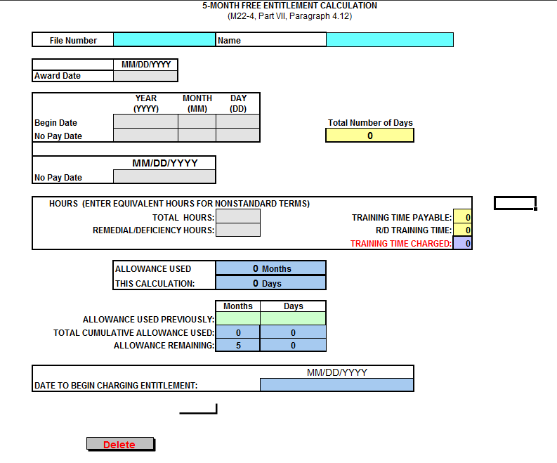
Five Months Free Entitlement Worksheet
The EXCEL spreadsheet must be used to calculate the entitlement charges for the use of the 5 free months of entitlement in the following:
Benefits Delivery Network (BDN)
The Imaging Management System (TIMS)
Personal Computer Generated Letters (PCGL)
Notes:
When entering hours, please be sure to enter "equivalent hours" with non-standard terms.

Slide 10
Entitlement Allowance Examples
Eligible for 45 months of entitlement under CH35, the claimant would have had to have used entitlement prior to August 1, 2018. Examples include the following:
Attended class in 2017
Current term began July 31, 2018 and the claimant is attending
Consumed at least one day of entitlement prior to August 1, 2018
Eligible for 36 months of entitlement under CH35, the claimant has not used any entitlement prior to August 1, 2018. Examples include the following:
Submitted an application for CH35 on or after August 1, 2018
Has a COE but has not registered for classes as of August 1, 2018
Current term spans August 1, 2018 but the claimant has not applied for benefits as of August 1, 2018.
Notes:
anyone who has never used CH35 benefits prior to August 1, 2018, will be eligible for up to 36 months of entitlement. If the student has used at least 1 day prior to August 1st, they will remain eligible for up to 45 months. They must have applied, been approved and the term began before 8/1. The key is having been paid under Chapter 35, consuming entitlement.

Slide 11
Knowledge Check
Does it matter if the claimant has used at least 1 day prior to August 1, 2018?
Yes, if they have used one day, they are entitled to 45 months of entitlement.
Will the claimant be eligible for 45 months if they’ve never used CH 35 before August 1, 2018?
No, they will receive 36 months of entitlement.
Notes:
used entitlement is the key along with August 1st. If you have used at least 1 day prior to 8/1, you retain 45 months. ALL else, receive 36 months.

Slide 12
Modifying BDN
BDN
Notes:
Claimants first using CH35 after August 1, 2018, the Benefits Delivery Network (BDN) will have to be adjusted via the 311 screen to reflect 36 months original entitlement. The following slides will explain how to make the adjustment.

Slide 13
Entitlement for Original Claims
All original CH35 claims show 45 months entitlement initially with “Prior VA Trng” blank
311 CHAPTER 35 ELIGIBILITY 03-30-10
FILE NUMBER END PRODUCT 240 NAME
DATE OF DEATH PERM AND TOT DISABILITY DATE 12-12-95
MIA/POW/FORCIBLY DETAINED DATE DIED ACTIVE DUTY
PRIOR VA TRNG - CHAP 35 MOS DAYS BIRTH DATE OF CLAIMANT 02-10-94
- OTHER EDUCATION LEVEL 12
VETERANS SERVICE PERIOD PTE SEX F BENEFICIARY SSN
CHILD DATA
FIRST RELEASE FROM ACTIVE DUTY
TIME LOST BEYOND CONTROL - BEGIN DATE
- END DATE
SPOUSE DATA
PERIOD OF DISABILITY - MOS DAYS
DATE ELECTED BY CLAIMANT
DELIMITING DATE 02-10-20 ALTERNATE 02-10-20
ORIGINAL ENTITLEMENT 45.00 NEXT SCREEN
The 311 screen establishes Chapter 35 eligibility
Notes:
When creating a CH35 record, the original entitlement will be 45 months. After 8/1/18, anyone who has never used entitlement under CH35 will have to be adjusted to 36 months.

Slide 14
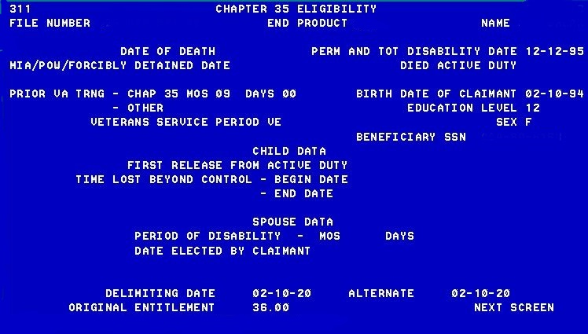
Processing Entitlement Adjustments for Original Claims No prior or Less than 12 months
0 < 45 months of previous entitlement used under any combination of benefits other than CH31—
Enter 09-00 next to “Chap 35 Mos” under “Prior VA Trng” to adjust Original Entitlement to 36-00.
Notes:
For claimants who have never used any education benefit or used less than 45 months of a combination of benefits other than CH31, enter 09 months 00 days next to “Chap 35” under Prior VA Training. This will reduce the original entitlement to 36 months.

Slide 15
Processing Entitlement Adjustments for Original Claims with Less than 12 months of Chapter 31
0 < 12months of previous entitlement used under CH31—
Enter 09-00 next to “Chap 35 Mos” under “Prior VA Trng” to adjust Original Entitlement to 36-00.
Notes:
If the claimant has used less than 12 months under CH31, enter the 09-00 as described in the previous slide. This will reduce the orginal entitlement to 36 months and properly calculate the 48 month rule.

Slide 16
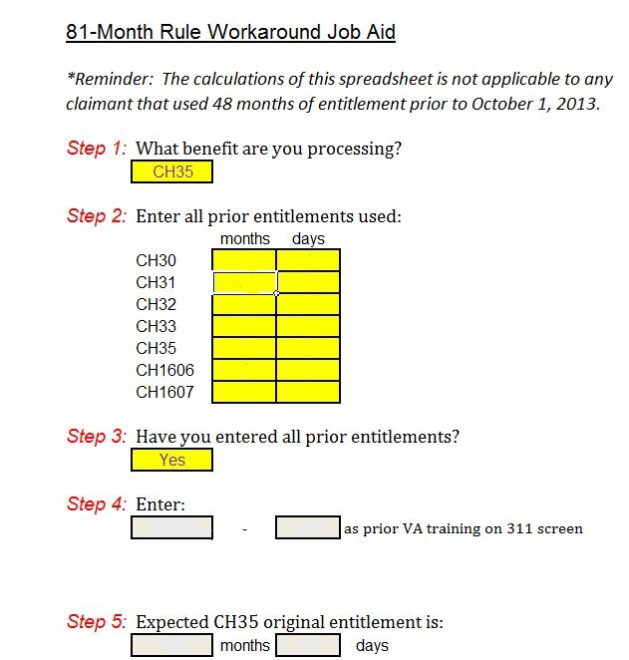
81- Month Rule Workaround Job Aid
The 81-Month Rule Job Aid should still be used to assist with calculations of CH35 entitlement.
When “Expected CH35 original entitlement is” greater than 36 months, adjust the 311 screen entries appropriately to restrict original entitlement to 36 months for those first enrolled August 1, 2018 or later.
Notes:
The 81-Month Rule Job Aid should still be used with calculations of CH35 entitlement. When Step 5 is greater than 36 months, adjustment of the 311 screen is needed to restrict the orginal entitlement to 36 months for those first enrolled August 1, 2018 or later.

Slide 17
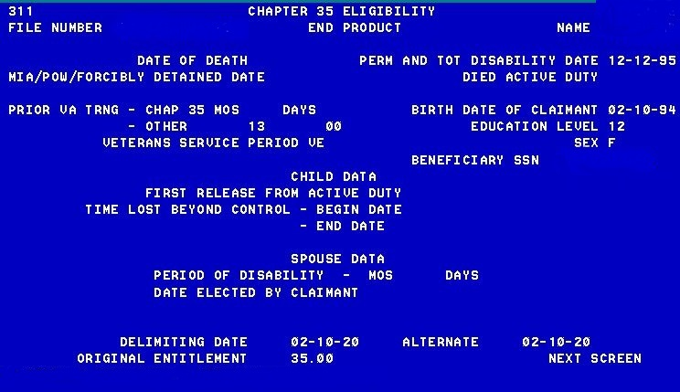
Processing Entitlement Adjustments for Original Claims with More than 45 months
>45 months of previous entitlement used under any combination of benefits other than CH31—
Use the 81 month Job Aid to calculate the amount of entitlement to enter next to “Other” under “Prior VA Trng”. Do NOT enter 09-00.
Notes:
For claimants who have used more than 45 months of entitlement under any combinations of benefits (excluding Ch31),use the 81 month Job Aid to calculate the amount used next to “Other” under Prior VA Training. Do NOT enter 09-00 next to CH35.

Slide 18
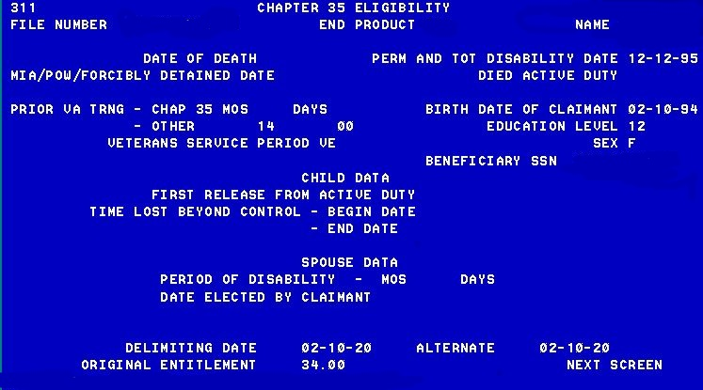
Processing Entitlement Adjustments for Original Claims with More than 12 months of Chapter 31
> 12 months of previous entitlement used under CH31—
Enter the entitlement used next to “Other” under “Prior VA Trng”. Do NOT enter 09-00.
Notes:
For claimants who have used more than 12 months of Ch31, enter the total amount used next to “Other” under Prior VA Training. This will properly calculate the 48 month rule and provide the correct original entitlement for CH35.

Slide 19
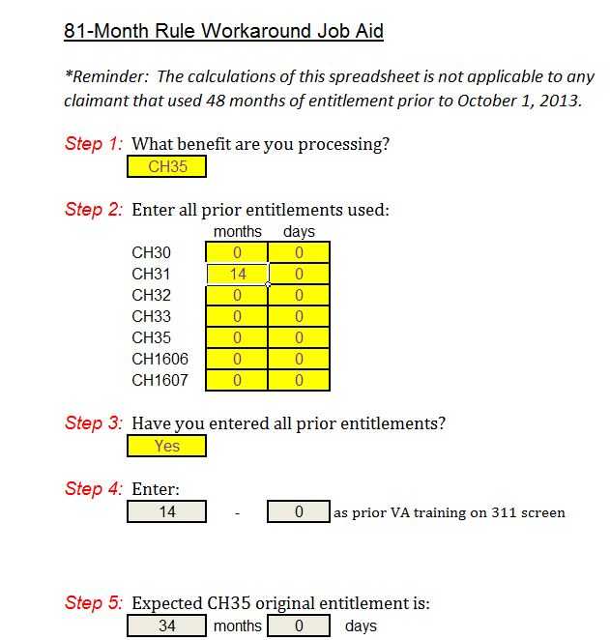
Job Aid Examples
Notes:
The example on the left shows entitlement to enter for a claimant who has used a total of 46 months prior to using CH35. 13 months should be entered next to “Other” prior VA Trng. The example on the right shows a claimantt who has used 14 months of CH31 prior to using CH35. 14 months should be entered next to “Other” prior VA trng.

Slide 20
Chapter 35 COEs only
Under the Certificate of Eligibility paragraph replace the sentence below:
This certifies that you are entitled to benefits for an approved program of education or training under the Dependents Educational Assistance Program (DEA). You have 45 months and 0 days of full time benefits.
With the following:
You will have 45 months and 0 days of full time benefits if you begin using your entitlement (attending a training program) prior to August 1, 2018; you will have 36 months of full time benefits if you begin using your entitlement (attending a training program) on or after August 1, 2018.
NOTE: Ensure original entitlement is adjusted to 36 months by editing the 311 screen prior to entering enrollments when training commences on or after August 1, 2018.
Notes:
For COEs created outside BDN like those seeking election development, replace the sentence – “read the slide”.

Slide 21
Chapter 35 Award Letter- (COE previously issued)
When processing a VA Form 1999 (00 award line – first enrollment) for a Chapter 35 claimant who previously received a COE and was advised they would have 45 months of entitlement:
If the enrollment term begins before August 1, 2018, there is no additional letter or extra steps to be taken in BDN
If the enrollment term begins on or after August 1, 2018, take the following steps:
Allow the BDN letter to go out. Also send the letter attached to the March 5, 2018, Policy Advisory, which explains why they are receiving fewer months of entitlement than initially told in their COE.
Notes:
When a COE has previously been sent to the claimant stating they have 45 months of entitlement but their term did not begin before August 1, 2018, send the letter attached to the March 5, 2018, Policy Advisory.

Slide 22
Chapter 35 Award Letter (COE and 1999 at same time)
When processing a VA Form 1999 (00 award line – first enrollment) for a Chapter 35 claimant where the application and enrollment cert are being processed at the same time.
If the enrollment term begins before August 1, 2018, process normally. There are no additional letters or BDN steps.
If the enrollment term begins on or after August 1, 2018, take the following steps:
Allow the BDN letter to go out. There is no need for an additional letter, as these claimants have never previously been told how much entitlement they were to receive.
Notes:
If a COE and a 1999 are being processed at the same, there is nothing to do. Let BDN process and no need to send the advisory attachment since they were never notified of 45 months.

Slide 23
Lesson References
38 USC 3511: Duration of educational assistance under Chapter 35
Harry W Colmery Veterans Educational Assistance Act of 2017
H.R. 1627- Public Law 112-154 Section 401
38 CFR 21.3044 Entitlement
M22-4 Part 7- Chapter 35 BDN Processing
311 Chapter 35 Eligibility Screen
38 USC 3695
Procedural Advisory : Implementing the 81 Month Rule for Survivors’ and Dependents’ Educational Assistance Program Beneficiaries
81-Month Rule Job Aid

Slide 24
Summary
Today you:
Identified when a claimant is eligible for 36 months vs 45 months of entitlement
Determined if any adjustments should be made in the Benefits Delivery Network (BDN) and create (or adjust) as needed
Modified the Certificates of Eligibility (COEs) or send additional letters

Slide 25
Questions?

Slide 26
TMS Assessment and Survey
The assessment and survey have been assigned to you in TMS.
The assessment is comprised of scenario-based questions.
The questions are based on the information you learned today.
You should be able to complete the assessment and survey within 30 minutes.
Be sure to complete both the assessment and the survey in TMS to receive credit for this training.

