Slide 1
VR&E Operational Excellence Training
Click here to view the recording
Recording Password: VREoet2020!
Supply Chain Management
Vocational Rehabilitation and Employment

Slide 2
Bottom Line Up Front
Compared to manufacturing industries, which have been the primary focus of Supply Chain Management, service industries are unique, with their own set of defining factors, characteristics and measurements
With services it is important to focus on the “service performance,” i.e. providing to the customer what they believe they contracted the service firm to deliver
Thus services are more of a transfer of capacity than a transfer of goods
Notes:
Smith, John D., "Towards a Theory of Services Supply Chain Management" (2013). ETD Archive. 272.
https://engagedscholarship.csuohio.edu/etdarchive/272

Slide 3
Training Objectives for this Session
Describe the industry perspective of Supply Chain and related management practices
Reinforce understanding of supply chain practices via a case study exercise
Describe how service chains are unique in terms of value chains, partnerships, performance, and capacity management
Notes:
Smith, John D., "Towards a Theory of Services Supply Chain Management" (2013). ETD Archive. 272.
https://engagedscholarship.csuohio.edu/etdarchive/272
Slone, Reuben E, Dittmann, J. Paul, Mentzer, John T.; “The New Supply Chain Agenda,” Harvard Business Press, Boston, MA, 2010.

Slide 4
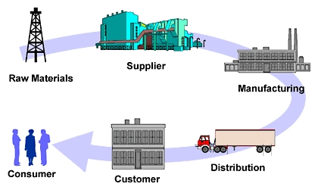
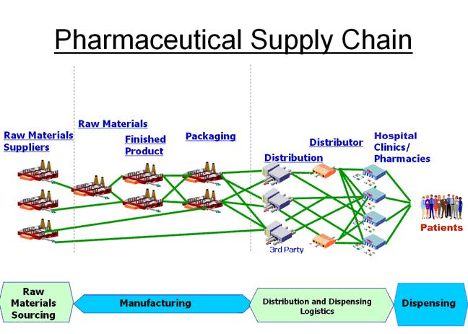
What is Supply Chain?
Notes:
Supply Chain Management (SCM) encompasses the planning and management of all activities involved in sourcing and procurement, conversion, and all logistics management activities.
Importantly it also include coordination and collaboration with channel partners, which can be suppliers, intermediaries, third party service providers, and customers.
In essence, Supply Chain Management integrates supply and demand within and across companies.

Slide 5
What is Supply Chain Management?
Supply Chain Management (SCM) encompasses the planning and management of all activities involved in sourcing and procurement, conversion, and all logistics management activities.
Importantly it also includes coordination and collaboration with channel partners, which can be suppliers, intermediaries, third party service providers, and customers.
In essence, Supply Chain Management integrates supply and demand within and across companies.
from the Council of Supply Chain Management Professionals

Slide 6
Supply Chain Management Process
Information Flow
Tier 2 Supplier
Tier 1 Supplier
Manufacturer
Consumer/End User
Logistics
Customer
Purchasing
Marketing
PRODUCT FLOW
Production
Finance
R&D
CUSTOMER RELATIONSHIP MANAGEMENT
SUPPLIER RELATIONSHIP MANAGEMENT
Supply Chain Management Process
CUSTOMER SERVICE MANAGEMENT
DEMAND MANAGEMENT
ORDER FULFILLMENT
MANUFACTURING FLOW MANAGEMENT
PRODUCT DEVELOPMENT AND COMMERCIALIZATION
RETURNS MANAGEMENT
© Supply Chain Management Institute. Source: Supply Chain Management: Processes, Partnerships, Performance, p. 3.

Slide 7
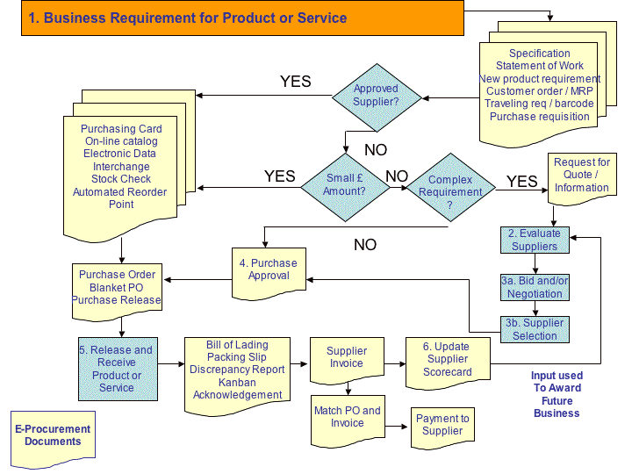
Supplier Management Starts with Business Requirements
Handfield, Robert, “The Procurement Process – Creating a Sourcing Plan: Procurement : A Tutorial” North Carolina State University Supply Chain Resource Cooperative, 26 Jan 2011.

Slide 8
Spectrum of “Demand Management”
Polaroid
Market
Forecast
from Mktg.
Replenish a buffer
close to cust. orders
Purchase by
a dealer
Forecast from
our customer
Order from a
distributor
Purchase by
an end user
Draft Strategy

Slide 9
Integrating Management Processes
Senior Leadership
Finance
Finance Goal
Demand sales and marketing, downstream channel partners
Strategic direction
Finance Plan
Supply production, logistics, etc., and upstream suppliers
Demand-supply integration (S&OP)
Demand Forecast
Capacity forecast
Demand Plan
Operational Plan
Supply chain is a horizontal, cross-functional process, commonly impeded by vertical, functional barriers
Industry leading practices to address these cross-functional disconnects include Sales & Operations Planning (S&OP) forums in which:
  Decision-makers must attend, with visible encouragement by the senior executive
  Senior operating, sales, marketing and finance executives must participate
  The process maintains focus on strategic issues, via adherence to disciplined agendas
Notes:
Mark Moon, PhD, University of Tennessee, January 2008.
http://www.forecastpro.com/Trends/MarkMoonMay2007.html
https://news.utk.edu/2018/04/12/study-identifies-seven-key-practices-to-mastering-demand-and-supply-integration/
5 more basic practices that must be present in an organization before companies can leverage DSI at a benchmark level—all disciplines working towards a single goal instead of simply optimizing their function; basing demand plans on unconstrained demand and supply plans on demonstrated capacity; leadership owning the DSI push; DSI influencing business decisions; and the DSI process including results assessment and plan development.
Sloan, Reuben E.; Dittmann, J. Paul; Mentzer, John T.; “The New Supply Chain Agenda: The 5 Steps that Drive Real Value," Harvard Business Press, 2010.

Slide 10



Case Study
Stage Stores Inc.
Notes:
http://corporate.stage.com/

Slide 11
Case Study Exercise
What would you do as the CEO at SSI given the following scenario?
You have just been informed that a virus is spreading across the globe and may create a global pandemic.
How would you use a SCM approach to plan for its eventual impact on your company.
  Think about the what you have learned during this presentation
  i.e., Value Streams, Integrating Management Processes, Demand Management, Supplier Management
Please enter which processes or functions you might focus on first and why?
Notes:
Sloan, Reuben E.; Dittmann, J. Paul; Mentzer, John T.; “The New Supply Chain Agenda: The 5 Steps that Drive Real Value," Harvard Business Press, 2010.

Slide 12
Service Chain Management Process
Service Chains are Unique
Information Flow
Service Providers
National Partners
Regional Partners
Service Broker
Service Consumers
Talent
Risk Mgmt.
Performance
CAPABILITY FLOW
Strategy
Forecasting
Service Catalog
TRUST
CAPACITY MANAGEMENT
INFORMATION SHARING
SUPPLY BASE REDUCTION
Service Chain Management Process
EFFECTIVE COMMUNICATION
SUPPLIER INVOLVEMENT
LONG-TERM RELATIONSHIP
SUPPLIER MANAGEMENT
CUSTOMER INVOLVEMENT
© Supply Chain Management Institute. Source: Supply Chain Management: Processes, Partnerships, Performance, p. 3.

Slide 13

Service vs. Firm Performance
“Service Performance” previously utilized SERVQUAL measurements
  However, effective application in service operations management requires going beyond these perceptive measures
“Service Performance” now includes:
  Service performance scale items
  Service comprehensiveness
  Service efficiency
  Customer responsiveness
  Tangibles
“Firm Performance” of the buying firm is operationalized by items indicating the extent of changes in:
  Return on investment (ROI)
  Growth in market share
  Growth in sales, and
  Profit margin on sales
For not-for-profit companies:
  Talent
  Budget
  Schedule
  Compliance
Notes:
Research on firm (or organizational) performance has typically applied either financial or non-financial criteria (Koh et al., 2007). When possible, it is generally preferred to utilize financial criteria to analyze an organization’s overall performance. However, researchers have noted the challenge of using only financial indicators due to the impact of confounding factors.
Parasuraman et al., 1985, 1988; 1.b. Voss and Johnston, 1995; Heskett et al., 1997; Glynn et al., 2003; Smith, 2013
a. Vickery et al., 2003; Glynn and Ennis, 2003; Min and Mentzer, 2004; Byrd and Davidson, 2003; Chen and 106 Paulraj, 2004; Li et al., 2006; b. Glynn, Ennis, 2003; Min and Mentzer, 2004; Byrd, Davidson, 2003; Li et al., 2006; Fawcett et al., 2007; Wisner, 2007; c. Glynn, Ennis, 2003; Min and Mentzer, 2004; Li et al., 2006; Fawcett et al., 2007; d. Vickery et al., 2003; Min and Mentzer, 2004; Chen and Paulraj, 2004; Li et al., 2006.

Slide 14

Capacity Management
Transfer of Capacity
Capacity Management
Refers to the planning/oversight of an organization’s capacity resources in order to economically meet its demand profile
Comes from the simultaneity of service production and consumption and it is the principle method by which service providers meet service demand
Unlike SCM in the manufacturing domain, which is focused on inventory, Service Supply Chain is focused on managing capacity
SCM Leading Practices
Trust
Effective communication
Information sharing
Supply base reduction
Capacity management
Supplier involvement
Long-term relationship
Supplier management
Customer involvement
Notes:
Smith, John D., "Towards a Theory of Services Supply Chain Management" (2013). ETD Archive. 272, p.79.

Slide 15

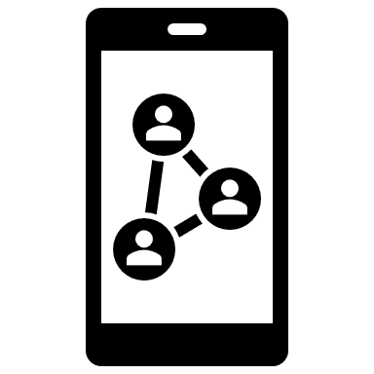

Effective Communication
“Information technology (IT) is not just a means to automate existing processes, but more importantly, an enabler of organizational change that ultimately leads to productivity improvements.”
IT enables effective communication:
Via a wide range of applications within service supply chain
Including everything:
  from personal productivity tools (spreadsheets, word processing and simple customer databases),
  to more sophisticated decision support systems,
  and everything in between
IT Elements:
IT sophistication, skills, capabilities
Electronic communication links (i.e., connectivity, integration)
Information processing effectiveness
Notes:
IT includes everything: Fletcher 1991
Dedrick et al., (2003) showed that IT does have a positive effect on productivity. They reviewed more than 50 articles on computers and productivity and found evidence to effectively refute the productivity paradox.
Smith, John D., "Towards a Theory of Services Supply Chain Management" (2013). ETD Archive. 272.
“Effectively managing service supply chains enables firms to develop higher-order information technology capabilities in service networks.

Slide 16
Building/Sustaining Successful Partnerships
Partnership Effectiveness
Takes commitment and a long time to develop strong relationship; takes dedicated effort to manage it
Must have a clear idea of what you want to accomplish
Outsourcing firms provide expertise and effective systems
Outsourcing firms are excellent in only one or two areas
    e.g. transportation OR warehousing OR customs brokerage
Few firms have real global presence and capability
A few companies outsource all functions worldwide; most use outsourcing in selected geographies or functions
Shared success goals and rewards work well

Slide 17
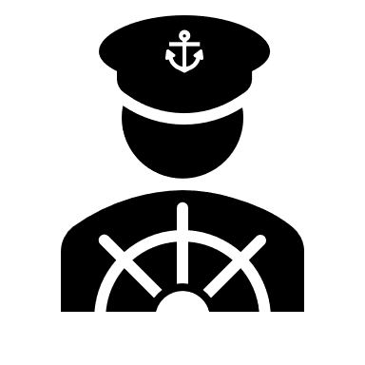




Critical Success Factors
Excellence flows from a supply chain strategy built on 5 leading practices of industry:
  Pick the right leaders and develop supply chain talent
  Keep up with supply chain technologies and trends
  Eliminate crippling cross-functional disconnects
  Collaborate with suppliers and customers
  Implement and sustain a disciplined process of project and change management
Notes:
Sloan, Reuben E.; Dittmann, J. Paul; Mentzer, John T.; “The New Supply Chain Agenda: The 5 Steps that Drive Real Value," Harvard Business Press, 2010.

