Slide 1
Quality Management System (QMS)
Briefed by: 214C/QMS Team
Name: George Boyd
Date: June 5, 2018
Notes:
Giving the class the “WIIFM” (What’s in it for me) with using QMS.
Field request for QMS to assist with EC notification.

Slide 2
Objectives
Notification of Error Correction
Layout and Data on “Error Correction Detail” page
Function of action commands on Error Correction Detail page
Access to Salesforce -> QMS -> Error Correction
Layout and Data on “My Error Correction Records”
Notes:
Instructional Hint: While providing objectives, explain how each will be addressed, presented and their benefit to processing Error Corrections.

Slide 3
References
QMS User Guide
M21-4, CH 6
VSR and RVSR Standards
Notes:
Explain to class how the references relate to the lesson on Error Corrections

Slide 4
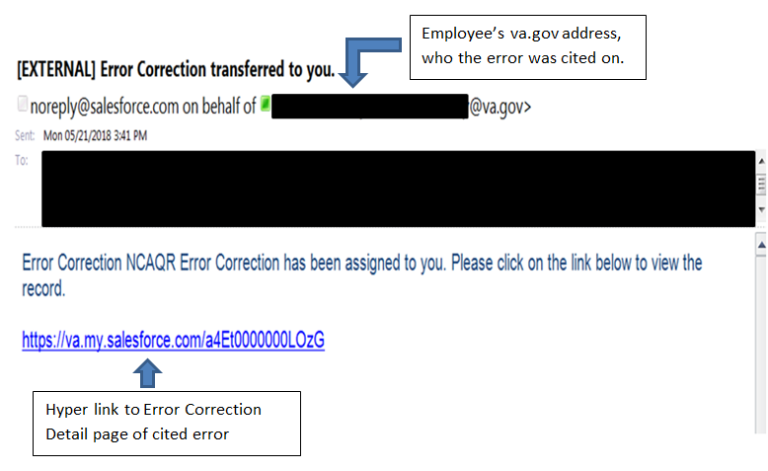
E-mail for Notification Letter
Notes:
Initial e-mail displayed in Employee’s outlook.
Stress the understanding each error on a review will receive its own e-mail notification. If two errors called for one review, there will be two notification e-mails.
Notification is forwarded to Floor employee and Floor employee’s Coach.

Slide 5
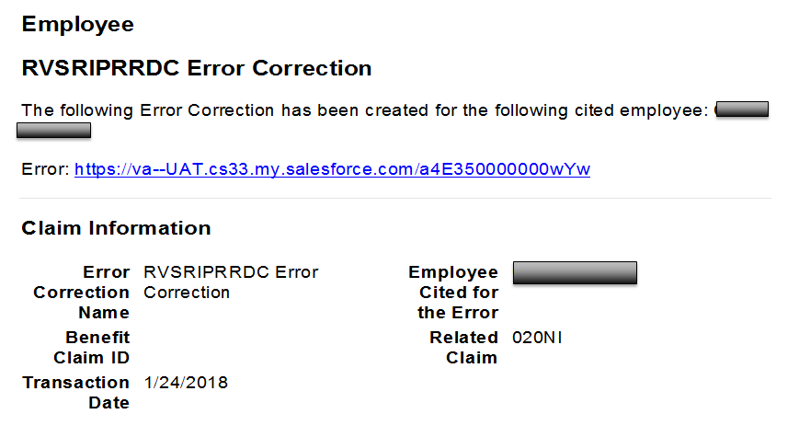
Notification Letter
Notes:
An individual Error Notification is forwarded to Floor employee and Floor employee’s Coach.
Content of e-mail is a glimpse of the details related to an individual cited error from a Quality Review. Employee should rely on the Error
Correction Detail page for full details of cited error.

Slide 6
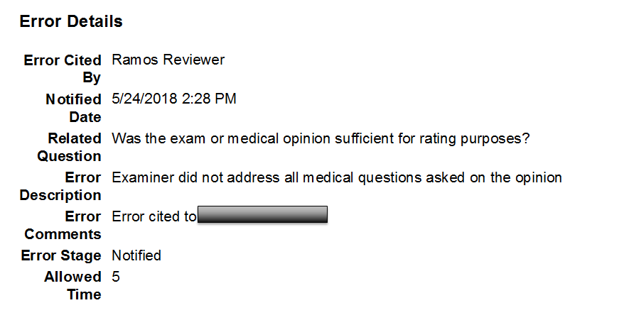
Notification Letter (cont.)
Notes:
Allowed Time – Displays the business days, after the initial notification date, to make a decision on the Error Correction, whether to Agree or you Disagree and want to request to a reconsideration on the cited error. Follow the employee's local policy on submitting a reconsideration (Rebuttal)

Slide 7
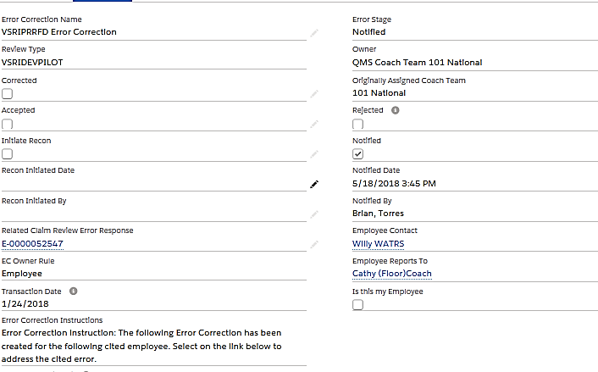
“Error Correction Detail” page
Notes:
Inform class this is a universal site for all Quality Review components. Ex VSC, STAR, PMC, etc.
Inform class on the primary action commands they will be utilizing. Ex, Accept Error Correction and Initiate Recon.
Drop down arrow provides access to the QRT Coach to manage the “Recon Decision”.

Slide 8
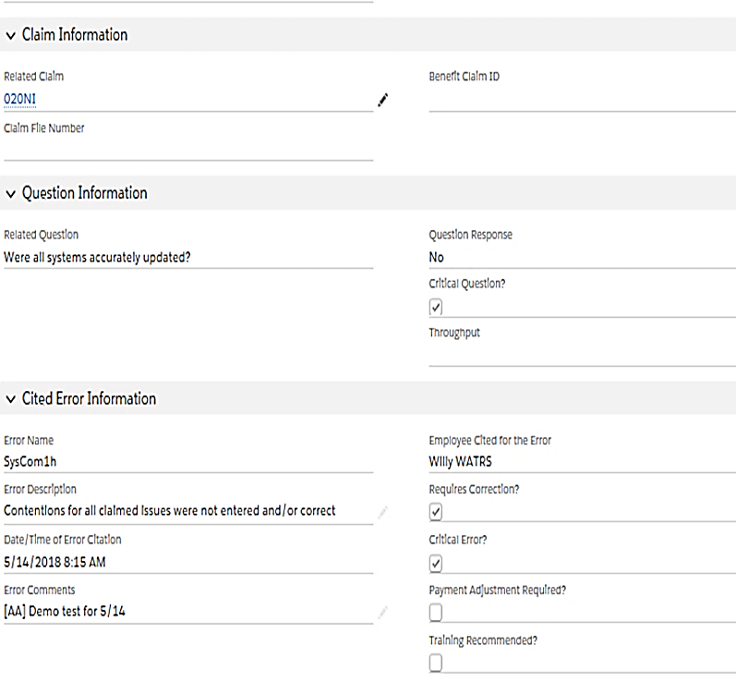
“Error Correction Detail” page
Notes:
Combine the Question and Cited Error Information
Error Name, Related Question, Error Description, Error Comments
REMINDER: SCREEN CONTENT IS FOR ALL QUALITY REVIEW COMPONENTS

Slide 9
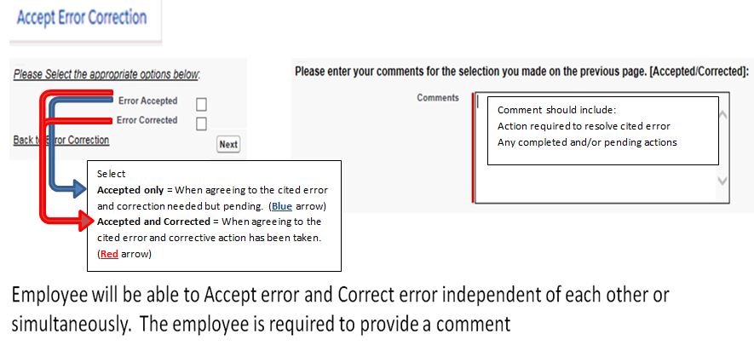
Accept Error Correction
Notes:
Employee can Accept, Correct, or Both
Comments should include the action required and completed, as well as adding the employee’s action plan and when they corrected the error.
Note: If an EP930 is necessary to correct the error cited, the employees Coach will ensure that the EP is CEST as necessary.
Once the comment is included, the “Next” button is clicked.

Slide 10
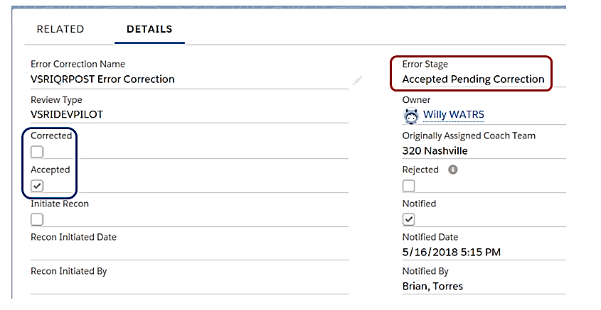
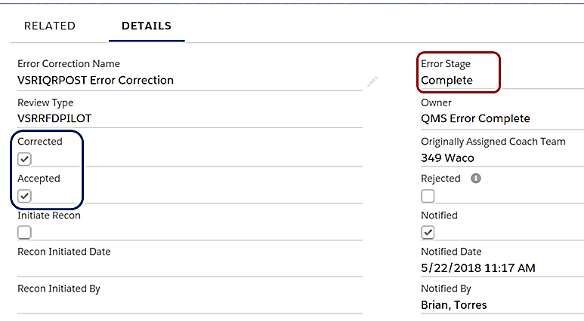
Accept/Correct and Completed (Screen shots)
Notes:
Employee can Accept only or Both
Accept only = Error Stage “Accept Pending Correction” Remains in the employee’s error correction records “View” list. and the employee is responsible for managing and
monitoring their Error Corrections.
Accept and Correct = Error Stage “Complete” Error is resolved and removed from the employee's “My Error Correction Records” list.

Slide 11
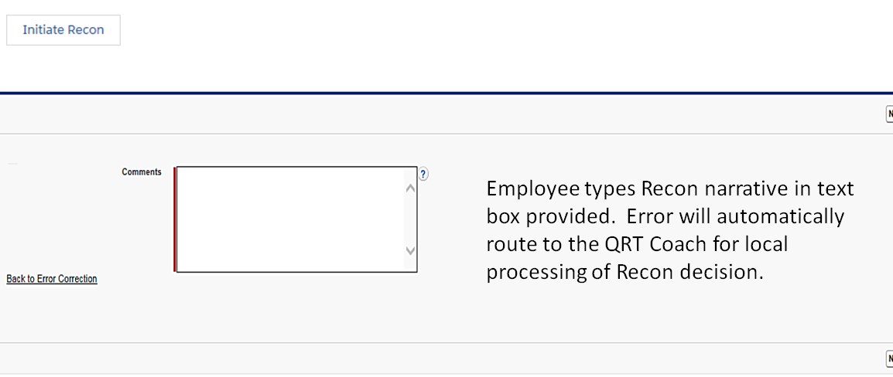
“Initiate Recon” (Reconsideration/Rebuttal)
Notes:
Comment box – Recommendation to include:
That you disagree with cited error
Why you disagree (brief explanation)
Reference to support your decision

Slide 12
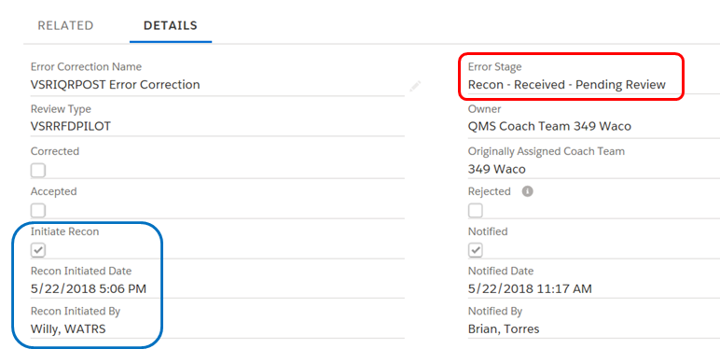
“Initiate Recon” (Reconsideration)
Notes:
The Error Correction has not been resolved, therefore the employee is still responsible for managing and monitoring the EC.

Slide 13
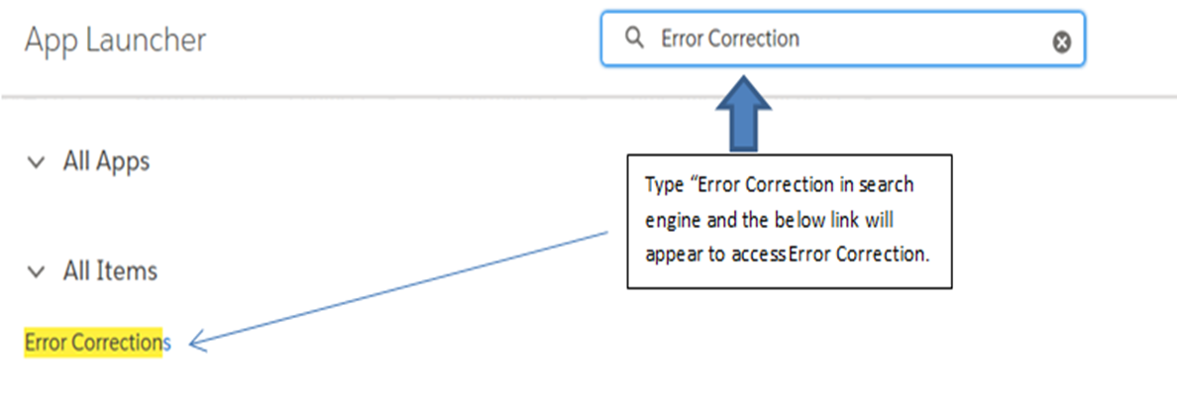
Access to SalesForce -> QMS
First screen displayed -> Open App Launcher

Slide 14
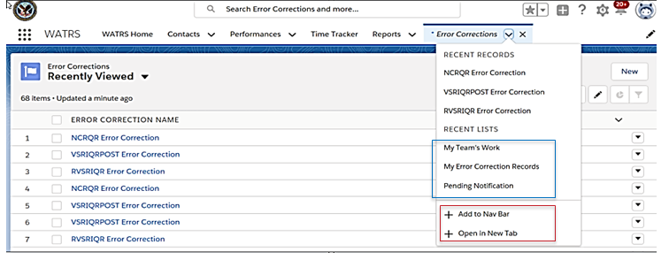
“Error Correction” Tab

Slide 15
Opening “My Error Correction Records”

Slide 16
Recap
Access and Process error resolution
Notification of Error Correction
Layout and Data on “Error Correction Detail” page
Function of action commands on Error Correction Detail page
Maintain and Monitor Pending Errors
Access to Salesforce -> QMS -> Error Correction
Layout and Data on “My Error Correction Records”

Slide 17
Things to Remember
Once Notification e-mail has been received will start a record of the time and date found on the “Error Correction Detail” page.
When providing comments in “Comment” boxes include all decision details. For instance: Why agree or disagree with the error, What action has been taken or pending, and a Reference to support decision.
QRT Coach will automatically receive the Error Correction once an “Initiate Recon” has been submitted.
QRT Coach is the only one who has access to the “Recon Decision” action command.
The list of Error Corrections under “View” is based on the position.
If an EP930 is necessary to correct the error cited the employees Coach will ensure that the EP is CEST as necessary.
Notes:
This is an opportunity to check and evaluate understanding of QMS and improving retention. Have class explain how they understood QMS Error correction functions.

Slide 18
Questions/Discussions
Email questions to:
VAVBAWAS/CO/QRT
Notes:
IMPORTANT
When emailing to QRT mailbox, it must be from QRT Coach Team or station’s management. If not, it will be returned with no action until your Coach or
station management has forwarded the message/request.

