Slide 1
Appeals Modernization 101
Compensation Service
May 2018
Veterans Benefits Administration

Slide 2
Overview
This training is designed for all employees involved with processing claims. It provides an overview of the new Appeals Modernization Act and the test program known as the Rapid Appeals Modernization Program (RAMP).
2

Slide 3
Objectives
At the end of this lesson, you will be able to:
Identify changes between the current and future appeals process.
Identify key points in the Appeals Modernization Act (PL No. 115-55, Veterans Appeals Improvement and Modernization Act of 2017).
Recall the three lanes associated with the Appeals Modernization Act.
Recognize a Rapid Appeals Modernization Program (RAMP) claim and associated end products (EP), including appropriate claim labels.
3

Slide 4
Current Appeal Process
The current VA appeal process, which is set in law, is a complex, non-linear process that is unlike other standard appeals processes across Federal agencies and judicial systems.
Process takes too long – There is no defined endpoint or timeframe. Agency cannot manage to a set goal for resolution time.
On average Veterans are waiting 3 years for a resolution on their appeals.
For those appeals that were decided by the Board in fiscal year (FY) 2016, on average, Veterans waited at least 7 years from filing their NOD until the Board decision issued that year.
Process is too complex – Veterans do not understand the process, it contains too many steps, and it is very challenging to explain it to them in a way that is understandable.
Splits jurisdiction between VBA and the Board – Accountability does not rest with one appellate body. Also creates inherent competition for resources internally within VBA to process both claims and appeals.
Features an open record and ongoing duty to assist – Continuous evidence gathering and readjudication prolongs the ability to reach a final decision. The appeal process essentially contains a hidden claims process.
4

Slide 5
Appeals Modernization Act
On August 23, 2017, the Veterans Appeals Improvement and Modernization Act of 2017 was signed into law.
The new law modernizes VA’s current claims and appeals process. It includes:
New review options for Veterans who disagree with VA decisions
Changes to VA’s duty to assist requirements
Improved decision notice requirements for all VA decisions
Mandatory reporting to Congress on the legacy appeals process and the new system
New protections for findings favorable to a claimant
Increased protection for effective dates when a claim is continuously pursued
The new law does not take effect until February 2019. All VA administrations must implement the law prior to the effective date.
5

Slide 6
New Review Options
The law creates a new decision review process.
It features three lanes:
Higher-Level Review – An entirely new review of the claim by an experienced adjudicator
Supplemental Claim – An opportunity to submit additional evidence
Appeal – Review by the Board of Veterans’ Appeals
Claimants have one year from the date VA issues notice of a decision to seek review through one of the new lanes.
6

Slide 7
New Decision Review Process
Veterans Benefits Administration
Board of Veterans’ Appeals
The Claim
(Establishes Effective Date)
VBA Decision
(Improved Notice)
Higher-Level Review
Same Evidence
125-Day Avg. Goal
Supplemental Claim
New Evidence
125-Day Avg. Goal
Appeal (NOD)
3 Options
365-Day Avg. Direct Docket Goal
120 Days
Except for appeals to the Court,
all filing deadlines are one year.
Court of Appeals for Veterans Claims
7

Slide 8
Overview of Review Options
Multiple options for Veterans/representatives
Use one lane at a time for a claimed issue
Choosing one lane over another does not prevent the Veteran/representative from later choosing a different lane
There are no limits to the number of times a Veteran may pursue a claimed issue in any of the given lanes
Effective date for benefits – Always protected if the Veteran pursues the same claimed issue in any of the lanes within one year
Duty to assist and open record – In the Supplemental Claim lane only, not the Higher-Level Review or Appeal lanes
Higher-Level Review – De novo review with full difference of opinion authority; replaces current DRO review process
Favorable findings – Requires VA to have clear and convincing evidence to change any findings favorable to a claimant in a previous VA decision
8

Slide 9
VBA Lanes
Supplemental Claim Lane
Higher-Level Review Lane
VA will readjudicate a claim if “new and relevant” evidence is presented or identified with a supplemental claim (open record)
VA will assist in gathering new and relevant evidence (duty to assist).
Effective date for benefits always protected (when submitted within one year of decision)
Replaces current “reopening” claims with “new and material” evidence
More experienced VA employee takes a second look at the same evidence (closed record and no duty to assist)
Option for a one-time telephonic informal conference with the higher-level reviewer to discuss the error in the prior decision
De novo review with full difference of opinion authority
Duty to assist errors returned to lower-level for correction (quality feedback)
9

Slide 10
BVA Appeal Lane
Evidence Only Docket
VBA Decision
Hearing Docket
When this option is selected on the NOD, the appellant will be scheduled for a Board hearing. Additionally, the appellant may submit evidence within the 90 day window following the scheduled hearing. The Board does not have a duty to assist and the record is otherwise closed.
When this option is selected on the NOD, the appellant may submit evidence within the 90 day window following submission of the NOD. The Board does not have a duty to assist and the record is otherwise closed.
NOD
Evidence Docket
Direct Docket
Hearing Docket
Direct Docket
When this option is selected on the NOD, the appellant receives direct review by the Board of the evidence that was before VBA in the decision on appeal. The Board has a 365-day timeliness goal for this docket. Quality feedback loop for VBA.
Additional evidence submitted within 90 days following NOD
Closed record and 365 days timeliness goal
Board hearing and additional evidence submitted within 90 days following hearing
Supplemental Claim
Board Decision
Appeal to CAVC
10

Slide 11
Benefits of the New Process
Understandable decision review system
Multiple review options instead of one
Improved notice about the reasons for VA’s decision and available decision review options
Early resolution of disagreements
Each lane with a clearly defined start/end point
Higher-Level Review and Appeal lanes provide quality feedback to VBA
VBA as claims agency, Board as appeals agency
Efficient use of VA’s and representatives’ resources for long-term savings and improved service for Veterans
11

Slide 12
Rapid Appeals Modernization Program
To test assumptions and facets of the new process, VA began a new program known as the Rapid Appeals Modernization Program (RAMP) on November 1, 2017
RAMP allows eligible Veterans with pending compensation appeals the option to have their decisions reviewed in the new Higher-Level Review or Supplemental Claim lanes
AMO Policy Letter 18-01 provides policy and procedural guidance on RAMP.
12

Slide 13
RAMP Eligibility
Participation is voluntary
Veterans must have an active disability compensation appeal in one of the following appeal stages:
NOD
Form 9
Certified to the Board (not activated)
Remand
Any Veteran that meets the requirements above may opt-in to RAMP.
13

Slide 14
RAMP Opt-in Elections
Veterans (or their representatives) must use the RAMP Opt-in Election document to request participation in RAMP.
The Appeals Resource Center in Washington, DC is the centralized intake center for all RAMP elections.
14

Slide 15
RAMP Supplemental Claim Lane
Any decision to award benefits must be based on new and relevant evidence or a clear and unmistakable error in the prior decision
In RAMP, VA presumes that there is new and relevant evidence when a Veteran first elects to participate
Tracking under End Product (EP) 683 with claim label RAMP-Supplemental Claim Review (Rating or Non-Rating)
Open evidentiary record with duty to assist Veterans in gathering evidence to support the claim
Decision authority given to RVSRs for rating issues and VSRs for non-rating issues
15
Notes:
Note: After receiving an initial decision under RAMP, Veterans have up to one year to file a notice of disagreement with the Board. The Board will not process NODs submitted in response to RAMP decisions until the new law becomes effective no earlier than February 2019.

Slide 16
RAMP Higher-Level Review Lane
De novo review of the issue(s) previously on appeal (difference of opinion authority)
Review of all evidence of record on the date that VA receives the Veteran’s RAMP election (closed record & no duty to assist)
Tracking under EP 682 with claim label RAMP - Higher Level Review (Rating or Non-Rating)
Decision authority granted to Decision Review Officers (DROs)
Optional one-time telephonic informal conference with the higher-level reviewer to identify specific errors in the case
Return of the claim for correction when a duty to assist error or required development is found and the higher-level reviewer cannot grant the maximum benefit (quality feedback loop)
16
Notes:
The Higher-Level Reviewer will only consider evidence which was before VBA at the time the appellant elected to opt-in to RAMP. VBA WILL NOT consider any evidence submitted after the appellant elected the Higher-Level Review lane. If a higher-level review is requested after a supplemental claim under RAMP, the evidentiary record is limited to the evidence of record at the time of the prior RAMP decision.

Slide 17
RAMP – Benefits
Benefits for Veterans and their representatives:
Faster decisions and early resolution of disagreements
Improved decision notices
Allows more Veterans to use the new, more efficient process
Demonstrates VA’s commitment to improve services for all Veterans who have appeals, not just those who receive a future decision
Accelerates resolution of legacy appeals at the earliest points in the process
Same effective date for benefits regardless of the Veteran’s choice of review option
Requires VA to have clear and convincing evidence to change any findings favorable to the Veteran in a previous VA decision
Veterans who participate in RAMP fill the Board’s new dockets first
17

Slide 18
RAMP Correspondence
If a RO receives physical correspondence from a claimant that is not on the standard election, indicating that they want to participate in RAMP, attach the ARC Centralized Mail fax coversheet and fax to (844) 531-7818. Annotate in VBMS notes.
If a RO receives electronic correspondence in the CM mail portal from a claimant that is not on the standard election, indicating that they want to participate in RAMP, RO Intake teams must transfer the mail package to the ARC CM queue and annotate in VBMS notes.
18

Slide 19
RAMP End Products (EPs) & Claim Labels
Higher-Level Reviews (HLR)
EP 682
RAMP – Higher Level Review - Rating
RAMP – Higher Level Review - Non-Rating
Supplemental Claims
EP 683
RAMP – Supplemental Claim Review Rating
RAMP – Supplemental Claim Review Non-Rating
RAMP – HLR – Additional Evidence
RAMP – HLR – DTA Error
19

Slide 20
Concurrent Claims Not Allowed
As with issues on appeal, issues under RAMP cannot be concurrently processed with a claim.
When processing a new claim, review VACOLS to see if the issue(s) claimed are currently on appeal and review to see if the issue(s) are a contention on an active or closed RAMP EP (682/683). RAMP issues are historical in VACOLS.
If a Veteran files a claim for an issue currently in RAMP, please send the “Claim already on Appeal” letter in Letter Creator available under the “IPC” area category. Select the option for RAMP.
If a Veteran requests reconsideration or files a legacy NOD for any contention processed (active or closed EPs) under RAMP, forward the document to the ARC for processing.
20

Slide 21
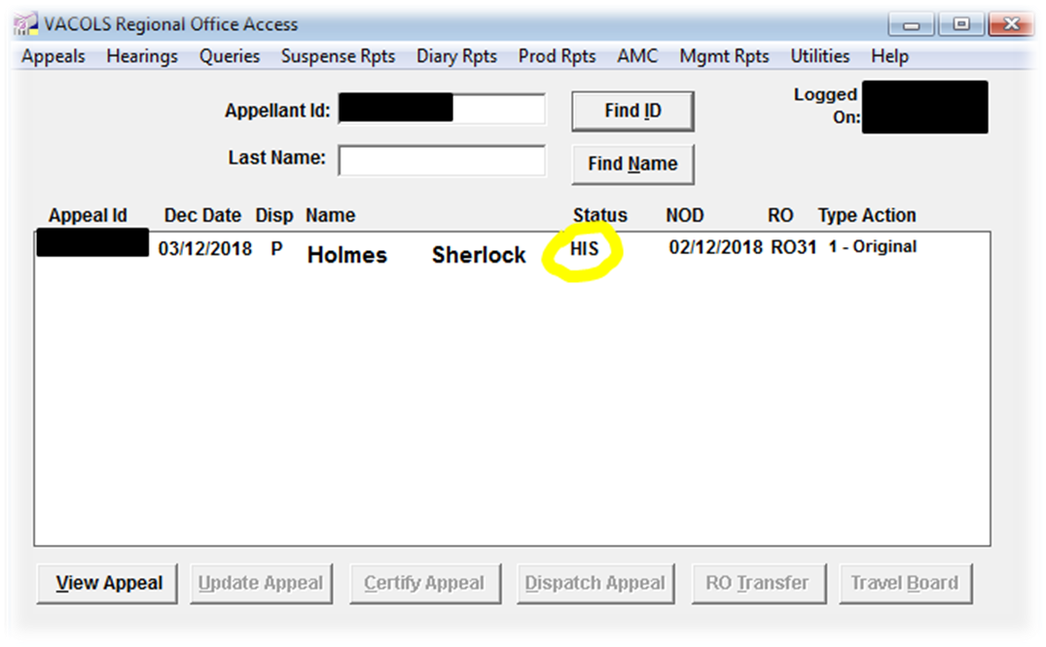
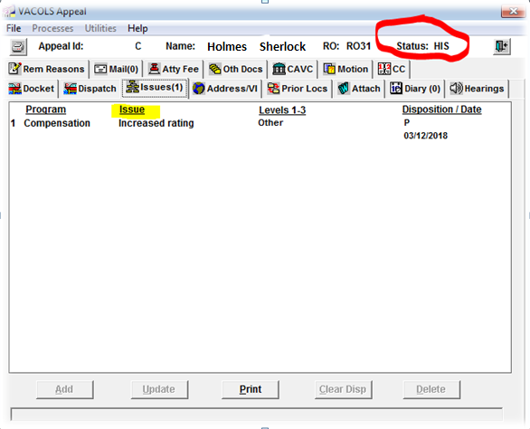
VACOLS
VACOLS is automatically closed out as historical (HIS) when a RAMP EP is established.
21

Slide 22
Identifying a RAMP Issue
Issues processed under RAMP can be identified by reviewing VBMS.
Review the VBMS claims screen for an EP 682 or EP 683 and check the contentions list
22

Slide 23
Identifying a RAMP Issue
Review the VBMS eFolder for a “RAMP Opt-in Election” document and a “RAMP Appeal Withdrawal Letter”
23

Slide 24
RAMP Communications
RAMP information is disseminated to eligible Veterans through
Web communication on internet sites such as VA.gov, and other VA social media sites (Facebook, Twitter, YouTube etc.)
Communications through regular mail, email, print, and traditional media outlets
Notice Letters mailed on a monthly basis based on a set schedule
Follow-up letters are sent 45 days after initial notice
RO contacts have a complete listing of mailed notices
Outreach material such as signage, pamphlets, brochures, etc.
Training products for external stakeholders (service organizations, congressional caseworkers, advocates for Veterans, and such other stakeholders)
In-person engagements such as VA town halls, and national and local outreach events
24

Slide 25
Frequently Asked Veteran Questions
Will RAMP be faster than the current process?
Yes. VA anticipates processing RAMP election in an average of 125 days. Current legacy appeals processing time can range from 3 to 7 years for resolution.
What will happen with my appeal if I choose not to participate in RAMP?
If a Veteran chooses not to participate, the appeal will continue to be processed under the current process. However, keep in mind, choosing RAMP will not delay a Veteran’s appeal or ability to seek Board review, it will more than likely result in faster resolution.
I have multiple appeals with multiple issues. Do I have to choose the same lane for all of them?
Yes. Under RAMP, a Veteran must choose either the Higher-Level Review lane or the Supplemental Claim lane for all eligible compensation issues under appeal.
What do I do if I disagree with my RAMP decision?
If a Veteran remain dissatisfied with the decision you receive in RAMP, he or she will have a year to use the other RAMP lane or appeal to the Board of Veterans’ Appeals for all issues addressed under RAMP to protect the potential effective date for benefits.
25

Slide 26
Frequently Asked Veteran Questions
What if I have a Board or DRO hearing pending? Can I opt-in?
It depends. If a Veteran’s appeal has not certified and activated by the Board, the appeal may be processed under RAMP. Under RAMP, Veterans and representatives can request an informal conference under the Higher-Level Review lane if they wish to speak with the decisionmaker; however, they cannot request a hearing.
Will participation in RAMP result in another denial and loss of my place in line?
No. VBA will review the claim anew and issue a new decision. If that decision is not favorable to the Veteran, he or she may continue the claim through an appeal to the Board. Veterans participating in RAMP will receive access to the new dockets, placing them at the front of the line when the new appeals process goes live in February 2019. This will likely result in faster review by the Board, than if the Veteran remained in the legacy process.
Will VA continue development on my appeal if I elect RAMP?
Yes, if the Veteran elects the Supplemental Claim lane. VA has a duty to assist Veterans in gathering evidence to substantiate the claim under the Supplemental Claim lane. VA will complete all development actions prior to issuing a decision. If a Veteran elects the Higher-Level Review lane, VA will discontinue developing for evidence and the record is limited to the evidence of record prior to receipt of the RAMP Opt-in Election form.
26

Slide 27
Additional Information
You may visit the Appeals Modernization page on www.VA.gov for more information on VA’s implementation of appeals modernization and RAMP.
https://benefits.va.gov/benefits/appeals-ramp.asp
27

Slide 28
Questions

