Slide 1
Compensation Service
February 2018
Establishing Veteran Status

Slide 2
Objectives
Identify three elements required to establish Veteran status for VA compensation purposes
Differentiate between duty statuses for Reservists and National Guard members qualification criteria
Recognize and identify acceptable evidence for verification of service
Identify discharge statuses that entitle a Veteran to compensation benefits

Slide 3
References
38 CFR 3.12a, Minimum active-duty service requirements
M21-1, Part III, Subpart ii, 6.A, Establishing Veteran Status
M21-1, Part III, Subpart ii, 6.B, Service Requirements and Verification of Eligibility
M21-1, Part III, Subpart iii, 2.A, General information on Service Records
M21-1, Part III, Subpart v, 1.B, Statutory Bars to Benefits and Character of Discharge (COD)
NOTE: Additional references are listed in the Handout

Slide 4
Definition of a Veteran
A person who served in active military, naval, or air service, and was discharged or released under conditions other than dishonorable.

Slide 5
Establishing Veteran Status
Three elements required to establish Veteran status for VA compensation purposes:
Individual must be identified as a Veteran by VA definition
Service must be verified with acceptable evidence
Character of discharge from service must be other than dishonorable

Slide 6
Duty Statuses Considered for Active Duty Service
Active duty (AD)
Active duty for training (ADT) to which a person is disabled or dies from injury/disease incurred or aggravated in the line of duty (LOD)
Inactive duty for training (IDT) to which a person is disabled or dies from injury incurred or aggravated in the LOD, or any of the following conditions:
Acute myocardial infarction; cardiac arrest; or cerebrovascular accident

Slide 7
Minimum Active Duty Service Requirements
Person must have completed:
Twenty-four (24) months of continuous active duty, or
Full period for which they are called or ordered to active duty
Exceptions to minimum active duty service requirements must be considered if requirements are not met (38 CFR 3.12a(d))

Slide 8
Reserve Service Qualifications
Reserve programs considered active duty for compensation purposes:
Active Guard Reserve (AGR)
Active Duty Support Program (ADS)
Active Duty for Special Work (ADSW)
Reserve programs NOT considered active duty for compensation purposes:
Initial Active Duty for Training (IADT)
Annual Training (AT)
Inactive Duty for Training (IDT)

Slide 9
National Guard Service Qualifications
National Guard Service
Army National Guard (ARNG)
Air National Guard (ANG)
Member served under Title 10 (10 U.S.C.) or Title 32 (32 U.S.C.)

Slide 10
National Guard Service
Title 10
Title 32
Guard unit or member activated for service to which reporting members service qualifies as active duty.
Full-time duty in the Armed Forces, such as unit deployment during war, including travel to and from such duty, except active duty for training.
Active duty characterized as Federal active duty
For VA Purposes, full-time operational support or service performed under 32 U.S.C. 316, 502, 503, 504, or 505
Duty performed for which member is entitled to receive pay from the Federal government, such as responding to a national emergency or performing duties
Does NOT meet VA definition of active duty

Slide 11
Verification of Service
Locate acceptable evidence of service
Verify active service dates
Verify character of discharge

Slide 12
Acceptable Evidence for Service Verification
DD Form 214 or Report of Separation (issued prior to DD-214s)
Digitally signed DD Form 214
PHS Form 1867
NOAA Form 56-16
NGB Form 22
3101 response from the service department
Veteran Identification Data (VID) screen in SHARE (BIRLS)
VIS (acceptable alternative verification of service)

Slide 13
Incomplete Service Verification
If available evidence is incomplete or appears questionable, request verification or additional data from
Personnel Information Exchange Systems (PIES)
Veteran Information Solution (VIS)
Defense Personnel Records Image Retrieval System (DPRIS)
If claimant submitted alternative form of evidence of service that cannot be accepted and military service cannot be verified, send a denial letter and furnish notice of procedural and appeal rights.

Slide 14
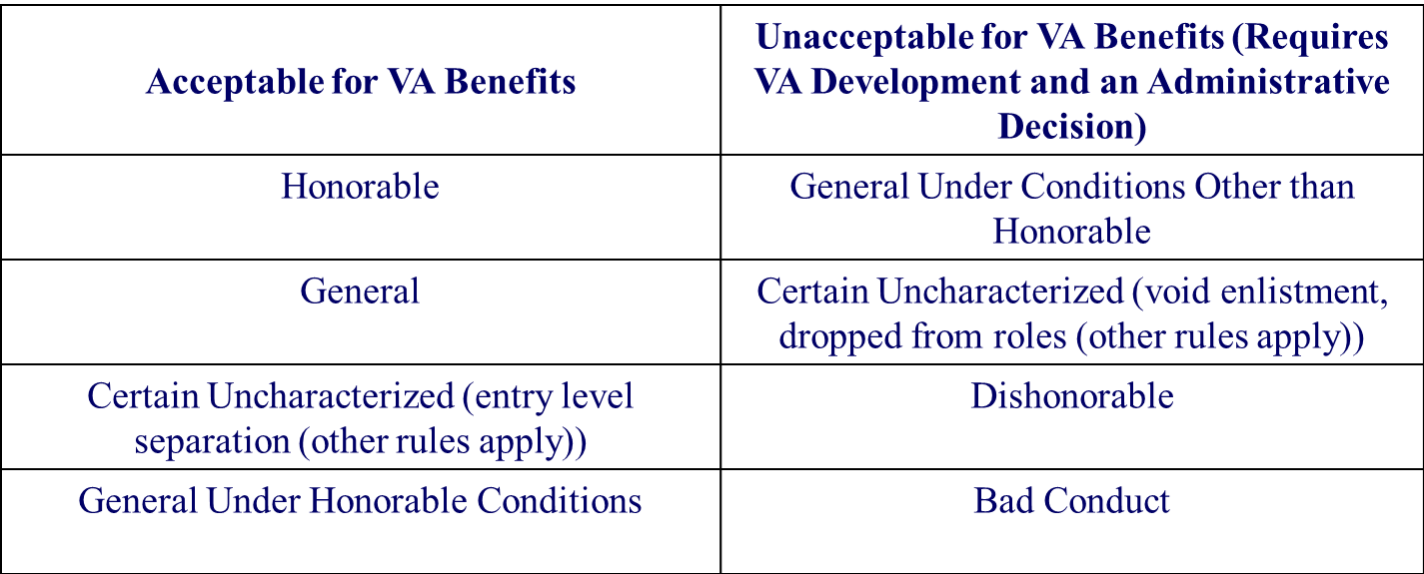
Character of Discharge Statuses
Character of discharge status could affect entitlement to VA benefits:

Slide 15
Questions

