Slide 1
Veterans Benefits Management System
VBMS Release 14.1 New Functionality Training
Controlled Unclassified Information
This training module contains fictitious Veteran information on various screens for training purposes
March 03, 2018

Slide 2
Understanding New Functionality within VBMS
Learning Objectives
After completing this training, users will be able to:
Filter the eFolder by Line of Business
Use the updated Annotator tool
Minimize the Search Bar
Set default user preferences for Annotator and eFolder filtering

Slide 3
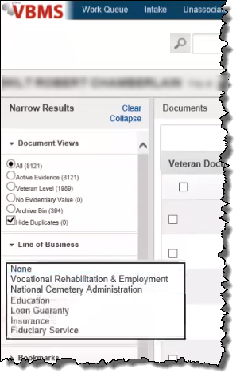
VBMS: Filter eFolder by Line of Business
The eFolder now provides users with the ability to filter by Line of Business
Notes:
VBMS 14.1 includes a new filtering capability in the eFolder. Users can filter by Line of Business to better find relevant eFolder documents.
The available Lines of Business included in this filter are Vocational Rehabilitation & Employment, National Cemetery Administration, Education, Loan Guaranty, Insurance, and Fiduciary Service.

Slide 4
VBMS: Annotator
The upgraded Annotator tool provides better performance and a sleeker user interface
New functionality includes
Toggle Annotation Opacity
Search within View Annotation List
1
2
NOTE: Enable the new Annotator for display within user preferences
Notes:
VBMS 14.1 has an improved Annotator tool.
You can view the underlying document in the Annotator by selecting the transparency icon. Clicking this icon once makes all annotations display 50% transparent. Clicking again makes all annotations fully transparent, while a third click resets the cycle and sets all annotations as 0% transparency.
You can also search, edit, and delete annotations from within the View Annotation List menu. Note that this search function only queries annotations, not the document itself.

Slide 5
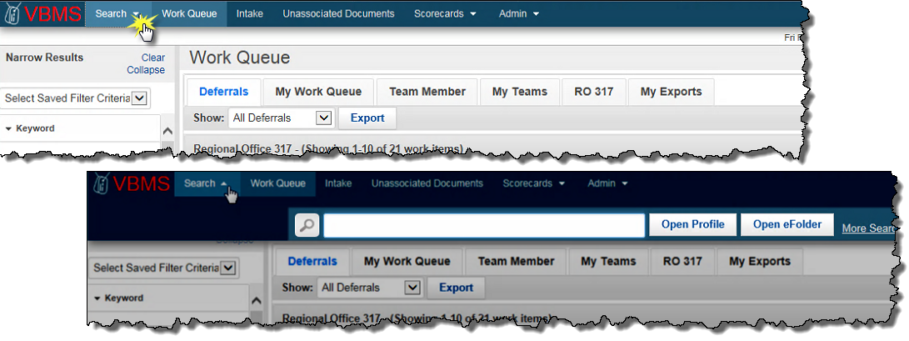
VBMS: Search Bar
VBMS now includes the ability to minimize the search bar to increase the amount of critical information displayed on screen
Uncheck the Always Show Search Bar option under User Preferences to enable this feature
Notes:
When you uncheck the Always Show Search Bar checkbox, the Search Bar will be minimized by default when you navigate to a new page. Select Search to display the Search Bar.

Slide 6
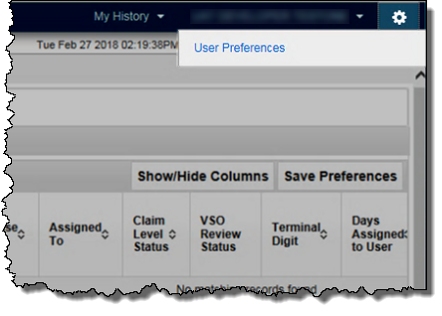
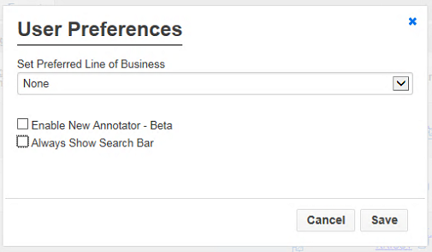
VBMS: Establish Default User Settings
Users can set the following preferences to run automatically upon VBMS login:
Line of Business filter to run by default in eFolder
Preferred Annotator view – original or updated version
Enable Search Bar minimizing
Users can access user preferences via the gear icon
Notes:
Within the user preferences window, you can select a Line of Business filter to run by default in the eFolder. You maintain the ability to adjust the filter within the eFolder, but the default setting will be for the line of business you select.
The original version of the annotator displays by default in VBMS 14.1. To enable the updated version, you must select Enable New Annotator - Beta within the user preferences window.
By unchecking the Always Show Search Bar checkbox, the Search Bar can be minimized.

Slide 7
Understanding New Functionality within VBMS: Knowledge Check
The new annotator will display by default in VBMS 14.1
True
False

Slide 8
Understanding New Functionality within VBMS: Knowledge Check
The new annotator will display by default in VBMS 14.1
True
False
The original annotator version displays by default. Adjusting the settings in the user preferences enables you to view the updated annotator.

