Slide 1
Claim Attributes
Compensation Service
March 2019
Notes:
Welcome to the Introduction to Medical Electronic Performance Support System (E P S S) course. To advance each slide, click anywhere on the screen.

Slide 2
Lesson Objectives
Identify Priority Processing claims
Determine the most accurate Claim Label for a claim
Recognize when Corporate Flash should be applied to a claim
Determine all Corporate Flashes applicable to a claim
Recognize when a Special Issue is applicable to a claim
Determine all Special Issues applicable to a claim
Notes:
Lesson Objectives
Upon completion of this lesson, you will be able to:
Identify how to access Medical EPSS
Identify how to access the Help Menu
Determine how to access the menu tabs at the top of the Medical EPSS
Determine how to utilize the Search function box on the main menu
Identify other reference tools
Locate elements within the Medical EPSS in a practical activity

Slide 3
References
M21-1, Part III, Subpart i, Chapter 3, Section A, Forms Claimants Must Use When Submitting an FDC
M21-1, Part III, Subpart iii, Chapter 1, Section F, Corporate Flashes
M21-1, Part III, Subpart ii, Chapter 1, Section D, Claims that Require Priority Processing
M21-4, Appendix C, Index of Claim Attributes
M21-4, Chapter 6, Appendix A: VSR Task Based Quality Review Checklist
Notes:
Reference
The references for this course are listed on the screen. You may click any hyperlinked references for further details.
Compensation Service Intranet Home Page
Rating Job Aids
http://epss.vba.va.gov/Medical EPSS

Slide 4
Overview
With the inception of National Work Queue (NWQ), uniformed claims establishment is essential and an important “component” of uniform claims are claim attributes, which impact workload and routing nationally.
The application of claim attributes is extremely important for the purpose of data consistency and data integrity. All processors must enter all applicable attributes throughout the claims process accurately and completely as possible.
Notes:
What is the Medical E P S S?
Tutorial information related to medical terminology and issues, using graphics and visual aids to illustrate various medical definitions and concepts
Information regarding the function of the body system and common conditions
Links to obtain more information on specific diseases, body parts, and medical terms

Slide 5
Claim Attributes and Agency Goals
There are a variety of claims attributes required at establishment, all of them serve their specific importance towards the claim or the claimant however, there are a few that are specifically important as they directly impact workload management towards national agency goals.
Notes:
What is the Medical E P S S?
Tutorial information related to medical terminology and issues, using graphics and visual aids to illustrate various medical definitions and concepts
Information regarding the function of the body system and common conditions
Links to obtain more information on specific diseases, body parts, and medical terms

Slide 6
Required Claim Attributes at Establishment
Address
Claim Label
Claim Level Suspense Reason
Claim Status
Corporate Flashes
Date of Claim
End Product
Military Service Data
Power of Attorney
Special Issues
Important: Underlined claim attributes have an impact on Workload Management and Routing
Notes:
What is the Medical E P S S?
Tutorial information related to medical terminology and issues, using graphics and visual aids to illustrate various medical definitions and concepts
Information regarding the function of the body system and common conditions
Links to obtain more information on specific diseases, body parts, and medical terms

Slide 7
Claims that Require Priority Processing
Claims from any claimant who is:
a participant in the Fully Developed Claim Program
homeless or experiencing extreme financial hardship
terminally ill
more than 85 years old, or
a survivor of a former Prisoner of War (FPOW).
Claims from any current or former member of the Armed Forces who:
became very seriously ill or injured/seriously ill or injured (VSI/SI) during service and is not already receiving Department of Veterans Affairs (VA) disability benefits
is diagnosed with Amyotrophic Lateral Sclerosis (ALS) or Lou Gehrig's Disease
is an FPOW, or
Veteran received the Medal of Honor, or

Slide 8
Claims that Require Priority Processing (Cont...)
Claims from any current or former member of the Armed Forces or a claimant whose claim is based on the death of a service member or former service member who received the Purple Heart:
original compensation or pension claims, or
an original claim for Dependency and Indemnity Compensation (DIC).

Slide 9
Claim Labels
A claim label pertains to the End Product (EP) of the claim. They describe the type of benefit claimed. Since there are multiple claims with the same EP number, claim labels help distinguish these types of claims.

Slide 10
Who Applies the Claim Label?
The claim label is first added at establishment however, everyone in the RO is responsible for ensuring that appropriate claim labels are applied and should make any necessary changes to address any deficiencies.
The claim label that best describes the situation and provides information vital to proper tracking should be used.

Slide 11
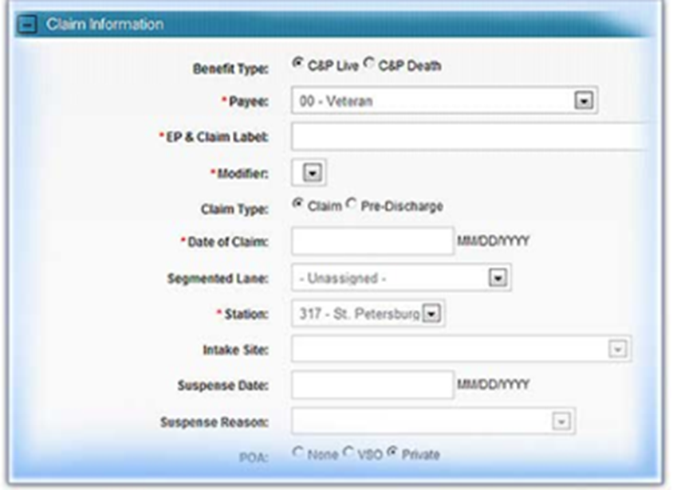
How is a claim label applied?
The claim label is applied at claims establishment. Here is an example of the claims establishment area in VBMS:
Note: VBMS requires completion of the
Segmented Lane field when establishing a
Claim, however, the lane assignment does
not affect NWQ routing.
Select Core (National) when assigning the
Segmented lane.

Slide 12
Claim Type
Here is an example of what a claim looks like in the “claim tab” in VBMS once established. The EP system is critical to workload monitoring, routing and work credit measurement for VBA staff.

Slide 13
Appropriate Claim Label Selection
A full list of all claim labels can be found at M21-4, Appendix C here are a few for discussion:

Slide 14
EP Code versus Claim Label
The EP could be the same, but the claim label is different. It is very important to pay close attention to the details surrounding the claim you are establishing.

Slide 15
Corporate Flashes
Corporate flashes are claimant - specific indicators which represent an attribute, fact, or status that is unlikely to change. A corporate flash can either be automatically generated by the system, or managed manually by a user. There may be more than one (1) corporate flash that is applicable.
Available corporate flashes not generated by the system must be identified and updated when applicable. We will primarily discuss those added manually.
All users are responsible for validating and updating corporate flashes when applicable.

Slide 16
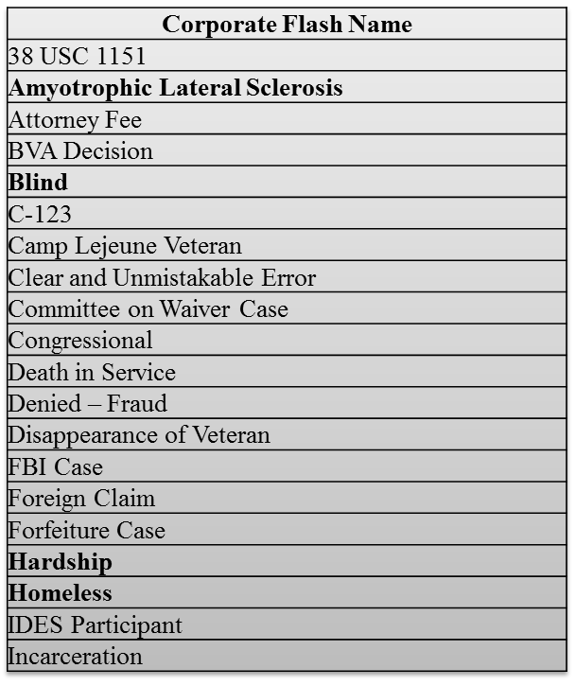
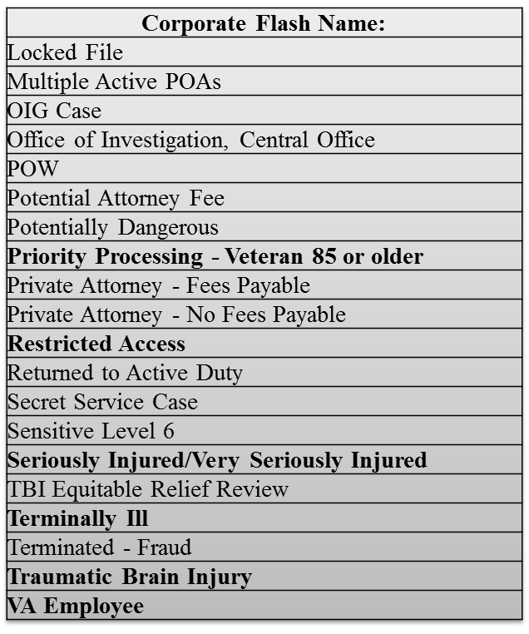
What Corporate Flashes are Required?
A full list of all available corporate flashes can be found at M21-4, Appendix C, Index of Claim Attributes.

Slide 17
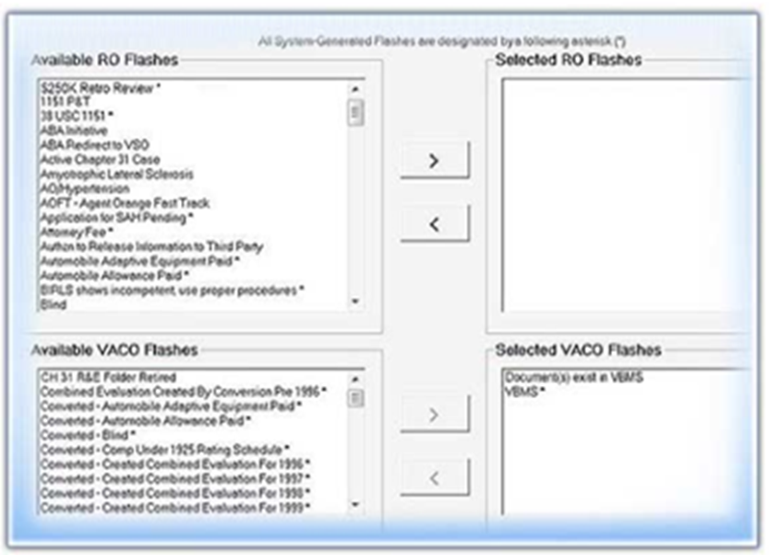
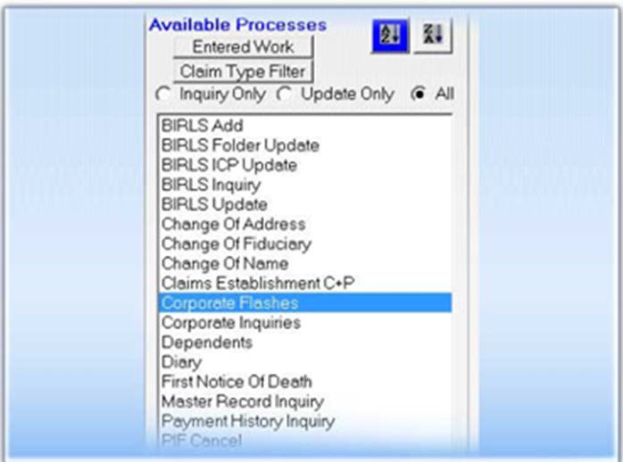
Corporate Flashes
Corporate Flashes are added through SHARE and are available for viewing and tracking in all systems.

Slide 18
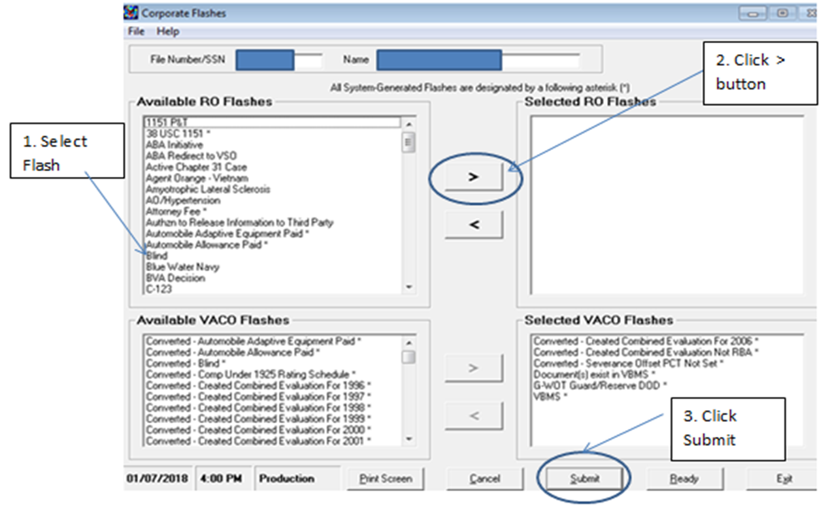
Adding a Corporate Flash
Step 1: Select the appropriate Flash.
Step 2: Click the carrot over button ( “>”).
Step 3: Click “Submit”.

Slide 19
Corporate Flash

Slide 20
Special Issues
Special Issues is related to a contention.
Claim specific indicators typically pertaining to certain contentions which represent a claim type, disability or disease, or other special notation that is only relevant to a current pending claim.
Special issues stay on for the duration of the claim and no longer exist when the claim has ended.
Mandatory with every case.

Slide 21
Special Issues
Why does VA need special tracking requirements?
Easy identification
Priority processing
National Work Queue (NWQ) routing rules

Slide 22
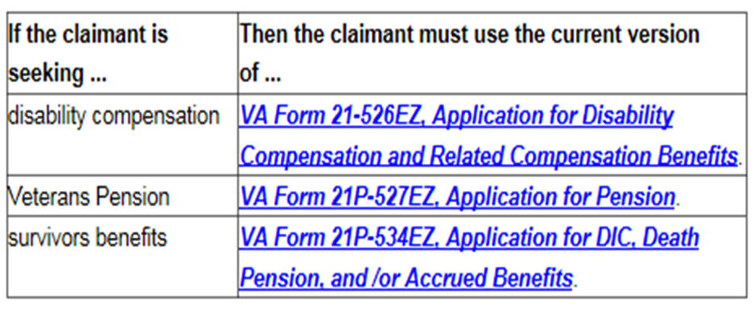
Fully Developed Claim - Special Issue
The Department of Veterans Affairs (VA) designed the Fully Developed Claim (FDC) Program for the purpose of
reducing its backlog of pending claims, and
improving claims-processing timeliness.
VA must receive one of the following forms in order to participate in the FDC program:

Slide 23
Special Issues

Slide 24
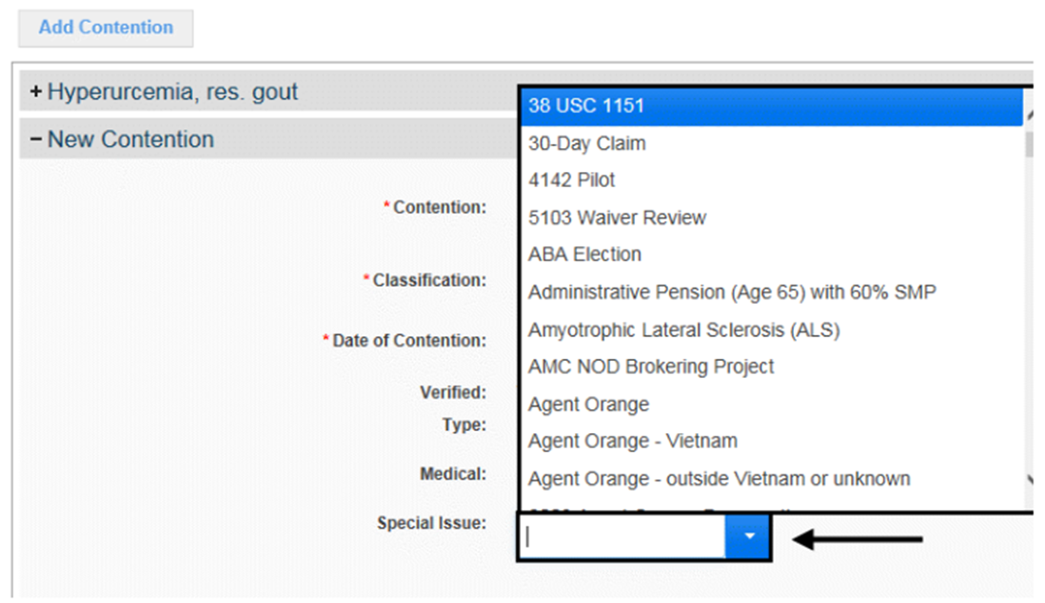
Entering Special Issue in VBMS
Step 1: Under the CONTENTION tab, select the SPECIAL ISSUES down arrow.

Slide 25
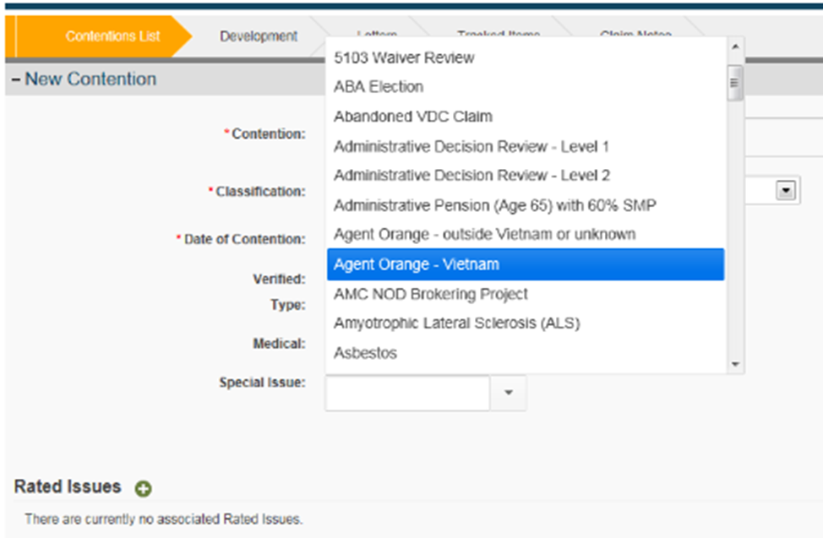
Entering Special Issue in VBMS
Step 2: Select the appropriate special issue to be associated to the contention.

Slide 26
Entering Special Issue in VBMS
Step 3: Select the SAVE button to save the special issue or the CANCEL button to discard the changes.
Note: If you finish adding special issues and want to add another contention select the SAVE and ADD button.

Slide 27
Review
Questions
Notes:
Questions?

