Slide 1
Compensation Service
April 2019
Centralized Benefits Communications Management (CBCM) Phase One - Centralized Printing
Notes:
Welcome to the Centralized Benefits Communication Management (CBCM) – Phase one, also known as Centralized Printing, provided by the training staff at VA Central Office. This presentation will provide an overview of how CBCM will benefit Veterans and claimants, VA staff, and stakeholders.

Slide 2
Purpose
Centralized Benefits Communications Management (CBCM) is a Veterans Benefits Administration (VBA) initiative designed to provide greater choice for claimants and beneficiaries in how they receive correspondence from VBA. The goal is to centralize and streamline the delivery of outbound communications across all VBA business lines.
Notes:
The purpose of this training is to introduce Centralized Benefits Communications Management (CBCM) the field. CBCM is a Veterans Benefits Administration (VBA) initiative designed to provide greater choice for claimants and beneficiaries in how they receive correspondence from VBA. The goal is to centralize and streamline the delivery of outbound communications across all VBA business lines.

Slide 3
Objectives
Upon completion of this training you will be able to:
Explain the new VBMS functionality of Package Manager.
Demonstrate how to create packages in VBMS-Core and VBMS-Awards.
Recognize whether the Package Manager sent the package to centralized printing.
Notes:
The objectives for this training are to
explain the new VBMS functionality of Package Manager
demonstrate how to create packages in VBMS-Core and VBMS-Awards, and
recognize whether the Package Manager sent the package to centralized printing.

Slide 4
Benefits
Improve the Compensation and Pension Experience
Provide a more automated and efficient means of generating and delivering notification letters to claimants
Allows more time for VSRs to continue processing claims
Reduce the risk of PII violations
Notes:
CBCM will be advantageous because it will:
Improve the compensation and pension experience,
Provide a more automated and efficient means of generating and delivering notification letters to claimants,
Allows more time for VSRs to continue processing claims, and
Reduce the risk of PII violations

Slide 5
Terms
Package Manager – VBMS functionality that allows you to create a package, to add documents, and to track who receives the correspondence.
Package – a group of documents in a particular order (i.e. – 5103 Letter, VA Form 21-4142, and incomplete form)
Distribution – electronic information that identifies recipients and mailing location.
Notes:
Important terms to know for the CBCM project are Package Manager, Package, and Distribution.
Package Manager means VBMS functionality that allows you to create a package, to add documents, and to track who receives the correspondence.
Package is a group of documents in a particular order. For example, a 5103 Notice Letter, VA Form 21-4142, and incomplete form.
Distribution means electronic information that identifies recipients and mailing location.

Slide 6
Federal Tax Information
VBMS is not an approved system for storing Federal Tax Information (FTI). Therefore, please do not add any documents to the VBMS eFolder that contains FTI or create a package for Centralized Printing using a document containing FTI.
Notes:
Please note that VBMS is not an approved system for storing Federal Tax Information (FTI). Therefore, please do not add any documents to the VBMS eFolder that contains FTI or create a package for Centralized Printing using a document containing FTI.

Slide 7
Creating packages in VBMS-Core
There are three ways you can create packages in VBMS-Core.
1. Letter chevron in the Claim Details
2. Veteran’s eFolder
3. Package Manager
Notes:
A package can be created in VBMS-Core in one of three of the following ways:
Letter chevron in the claim details,
Veteran’s eFolder, and
Package manager.

Slide 8
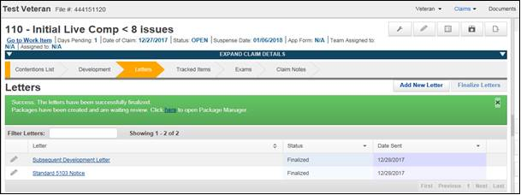
Creating Packages in Letter Chevron
VBMS-Core will automatically create a package in the Letter Chevron after you finalize a letter.
Once the green Success Banner appears, click the link.
Notes:
Once a letter is finalized from the letter chevron, a green banner will appear with a link to Package Manager like the one in this screenshot. Once the green success banner appears, click the link.

Slide 9
Creating Packages in Letter Chevron
Next, select the name of the package you just created.
*Note: Package name will be based on letter name and date of letter. The package will also be in “Draft” status.
Notes:
The link will take you to the Package Manager page in VBMS. The page will start on the “Distributions” tab. Select the name of the package you just created. The package name will be based on the letter name and date of letter you just finalized. It will also be in “Draft” status.
You can also select the “Packages” tab and then select the name of the package you just created. Either way will direct you to the screen where you can add documents and/or enclosures to the package.

Slide 10
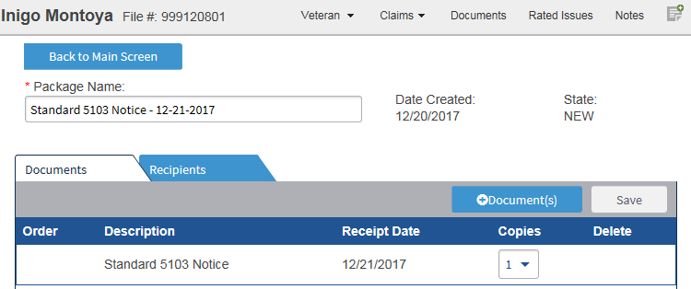
Creating Packages in Letter Chevron
Add document(s) from the efolder or standard enclosures by clicking the “+Document(s)” button.
Note: Only use standard forms in the Package Manager.
Notes:
Upon selecting the package name, you will be directed to the next screen where you can add documents from the eFolder or standard enclosures to the package. It will default on the “Documents” tab. To add a document or enclosure, click on the “Document(s)” button highlighted in the screenshot.
An important thing to note is that you are to only use standard forms in the Package Manager.

Slide 11
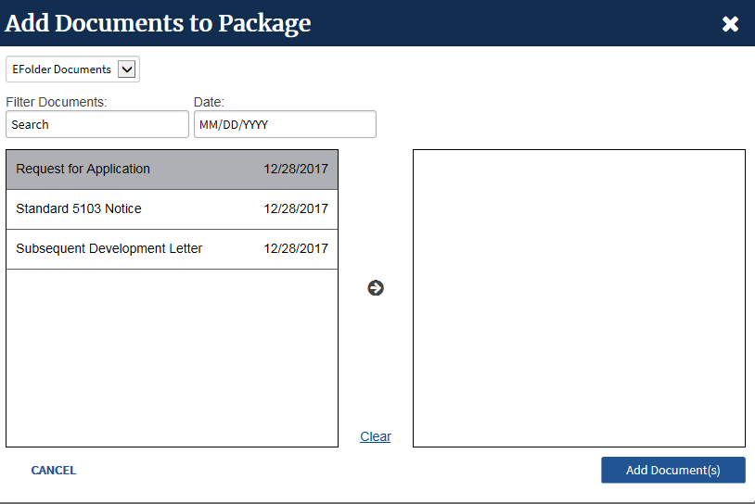
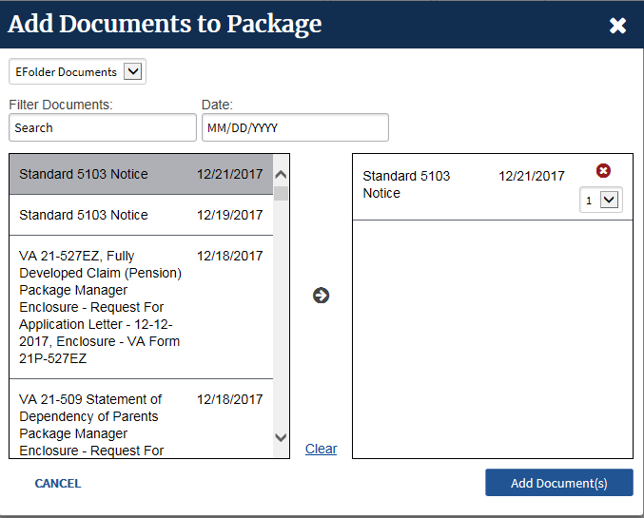
Creating Packages in Letter Chevron
To add eFolder document(s):
Select the document(s)
Select the arrow to move the document(s), then select Add Document(s).
Notes:
To add eFolder documents to a new package you must first select the document you wish to add. Next, select the arrow in the middle of the screen to move the document(s) to the right hand portion of the screen. Finally, select the “Add Document(s)” button.

Slide 12
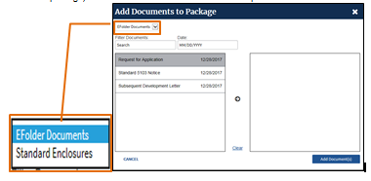
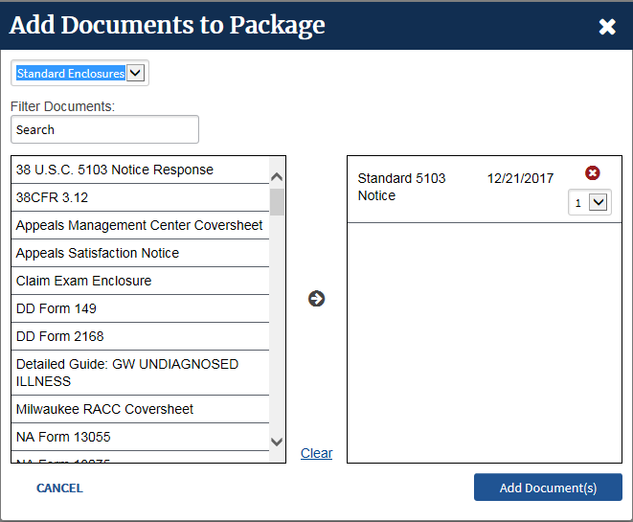
Creating Packages in Letter Chevron
To add standard enclosures, such as, VA Form 4107,
Click the Drop-Down Menu
Select the standard enclosure(s)
Use the arrow to move the enclosure(s) and select “Add Document(s).”
Notes:
To add standard enclosures, the user
- first selects the Standard Enclosures option from the drop down menu in the top left corner of the screen as shown in the left screen shot.
- Next, selects the enclosures to be added.
- Then selects the arrow in the middle of the screen to move the document(s) to the right hand portion of the screen.
- And finally, selects the “Add Document(s)” button.

Slide 13
Creating Packages in Letter Chevron
Verify the address.
Select the “Add Recipient” button if needed.
Indicate if the recipient is an “Individual” or “Organization.”
Verify all information indicated by an asterisk.
Save
Send Package for each recipient
Notes:
After adding documents and/or standard enclosures, the user will then select the “Recipients” tab. Under this tab, the user will add a recipient(s). To add a recipient, the user must:
Verify the address
Select the “Add Recipient” button is needed.
Indicate if the recipient is an individual or organization.
Verify all information or complete all boxes indicated by an asterisk.
Select the “Save” button if any changes were made.
Select the “Send Package” button for each recipient.

Slide 14
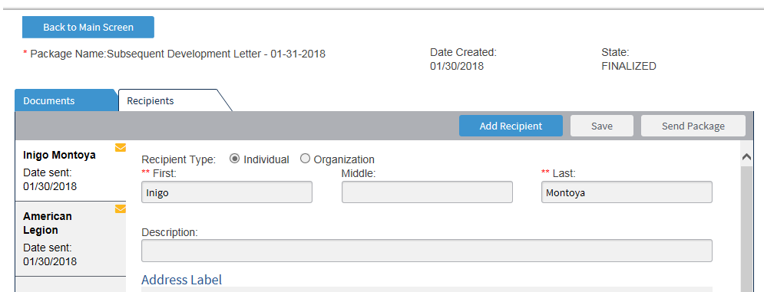
Creating Packages in Letter Chevron
You will know the package was sent to Centralized Printing when:
The circle icon becomes an envelope.
The status changes to “FINALIZED.”
Close this window to return to VBMS-Core.
Notes:
Once you select the “Send Package” button, you will know the package was sent to Centralized Printing when:
- The circle icon becomes an envelope, and
- The status changes to “FINALIZED.”
Once you see these, you can close the window to return to VBMS-Core.

Slide 15
Additional Ways to View Package Status: Distributions Tab
You will see the following “Distributions Tab” status messages:
Draft, circle; The package is not finalized. This status means the user must finalize the package to be sent.
In Progress, envelope; The package is finalized and sent to Centralized Printing. No action is needed.
Success, checkmark; Centralized Printing received and accepted the package. No action is needed.
Fail, exclamation point; Centralized Printing received the package, but unable to print it. User should contact VAVBAWAS/CO/VCIP
Notes:
Under the “Distributions” tab, users can see the status of the package. The user will see one of the following four (4) statuses:
Draft with a circle indicates the package has not been finalized and sent. This status means the user must finalize the package to be sent.
In Progress with an envelope indicates the package has been finalized and is being processed by Centralized Printing. This status means the user does not need to take any further action.
Success with a checkmark indicates Centralized Printing has received and accepted the package. This status means that no user action is needed.
Fail with an exclamation point indicates Centralized Printing has received the package, but is unable to print it. In this rare instance, the User should contact VAVBAWAS/CO/VCIP.

Slide 16
Additional Ways to View Package Status: Package Tab
You will see the following “Packages” status messages:
New, blue circle; The package has not been finalized and sent. User needs to finalize and send package.
Finalized, green circle; The package has been sent to Centralized Printing. No further action is needed.
Notes:
Under the “Packages” tab, users can see the status of the package. The user will see one of the following two (2) status messages:
New with a blue circle indicates the package has not been finalized and sent. This means the User needs to finalize and send package.
Finalized with a green circle indicates the package has been sent to Centralized Printing. This means no further action is needed.

Slide 17
Creating Packages in the eFolder
Packages can be manually created from the eFolder by selecting the applicable document(s), then selecting “Add to Package” from the Action Drop Down menu.
*Note: Letters created using PC Generated Letters (i.e. PCGL and letter creator) will be sent after the letter has been uploaded to the eFolder.
Notes:
Packages can be manually created from the eFolder by selecting the applicable document or documents, then selecting the option “Add to Package” from the action drop down menu. This screen shot highlights these actions.
An important note is that letters created using PC generated letters will be sent after the letter has been uploaded to the eFolder.

Slide 18
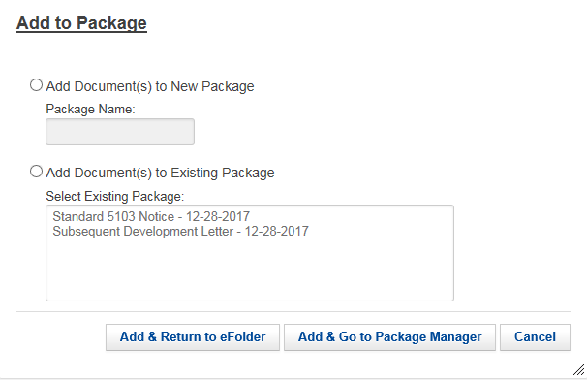
Creating Packages in the eFolder
After you select, “Add to Package,” chose one of the following:
add the document(s) to a new package, or
add the document(s) to an existing package.
Note: All new packages will require you to
create a package name.
Example, “Due Process Notification request
– 12/28/2017” as a Package name (correspondence date).
Notes:
Once you make the selection “Add to Package” you will then be required to either:
add the document(s) to a new package, or
add the document(s) to an existing package.
The screen shot on this slide displays the visual for your options.
If you are adding a document(s) to a new package, you must input a name for the package. For example, “FOIA Request – 12/28/2017.”

Slide 19
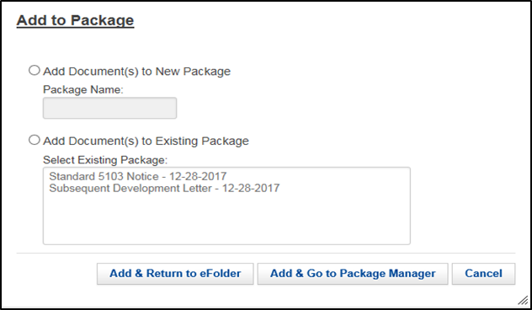
Creating Packages in the eFolder
If you select either “Add and Return to eFolder,” or “Add & Go to Package Manager,” you will be have the option of adding additional documents to your package.
Notes:
The user can either select:
“Add and Return to eFolder,” or
“Add & Go to Package Manager.”
From either selection, the user will have the option of adding additional documents to the package.

Slide 20
Creating Packages in Package Manager
You can create a new or an existing package by just clicking on the Package Manager from the Veteran’s Drop Down menu.
Notes:
The user can create new or an existing package. To access the Package Manager, the user will need to select the Package Manager option under the Veteran Drop Down Menu. This action will take the user to the Package Manager screen.

Slide 21
Creating Packages in Package Manager
Next, click create and build your package. Once you are done, it will be in a “NEW” status.
Notes:
Here, the user must select the “Create” button to begin building the package. After building the package, it will be listed under the “Packages” tab with a “New” status.

Slide 22
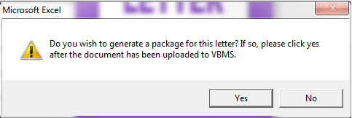
Using Letter Creator
Letter Creator can be used in conjunction the Package Manager.
Follow normal procedures for creating letters in Letter Creator and saving letters.
The letter creator will prompt you to upload document through the upload screen in VBMS.
Once the letter is seen in the eFolder, navigate back to letter creator and select, “yes” on the prompt to generate a package.
Note: Do NOT change the
default name when saving.
Notes:
Letter Creator can still be used with the Package Manager and has been upgraded to sync with the new functionality. Nothing has changed with drafting letters through Letter Creator so you will still follow the normal procedures for creating letters in Letter Creator and saving letters.
The Letter Creator will prompt the user to upload the document through the upload screen in VBMS. Once the letter is seen in the eFolder, navigate back to Letter Creator and select yes on the prompt to generate a package.
Reminder to not change the default name given to the letter when saving.

Slide 23
Deleting a Package Created in Error
You can delete a package in “New” status by selecting Delete (trash can icon).
Notes:
If there is a package you no longer need, you have the ability to delete it under the “Packages” tab. In order to do so, select the trash can icon on the same line as the package name to delete the package.

Slide 24
Creating Packages in VBMS-Awards
After generating an award, navigate to the “Award Letter Interview” and select “Gen Letter.”
Click “Enclosures”
Note: Package Manager sends the documents you indicate. You should only add documents that are not already in the Letter Preview.
Notes:
Just as there is a way to create a package in VBMS Core, a user can also create a package in VBMS Awards.
After generating an award, the user must navigate to the “Award Letter Interview” by selecting Gen Letter button.
Once in the “Award Letter Interview, ” the user will select the “Enclosures” tab.
Please note that the Package Manger sends the documents you indicate. Thus, the user should only add documents that are not already in the Letter Preview.

Slide 25
Creating Packages in VBMS-Awards
To send additional enclosures, specify the recipients, using the “Enclosures” tab:
Select “N” under “Part of Award Ltr,” if it is not a part of the normal award package.
Select the recipient(s) using the pencil scratchpad icon.
Enter the “Enclosure Order.” For example, if this enclosure goes first, then place a 1 in the space.
Notes:
If you need to send additional enclosures to only certain recipients, such as the Rating Codesheet to a POA but NOT a Veteran, you can do this in the “Enclosures” tab. To do so, select “N” under “Part of Award Ltr” and then select the appropriate recipient(s) using the pencil scratchpad icon.
Users must enter a unique number into the “Enclosure Order” when adding documents this way.

Slide 26
Creating Packages in VBMS-Awards
After building the package, navigate to “Recipients” tab and ensure recipients’ addresses are correct.
- You can add an additional recipient by selecting the “Add” button.
If there is not a predefined address for the VSO, then manually input the address fields and save. Note, it should be the claimant’s SOJ.
Notes:
After building the package, the user must navigate to the “Recipients” tab. Here, the user must ensure the recipients’ addresses are correct.
Under the “Recipients” tab, the user can also add any additional recipients by selecting the “Add” button. If there is not a predefined address for the VSO, then the user must manually input the information in the address fields and save. Please note that the address of the VSO must be the claimant’s SOJ address.

Slide 27
Creating Packages in VBMS-Awards
After all recipients have been identified, click on the arrow under “Delivery Method.”
*Note: If the Award requires concurrence, the delivery method and recipient information will continue from the Authorizer’s changes.
Notes:
After all recipients have been identified, click on the arrow under “Delivery Method.”
Please note that if an award requires concurrence, the delivery method and recipient information will persist from the Authorizer’s changes.

Slide 28
Creating Packages in VBMS-Awards
The promulgating VSR will select “Print Central.”
Once all the recipients are added and the delivery method of “Print Central” is complete, select “Accept”
Notes:
Upon clicking the drop down menu, the new “Print Central” delivery option will reveal. Selecting this option will send the letter distribution for that recipient to the Package Manager upon finalization.
Once all the recipients rows are complete, the user must select the “Accept” button.

Slide 29
Creating Packages in VBMS-Awards Authorization Review
Navigate to the Correspondence Summary to review a snapshot of both “Recipients” and “Enclosures” tabs.
Authorizer can make edits to either recipients or enclosures in their respective tabs
Notes:
After the user completes the necessary information under the “Recipients” and “Enclosures” tabs, the user can navigate to the “Correspondence Summary” tab to review both Recipients and Enclosures for the correspondence.
The authorizer can make edits to either recipients or enclosures in their respective tabs.

Slide 30
Creating Packages in VBMS-Awards Authorization Review
Authorizers will receive the following message when a “Print Central” letter is authorized and successfully sent to Package Manager.
If the package failed to submit, the message will refer the user to the Package Manager.
Notes:
Once an award is finalized, users will receive one of 2 messages. If the package is successfully sent to package manager, then the message will indicate success. However, if the package failed to submit, the message will refer the user to the Package Manager.

Slide 31
Creating Packages in VBMS-Awards Authorization Review
You can verify that packages sent from VBMS Awards were received by Package Manager and sent to Centralized Printing by navigating to the Package Manager for that Veteran in VBMS Core.
The “Recipient tab” status should show, “In Progress” for successful submission
Notes:
Users can verify that packages sent from VBMS Awards were received by Package Manager and sent to Centralized Printing by navigating to the Package Manager for that Veteran in VBMS Core. The “recipient tab” status should show “in progress” for successful submission.

Slide 32
VSO Copies of Correspondence
Copies of communications (letters) for VSO Representatives will be printed along with the claimant’s copy and mailed to the SOJ. The SOJ will disseminate VSO copies to co-located organizations.
Notes:
Copies of communications (letters) for VSO Representatives will be printed along with the claimant’s copy and mailed to the SOJ. The SOJ will disseminate VSO copies to co-located organizations. For offsite VSOs forward the mail to the local VSO office.

Slide 33
Recap
Explain the new VBMS functionality of Package Manager.
Demonstrate how to create packages in VBMS-Core and VBMS-Awards.
Recognize whether the Package Manager sent the package to centralized printing.
Improve the overall experience for our internal and external stakeholders.
Notes:
In conclusion, this presentation:
Explained the new VBMS functionality of Package Manager,
Demonstrated how to create packages in VBMS-Core and VBMS-Awards,
How to recognize whether the Package Manager sent the package to centralized printing, and
With your assistance, improve the overall experience for our internal and external stakeholders.
Available with this presentation are Job Aids that provide help with functionality in both VBMS-Core and VBMS-Awards and the job position role. Also available is a FAQ Sheet providing answers to frequently asked questions that will assist with this transition.
In order to receive credit for this training, make sure to complete the assessment in TMS.

Slide 34
Questions

