Slide 1
Compensation Service
February 2018
Request for Clarification/Modification Request/Rework Request in Exam Management

Slide 2
Objectives
Utilizing the training materials, VBMS Core User Guide, and available references, claim processors will be able to identify the steps required to respond to a request for clarification, complete a modification request, and complete a rework request, within the Exam Management in VBMS, and complete the post-assessment with a minimum of 80% accuracy.

Slide 3
References
M21-1, Part III, Subpart iv, 3.A, Examination Request Overview
M21-1, Part III, Subpart iv, 3.C, Control of Examinations
M21-1, Part III, Subpart iv, 3.D, Examination Reports
VBMS Core User Guide – Release 14.1

Slide 4
Terminology
Request for Clarification – is communication from the examining facility, indicating that additional information about an examination request or a specific contention is necessary. The request is electronically routed for review and subsequent action by claim processors is required.
Modification Request – is a communication from VBA, following successful submission of an exam scheduling request, allowing claim processing personnel to change the exam request address, modify appointments, add special instructions, cancel contentions, or cancel the exam request entirely.
Rework Request – is a communication from VBA, after an exam has been completed and results have been received for all contentions, if the results are insufficient or inadequate, you can create a rework request to ask for updated exams.

Slide 5
Request for clarification

Slide 6
Request for Clarification
Communication from examining facility to claim processors
Cannot modify an exam scheduling request until a response to a request for clarification is submitted
Add clarifying information at the claim level, the contention level, or both
Full Edit – Ability to change all data on the Claim Information page except the destination of the exam scheduling request (no appointments have been scheduled)
Narrative Response – Only option when the exam scheduling request contains one or more appointments
Cannot add new contentions to the exam scheduling request during this response workflow

Slide 7
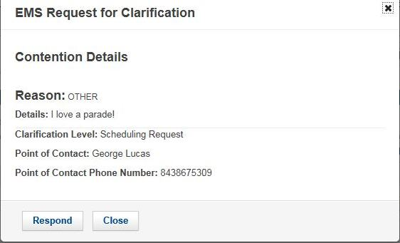
Responding to a Request for Clarification
To respond to a request for clarification from the Exam Scheduling Request Summary Page select:
Request for Clarification icon → EMS Request for Clarification dialogue box → Respond
Actions menu → Edit clarification Response

Slide 8
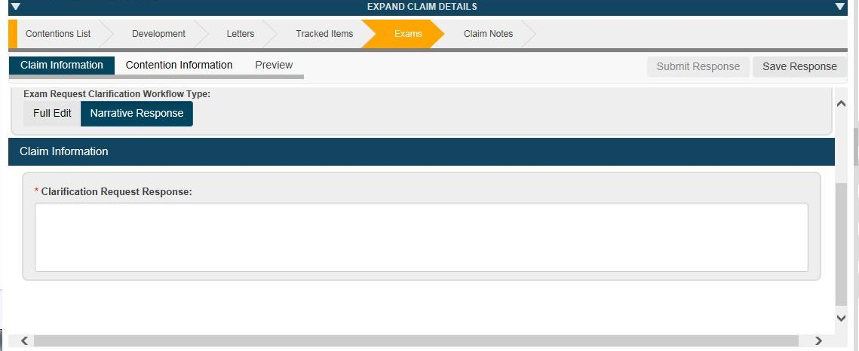
Responding to a Request for Clarification (continued)
If the request for clarification arises at the exam scheduling request level and the examination appointment(s) has/have been scheduled (Narrative Response only)
Select the Claim Information tab
Enter necessary information in the Clarification Request Response field
Entry of separate clarification responses on the Contention Information tab is optional in this instance

Slide 9
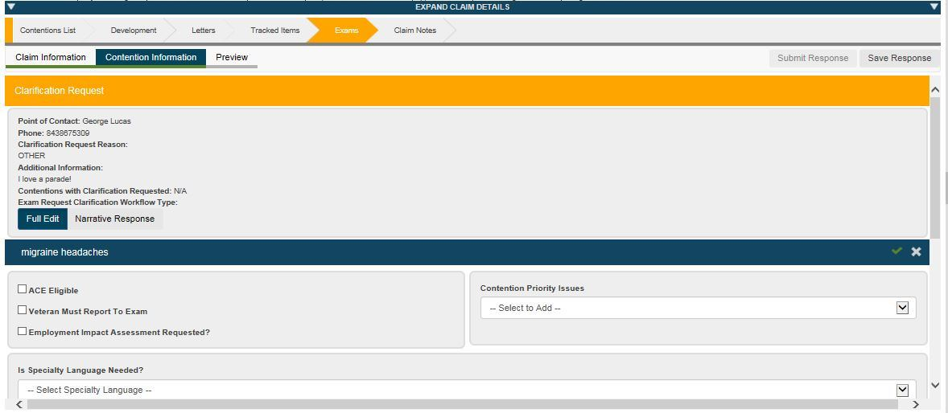
Responding to a Request for Clarification (continued)
If the request for clarification arises at the exam scheduling request level and the examination appointment(s) have not been scheduled and edits or corrections are required
Select Full Edit button from Claim Information tab
Enter necessary information in the Clarification Request Response field
Use the Claim Information tab to make any and all necessary corrections to claim-level system entries and attributes
Use the Contention Information tab to make any and all necessary corrections to system entries associated with affected contentions

Slide 10
Responding to a Request for Clarification (continued)
If the request for clarification arises at the exam scheduling request level and the examination appointment(s) have not been scheduled and edits or corrections are not required
Select Narrative Response button from Claim Information tab
Enter necessary information in the Clarification Request Response field
Use the Contention Information tab to add contention specific clarification request responses if desired or appropriate

Slide 11
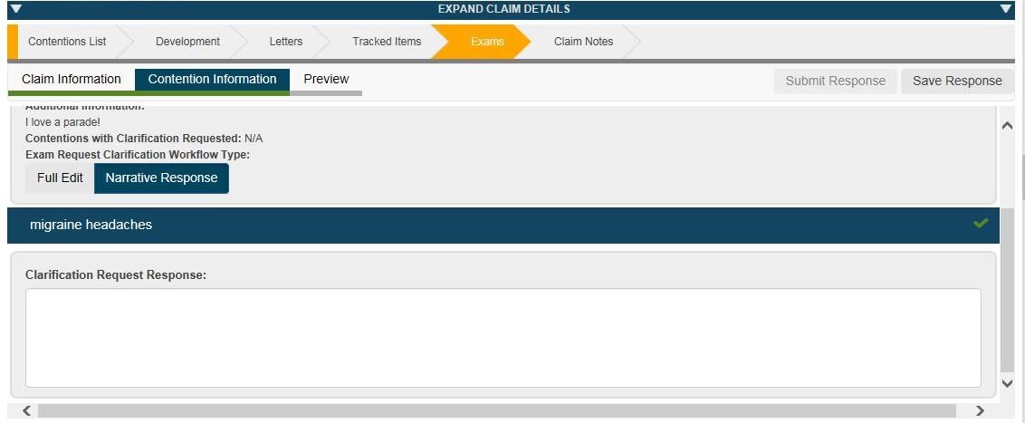
Responding to a Request for Clarification (continued)
If the request for clarification arises at the contention level and the examination appointment(s) has/have been scheduled (Narrative Response only)
Select the Contention Information tab
Enter necessary information in the Clarification Request Response field
Entry of a clarification request response on the Claim Information tab is optional in this instance

Slide 12
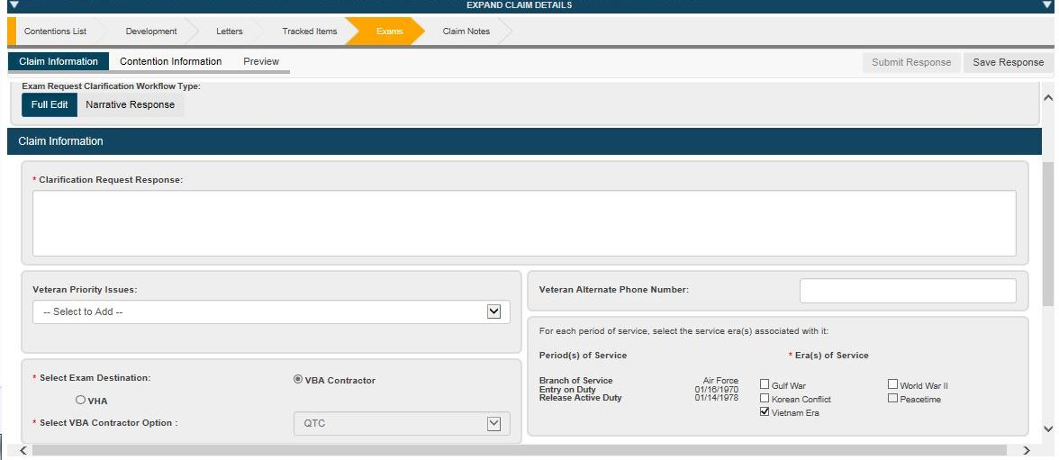
Responding to a Request for Clarification (continued)
If the request for clarification arises at the contention level and the examination appointment(s) have not been scheduled and edits or corrections are required
Select Full Edit button from Claim Information tab
Enter necessary information in the Clarification Request Response field
Use the Claim Information tab to make any and all necessary corrections to claim-level system entries and attributes
Use the Contention Information tab to make any and all necessary corrections to system entries associated with affected contentions

Slide 13
Responding to a Request for Clarification (continued)
If the request for clarification arises at the exam scheduling request level and the examination appointment(s) have not been scheduled and edits or corrections are not required
Select Narrative Response button from Contention Information tab
Enter necessary information in the Clarification Request Response field

Slide 14
Responding to a Request for Clarification (continued)
Complete all required fields
Preview the Request for Clarification response
Submit Response
Veteran’s eFolder
Document Type: Exam Request
Subject: Clarification Response

Slide 15
Modification Request

Slide 16
Modification Request
Modification Request – is created to change the exam request address, modify appointments, add special instructions, cancel contentions, or cancel the exam request entirely.
Can be submitted for any exam scheduling request in Open status
Cannot be initiated, if a response to a Request for Clarification has not been sent

Slide 17
Modification Request (continued)
Cancel Entire Scheduling Request: Use this option to cancel the exam scheduling request. If you select this option, you cannot select any other modification reasons.
Cancel Contentions: Use this option to cancel one or more contentions on the exam scheduling request.
Change Address: Use this option to add or edit a preferred geographic address, or use the current mailing address in the Veteran Profile.
Modify Appointments: Use this option to request that an appointment be rescheduled or cancelled. (At least one appointment has been scheduled)
Provide Special Instructions: Use this option to add special instructions for one or more contentions on the exam scheduling request.

Slide 18
Modification Request (continued)
Can select more than one Modification type, with the exception of Cancel Entire Scheduling Request
Cancel Entire Scheduling Request will disable the selection of all other types

Slide 19
Modification Request (continued)
Cancel Contentions
Select the contentions to be canceled
Enter the Cancellation Reason
Other – requires an explanation in the rationale for contention cancellation box
Do not cancel contentions if there is an appointment scheduled within 24 hours

Slide 20
Modification Request (continued)
Change Address
Modification Address – Select Mailing Address or Preferred Geographic Location
Copy Preferred Address – To add the current preferred geographic location

Slide 21
Modification Request (continued)
Modify Appointments
Only shown if at least one appointment has been scheduled
This is a request for Exam Management System (EMS) to modify appointments
Type of Change – Reschedule or Cancellation
Reason for Change – Free text

Slide 22
Modification Request (continued)
Provide Special Instructions
Enter the required special instructions

Slide 23
Modification Request (continued)
Cancelling Exam Scheduling Requests
Select Cancel Entire Scheduling Request
Select a reason from Cancellation Reason list
Other – requires an explanation in the rationale for contention cancellation box
Do not cancel contentions if there is an appointment scheduled within 24 hours

Slide 24
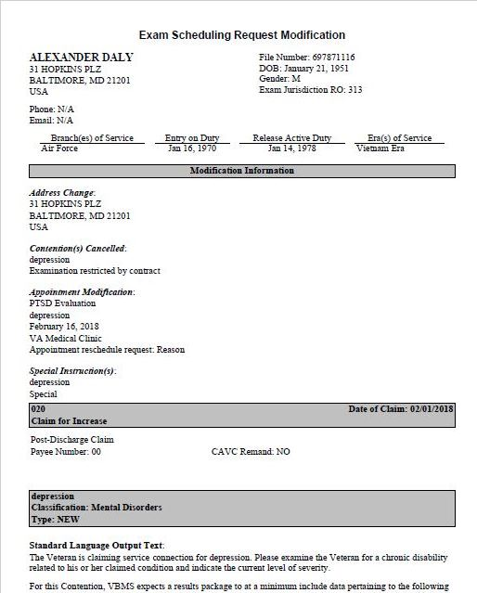
Modification Request (continued)
Preview the modification request
Submit Modification
Veteran’s eFolder
Document Type: Exam Request Modification
Subject: Exam Request

Slide 25
Rework Request

Slide 26
Rework Request
Rework Request – is communication from the claims processor about insufficient or inadequate examinations. This is a request for an updated or corrected exam.
Only shown for exam scheduling request with a Completed status
VBA Contract examiners – 14 days to clarify any insufficiency

Slide 27
Rework Request (continued)
To complete a Rework Request from the Exam Scheduling Request Summary Page select:
Informational Indicator → notification when a Results Package is received
Actions menu → Rework

Slide 28
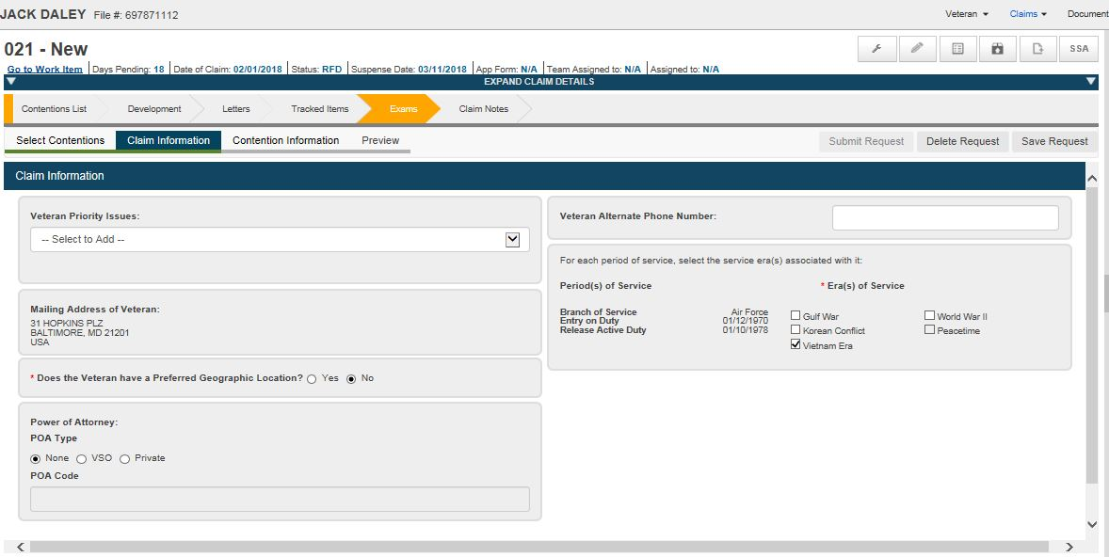
Rework Request (continued)
Only able to select the contentions associated with the initial exam scheduling request
Select the contention that requires rework
Select Claim Information tab and edit information as needed

Slide 29
Rework Request (continued)
For each contention selected for rework request provide:
Rework Type
Rework Reason
Detailed Rationale for Rework

Slide 30
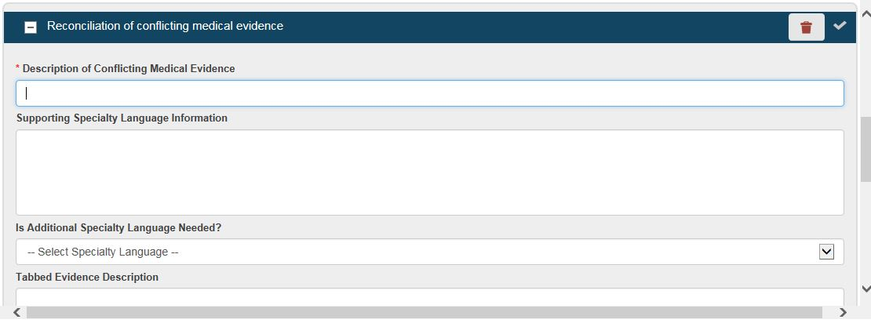
Rework Request
If the contention needs resolution of a conflicting opinion or diagnosis
Select the Is Specialty Language Needed?, then
Select Reconciliation of conflicting medical evidence
Complete the Description of Conflicting Medical Evidence and any other fields, as applicable

Slide 31
Rework Request
Preview the rework request
Submit Rework
VBA Contractor Examiner from initial scheduling request
Veteran’s eFolder
Document Type: Exam Request
Subject: Exam Rework

Slide 32
Questions
If you encounter technical issues under the new Exam Management in VBMS Release 14.1 functionality, please submit a ticket to the National Service Desk (NSD), itsc@va.gov.
For other questions, please email VAVBAWAS/CO/Contract Examination Inquiries.

