Slide 1
Compensation Service
February 2018
Creating Exam Scheduling
Request in VBMS

Slide 2
Objectives
Utilizing the training materials, VBMS Core User Guide, and available references, claim processors will be able to identify the steps required to create exam scheduling requests in VBMS, and complete the post-assessment with a minimum of 80% accuracy.

Slide 3
References
M21-1, Part III, Subpart iii, 1.F, Record Maintenance During the Development Process
M21-1, Part III, Subpart iv, 3.A, Examination Request Overview
M21-1, Part III, Subpart iv, 3.C, Control of Examinations
M21-1, Part III, Subpart iv, 3.D, Examination Reports
M21-1, Part III, Subpart iv, 3.F, Examination in Special Situations
M21-1, Part III, Subpart iv, 4.M, Endocrine Conditions
M21-1, Part III, Subpart iv, 4.O, Mental Disorders
VBMS Core User Guide – Release 14.1

Slide 4
Navigating The Exam Menu

Slide 5
Exam Scheduling Request Summary
Heart

Slide 6
Exam Scheduling Request Summary - Indicators

Slide 7
Exam Scheduling Request Details (View Details)

Slide 8
Exam Scheduling Request History (View History)

Slide 9
Creating Exam Scheduling Request

Slide 10
Create New Request

Slide 11
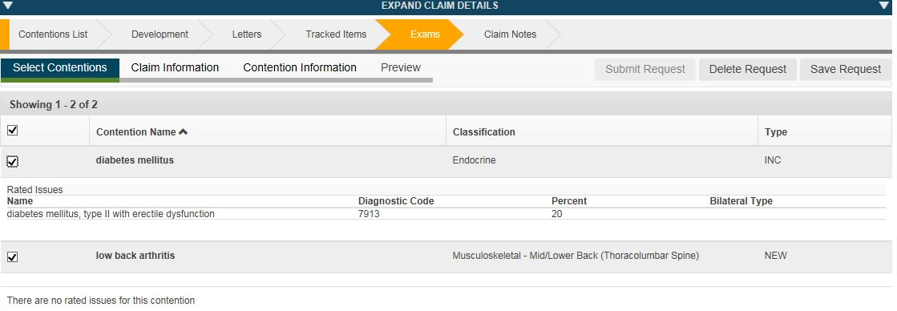
Select Contentions Tab

Slide 12
Claim Information Tab

Slide 13
Contention Information Tab

Slide 14
Contention Information Tab (continued)

Slide 15
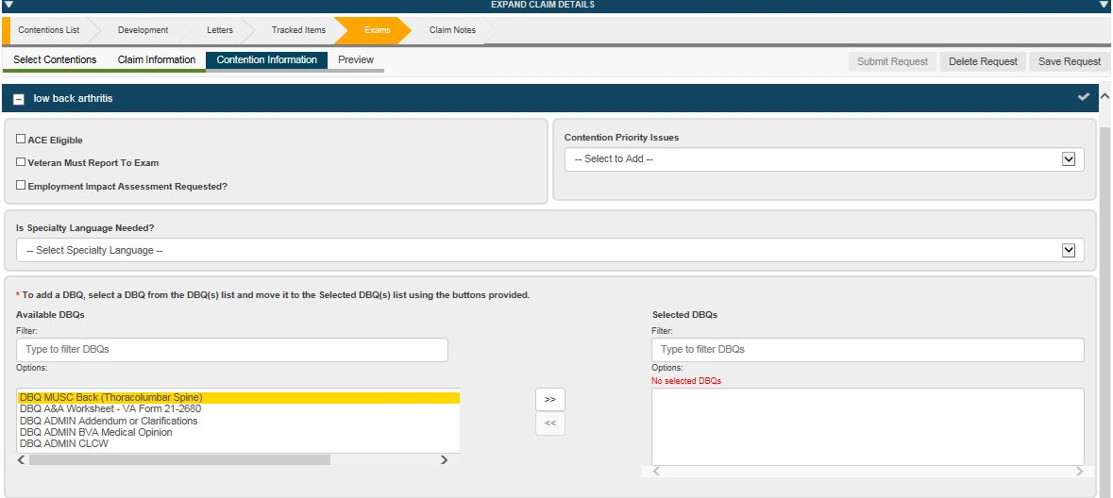
Contention Information Tab (continued)

Slide 16
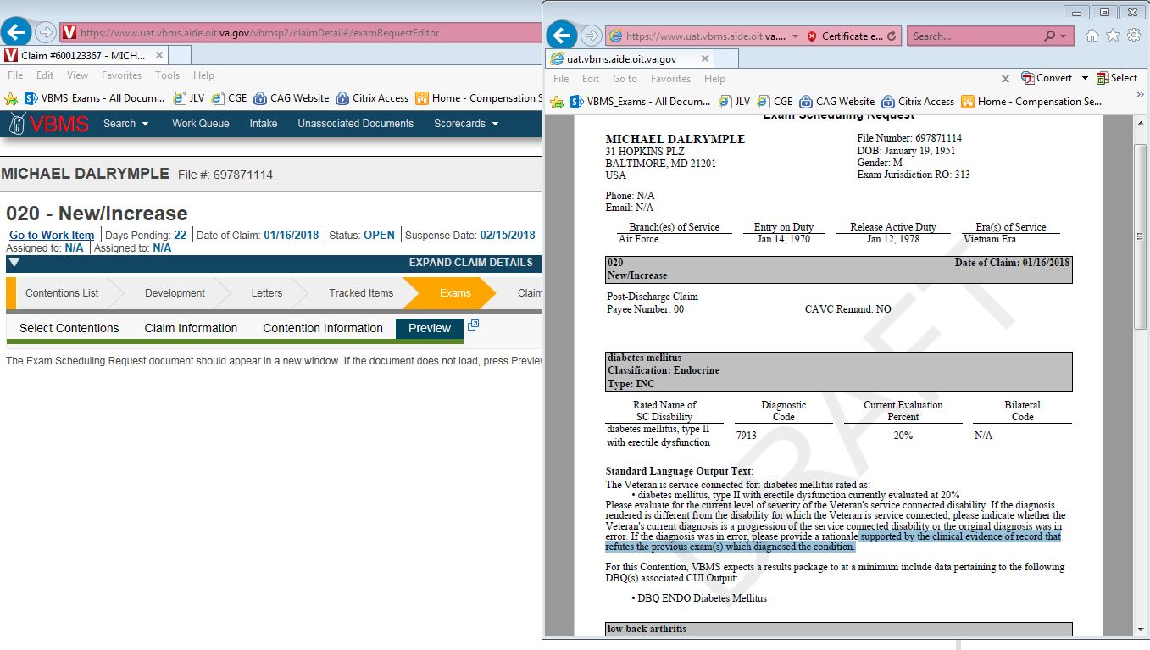
Preview Tab

Slide 17
Edit Request & Delete Request

Slide 18
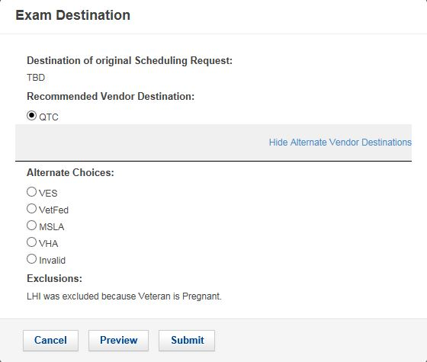
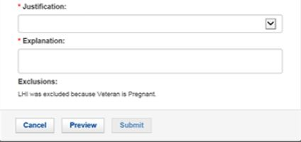
Exam Destination Dialog

Slide 19
Submit Request
PDF is generated and uploaded to the Veteran’s eFolder
Document type of ‘Exam Request’ and a subject that is blank
VBMS → Data Access Services (DAS) → Exam Management System (EMS)
View History (Exam Scheduling Request Summary)
Scheduling Request Submitted
Scheduling Request Successfully Delivered
Scheduling Request Delivery Failed

Slide 20
Scenarios

Slide 21
Scenario 1 – EP 110 (within a year of discharge)
The Veteran has filed an original claim for service connection within a year of discharge
Hearing loss (due to hazardous noise exposure)
Tinnitus (due to hazardous noise exposure)
Left knee strain
Posttraumatic stress disorder (PTSD).
insomnia, anxiety and depression
Watch as I go through the steps of this exam request…

Slide 22
Scenario 2 – EP 020 (Diabetes Mellitus with Complications)
The Veteran has filed a claim (outside of a year from discharge)
Diabetes mellitus, type II with erectile dysfunction (increase)
Left lower extremity peripheral neuropathy (secondary to DM II)
Right lower extremity peripheral neuropathy (secondary to DM II)
Watch as I go through the steps of this exam request…

Slide 23
Scenario 3 – EP 020 (Increase, Secondary, and SMC A&A)
The Veteran has filed a claim (outside of a year from discharge)
Right knee degenerative joint disease (increase)
Left knee degenerative joint disease (secondary to the SC right knee)
Special monthly compensation Aid & Attendance (service connected heart condition evaluated at 100% disabling).
No VA Form 21-2680 was received with claim.
Watch as I go through the steps of this exam request…

Slide 24
Questions
If you encounter technical issues under the new Exam Management in VBMS Release 14.1 functionality, please submit a ticket to the National Service Desk (NSD), itsc@va.gov.
For other questions, please email VAVBAWAS/CO/Contract Examination Inquiries.

