Slide 1
Compensation Service
February 2018
Exam Scheduling Request Submission Status and Exam Activity

Slide 2
Objectives
Utilizing the training materials, VBMS Core User Guide, and available references, claim processors will be able to identify exam scheduling request submission statuses and exam activity within Exam Management in VBMS, and complete the post-assessment with a minimum of 80% accuracy.

Slide 3
References
M21-1, Part III, Subpart iv, 3.A, Examination Request Overview
M21-1, Part III, Subpart iv, 3.C, Control of Examinations
M21-1, Part III, Subpart iv, 3.D, Examination Reports
VBMS Core User Guide – Release 14.1

Slide 4
Exam scheduling Request submission statuses

Slide 5
Submission Successful
Contention tracked item – Exam Request – [Contention Name]
Tracked item initial suspense – 30 days
Exam Scheduling Request level – Open
Contention level – Triage
View History – Scheduling Request Received
Claim suspense – 30 days
Claim suspense reason – VA/Contract exam requested, awaiting results

Slide 6
Submission Failure – Within VBMS
If there is an initial point of failure within VBMS, after selecting Submit Request
A red banner error message will appear
Claim processor can immediately retry the submission

Slide 7
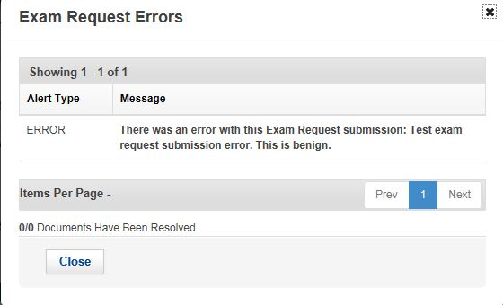
Submission Failure – VBMS to DAS (Outbound)
Exam Scheduling Request level – Error
Tracked Item – Exam Request Processing
Tracked Item & Claim Level Suspense – current date
Error encountered icon – Exam Scheduling Request Summary page
Retry Submission – Under the Actions menu
Suspense Date - current date +1
Resubmission Success – Tracked item is deleted
Resubmission Failure – Tracked item remains & suspense date is set to current date

Slide 8
Exam Activity

Slide 9
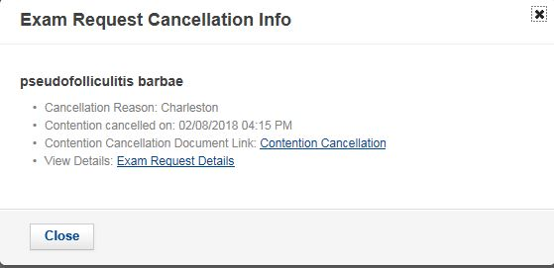
Contention Activity – Contentions Cancelled by EMS
Informational Indicator - Exam Scheduling Request Summary page
Contention level status – Canceled
If all contentions are canceled, Exam Scheduling Request level status is updated to Canceled
Tracked item – Updated with a received date
EMS Contention Cancellation document – added to eFolder

Slide 10
Contention Activity – Contentions Deleted Outside of VBMS
When a contention associated with an exam scheduling request is deleted in an application outside of VBMS
Error Encountered icon – Exam Scheduling Request Summary page
Contention Deleted - Exam Scheduling Request Summary & Details screens
Create a modification request to cancel the deleted contentions

Slide 11
Appointment Activity – Scheduled Appointments
Contention level status – Scheduled
Appointment level status – scheduled or ACE assigned
Claim Suspense date – date of appointment + five (5) days
If there are changes – set to the new appointment date + five (5) days

Slide 12
Appointment Activity – Completed or Cancelled Appointments
Appointment and contention level status – Completed
Scheduled appointment is completed
Exam Scheduling Request level status – Completed
If all other exams and contentions on request are completed or canceled
Appointment and contention level status – Canceled
Scheduled appointment is canceled
Exam Scheduling Request level status – Canceled
If all other exams and contentions on request are canceled

Slide 13
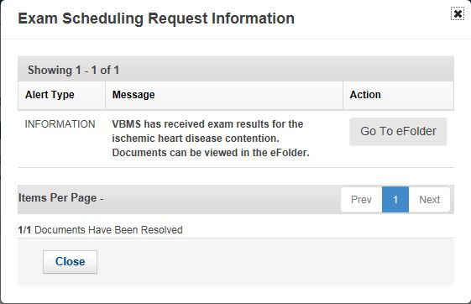
Complete Results Available
Contention level status – Complete
Exam results are received & no appointment exists
Informational Indicator – Exam Scheduling Request Summary page
Summary of how many documents were resolved.
Exam Scheduling Details and History page – Provides link to results, date received, records the status of “Exam Results Received” (next slide)

Slide 14
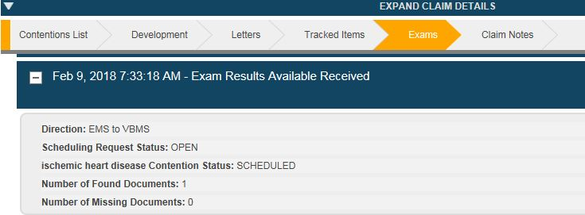
Complete Results Available (continued)

Slide 15
Complete Results Available (continued)
Resolve Document button (image not available)
If one or more documents are unresolved (upload error), the DBQs should be corrected (via a National Service Desk (NSD) ticket) and re-uploaded
Claim processor manually resolved by selecting the “Resolve Document” button
All documents are successfully resolved, the contention tracked item is closed, with the current date in the Received Date field

Slide 16
Questions
If you encounter technical issues under the new Exam Management in VBMS Release 14.1 functionality, please submit a ticket to the National Service Desk (NSD), itsc@va.gov.
For other questions, please email VAVBAWAS/CO/Contract Examination Inquiries.

