Slide 1
Compensation Service
February 2018
Introduction to Exam Management in VBMS

Slide 2
Objectives
Utilizing the training materials, VBMS Core User Guide, and available references, claim processors will be able to identify the fundamentals of and manual references that apply to Exam Management in VBMS, and complete the post-assessment with a minimum of 80% accuracy.

Slide 3
References
M21-1, Part III, Subpart iii, 1.B, Evidence Requested from the Claimant
M21-1, Part III, Subpart iii, 1.F, Record Maintenance During the Development Process
M21-1, Part III, Subpart iv, 3.A, Examination Request Overview
M21-1, Part III, Subpart iv, 3.C, Control of Examinations
M21-1, Part III, Subpart iv, 3.D, Examination Reports
M21-1, Part III, Subpart iv, 3.F, Examination in Special Situations
VBMS Core User Guide – Release 14.1
Exam Request Builder (ERB) User Guide
Exam Integration: As-Is, To-Be Visual Aid

Slide 4
What is the Exam Management Functionality
Initiate and develop exam scheduling request
All claims with Benefit Program Type of ‘CPL’ (live Veteran claims), except A&A spouse and helpless child
Scheduling request for all contention types, except ‘non-medical’ or with ‘Administrative Issue’ classification
Integration with Exam Management Systems (EMS)
VBA Contractors (current)
VHA (pending)
Data Access Services (DAS)
Services related to storing, retrieving, or acting on data kept in a database or repository.

Slide 5
Terminology
Exam scheduling request – VBA sends a list of contentions to the examining entity requesting that all appropriate examinations necessary to provide required DBQ results be scheduled.
Disability Benefit Questionnaires (DBQs) – is(are) a(n) part of an exam(s) result package, not the exam itself. Clinicians add additional DBQs to results package as findings dictate.
Examinations – Clinical encounters scheduled by the examining entity (VHA or VBA Contracted) can include all normal exams as well as lab work, imaging, and other tests and clinical studies.

Slide 6
As-Is → To-Be

Slide 7
As-Is → To-Be (continued)

Slide 8
Expectations for EMS in VBMS Release 14.1
Data and language automation
ERB – S – as needed (Military Sexual Trauma (MST) and Female Sexual Arousal Disorder (FSAD))
Destination determination
Preview, editing and final submission
System consolidates and sends exam scheduling request
System receipt of status updates and exam results
Exam related deferrals

Slide 9
Examination Request tools

Slide 10
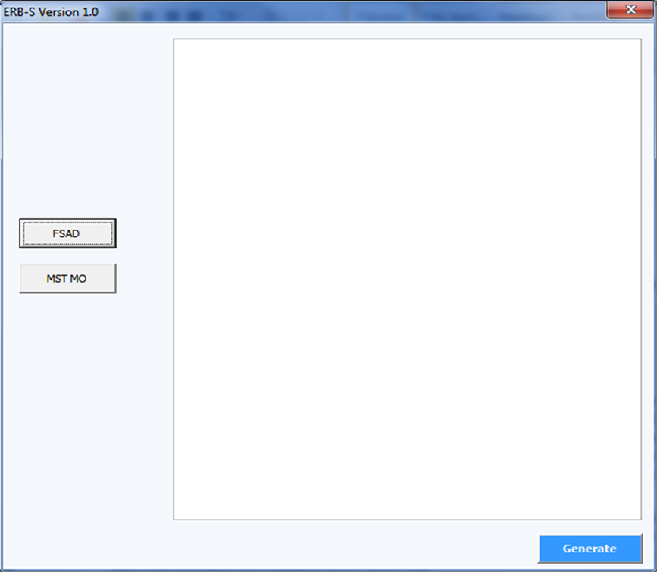
Exam Request Builder – Simplified (ERB-S)
Workaround while awaiting integration into the current or future versions of VBMS (M21-1.III.iv.3.A)
VBMS Release 14.1 use for the following:
MST MO: Select Other in the ‘Select Specialty Language’ drop-down menu, then input generated text in the ‘Supporting Specialty Language Information’ field. (M21-1. IV.ii.1.D.)
FSAD: Input in the ‘Special Instructions’ field under the ‘Available DBQs’ and ‘Selected DBQs’ boxes. (M21-1.III.iv.4.J)

Slide 11
Examination Request Routing Assistant (ERRA)
Mandatory use of the ERRA Tool is required
Determine if exam scheduling request should go to VHA or a VBA Contract Examiner
VBA Contract Examiner will not be specified
Determined based on VHA capacity reporting
Remember, to review Contract Exam Exclusions List (M21-1.III.iv.3.A)

Slide 12
ERRA

Slide 13
Veteran’s Profile Screen & Contentions List

Slide 14
Veteran’s Profile Screen & Contentions List
Veteran’s Profile Screen
Review address and phone number
Contentions List (on the Development Plan task bar)
Contention field
Classification field
Type Field
Medical field
Special Issue field, when applicable
Rated Issues

Slide 15
Editing and Removing Contentions Included on an Exam Scheduling Request
Editing Contentions
Exam Scheduling Request Contention Notification
Exam Request in Draft Status – update prior to submitting initial request
Exam Request in Open Status – submit the appropriate modification request
Removing Contentions within VBMS
Not permitted to delete a contention
Removing Contentions outside of VBMS
An error icon is added to the request
Contention Deleted – shown in Summary and Details view
Modification Request – required to cancel the deleted contention(s)

Slide 16
Exam Related Statuses

Slide 17
Exam Statuses – Draft

Slide 18
Exam Statuses – Processing

Slide 19
Exam Statuses – Error

Slide 20
Exam Statuses – Open (Contention Level – Triage and Request for Clarification)

Slide 21
Exam Statuses – Open (Contention Level – Scheduled)

Slide 22
Exam Statuses – Completed

Slide 23
Exam Statuses – Canceled

Slide 24
Exam Scheduling Request Tracked Items

Slide 25
Exam Scheduling Request Tracked Items
Exam request processing
Temporary (~2 days) while awaiting successful submission to DAS
Exam request or exam rework request is successfully submitted to the EMS
Suspense Reason: VA/contract exam requested, awaiting results
When one or more medical examinations are scheduled for a contention
Automatically set to the date of the furthest medical examination appointment date plus the ‘float’ days (5 calendar days)
Exam request - VHA request for clarification or exam request - VBA contractor request for clarification
Suspense Reason: VHA request for clarification or VBA contractor request for clarification

Slide 26
Questions
If you encounter technical issues under the new Exam Management in VBMS Release 14.1 functionality, please submit a ticket to the National Service Desk (NSD), itsc@va.gov.
For other questions, please email VAVBAWAS/CO/Contract Examination Inquiries.

