Slide 1
Compensation Service
January 2018
Introduction to End Product Controls and
Claims Establishment

Slide 2
Lesson Objectives
Identify how End Product (EP) controls affect claim management, productivity, and staffing
Identify a duplicate claims folder number and avoid creation of a duplicate claims folder
Establish a claim using Veteran Benefits Management System (VBMS)
Describe procedures for adding contentions and special issues into VBMS
Define procedures for creating a Corporate or Regional Office Flashes

Slide 3
References
M21-1, Part III, Subpart ii, 1.C, Initial Screening Policies
M21-1, Part III, Subpart ii, 3.D, Claims Establishment
M21-1, Part III, Subpart iii, 1.F, Record Maintenance During the Development Process
M21-1, Part III, Subpart ii, 3.A, Assignment of Claims Folder Numbers
M21-1, Part III, Subpart ii, 4.E, Consolidation of Duplicate Beneficiary Identification and Records Locator Subsystem (BIRLs) Records and Corporate Records
M21-1, Part III, Subpart iii, 5, General Information on Relationship and Dependency
M21-4, Appendix B, End Product Classification Codes and Work Rate Standards for Quantitative Measurement
SHARE User’s Guide
VBMS User Guide
VBMS Online Help

Slide 4
End Products
The End Product (EP) system is the primary workload monitoring and management tool for the Veterans Service Center (VSC).
Correct work measurement is essential to:
  Substantiate proper staffing requirements
  Determine productive capacity
  Formulate the annual budget submission to the Secretary, Office of Management and Budget (OMB), the President, and Congress

Slide 5
Establishing and Maintaining EP Controls
Each claim should be promptly paced under EP control.
EP should remain pending until all required actions on that claim have been completed.

Slide 6
Examples of EPs
EP codes 010 and 110 are used for original claims, based on the number of disabilities claimed:
    EP 010 - claims containing eight issues or more
    EP 110 - claims containing seven issues or less
EP codes 020 are used for non-original claims regardless of the number of disabilities claimed. M21-1 III.ii.3.b includes more information on determining the EP for original and supplemental rating related claims.
EP codes 130 are used for dependency claims.

Slide 7
Preparing for Claims Establishment (CEST)
Step | Action
1 | Review the VBMS exclusions to determine the system in which to place the claim under control.
2 | Important***Check for a previously established claims folder number.
3 | Determine the current claims folder format and request scanning of paper claims folders.
4 | Establish a claims folder in VA systems (if necessary).

Slide 8
Duplicate Record Prevention
Assigning a Claims Folder Number
Associate the records for all claimants and beneficiaries to a claims folder number. There are two types of claims folder numbers used by the Veterans Benefits Administration (VBA) based on
  the Veteran’s Social Security number (SSN), or
  an eight-digit claims folder number assigned through the Beneficiary Identification and Records Locator Subsystem (BIRLS).
Use the table located in M21-1.III.ii.3.A to determine the claims folder number to assign.
All documents received by VBA with identifying personal information require association with a claims folder number regardless of the need for claims establishment or confirmation of Veteran status.
Important: To avoid duplicate claim (DUPC) processing, conduct a thorough search of all systems for a previously established claims folder number as outlined in M21-1, Part III, Subpart ii, 3.A.

Slide 9
Duplicate Record Prevention
When to assign a Claims Folder Number
All documents received by VBA with identifying personal information require association with a claims folder number regardless of the need for claims establishment or confirmation of Veteran status.
Important: To avoid duplicate claim (DUPC) processing, conduct a thorough search of all systems for a previously established claims folder number as outlined in M21-1, Part III, Subpart ii, Chapter 3, Section A.

Slide 10
Duplicate Record Prevention
Preventing Duplication of BIRLS Records
Prior to the addition of any new Beneficiary Identification and Records Locator Subsystem (BIRLS) record, the following must be completed to avoid the creation of a duplicate corporate record:
  select BIRLS INQUIRY in the Veterans Benefits Administration (VBA) application Share
  input the file number for the Veteran, and
  follow the instruction in M21-1 Part III, Subpart ii, Chapter 4, Section E
Important: An alternative search can be competed using VBMS “More Search Options”. This is an expedient search but is not a conclusive search.

Slide 11
CEST in VBMS vs SHARE
VBMS | SHARE
All original and subsequent claims for compensation | Any claim where the claimant is an organization
Pension and survivor claims | Appeals where the appellant is not a child, spouse, or parent of the veteran
Most claims types for which a VBMS record already exists | Accrued claims upon the death of a surviving spouse or child
 | Pending paper claims, including any new claim filed while a paper claim is pending
 | A claim or work item for which the claimant has a department of veterans affairs (VA) appointed fiduciary

Slide 12
Establishing New EP
Verify Veteran’s contact information on the Veteran’s Profile
Complete the entries on New Claim Screen
Add Contentions
Veteran’s service information should be verified prior to establishing a new claim. If service information needs to be updated that action will take place in SHARE, BIRLS Update and Participant Profile.

Slide 13
Date of Claim (DOC)
For CEST purposes, the DOC is the earliest date the claim was received by the VA. Examples include but are not limited to:
    eBenefits
    VA Regional Office
    VA Centralized Mail Facility
    VA employee at an outreach event
    VA Public Contact team
    VA Call Center
    VA Medical Center
VA requires a date stamp received by Intake Processing Center (IPC) or an electronic date stamp on all information received, including claims, applications, and associated evidence.

Slide 14
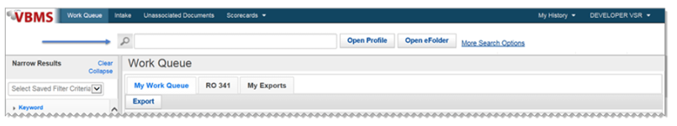
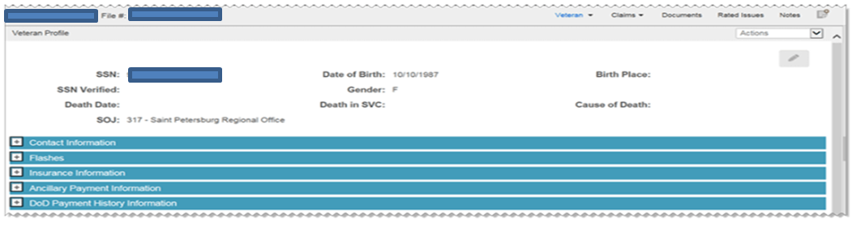
Veteran’s Profile Screen
Search file number here

Slide 15
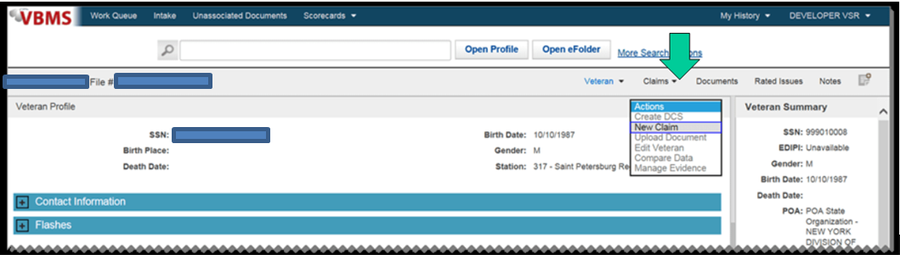
Establishing a New Claim
Upon verifying the Veteran’s personal information and ensuring identity of the Veteran for which the claim is being established, Click Actions and select New Claim. The Claim Establishment page opens to the New Claim Information section.

Slide 16
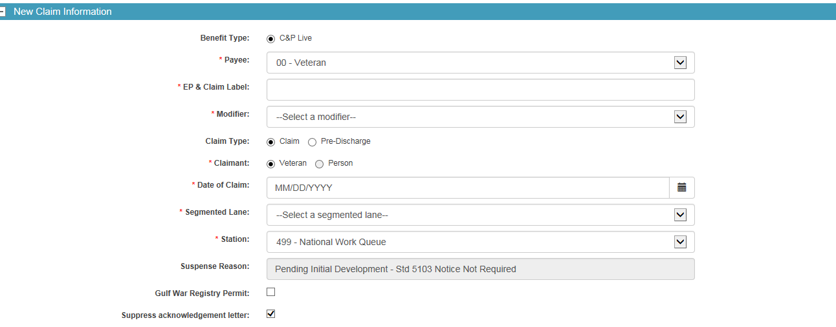
New Claim Information Screen

Slide 17
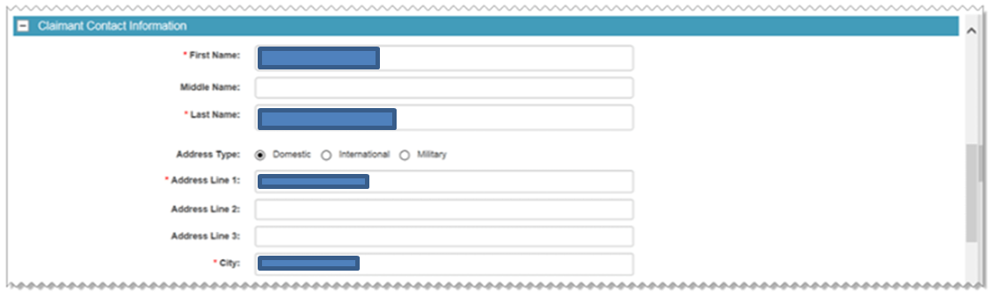
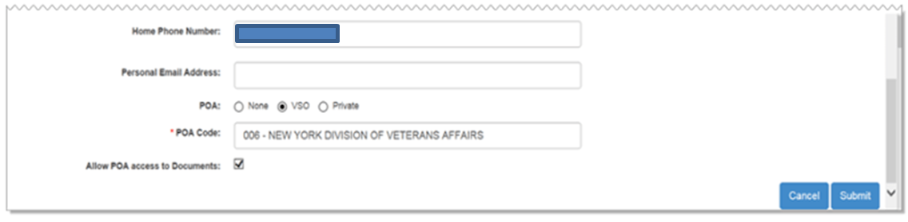
Claimant Contact Information
Verify the Veteran’s information and change as needed.

Slide 18
Contentions
Upon clicking Submit from the claim information screen the system automatically directs to the contention adding process.
All claimed issues must be entered as contentions as they are claimed by the Veteran on the application for benefits.
Each claimed issue, including non-rating issues, must be entered as a separate contention. Non-rating contentions should relate to the specific benefit being sought.

Slide 19
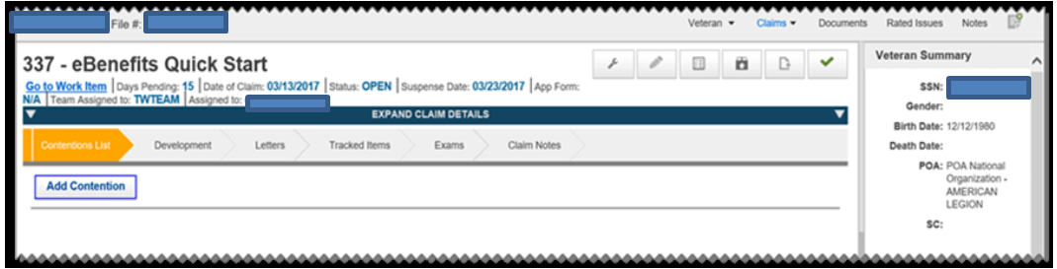
Adding Contentions
Once directed to the contention development task bar click
“add contention” then allow the system to guide you.

Slide 20
Adding Contentions (Cont)
Add the contention, classification, date of contention, verified,
type and medical.

Slide 21
Example of Appropriate Naming
A Veteran submits a claim for ringing in the ears. The contention should be entered as ringing in the ears.
A veteran submits a claim to add a spouse and a child. Create separate contentions for the spouse and child in the manner below:
  Dependency claim for [name of spouse], and
  Dependency claim for [name of child]

Slide 22
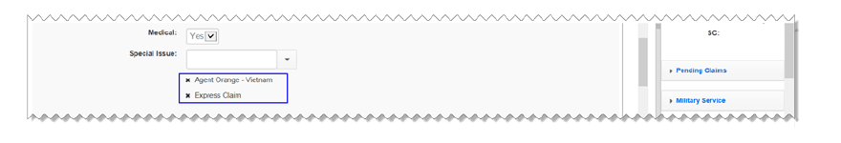
Special Issues
Special issues apply to the contention. Select an issue from the list that apply. You can add multiple special issues to a contention, but you cannot enter the same special issue more than once.

Slide 23
Rated Issues
Contentions with a type that is secondary or increase are often associated with issues that have been previously determined.

Slide 24
Reviewing Established Contentions
All contentions must be verified in order for them to be available via eBenefits.
Contentions automatically entered by the system that are missing critical information will be marked unverified. The claims processor must update the missing/correct information.
Contentions that need reviewed are indicated with an alert Icon.

Slide 25
Adding Flashes in SHARE
Claimant flashes are claimant-specific indicators that represent an attribute, fact, or status that may occasionally change such as:
  POW
  Homeless
  Hardship
  Blind Veteran
Flashes can be reviewed in VBMS but must be entered through SHARE if they are entered manually.

Slide 26
How to Add a Flash in SHARE
Open Share from your Start menu
Under Search Criteria, enter the File Number
Select the Submit button
Select Corporate Flash from the Available Processes list on the Ready Screen

Slide 27
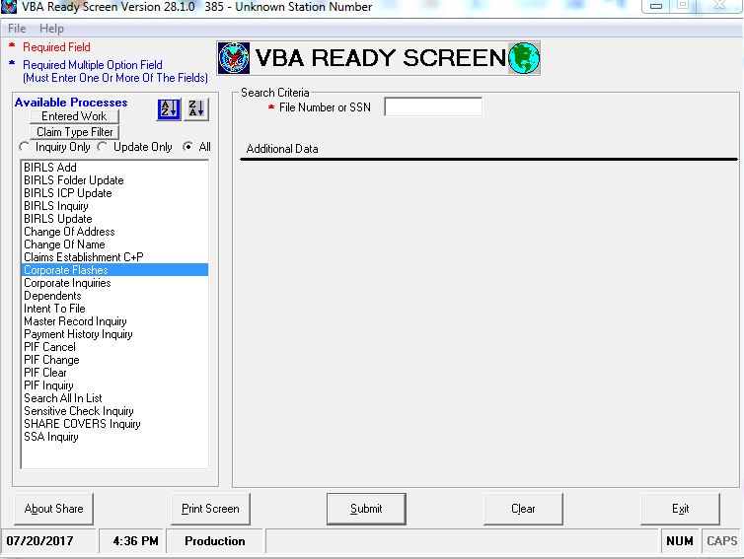
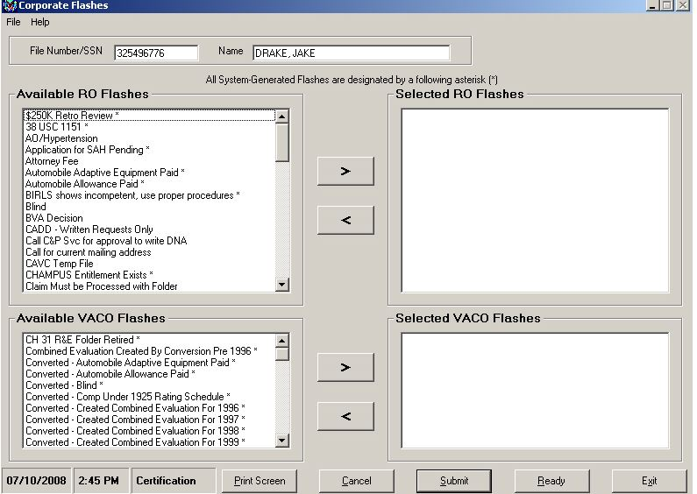
How to Add a Flash in SHARE (Cont)
Select desired flashes from the Available RO Flashes or Available VACO Flashes. Use the > button to add the flashes to the Selected boxes. When all flashes are selected, click the Submit button. A message will be displayed stating the updates are complete.

Slide 28
Handout Review and Questions
Attachment A: End Product Codes
Attachment B: VBMS Claims Establishment Flowchart
Attachment C: Exercise

Slide 29
Questions

