Slide 1
Compensation Service
January 2018
Dependency and Apportionment Claims Establishment

Slide 2
Lesson Objectives
To understand the procedures for and how to effectively establish a dependency claim.
To understand the procedures for and how to effectively establish a claim for apportionment.

Slide 3
References
M21-1, Part III, Subpart iii, Chapter 5, Section A
M21-1, Part III, Subpart i, Chapter 4, Section E
M21-1, Part III, Subpart ii, Chapter 3, Section D
M21-1, Part III, Subpart iii, Chapter 1, Section F
M21-4, Appendix B

Slide 4
Dependency Claim Overview
The VA may pay additional disability compensation to a Veteran for his/her dependent(s) if the Veteran has a combined disability rating of at least 30 percent
VA may pay additional Dependency and Indemnity Compensation (DIC) to a surviving spouse for any of his/her children that VA recognizes as children of the Veteran on whose death the DIC award is based

Slide 5
Dependency Claim Overview (continued)
The existence of dependents and the amount of their income is a factor in determining entitlement in both Veterans pension and survivors pension cases
A claimant’s entitlement to survivors benefits, such as DIC and survivors pension, is contingent on his/her relationship to the Veteran on whose death the benefit is based

Slide 6
Prescribed Forms for Dependency
Effective March 24, 2015, a claimant must submit a dependency claim on the prescribed form.
M21-1, Part III, Subpart ii, Chapter 2, lists the prescribed forms which can be used.
The most common form used is the VA Form 21-686c, Declaration of Status of Dependents.

Slide 7
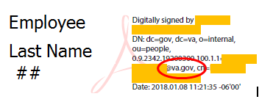
Dependency Claims Signed by VA Employees
A call center or Regional Office employee can complete and sign a VA Form 21-686c and VA Form 21-674.
The form must include clear identification of the employee executing the form through a digital signature or a wet signature, when electronic submission is not available.
38 CFR 3.160(a)(2) allows VA to accept a VA Form 21-686c that a VA –recognized representative (power of attorney) signs and submits to VA on a claimant’s behalf as if the claimant submitted it himself/herself.

Slide 8
A Claim for a Child Incapable of Self-support
A claim for a child incapable of self-support (helpless child) can be submitted on one of the following forms:
21-526
21-526b
21-526EZ
21-686c, Declaration of Status of Dependents
21P-527
21P-527EZ
21-534, Application for Dependency and Indemnity Compensation, Death Pension and Accrued Benefits by a Surviving Spouse or Child (Including Death Compensation if Applicable)
21P-534EZ, Application for DIC, Death Pension, and/or Accrued Benefits
21P-534a, Application for Dependency and Indemnity Compensation by a Surviving Spouse or Child - In-Service Death Only

Slide 9
A Claim for a Child Incapable of Self-support (continued)
A VA Form 21-0538, Status of Dependents Questionnaire, will also be accepted as a claim to add the dependent(s) to the Veteran’s award.
End products needed to add child incapable of self-support to a Veteran’s award:
Veteran in receipt of pension. EP 120
Veteran in receipt of compensation. EP 020

Slide 10
Establishing Dependency Claims in VBMS
When a substantially complete claim for dependency has been received the appropriate end product (EP) will be established in VBMS.
Use of contentions for each claim is mandatory.
A Veteran submits a claim to add a spouse and a child to a running award. Create separate contentions for the spouse and child as follows:
Dependency claim for [name of spouse], and
Dependency claim for [name of child].

Slide 11
End Products (EP)
Most dependency claims are controlled using EP 130 series.
An EP 120 would be established for an initial claim on a child incapable of self-support based on pension entitlement.
An EP 020 would be established for an initial claim on a child incapable of self-support based on compensation entitlement.
When information is received that suggests a potential under/overpayment may exist, Veterans Service Centers (VSCs) must establish an EP 693 concurrently with a controlling EP to monitor timeliness in completing action on potential under/overpayments. Therefore an EP 693 would also be established when a claimant is requesting that their dependent be removed from their award.

Slide 12
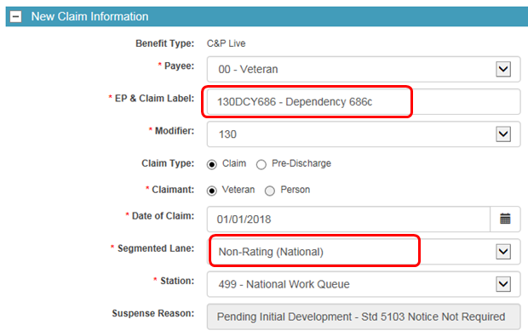
End Products (EP)
Ensure the correct claim label and segmented lane are selected when establishing the EP in VBMS.

Slide 13
Establishing an Apportionment Claim
An apportionment claim can be filed against the Veteran’s benefit, as described in M21-1, Part III, Subpart v, 3.A.
Apportionment claims must be established in VBMS, unless otherwise directed by the Office of Field Operations (OFO).

Slide 14
General Information on Establishing Apportionment Claims
An apportionment may be paid to
an estranged spouse and child
children in an estranged spouse’s custody
a child or children not living with the primary beneficiary or surviving spouse and to whom the primary beneficiary or surviving spouse is not reasonably contributing, or
a dependent parent (in compensation cases).

Slide 15
Establishing a Claim for Apportionment
In order for a claimant to receive an apportionment of a competent primary beneficiary’s benefits, the claimant must file a claim on VA Form 21-0788, Information Regarding Apportionment of Beneficiary’s Award.
If a request for an apportionment is received and it is not on the prescribed form you would establish an EP 400 with the claim label Request for Application and use VBMS to generate the letter titled Request for Application – Apportionment

Slide 16
Establishing a Claim for Apportionment (continued)
Step 1: Open the Veteran’s profile page.
Step 2: From the ACTIONS drop-down menu, select NEW CLAIM.
Step 3: Select the PAYEE code that identifies the individual who will receive the apportioned funds.
Step 4: Click the drop-down menu after ensuring the
CLAIMANT field is set to Person, and
SHOW ALL DEPENDENTS/CLAIMANTS radio button is selected.

Slide 17
Establishing a Claim for Apportionment (continued)
Step 5:
If the individual to receive the apportioned funds is available select the individual from the list verify and/or update the required claimant contact information fields, and proceed to Step 7.
If the individual to receive the apportioned funds is not available the individual will need to be added to the corporate record. Proceed to the next step.
Step 6:
Click the SEARCH FOR PERSON button and attempt to lookup the individual by SSN and other details. If found select EXISTING CLAIMANT BUTTON. If not found click the CREATE NEW CLAIMANT button and complete the required fields.

Slide 18
Establishing a Claim for Apportionment (continued)
Step 7: Enter the DATE OF CLAIM.
Step 8: Assign the claim to the Non-Rating (National) segmented lane.
Step 9: Click SUBMIT at the bottom of the page.
Step 10: Ensure the mailing address is valid and in the proper mailing format on the address verification pop-up screen that appears.
VBMS will automatically open the CONTENTIONS LIST. Using the table below, complete the NEW CONTENTION fields then click the SAVE button.

Slide 19
Establishing a Claim for Apportionment (continued)
Review
In the field ... | Enter ...
CONTENTION | Apportionment Claim.
CLASSIFICATION | Administrative Issue.
DATE OF CONTENTION | date the claim was received.
TYPE | New.
MEDICAL | No.

Slide 20
Establishing a Claim for Apportionment (continued)
Step 12: Navigate back to the Veteran’s profile screen, and select MANAGE EVIDENCE from the ACTIONS drop-down menu.
Step 13: Add each piece of mail or mail packet by selecting the ADD unsolicited tab
entering the required information and clicking the ADD EVIDENCE button, repeating until all evidence has been entered, and
selecting COMPLETE.

Slide 21
Establishing a Claim for Apportionment (continued)
If you receive a claim for apportionment on VA Form 21-0788, Information Regarding Apportionment of Beneficiary’s Award for more than one child (claimant) you would establish a separate EP for each payee code.

Slide 22
Summary
Review

