Slide 1
Compensation Service
January 2018
Review of COVERS, Claims Folder Creation and File Requests

Slide 2
Objectives
Establish a new electronic claims folder
Determine when to convert paper files to electronic folders
Demonstrate proper procedure to request folder in COVERS
Discuss basic overview of the report functionality in COVERS

Slide 3
References
M21-1, Part III, Subpart ii, 3.B, Paper and Electronic Claims Folders
M21-1, Part III, Subpart ii, 4.A, Paper Claims Folders Storage and Control
M21-1, Part III, Subpart ii, 5.E, General Policies for Permanent Transfer-In of Paper Claims Folders
COVERS online users guide

Slide 4
Establish a Claims Folder in SHARE
A claims folder is established in VA systems automatically via PROADM when a(n):
Original claim is established using the CLAIMS ESTABLISHMENT C+P command in SHARE
The BIRLS command is executed, or
The FIRST NOTICE OF DEATH command is executed

Slide 5
Manually Establishing a Claims Folder in VA Systems
Follow the steps in your handout to manually establish a claims folder in VA systems when:
A BIRLS record exists,
No claims folder exists, and
Processing of mail does not require executing the CLAIMS ESTABLISHMENT C+P command in SHARE.

Slide 6
Paper vs Electronic Files
The majority of claims folders are currently maintained in electronic systems (VBMS and LCM), but some files are still established and/or retained in paper formats:
all sensitive level 8 claims including witness protection, and classified claims
and
IDES claims requiring Military Services Coordinators to build a physical claims folder for original disability compensation claims. Original IDES claims require creation of a paper claims folder only when service treatment records (STRs) provided to the MSC are
hard copies, or
a combination of hard copies and electronic.

Slide 7
When to Convert Paper Folders to eFolders
If the newly established EP … | And the station number listed in the current folder location field is … | Then …
requires conversion of the claims folder | the same as the regional office (RO) processing the documents | obtain the volumes remaining in paper through local procedures, and route to scanning for conversion.
requires conversion of the claims folder | a facility: related to another jurisdiction, and not the Records Management Center (RMC) (station 376) | submit a request for permanent transfer of the claims folder through COVERS.
requires conversion of the claims folder | RMC | follow the guidance in M21-1, Part III, Subpart ii, 3.B.1.g
does not require conversion of the claims folder | either the same or different from the RO processing the documents | manage evidence, and upload the documents to the eFolder.

Slide 8
What is COVERS?
COVERS (Control of Veterans Records System) is a Microsoft Windows-based Client/Server application using barcode technology to support RO (Regional Office) and RMC (Record Management Center) folder activities, including requests, mail, search, and external transfers.

Slide 9
What is COVERS Folder Inquiries and Requests
One function of COVERS is tracking folder locations; a COVERS “Inquiry” will tell you the current location of a folder. There are several locations set specifically for eFolders. Some examples include, but are not limited to:
DCSC1, DCSC2, DCSS1, PALL01, VBMSRT, NEWXFR and INVBMS

Slide 10
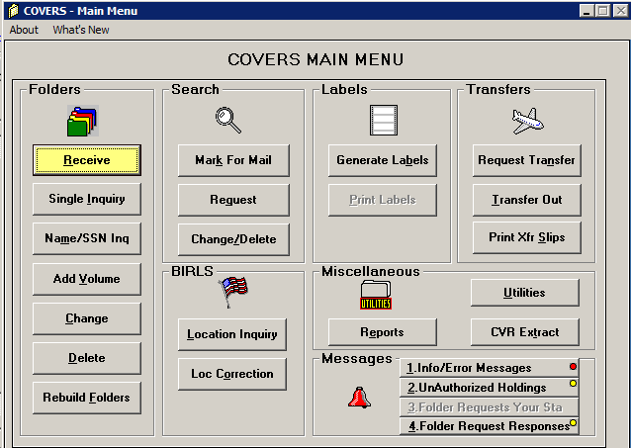
COVERS Folder Inquires and Requests
To conduct an inquiry to determine the current location of a claims folder use the “Single Inquiry” button, enter the file number and folder type and press “OK.” If a folder type is not selected – the single inquiry function defaults to “claims” folder type.

Slide 11
COVERS Folder Inquiries and Requests
Claims processors use the COVERS locations table when a paper claims folder is sent for scanning conversion or when establishing a claims folder where no paper claims folder previously existed.
COVERS Location | Description
DCSC1 | Converted and stored at CACI Newnan, GA
DCSC2 | Converted and stored at CACI Mt Vernon, KY
DCSS1 | Converted and stored at SMS Janesville, WI
DCSS2 | Converted by Records Management Center (RMC) and stored at SMS Janesville, WI
PALL01- PALL22 | Converted and stored at RMC
VBMSRT | Location for claim folders that exist only in VBMS
INVBMS | Location for claim folders that exist only in VBMS
EFILE | Location for claim folders that exist only in VBMS
INVVA | Location for claim folders that exists in LCM
NEWXFF | Location for claim folders that exists in LCM
ICMHS | Converted as part of the File Bank Extraction program.

Slide 12
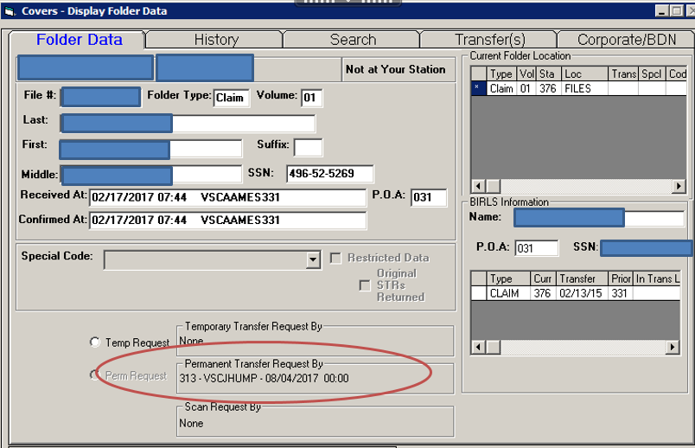
COVERS Folder Inquiries and Requests
If an inquiry reveals that a paper file exists for a claims folder you can request the folder by utilizing the “Perm Request” function from the COVERS “single Inquiry “ screen. Each RO will have its own procedures for responding to folder and mail searches.

Slide 13
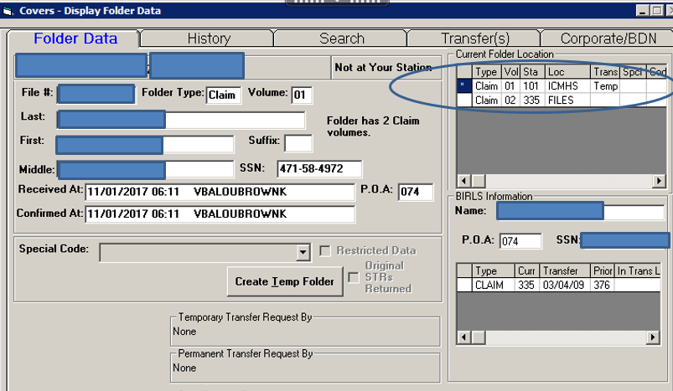
COVERS Folder Inquiries and Requests
Due to recent File Bank Extraction the file banks of all regional office have been sent to the vendor for eventual upload. If a claim is received for a veteran who has a claims folder pending upload from file bank extraction a ticket must be submitted for expedite using the OBPI-VCIP Issue Tracker.

Slide 14
COVERS Folder Inquiries and Requests
Do not use the “Request” function from the main menu to request a folder in COVERS.
Note: Do not “Receive” a claims folder until it is in your possession.
Important: Never use the “Request” or “Receive” functions in COVERS for eFolders; receiving an eFolder in COVERS will update the system to indicate the file is in your possession and can cause confusion for anyone searching for the file at a later time.

Slide 15
Introduction to COVERS Reports
COVERS provides reports to help authorized users track various aspects of system usage. Reports are available from the Utilities menu.
The following in a sample of COVERS reports available from the Reports selection screen:
Search List by Search Location
Search List by Priority Code
Search List by Folder Location
Search List by Terminal Digit
Folder Statistics Report

Slide 16
To Generate a COVERS Report
Select the Reports button or the Utilities button from the COVERS Main Menu.
If utilizing the Utilities Menu, select the Reports button. The Reports Selection menu will appear.
Request a report by clicking on the name of the report and selecting the OK button, or by double-clicking on the name of the report.

Slide 17
Questions?

