Slide 1
Compensation Service
January 2018
Introduction to VA Forms

Slide 2
Objectives
Explain the components of the Standard Claims and Appeals Form rule for all claims received on and after March 24, 2015.
Identify and list acceptable prescribed forms.

Slide 3
References
38 CFR 3.151, Claims for disability benefits
38 CFR 3.150, Forms to be furnished
38 CFR 3.155, How to file a claim
38 CFR 3.155(b), Intent to File a Claim
M21-1, Part III, Subpart ii, Chapter 2, Section B, Benefit Programs and Types of Claims
M21-1, Part III, Subpart ii, Chapter 2, Section C, Informal Claims Received Prior to March 24, 2015, Communication of an Intent to File (ITF), and Requests for Application
M21-1, Part III, Subpart ii, Chapter 3, Section C, What Constitutes a Complete VA Form 21-22 or 21-22a

Slide 4
Standard Claims and Appeals Form Rule
The four major components of the “Standard Claims and Appeals Form” rule include:
Requiring all claimants to submit claims on a standard VA-prescribed form
Eliminating 38 CFR 3.157
Creating an intent to file (ITF) process, and
Using a Standard Notice of Disagreement form.

Slide 5
Importance of the March 24, 2015 Date
Claims received before March 24, 2015 are not required to be submitted on prescribed forms.
VA stopped accepting informal claims on March 24, 2015. Claimants desiring the benefit of filing an informal claim must now communicate to VA “intent to file” a claim.
The Intent to File form, VA Form 21-0966, acts as an “effective date placeholder” which preserves the date of claim if a substantially complete application is received.

Slide 6
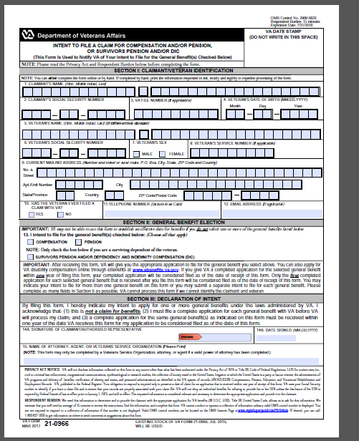
VA Form 21-0966, Intent to File

Slide 7
Standard Claims and Appeals Form Rule Changes
Effective March 24, 2015, VA will only recognize compensation, pension , survivors and related claims if they are submitted on the required standard forms. The type of form accepted is based on the benefit sought.
Elimination of 38 CFR 3.157, which allowed various documents other than claims forms to be considered as claims, specifically VA reports of hospitalization, examination, and other medical records which could be regarded as informal claims for increase, or to reopen a previously denied claim.
VA will recognize an Intent to File (ITF) a claim for benefits if it is submitted on the required VA Form 21-0966, Intent to File, indicating the benefit sought. An Intent to File may be accepted if it is signed by the veteran or authorization representative (POA) on behalf of the Veteran.
VA will only accept issues listed on a timely VA Form 21-0958, Notice of Disagreement, as part of the appeals submission for compensation.

Slide 8
Benefit Requests not Requiring a Prescribed Form
A prescribed claim form is not required for requests for:
review based on clear and unmistakable error (CUE)
reconsideration
substitution
a finding of incompetency received from a first or third party, and
removal of a dependent.

Slide 9
Acceptable Forms
For compensation claims, VA encourages the use of VA Form 21-526 EZ, however the following forms are acceptable:
VA Form 21-526
VA Form 21-526b
VA Form 21-526c
VA Form 21-8940 (for Individual Unemployability)
VA Form 21-4502 (for Automobile and Adaptive equipment claims)
VA Form 26-4555 (for Specially Adapted Housing/Special Housing Adaption benefits

Slide 10
Common VA Forms
A way to identify VA Forms is to review the form number itself. The first two numbers identify the division within VA to which the form belongs.
Some common division numbers you will see are:
10 = Veterans Health Administration
21 = Veterans Benefits Administration
22 = Education
26 = Loan Guaranty
28 = Vocational Rehabilitation
29 = Insurance

Slide 11
Common VA Forms
Some Common VA Forms you will see relate to these categories and forms:
CHAMPVA FOIA/Privacy Act VA Form 21-526
Dependency VA Form 10-7131 VA Form 21P-527
Retired Pay SAH/SHA VA Form 21-534
Drill Pay VA Form 21-22 VA Form 21P-534
Education VA Form 21-8940 VA Form 21P-530
Finance VA Form 28-1900 VA Form 21P-601

Slide 12
Review
Questions?

