Slide 1
System Updates and Compliance
Compensation Service
January 2018

Slide 2
Objectives
Understand the requirements for updating Contact Information and Direct Deposit Processing
Understand the requirements for Change of Name Processing
Understand the requirements for Processing Third Party Information Requests
Understand the requirements for Updating Military Service Information

Slide 3
References
M21-1, Part III, Subpart ii, Chapter 3, Section C, System Updates
M21-1, Part III, Subpart ii, Chapter 1, Section E, Centralized Mail (CM) Intake
M21-1, Part III, Subpart v, Chapter 9, Section A, Fiduciary Hub Jurisdictions and Contact Information

Slide 4
Updating Contact Information and Direct Deposit Processing
Change of contact information or direct deposit notification may come in multiple formats including
a signed statement from the claimant
telephone contact with the claimant, after identity has been verified
undeliverable mail with the United States Post Office (USPS) forwarding address sticker affixed to the envelope
VA Form 20-572, Request for Change of Address/Cancellation of Direct Deposit
other Department of Veterans Affairs (VA) forms that contain the information

Slide 5
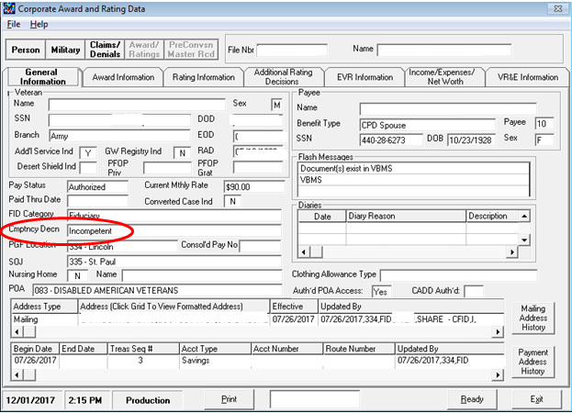
Updating Contact Information and Direct Deposit Processing
Prior to making an address change verify that the veteran does not have a fiduciary.

Slide 6
Updating Contact Information and Direct Deposit Processing
For any claimant assigned a fiduciary do not
change the address
establish a direct deposit account, or
change a direct deposit account.
An address change request is to be sent to the Fiduciary Hub of jurisdiction. Contact and jurisdiction information for the Fiduciary hubs can be found at M21-1, Part III, Subpart v, Chapter 9, Section A

Slide 7
Updating Contact Information in VBMS
Updating contact information in VBMS is done from the veteran’s profile screen.

Slide 8
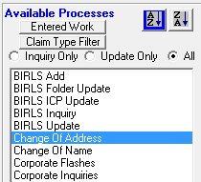
Updating Contact Information in VBMS
Updating contact information in SHARE is done using the Change of Address command.

Slide 9
Updating Direct Deposit Information
Direct Deposit information must be updated when it is received from the veteran or claimant. This includes when establishing an initial claim in VBMS if the claim documents include this information.
While a claim is normally established in VBMS, direct deposit information has to be updated in SHARE via the “Change of Address” screen.

Slide 10
Change of Name Processing
VA requires the claimant or appointed VSO, agent, or attorney representing the claimant, to submit a signed request and sufficient evidence of a legal name change before the claimant’s name can be changed in VA systems unless otherwise noted in M21-1, Part III, Subpart iii, Chapter 8
To change a veteran or claimant’s name in SHARE the BIRLS Update command is used. (This will also update the information in VBMS)
A veteran or claimant’s name can be changed in VBMS by editing the veteran’s profile in VBMS. (This will also update the information on the corporate record)

Slide 11
Processing Third Party Information Requests
VA Form 21-0845, Authorization to Disclose Personal Information to a Third Party, allows the National Call Centers (NCCs) and regional offices (ROs) to release specified information normally protected under privacy provisions to family members or other designated persons who are not POAs, agents, or fiduciaries.

Slide 12
Processing Third Party Information Requests
To be valid, the VA Form 21-0845 must contain or meet the following criteria to be considered substantially complete:
the signature of Veteran/claimant and date
the name and claims folder number of the Veteran/claimant
the contact information (address, daytime or cell phone number, or e-mail address)
the type of information authorized for release
the length of time authorization is valid, if applicable
a security question and answer
the form date stamped by the VA
the form designates only one person or organization, and
if the Veteran has a fiduciary, the signature of the fiduciary.

Slide 13
Updating Military Service Information
Claims processors are responsible for ensuring that any unverified period of active duty is entered into VA systems as soon as VA is notified of the (unverified) period of active duty.
Update a period of active duty in BIRLS by performing a BIRLS Update.

Slide 14
Practical Exercise

Slide 15
Questions

