Slide 1
Musculoskeletal System – Lower Extremities
Compensation Service
January 2018

Slide 2
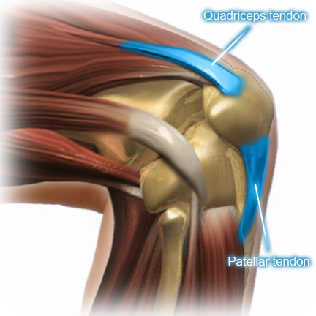
Lesson Objectives
Upon conclusion of the lesson and given available references, the RVSR will accurately identify, adjudicate, and evaluate musculoskeletal contentions for the lower extremities.

Slide 3
References
38 CFR 3.808 – Automobiles or other conveyances and adaptive equipment; certification
38 CFR §4.40 – Functional Loss
38 CFR §4.45 – The Joints
38 CFR §4.46 – Accurate Measurement
38 CFR §4.59 – Painful Motion
38 CFR §4.71 – Measurement of Ankylosis and Joint Motion
38 CFR §4.71a – Rating Schedule of Musculoskeletal Disabilities
M21-1 Part III, Subpart iv, Chapter 4, Section A – Musculoskeletal Conditions

Slide 4
References
DeLuca v. Brown, 8 Vet.App. 202 (1995)
Burton v. Shinseki, 25 Vet.App. 1 (2011)
Mitchell v. Shinseki, 25 Vet.App. 32 (2011)
Petitti v. McDonald, 27 Vet.App. 415 (2015)
Sowers v. McDonald, 27 Vet.App. 472 (2016)
Correia v. McDonald, 28 Vet.App. 158 (2016)
Southall-Norman v. McDonald, 28 Vet.App. 346 (2016)

Slide 5
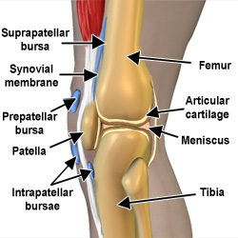
Knee Overview
The knee is a major, hinged joint that connects the thigh and lower leg. It is formed by the femur, the tibia, and the patella.
Common knee-related diagnoses include:
patellofemoral pain syndrome,
chondromalacia patella,
degenerative joint disease, and
traumatic arthritis
Regardless of diagnosis, functional impairments native to knee conditions routinely involve instability, limitation of flexion, and/or limitation of extension, evaluated under DC 5257, 5260, and/or 5261, respectively.

Slide 6
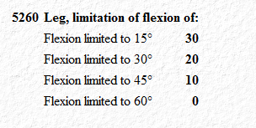
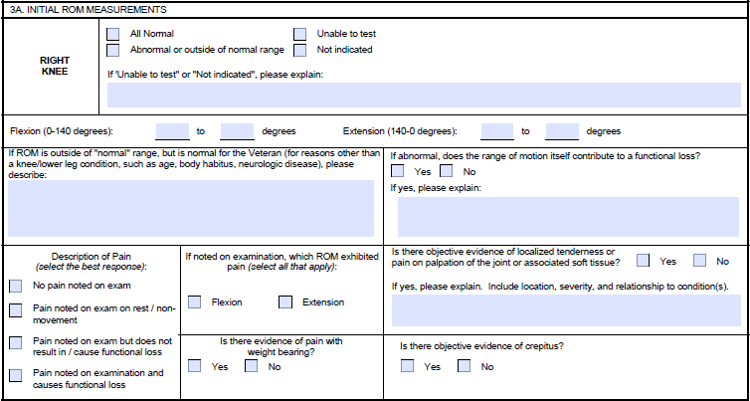
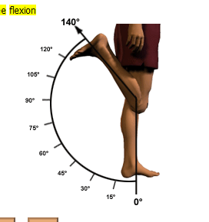
Limitation of Knee (Leg) Flexion (DC 5260)
Rating Schedule Criteria
Evaluation Builder
DBQ Excerpt

Slide 7
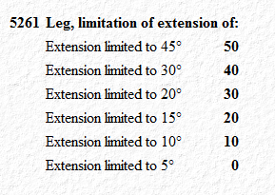
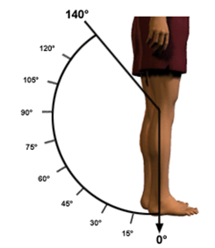
Limitation of Knee (Leg) Extension (DC 5261)
Rating Schedule Criteria
Evaluation Builder
DBQ Excerpt

Slide 8
Multiple Evaluations for Limited Motion of the Knee
Separate evaluations may be authorized under diagnostic codes 5260 & 5261 for knee disabilities productive of schedular limited flexion and extension (VAOPGCPREC 09-04).
Extension and flexion must meet schedular criteria to warrant separate ratings (38 CFR 4.31).
Painful motion is not to be rated separately from or in addition to limited motion of the same joint.

Slide 9
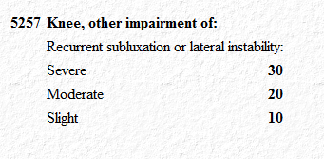
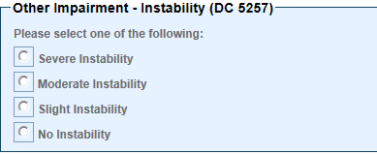
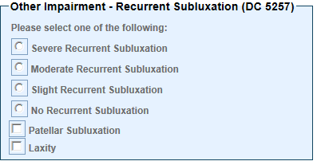
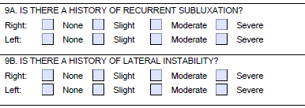
Knee Subluxation/Instability (DC 5257)
Rating Schedule Criteria
Evaluation Builder
DBQ Excerpt

Slide 10
Multiple Compensable Evaluations for Limited Motion and Instability
Per VAOPGCPREC 9-98, knee instability is separate and distinct from limitation of motion and may be awarded a compensable evaluation under DC 5257, even where compensation is otherwise payable under DCs 5260 and/or DC 5261.
Therefore, separate compensable disability ratings for flexion, extension, and instability may be authorized in any combination.

Slide 11
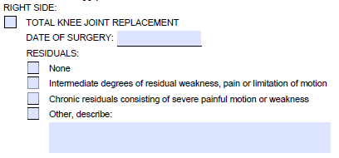
Knee Replacements (DC 5055)
Rating Schedule Criteria
DBQ Excerpt
Evaluation Builder

Slide 12
Hip Overview
The hip is a ball-and-socket joint; the head of the femur fits into the acetabulum of the hip bone.
Common hip diagnoses include:
trochanteric bursitis,
degenerative joint disease, and
traumatic arthritis
Functional impairments in the hip routinely involve limitation of extension, limitation of flexion, and/or limitation of abduction/adduction/rotation, evaluated under DC 5251, 5252, and/or 5253, respectively.

Slide 13
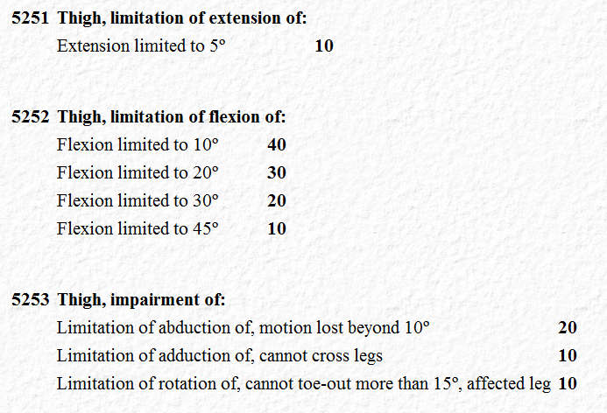
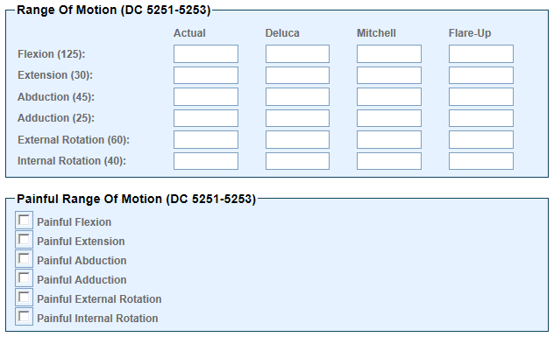
Limitation of Hip Motion (DCs 5251-5253)
Rating Schedule Criteria
Evaluation Builder

Slide 14
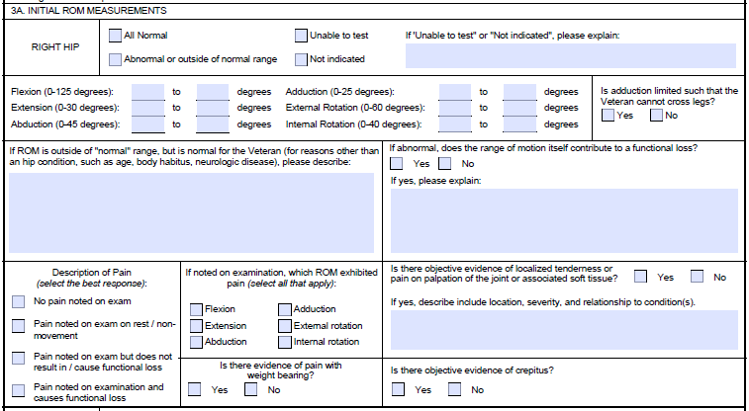
Limitation of Hip Motion (DCs 5251-5253)
DBQ Excerpt

Slide 15
Multiple Evaluations for Limited Motion of the Hip
Separate evaluations may be authorized under diagnostic codes 5251, 5252, & 5253 for hip disabilities productive of limited flexion, extension, and abduction/adduction/rotation (VAOPGCPREC 09-04).
There are no schedular criteria for a noncompensable evaluation under these diagnostic codes. Any limitation in these planes results in a 0 percent evaluation under the appropriate code (38 CFR 4.31).
Painful motion is not to be rated separately from or in addition to limited motion of the same joint.

Slide 16
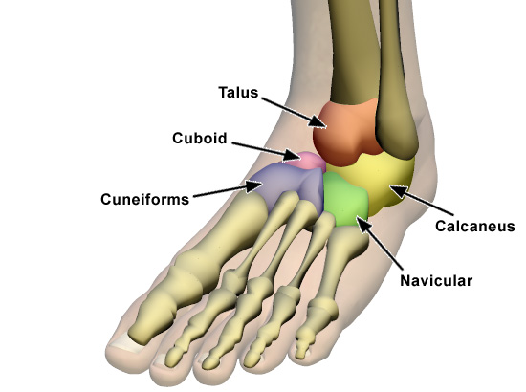
Ankle Overview
The ankle is a major, hinged joint between the lower leg and foot where the tibia, fibula, and talus meet.
Common ankle diagnoses include:
tendonitis,
lateral collateral ligament sprain,
degenerative arthritis, and
traumatic arthritis
Ankle impairment frequently involves limitation of motion, evaluated under DC 5271.

Slide 17
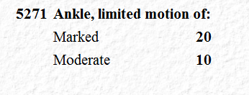
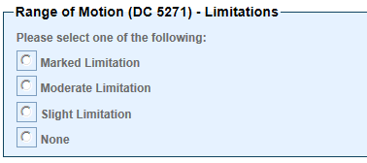
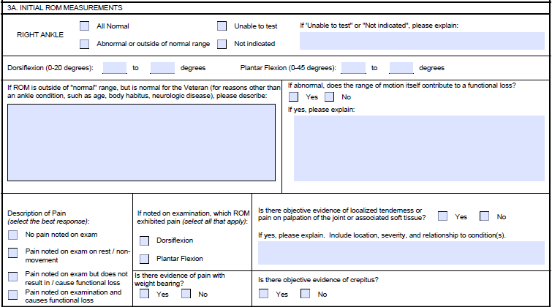
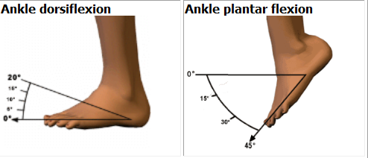
Limitation of Ankle Motion (DC 5271)
Rating Schedule Criteria
Evaluation Builder
Planes of Motion MEPSS
DBQ Excerpt

Slide 18
Ankle Considerations
Moderate limitation of ankle motion is
less than 15 degrees dorsiflexion or
less than 30 degrees plantar flexion.
Marked limitation of motion is
less than five degrees dorsiflexion or
less than 10 degrees plantar flexion.
Separate evaluations are not warranted for limited dorsiflexion with limited plantar flexion. A separate evaluation for ankle instability should not be established.

Slide 19
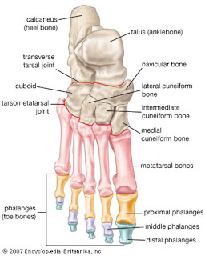
Foot & Toes Overview
The foot is a complex structure comprising numerous bones and joints.
Common foot diagnoses include:
pes planus,
plantar fasciitis, and
traumatic/degenerative arthritis
Pes planus and plantar fasciitis are evaluated under DC 5276; traumatic injuries to the foot are evaluated under DC 5284.

Slide 20
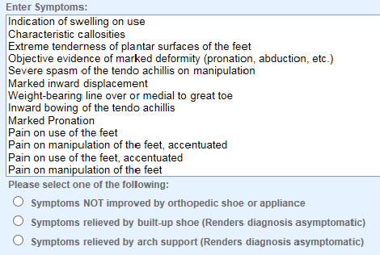
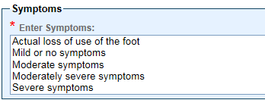
Common Foot Evaluations (DCs 5276 & 5284)
Evaluation Builder
Rating Schedule Criteria
Evaluation Builder
Rating Schedule Criteria

Slide 21
Foot Considerations
Be cautious when using DC 5284 – it cannot be used to evaluate the other eight foot conditions listed in 38 CFR 4.71a
Metatarsalgia (under DC 5279) cannot be evaluated separately from either pes planus or plantar fasciitis (under DC 5276/5299-5276, respectively)
Only one evaluation can be assigned for painful motion of multiple toes on either foot under 38 CFR 4.59 (coded under DC 5284)

Slide 22
Impact of Court Holdings
From the DeLuca holding, results of three repetitions of ROM on examination
From the Mitchell holding, an opinion regarding functional impairment during flare-ups or repeated use over time if pain is associated with movement
From the Petitti holding, that a minimum compensable evaluation under 38 CFR 4.59 does not require objective evidence
From the Sowers holding, that an evaluation under 38 CFR 4.59 is limited to the appropriate diagnostic code for the disability
From the Correia holding, that examination should follow all requirements of 38 CFR 4.59 in range of motion testing
From the Southall-Norman holding, that an evaluation under 38 CFR 4.59 is not limited to diagnostic codes with range of motion criteria

Slide 23
Final Considerations
Presumption of service connection under 38 CFR 3.309(a) for arthritis
The term "prosthetic replacement" means a total replacement of the named joint, except that for DC 5054, the term means a total replacement of the head of the femur or of the acetabulum.
Special monthly compensation for loss of use of a foot/lower extremity
Ancillary decisions, to include automobile allowance

Slide 24
Questions

