Slide 1
FOR TMS TRAINING CREDIT
To obtain training credit in TMS, there is no need to review these slides at this time – immediately close this box by using your mouse to select the “X” in the upper right-hand corner; select the “Return to Content Structure” button; and, select the next link (Video) to view the edited audio-video recording of the Quality Call along with the Call Notes
These slides are included here only in case you want to use them later for training purposes or reference
These are the same slides that are shown in the audio-video recording

Slide 2
January 10, 2018
Compensation Service
Quality Call

Slide 3
Welcome to the January 2018 Quality Call
Bonnie Kirby
Senior Quality Review Specialist
Quality Review Team
Quality Assurance

Slide 4
Opening Remarks
John Capozzi
Assistant Director
Quality Assurance

Slide 5
December 2017 Quality Call Quiz Presented by Bonnie Kirby

Slide 6
Quiz Question Guidance
Questions will be shown on the next few slides
Quiz screen will be displayed after each question slide
Using your mouse , please select your response
Please do NOT type your answer into the Chat Box
Note: If you are in a group setting using only one computer, poll the group and have somebody use the mouse at the computer to select the group’s response
Quiz results will be discussed after everybody has responded

Slide 7
Quiz Question # 1 – Use Mouse to Select Answer
M21-1 III.iv.4, Rating Specific Disabilities, will be undergoing reorganization to correspond with 38 CFR Part 4.
True
False

Slide 8
Quiz Answer # 1
True
This reorganization will pave the way for upcoming VASRD updates in 38 CFR Part 4. Please pay attention to the Key Changes documents, and remember that there could be a brief time where a manual citation appears incorrect or missing information as it is being transitioned to its new location.

Slide 9
Quiz Question # 2 - Use Mouse to Select Answer
When developing a Camp Lejeune claim, which of the following is required before routing the case to the appropriate RO?
Resolving any character of discharge issue
Verifying a diagnosis for the claimed condition
Both
Neither

Slide 10
Quiz Answer # 2
Both
The Regional Office of Jurisdiction (ROJ) is responsible to resolve any character of discharge issues and verify a diagnosis for the claimed condition prior routing the claim to the appropriate RO. In addition, remember to add the specific language in subsequent development letters in applicable situations.
M21-1 IV.ii.1.l.7.c-e-j

Slide 11
Quiz Question # 3 – Use Mouse to Select Answer
At what point prior to separation can an active duty service member submit a pre-discharge Decision Ready Claim (DRC) for direct service connection?
Less than 90 days prior to separation
Less than 120 days prior to separation
Anytime
Less than 30 days prior to separation

Slide 12
Quiz Answer # 3
Less than 90 days
The separating service member is eligible to submit a pre-discharge DRC for direct service connection when he/she has less than 90 days (89 days or less) remaining on active duty at the time of the DRC initiation.
M21-1 III.i.3.C.1.c

Slide 13
Quiz Question # 4 – Use Mouse to Select Answer
Depending on the number of issues and complexity of the case, decision makers can decide whether or not to use the VBMS-R embedded Evaluation Builder in his/her rating decision.
True
False

Slide 14
Quiz Answer # 4
False
Use of the VBMS-R embedded rules-based tools, such as the Evaluation Builder and Hearing Loss Calculator, is mandatory. All body systems are now part of VBMS-R, including the SMC Calculator.
M21-1 III.iv.6.C.5.c

Slide 15
What’s New in M21-1?
Dustin Williams
Manual Editor
Maintenance Staff
Procedures

Slide 16
Adjusting Apportioned Awards
M21-1, Part III, Subpart v, 3.B
Identified the proper effective date for discontinuing an apportionee’s award when eligibility is lost (III.v.3.B.1.g)
Added instructions to remove a spouse-apportionee from a Veteran’s award when the Veteran reports marriage dissolution (III.v.3.B.1.f)

Slide 17
Adjusting Apportioned Awards (Cont’d)
Added instructions for
handling an apportionment suspended because payments were returned as undeliverable (III.v.3.B.1.k)
removing an apportionee due to whereabouts unknown (III.v.3.B.1.l), and
discontinuing an apportionment for a child once the primary beneficiary has begun payment child support (III.v.3.B.4)

Slide 18
Redesigned Automated Decision Letter (RADL)
Revisions to M21-1, Part III, Subpart v, 2.B, Decision Notices, to reflect new functionality and renewed enclosure of rating narrative
Rescission of M21-1, Part III, Subpart iv, 6.F, Automated Decision Letter (ADL) Rating Procedures
Relocation of continually relevant guidance to other M21-1 destinations
EPs and claim types eligible/ineligible for RADL processing (III.v.2.B.4.c)
VBMS-R ANALYSIS screen fields and text attributes (III.iv.6.C.5.d)

Slide 19
Deployment of RADL (Cont’d)
Other content relocations
General decision language standards and tips (III.iv.6.C.5.f)
Rating narrative text generation (III.iv.6.C.5.e)
Avoidance of free-text contention use (III.iv.6.C.3.e)
Addressing permanence of SC malignancies (III.iv.5.B.3.b)
See III.iv.6.F’s Key Changes Document for a more detailed account of retained principles and their destinations

Slide 20
Redesigned Automated Decision Letter Project
Steven Dunaway
Management and Program Analyst
Interagency Data Sharing Staff
Procedures

Slide 21
Manual Guidance and Updates
M21-1 III.v.2.B – Decision Notices – Updated
M21-1 III.iv.6.F – ADL Rating Procedures - Rescinded

Slide 22
RADL Overview
The RADL functionality within VBMS-A provides for the automated generation of decision notices – rules-based logic inserts into decision notices system-generated language based on the specific decision(s) VA made on a claim
The use of system-generated language allows for the standardization of decision notices, while streamlining the process for the end-user

Slide 23
RADL Overview (Cont’d)
Claims processors may use RADL to generate a decision notice for the following types of decisions
EPs 110, 010, 020, 130, 290 310, 320, 600, 687, 689, 690, and 930
Administrative denials based of pension on incompatible military service, to include
no active duty service
no wartime service
less than 90 days of service, and/or
minimum service requirements not met (24 months of service, after September 7, 1980)

Slide 24
Major RADL Updates with VBMS 14.0
VBMS-C & VBMS-A users can add one or more copies of standard and eFolder enclosures to any letter that is not auto-generated
VBMS-C external service users can add one or more copies of standard and eFolder enclosures to the Statement of Case* letter or the Benefits Estimate letter
The Rating Narrative Letter is included as an enclosure
The Automated Decision Letter Predetermination Notice now includes a 3.105e version of the letter

Slide 25
Major RADL Updates with VBMS 14.0 (Cont’d)
The Automated Decision Letter has been redesigned to include the following additional features
A free text entry section
A Rating Decision section and a reference to the Explanation of Payment section
An Appeals Satisfaction Notice enclosure*
An editable POA/VSO section

Slide 26
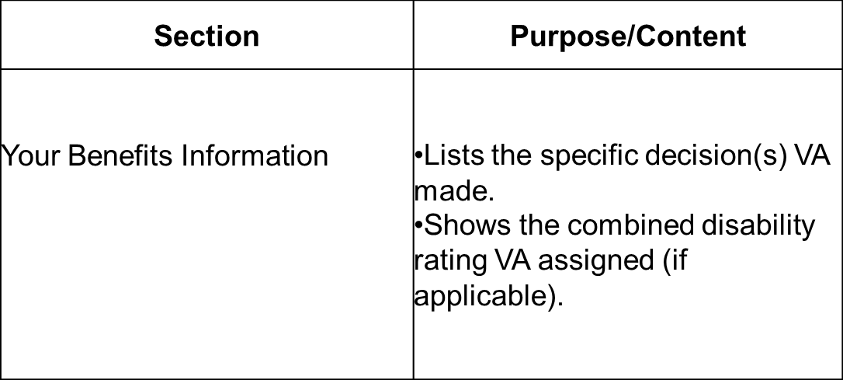
Your Benefits Information
The example table below describes the purpose/content of individual sections of an RADL-generated decision notice

Slide 27
Requesting Information
Claims processors may use a feature within RADL that allows them to include in decision notices a request for
completion of a VA Form 21-686c
a marriage certificate
(a) divorce certificate(s)
(a) birth certificate(s)
(a) Social Security number(s), and/or
information regarding a
child’s school attendance, and/or
step-child’s relationship to a Veteran

Slide 28
Additional Benefits
Information on additional benefits is automatically tailored to individual claimants based upon the award
Examples of categories include, but are not limited to
Education Loans
Job Training and Employment
Mental Health Counseling
Clothing Allowance
VA Medical Care
Government Life Insurance
Social Security Administration Benefits

Slide 29
Rating Criteria Clarifications
Eric Mandle
Lead Consultant
Regulations Staff
Policy

Slide 30
Hypothyroidism With Myxedema (DC 7903)
VBMS-R incorrectly generates 100% for hypothyroidism, without myxedema, when “mental disturbance” is selected
100% is not warranted unless there is myxedema
Evaluation Builder will be updated
Please refer to VBMS Tips and Tricks Release 14.0 for a workaround regarding this issue
https://vbaw.vba.va.gov/VBMS/docs/VBMSTips_and_Tricks14_0.pdf

Slide 31
Tinnitus (DC 6260)
Claims processor cannot concede “acoustic trauma”
Can only concede “noise exposure”
Refer to references, such as, M21-1 III.iv.4.B.4.e-g-h
Manual revisions are forthcoming for M21-1 III.iv.4.B.4.f

Slide 32
Tinnitus (DC 6260) (Cont’d)
Tinnitus is a presumptive condition under 38 CFR 3.309a
Can be granted if diagnosed and manifested to a compensable degree within a year from discharge
Medical opinion not needed, unless evidence shows the condition may have been caused by post-service event, injury, or illness
Refer to references, such as, M21-1 III.iv.4.B.4.h
Manual revisions are forthcoming for M21-1 III.iv.4.B.4.a; M21-1 III.iv.4.G.1.d; and, M21-1 IV.ii.2.B.2.a

Slide 33
Q-Tips
David Hannigan
Chief
Quality Review Team
Quality Assurance

Slide 34
Fun way to share ideas in a simple tip format
Your Q-Tips are welcome and requested
We will help each other by sharing knowledge
Send your ideas to David Hannigan
david.hannigan@va.gov

Slide 35
Q-Tip # 1
Decision makers are still required to upload the SMC Calculator results in the claims folder
SMC Calculator has now been embedded in VBMS
It is a continued requirement to upload the SMC Calculator results in the claims folder
M21-1 IV.ii.2.H.1.h

Slide 36
Q-Tip # 2
How to route a reconsideration case in QMS to Quality Assurance
Per the National Quality Error Corrections SOP released to all ROs on November 20, 2017, follow these two steps
Step 1: The clearing RO’s QRT Coach or designee will select the “Initiate Recon” button within the QMS Error Correction Record
Rationale for removing the error(s) with supporting citations must be entered into the free text field – then select the “Next” button
Step 2: Select the “Recon Decision” button, select “STAR CS Team,” and then the “Next” button to complete the submission of the case
If this button is not selected, the case is never routed to Quality Assurance

Slide 37
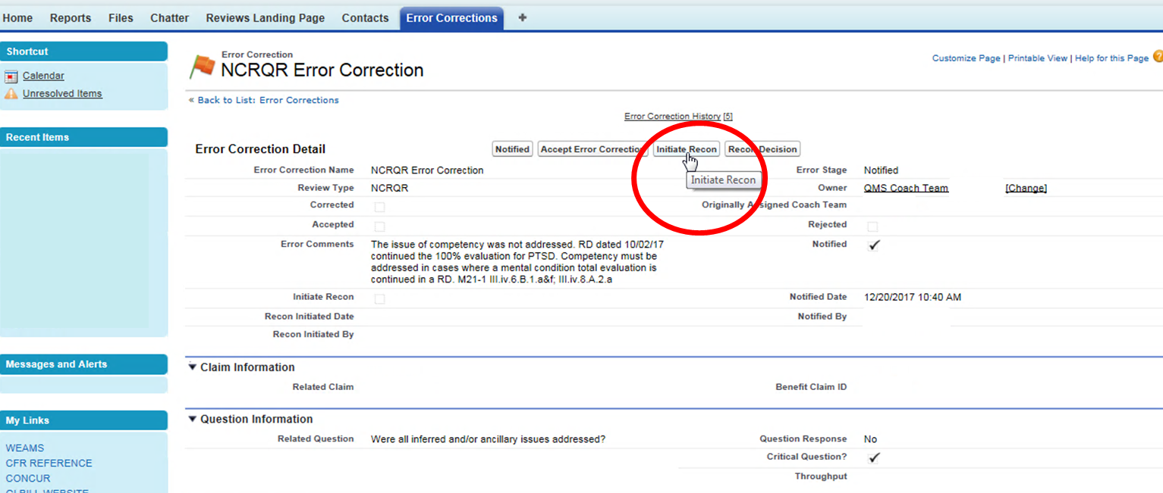
Step 1
Select “Initiate Recon” button on Error Correction Detail screen

Slide 38
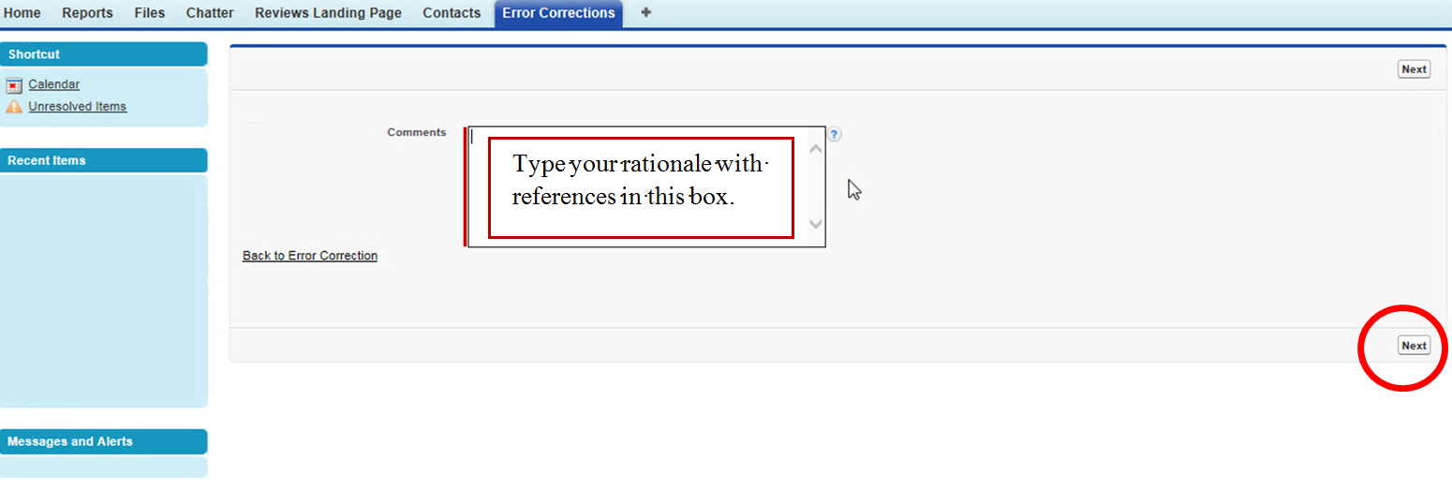
Step 1 (Cont’d)
Type your rationale and references into the Comments box and then select “Next”

Slide 39
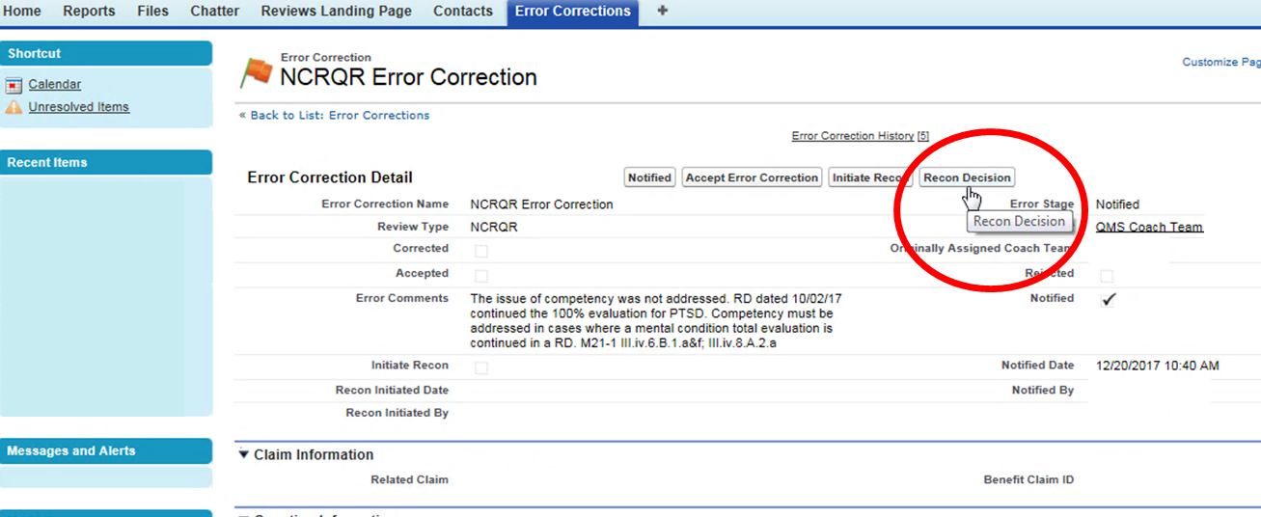
Step 2 – This is Important !
Select “Recon Decision”

Slide 40
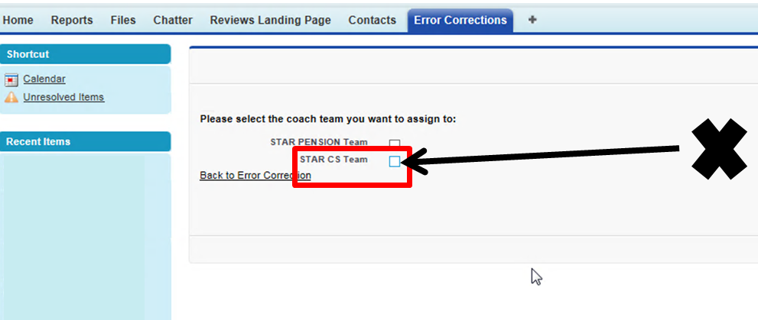
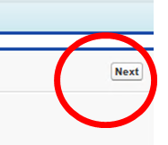
Step 2 (Cont’d)
Select “STAR CS Team” and then select “Next”
Only now is the reconsideration request routed to Quality Assurance

Slide 41
National Quality Error Correction Guidance
Melvin Gerrets
Chief
Program Operations
Quality Assurance

Slide 42
Standard Operating Procedures (SOP)
National Quality Error Correction SOP effective 11/20/2017
Outlines standardized actions required to address national error corrections in QMS for claims processors, QRTs, and supervisors
M21-4 Chapter 3 will be updated

Slide 43
Significant Changes To Note
Correcting RO
QA will identify the RO responsible for correcting the error(s)
Only one RO will be assigned to correct all errors, which may include errors committed by another RO
Identified Responsible Employee
QA will identify the employee that caused the error (in most cases)
EP 930s
EP 930 with claim label Correction of National Quality Error must be established for any completed claim with a cited error, even those that do not require rating or award corrective action

Slide 44
Significant Changes To Note (Cont’d)
VBMS Note Requirement
Requirement to enter permanent VBMS Note
Per M21-1 III.ii.4.G.2.m and M21-4 Appendix B II.930
Will be added for all error corrections, to include those where an EP 930 is not warranted
Do Not Recall Special Issue
The special issue National Quality Review must be applied immediately and removed when corrective action is executed
National Work Queue (NWQ)
Claim label and special issue must be applied for proper routing
NWQ is priority assigning national quality error corrections

Slide 45
Poll Questions
Robert Johnson
Senior Quality Review Specialist
Quality Review Team
Quality Assurance

Slide 46
Interactive Poll Question Guidance
Questions will be shown on the next few slides
Poll graph will be displayed after each question slide
Using your mouse , please select your response
Please do NOT type your answer into the Chat Box
Note: If you are in a group setting using only one computer, poll the group and have somebody use the mouse at the computer to select the group’s response
Poll results will be discussed after everybody has responded

Slide 47
Poll Question # 1 – Use Mouse to Select Answer
Veteran reports divorce from his spouse who receives an apportionment of his VA benefit. Remove the spouse from the award, but do not discontinue the apportionment without
sending a letter to the Veteran to confirm the divorce
sending a proposed adverse action letter to the Veteran
sending a letter to the spouse to confirm the divorce, or
sending a proposed adverse action letter to the spouse.

Slide 48
Poll Question # 1 - Answer
Sending a proposed adverse action letter to the spouse
Furnish a notice of proposed adverse action to the apportionee and allow 60 days to respond.
M21-1 III.v.3.B.1.g

Slide 49
Poll Question # 2 – Use Mouse to Select Answer
Redesigned Automated Decision Letters that notify a claimant of a rating decision must include a copy of the rating decision itself.
True
False

Slide 50
Poll Question # 2 - Answer
True
Redesigned ADL (RADL) decision notices that notify a claimant of a rating decision include a copy of the actual rating decision.
M21-1 III.v.2.B.1.f & h
M21-1 III.v.2.B.4

Slide 51
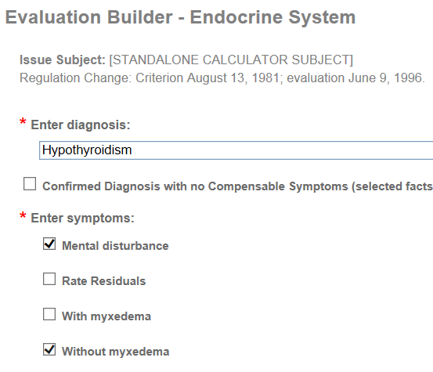
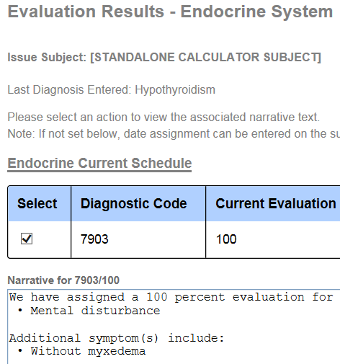
Poll Question # 3 – Use Mouse to Select Answer
Examination and rating decision narrative confirms a diagnosis of hypothyroidism with mental disturbance, but without myxedema. An evaluation of 100% is assigned. Is the 100% evaluation correct? Yes or No

Slide 52
Poll Question # 3 - Answer
No
100% is not warranted unless there is myxedema. The Evaluation Builder incorrectly generates 100% for hypothyroidism, without myxedema, when “mental disturbance” is selected – it will be updated.
38 CFR Part 4.119 – DC 7903

Slide 53
Poll Question # 4 – Use Mouse to Select Answer
Since the stand-alone SMC Calculator has now been added to VBMS-R, it’s no longer required to upload the SMC Calculator results anymore to the claims folder.
True
False

Slide 54
Poll Question # 4 - Answer
False
It is a continued requirement to upload the SMC Calculator results in the claims folder.
M21-1 IV.ii.2.H.1.h

Slide 55
Questions – Suggestions – Next Quality Call
Presented by:
Robert Johnson

Slide 56
Questions Relating to Today’s QC Topics
Questions on topics presented must be emailed to the Compensation Service Quality Review Team @ InternalQRS.VBAVACO@va.gov
Emails must include Cc to your Coach or other RO management
Emails must contain the name of the topic(s) with your question(s)
Questions must be submitted to the mailbox by COB today (day of the QC)
Questions submitted after COB today will not be accepted
Email questions are limited to those pertaining to only the topics presented, and responses will not be provided to any questions that are not related to the topics presented during today’s Quality Call
Questions will be posted with official guidance in the Call Notes

Slide 57
Do You Have Suggestions for Topics?
Please feel free to email your topic suggestions to the Compensation Service Quality Review Team @ InternalQRS.VBAVACO@va.gov
In your email, be sure to include:
Cc to your Coach or other RO management
Name of the topic
Intended audience (VSR – SVSR – RVSR – DRO – AQRS – RQRS)
Applicable M21-1 and/or 38 CFR citations
Quality Call Notes can be found at the STAR Home Page on the Compensation Service Intranet site, TMS, and VBA Learning Catalog
Audio recordings of the Quality Calls with separate copies of the PowerPoint slides can be found in both TMS and VBA Learning Catalog

Slide 58
Next Quality Call
A Compensation Service Quality Call is usually presented each month
Next Quality Call – Wednesday, February 14th at 1:30 pm Eastern

