Slide 1
Phase 5, Part 5b Knowledge Check Preparation
PMC VSR Advanced Core Course
Phase 5: Stages of a Claim
Part 5: Award Adjustments

Slide 2
Why It Matters!
Preparing an award adjustment, such as adding or removing a dependent may involve applying due process. It may also cause an overpayment. It is important to provide the claimant with the opportunity to submit evidence or information as well as request a waiver of overpayment.

Slide 3
Knowledge Check Preparation Overview
This preparation will consist of the following:
Lesson objectives review
Partner activity
Individual activity
Question/answer forum

Slide 4
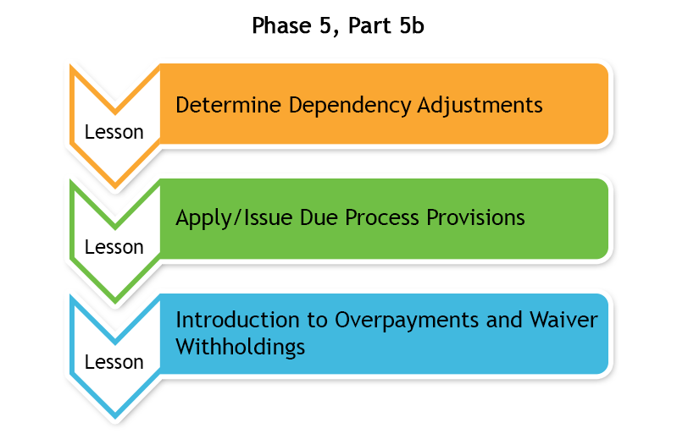
Phase 5, Part 5b Lessons

Slide 5
Determine Dependency Adjustments
Used to determine who can be considered a dependent
Used to determine allowance based on addition or removal of dependent(s)
  Can affect award and payment amount
  May require development or due process

Slide 6
Determine Dependency Adjustments
Objectives
Determine award adjustment based on change in dependency
Determine changes in dependency
Determine actions to take based on dependency changes
Determine the award adjustment based on change in dependency

Slide 7
Determine Dependency Adjustments
Question Writing Opportunity
Instructions:
  Use Appendix C: Question and Answer Worksheet to write any questions regarding dependency adjustments.
  Questions will be answered at the end of this preparation.
Time allowed: 5 minutes

Slide 8
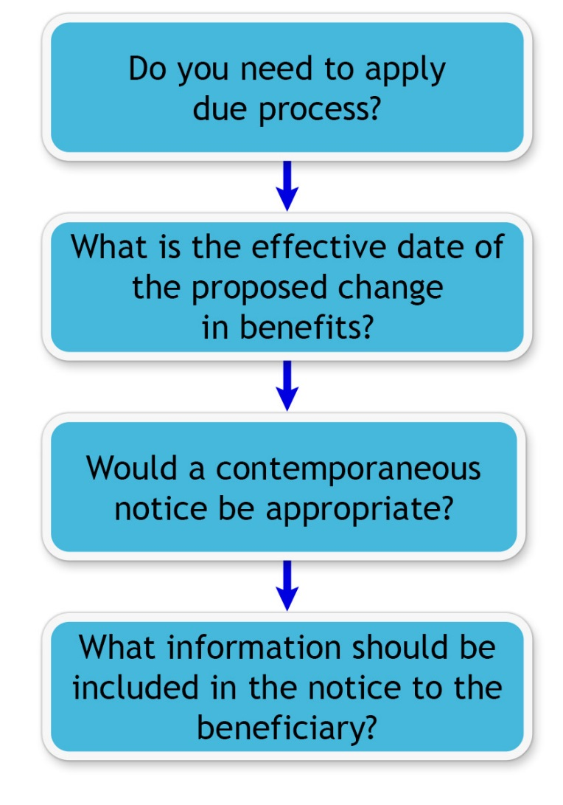
Apply/Issue Due Process Provisions

Slide 9
Apply/Issue Due Process Provisions
Objectives
Apply due process provisions to a claim.
Determine if due process is applicable to a claim.
Determine effective dates for the proposed change in benefits.
Determine if change requires contemporaneous notice or due process notification letter.
Identify due process elements for the due process letter/contemporaneous notice.

Slide 10
Apply/Issue Due Process Provisions
Question Writing Opportunity
Instructions:
  Use Appendix C: Question and Answer Worksheet to write any questions regarding applying due process.
  Questions will be answered at the end of this preparation.
Time allowed: 5 minutes

Slide 11
Partner Activity—Dependency
Adjustment and Due Process
Instructions:
  Divide into pairs.
  Review example claim in VBMS.
  Answer the questions listed in Appendix B: Phase 5, Part 5b Worksheet.
  Use the job aids listed in Appendix A.
  Be prepared to share your finished activity with the class.
Time allowed: 25-30 minutes

Slide 12
Partner Activity—
Dependency Adjustment and Due Process
Answers (1 of 2)
Has the dependency change information been submitted by the claimant, fiduciary, or third party? Provide rationale for your decision. Correct answer will be provided by the instructor.
Is the dependent being added or removed from the award? Provide rationale. Correct answer will be provided by the instructor.
Is all the information present to add or remove the dependent? Provide rationale. Correct answer will be provided by the instructor.

Slide 13
Partner Activity—
Dependency Adjustment and Due Process
Answers (2 of 2)
What is the effective date of proposed change in dependency? Correct answer will be provided by the instructor.
Based on your review of the claim, does the claim require due process or contemporaneous notice? Provide rationale. Correct answer will be provided by the instructor.
What needs to be included in the due process letter/contemporaneous notice? Correct answer will be provided by the instructor.

Slide 14
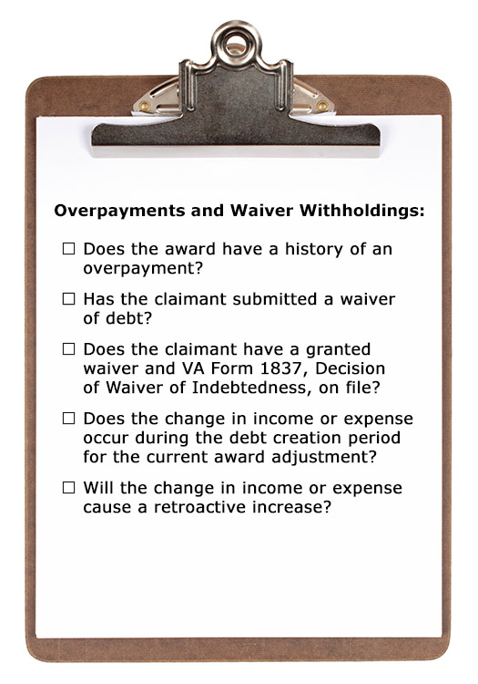
Introduction to Overpayments and Waiver Withholdings

Slide 15
Introduction to Overpayments and Waiver Withholdings Objectives
Recognize whether a waiver withholding is required.
Recognize an overpayment in VBMS-A.
Recognize a retroactive award increase.
Recognize whether a waiver has been granted.
Recognize whether a retroactive award increase occurs during the debt creation period.

Slide 16
Introduction to Overpayments and
Waiver Withholdings Question Writing
Opportunity
Instructions:
  Use Appendix C: Question and Answer Worksheet to write any questions regarding overpayments and waiver withholdings.
  Questions will be answered at the end of this preparation.
Time allowed: 5 minutes

Slide 17
Individual Activity—Overpayments and Waiver Withholdings
Instructions:
  Review the scenario in Appendix B: Introduction to Overpayments and Waiver Withholdings Scenario section.
  Answer the questions provided at the end of the scenario.
  Use the job aids listed in Appendix A.
  Be prepared to discuss your answers with the class.
Time allowed: 15-20 minutes

Slide 18
Individual Activity—Overpayments and
Waiver Withholdings Answers
Yes, the original award was granted based on Mr. Keller having no income. The statement received in February indicating part time employment created an overpayment.
10-01-14 to 04-30-16. The October date is the date he received an increase in income and the April date is based on the date the claim was processed.
May 15, 2016
No. Because this is after the debt period, you would not withhold the retroactive benefit during this time period.

Slide 19
Question and Answer Forum
Instructions:
  Divide into groups of three or four.
  Review the Appendix C: Question and Answer Worksheet with your group.
  Mark any questions that need further clarification from the instructor.
  Be prepared to share your answers with the class.
Time allowed: 10–15 minutes

Slide 20

Question and Answer Clarification

Slide 21
What’s Next?
Phase 5, Part 5b: Award Adjustment Knowledge Check

