Slide 1
Phase 5, Part 5a Knowledge Check Preparation
PMC VSR Advanced Core Course
Phase 5: Stages of a Claim
Part 5: Award Adjustments

Slide 2
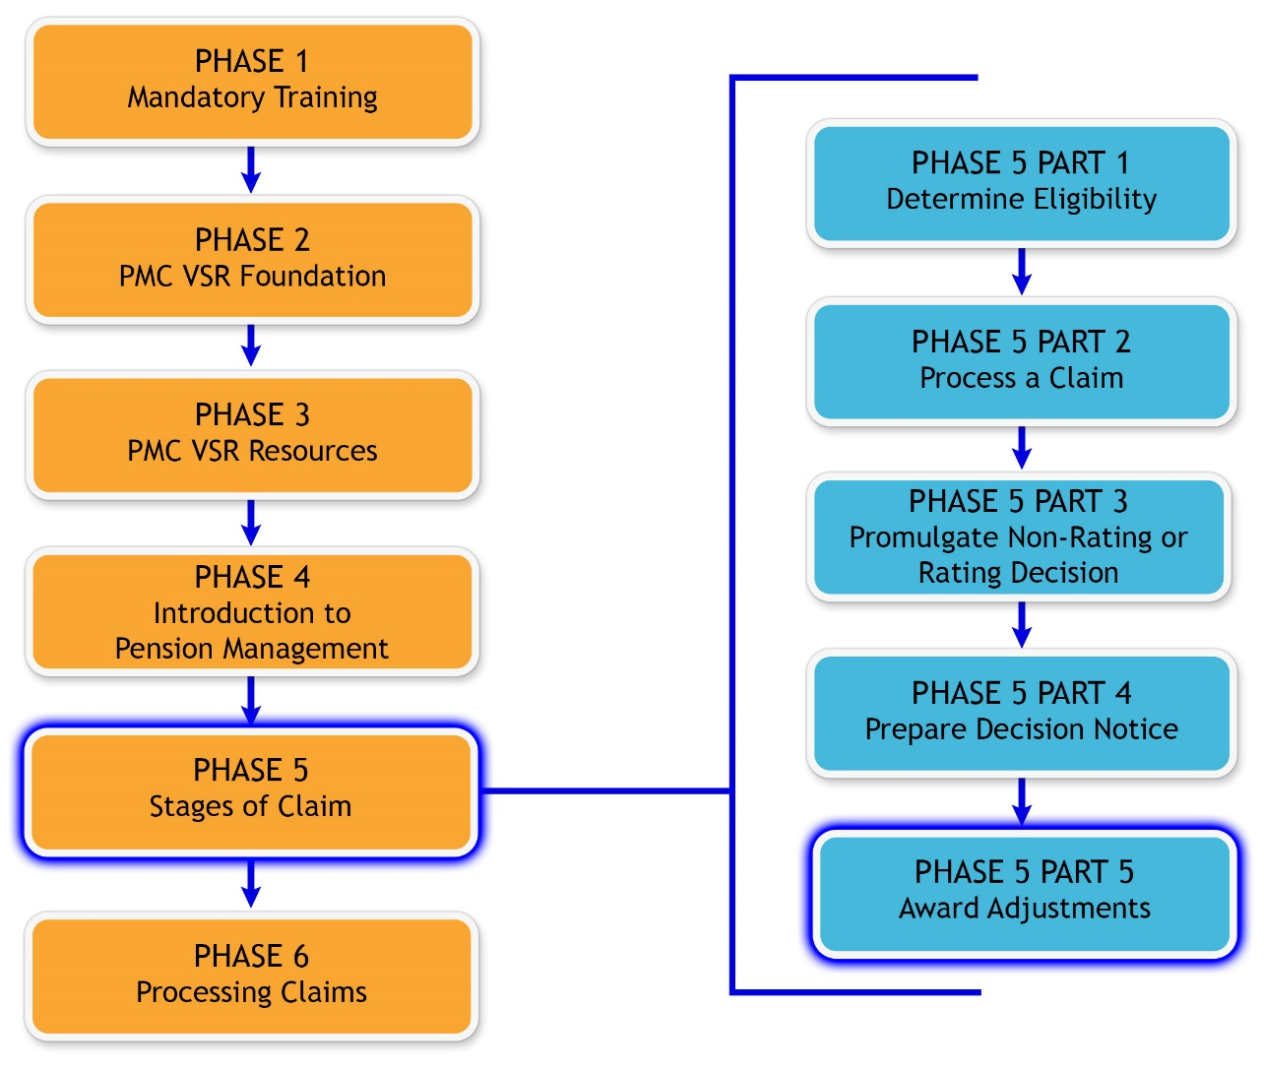
You Are Here

Slide 3
Why It Matters!
Preparing an award adjustment involves reviewing any additional information provided by the claimant or third party, and deciding the reason for adjustment.

Slide 4
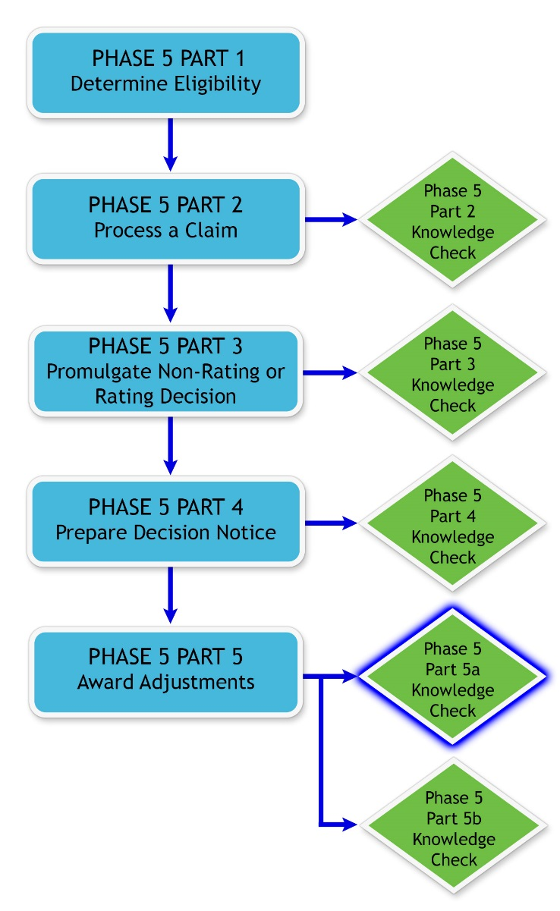
Knowledge Check

Slide 5
Knowledge Check Preparation Overview
This preparation will consist of the following:
Lesson objectives review
Partner activities
Question/answer forum

Slide 6
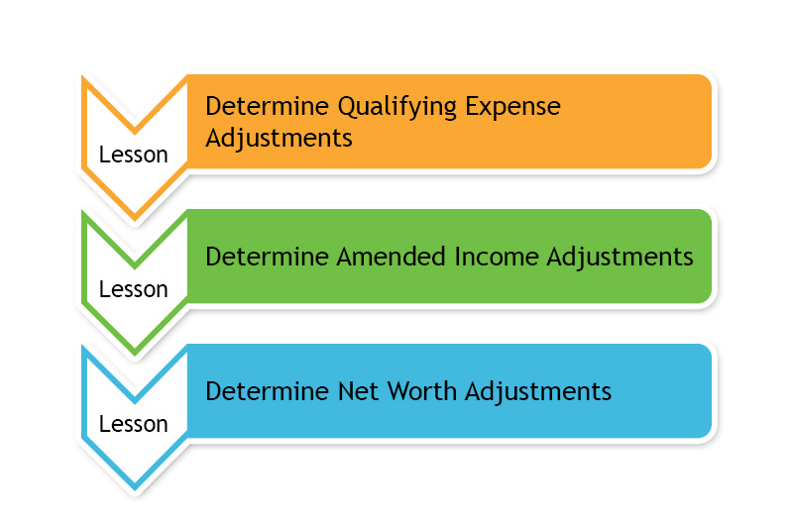
Phase 5, Part 5a Lessons

Slide 7
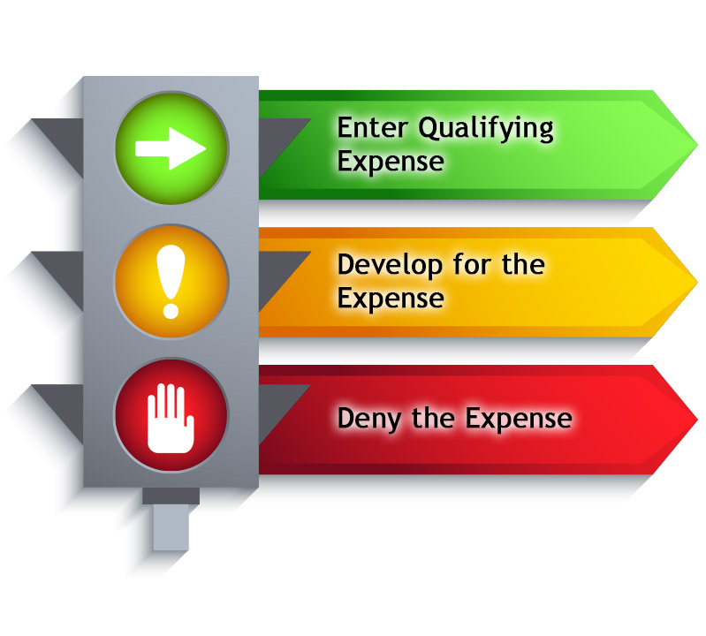
Determine Qualifying Expense Adjustments

Slide 8
Determine Qualifying Expense Adjustments
Objectives
Determine qualifying expense adjustments.
Determine whether medical expense qualifies for an award adjustment.
Determine whether final expense qualifies for an award adjustment.
Determine whether educational expense qualifies for an award adjustment.

Slide 9
Qualifying Expense Adjustments Question
Writing Opportunity
Instructions:
  Use Appendix D: Question and Answer Worksheet to write any questions regarding qualifying expense adjustments.
  Questions will be answered at the end of this preparation.
Time allowed: 5 minutes

Slide 10
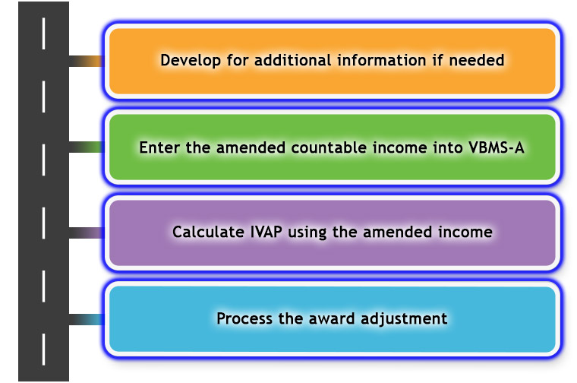
Determine Amended Income Adjustments

Slide 11
Determine Amended Income Adjustments
Objectives
Determine award adjustment based on amended income.
Determine whether income type is countable.
Determine whether to develop for amended income information.
Determine whether amended income information is received within the time limit.
Determine whether amended income qualifies for an award adjustment.

Slide 12
Amended Income Adjustments Question
Writing Opportunity
Instructions:
  Use Appendix D: Question and Answer Worksheet to write any questions regarding processing an award action.
  Questions will be answered at the end of this preparation.
Time allowed: 5 minutes

Slide 13
Determine Net Worth Adjustments
Once the amended net worth has been calculated, then the award adjustment for net worth may result in one of the following two outcomes:
  Update the VBMS-A with amended net worth amount
  A termination of benefits
An administrative decision for net worth determines if the net worth is a bar to benefits

Slide 14
Determine Net Worth Adjustments
Objectives
Determine award adjustment based on changes to net worth.
Determine whether amended net worth is an inclusion or an exclusion.
Determine whether a net worth determination is required.
Determine whether to develop for additional net worth information.
Determine whether net worth is a bar to benefits.

Slide 15
Net Worth Adjustments Question
Writing Opportunity
Instructions:
  Use Appendix D: Question and Answer Worksheet to write any questions regarding net worth adjustments.
  Questions will be answered at the end of this preparation.
Time allowed: 5 minutes

Slide 16
Partner Activity—Award Adjustment
Instructions:
  Find a partner.
  Review example claim in Appendix B: Example Claim.
  Answer the questions listed in Appendix C: Phase 5, Part 5a Worksheet.
  Use the job aids listed in Appendix A.
  Be prepared to share your finished activity with the class.
Time allowed: 25-30 minutes

Slide 17
Partner Activity—Award Adjustment
Answers (1 of 3)
Medical Expenses Answers:
Description | Amount Paid | Date Paid | Provider | Paid For | UME or CME?
Medicare (Part B) Premium | $108.00/ month | 2017 | Social Security | Veteran | CME
In-Home Caregiver | $600.00/ month | 2017 | Debbie Williams | Veteran | CME

Slide 18
Partner Activity—Award Adjustment
Answers (2 of 3)
The evidence provided to accept the medical expenses are the VA Form 21P-8416, Medical Expense Report, In-Home Attendant Care Expense Statement/Attendant Affidavit, and the verification with Social Security to accept the Medicare Premiums.
The amended income information includes the Veteran’s COLA increase to his Social Security income and lottery winning.
IVAP: $299
Payment date: 2/01/2017 (based on Omnibus)
The IVAP will result in an increase of the pension rate. The Veteran’s monthly pension rate on his running award was $526 and now is $1050.

Slide 19
Partner Activity—Award Adjustment
Answers (3 of 3)
Amended Net Worth: $37,000
Net worth is not a bar to benefits. The claimant’s assets are not sufficiently large enough that the claimant could live off these assets for a reasonable period of time.

Slide 20
Question and Answer Forum
Instructions:
  Divide into groups of three or four.
  Review the Appendix D: Question and Answer Worksheet with your group.
  Mark any questions that need further clarification from the instructor.
  Be prepared to share your answers with the class.
Time allowed: 10–15 minutes

Slide 21

Question and Answer Clarification

Slide 22
What’s Next?
Phase 5, Part 5a: Award Adjustment Knowledge Check

