Slide 1
Lesson 3: Determine Net Worth Adjustments
PMC VSR Advanced Core Course
Phase 5: Stages of a Claim
Part 5: Award Adjustments

Slide 2
Lesson Objectives
Determine award adjustment based on changes to net worth.
Determine whether amended asset is an inclusion or an exclusion.
Determine whether a net worth determination is required.
Determine whether to develop for additional asset information.
Determine whether net worth is a bar to benefits.

Slide 3
Why It Matters!
The Determine Net Worth Adjustments course is important because VA pension is a needs-based benefit and is not intended to preserve the estates of individuals who have the means to support themselves.

Slide 4
Definitions (1 of 4)
Net worth, for claims received on or after October 18, 2018, is the sum of a claimant’s assets, and IVAP.
Assets are the fair market value of all property that an individual owns, including all real and personal property
Fair market value is the price at which an asset would change hands between a willing buyer and seller.
The covered asset amount is the monetary value by which a claimant’s net worth would have exceeded the limit due to covered asset(s) alone if the uncompensated value of the covered asset(s) had been included in net worth.

Slide 5
Definitions (2 of 4)
A Look-back period means the 36-month period immediately preceding the date on which VA receives either an original pension claim, or a new pension claim after a period of non-entitlement
  A look-back period will not include any date prior to October 18, 2018
  The look-back period starts from the date a formal claim is submitted after a period of non-entitlement.
  A look-back period does not start from the date of an intent to file.

Slide 6
Definitions (3 of 4)
A penalty period:
  is a period of non-entitlement due to the transfer of a covered asset(s) during the look-back period
  cannot exceed 5 years
  begins on the first day of the month following the date of the last transfer, and
  is calculated by dividing the total covered asset amount by the monthly penalty rate and rounding down.
    The resulting whole number is the number of months VA will not pay pension.

Slide 7
Definitions (4 of 4)
For claims received on or after October 18, 2018, the bright-line net worth limit for pension entitlement is $123,600
  The current net worth limit for pension entitlement is listed on the Veterans Pension Rate Table.
  This limit is increased by the same percentage as the COLA in Social Security benefits.
    Net worth is assets plus IVAP (assets + IVAP).
Deny or discontinue pension if a claimant’s net worth exceeds the limit.
  The net worth calculator must be saved if pension is denied or discontinued due to excessive net worth.

Slide 8

Review Net Worth

Slide 9
Review Net Worth Status
Determine Asset Inclusions
Calculate Net Worth

Slide 10
Review Assets
Inclusions/Exclusions
Determine Asset Inclusions
Calculate Net Worth

Slide 11
Review Assets
Inclusions/Exclusions Answers
Inclusion examples:
  Real estate (not including primary residence)
  Retirement
  Stocks
  Bonds
  Bank deposits
Exclusion examples:
  The claimant's primary residence
  Normal household objects and possessions
  Motor vehicles used for family transportation

Slide 12
Asset Inclusions/Exclusions Example
(1 of 2)
Melissa Stevens owns a duplex with a current market value of $500,000 and occupies half of the duplex. Mrs. Stevens owes $400,000 on the mortgage on the property. Mrs. Stevens owns the following:
Clothing and personal articles worth about $9,000
Car (primary means of transportation) worth $7,000
Fine art painting worth $15,000
Furniture worth $2,000

Slide 13
Asset Inclusions/Exclusions Example Answers
Asset Inclusions
  Fine Art painting worth $15,000
  Market value of half of duplex $250,000
Asset Exclusions
  Market value of half of the duplex ($250,000 of the market value of the duplex–other half that Mrs. Steven’s uses as personal home)
  Clothing and personal articles worth about $9,000
  Car (primary means of transportation) worth $7,000
  Furniture $2,000

Slide 14
Asset Inclusions/Exclusions
Example (2 of 2)
Susan Blackman, surviving spouse of Richard Blackman, applies for Survivor’s pension on June 15, 2020. Mrs. Blackman’s VA Form 21P-534EZ Application for DIC, Death Pension, and/or Accrued Benefits, indicates that she has $22,000 in non-interest-bearing bank accounts, $4,000 in interest bearing bank accounts, and $100,000 in a living trust. IVAP is $0. On July 15, 2020, a MAP-D development letter was sent requesting documentation regarding Mrs. Blackman’s trust. Mrs. Blackman’s response on August 5, 2020, included the trust agreement. This agreement indicated that Mrs. Blackman’s assets were transferred to a living trust in February 2020. The agreement further explains that these assets may be liquidated in full.

Slide 15
Asset Inclusions/Exclusions Example (2 of 2) Answers
Asset Inclusions
  non-interest-bearing bank accounts $22,000
  interest-bearing bank accounts $4,000
  count the total value of the trust $100,000

Slide 16
Review
Calculate Net Worth
Determine Asset Inclusions
Calculate Net Worth

Slide 17
Review Calculate Assets
Example Answers
Mrs. Stevens’s net worth:
IVAP: $10,000
Fine Art painting: $15,000
Market value of half of duplex $250,000
Remember, Mrs. Stevens owes $400,000 on the mortgage on the property.

Slide 18
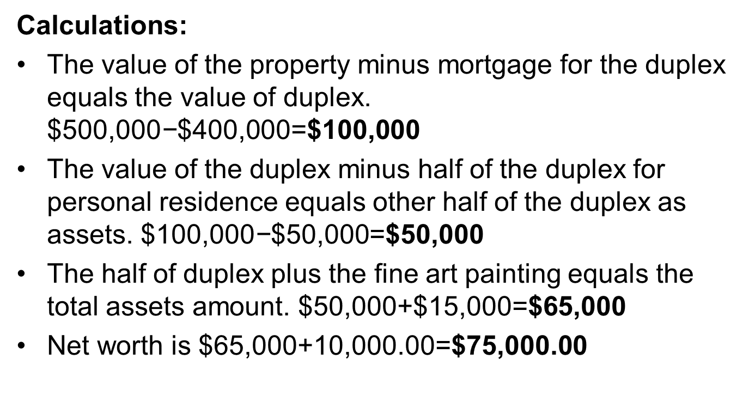
Review Calculate Net Worth Example
Answers
Calculations:
The value of the property minus mortgage for the duplex equals the value of duplex. $\text{\$500,000}\text{−}\text{\$400,000=}\text{\$100,000}$
The value of the duplex minus half of the duplex for personal residence equals other half of the duplex as assets. $\text{\$100,000}\text{−}\text{\$50,000=}\text{\$50,000}$
The half of duplex plus the fine art painting equals the total assets amount. $\text{\$50,000+\$15,000=}\text{\$65,000}$
Net worth is $65,000+10,000.00=$75,000.00

Slide 19
Practice Exercise—Review Net Worth
Instructions:
  Divide into pairs.
  Access Claim 1.
  Use Appendix B: Part A—Review Net Worth worksheet to show your work.
  Work as a group to calculate the net worth based on Example Claim 1.
Time allowed: 20 minutes

Slide 20
Practice Exercise—Review Net Worth
Answers
Answers provided by instructor based on example claim selected.

Slide 21
Net Worth Award Adjustments
Net worth adjustments are different than income and expense adjustments
Net Worth adjustments are not:
  Compared to MAPR
  Compared on a sliding scale—either net worth is acceptable or is a bar to benefits

Slide 22
Conversion of Assets
A surviving spouse sold her family home for $325,000. Before the sale, the value of her home was an exclusion from assets. Now, the income from the sale converts to an inclusion.

Slide 23
Award Adjustments Based on
Amended Net Worth
Once the amended net worth has been calculated, then the award adjustment for net worth may result in one of the following two outcomes:
An update to VBMS-A with amended net worth amount
A termination of benefits

Slide 24
Update VBMS-A with Amended
Net Worth Amount
Process the award adjustment by updating the VBMS-A with the amended net worth amount.

Slide 25
Update VBMS-A with Amended
Net Worth Amount Example 1
On May 15, 2020, we received a VA Form 21-4138, Statement in Support of Claim together with copy of a Bill of sale, from Veteran Jesse Lacey. He reported that he sold his Daisy Lane home on January 21, 2020, and received a lump sum payment in the amount of $25,000. We have previously been considering net worth of $10,000. The Veteran’s IVAP is $12,000.

Slide 26
Update VBMS-A with Amended
Net Worth Amount Example 1 Answers
What is the updated net worth information provided by Mr. Lacey?
  Lump Sum payment of $25,000
What is the amended net worth?
  Amended Net Worth: $47,000

Slide 27
Update VBMS-A with Amended
Net Worth Amount Example 2
VA receives a claim from Jacob Wright, a single Veteran, on April 15, 2020. Mr. Wright’s VA Form 21P-527EZ, Application for Pension, indicates he has previously reported assets of $10,500 in non-interest-bearing bank accounts, $1,000 in a CD, and his collectible 1954 Buick Skylark car worth $6,500. He now reports his primary residence is worth $190,000, based on his most recent assessment. Mr. Wright’s only source of income is his monthly Social Security benefit of $950 and has not reported any medical expenses.

Slide 28
Update VBMS-A with Amended
Net Worth Amount Example 2 Answers
What is the updated net worth information provided by Mr. Wright?
  Mr. Wright’s net worth has not changed.
What is the amended net worth?
  Mr. Wright’s net worth remains $29,400.

Slide 29


No Change Letter Demo

Slide 30
To Develop or Not To Develop
If complete asset/income information is on file, then development is not needed. Instead, calculate the current net worth and provide a contemporaneous notice to the claimant.
If complete asset/income information is not on file, then develop for the missing information. Inform the claimant of the proposed adverse action with the development letter.

Slide 31
Contemporaneous Notice Versus
Proposed Adverse Action
What are the differences between a contemporaneous notice and a proposed adverse action?

Slide 32
Contemporaneous Notice
Send for net worth if all the following conditions are met:
the beneficiary/fiduciary provides factual, unambiguous information or statements regarding updated net worth information
a termination of benefits is warranted for the excessive net worth
the person furnishing the information or statement must know, or be on notice, that such information will be used to calculate benefits

Slide 33
Contemporaneous Notice Example
Veteran Donald Johnson has been receiving nonservice-connected pension since August 2013. On August 15, 2021, he submits a completed VA Form 21P-0516-1, Improved Pension Eligibility Verification Report (Veteran with No Children), indicating that his net worth has increased. His original application included his antique automobile appraised at $70,000. As of June 2021, the antique automobile is appraised at $115,000. Mr. Johnson’s total assets are $135,000, including $20,000 in a non-interest-bearing bank account. The Veteran’s IVAP is $10,000.

Slide 34
Contemporaneous Notice Example
Answers
What is the updated net worth information provided by Mr. Johnson?
  Appraisal for antique automobile increased to $115,000
What is the amended net worth?
  $145,000
On what date will benefits be terminated?
  January 1, 2022

Slide 35
Contemporaneous Notice Demo

Slide 36
Development and Proposed Adverse Action
A proposed adverse action provides the beneficiary with the opportunity to provide additional evidence to contest the action.

Slide 37
Development and Proposed Adverse Action Example
David Smith is a World War II era Veteran with a running Veteran’s pension award. His original application show that he had no net worth to report. On May 18, 2021, he submits information explaining that he sold his primary residence on February 15, 2021. The Veteran also reports that he entered an assisted living facility on May 5, 2021, and submits a VA Form 21P-8416, Medical Expense Report, and a Care Expense Statement outlining his admission and the monthly rate he pays. The Veteran’s IVAP is $0. However, the Veteran did not provide the profit amount of the sale of his home.

Slide 38
Development and Proposed Adverse Action Example Answers
What is the updated net worth information provided by Mr. Smith?
  Mr. Smith’s primary residence was sold so this is considered a conversion of assets
What is the amended net worth?
  Unknown
Is complete asset information required for the amended net worth?
  Yes, a development letter with a proposed adverse action will be sent to the claimant

Slide 39
Development and Proposed
Adverse Action Example Demo

Slide 40
Practice Exercise—Net Worth
Instructions:
  Divide into groups of three.
  Access Claim 2.
  Work as a group to:
    Calculate the amended net worth
    Answer the questions in Appendix B: Part B—Net Worth worksheet
Time allowed: 20 minutes

Slide 41
Practice Exercise—Net Worth Answers
Answers provided by instructor based on example claim selected.

Slide 42
Final Decision Notice Demo

Slide 43
Termination of Benefits
Terminate the award the first of the year of the following calendar year.

Slide 44
Practice Exercise—Net Worth Determination
Instructions:
  Divide into pairs.
  Access Claim 3.
  Use Appendix B: Part C—Net Worth worksheet to show your work.
  Work as a group to:
    Calculate the amended net worth
    Determine the outcome for the amended net worth
Time allowed: 20 minutes

Slide 45
Practice Exercise—Net Worth Determination
Answers
Answers provided by instructor based on example claim selected.

Slide 46
Lesson Summary
Once the amended net worth has been calculated for a running award, then the award adjustment for net worth may result in one of the following two outcomes:
  An update to amended net worth amount in VBMS-A
  A termination of benefits

Slide 47

Questions?

Slide 48
What’s Next
Phase 5: Part 5a, Knowledge Check Preparation
Complete Determine Net Worth Adjustments Course Evaluation: TMS ID: 4408488

