Slide 1
Phase 5, Part 3: Knowledge Check Preparation
PMC VSR Advanced Core Course
Phase 5: Stages of a Claim
Part 3: Promulgate Non-Rating or Rating Decision

Slide 2
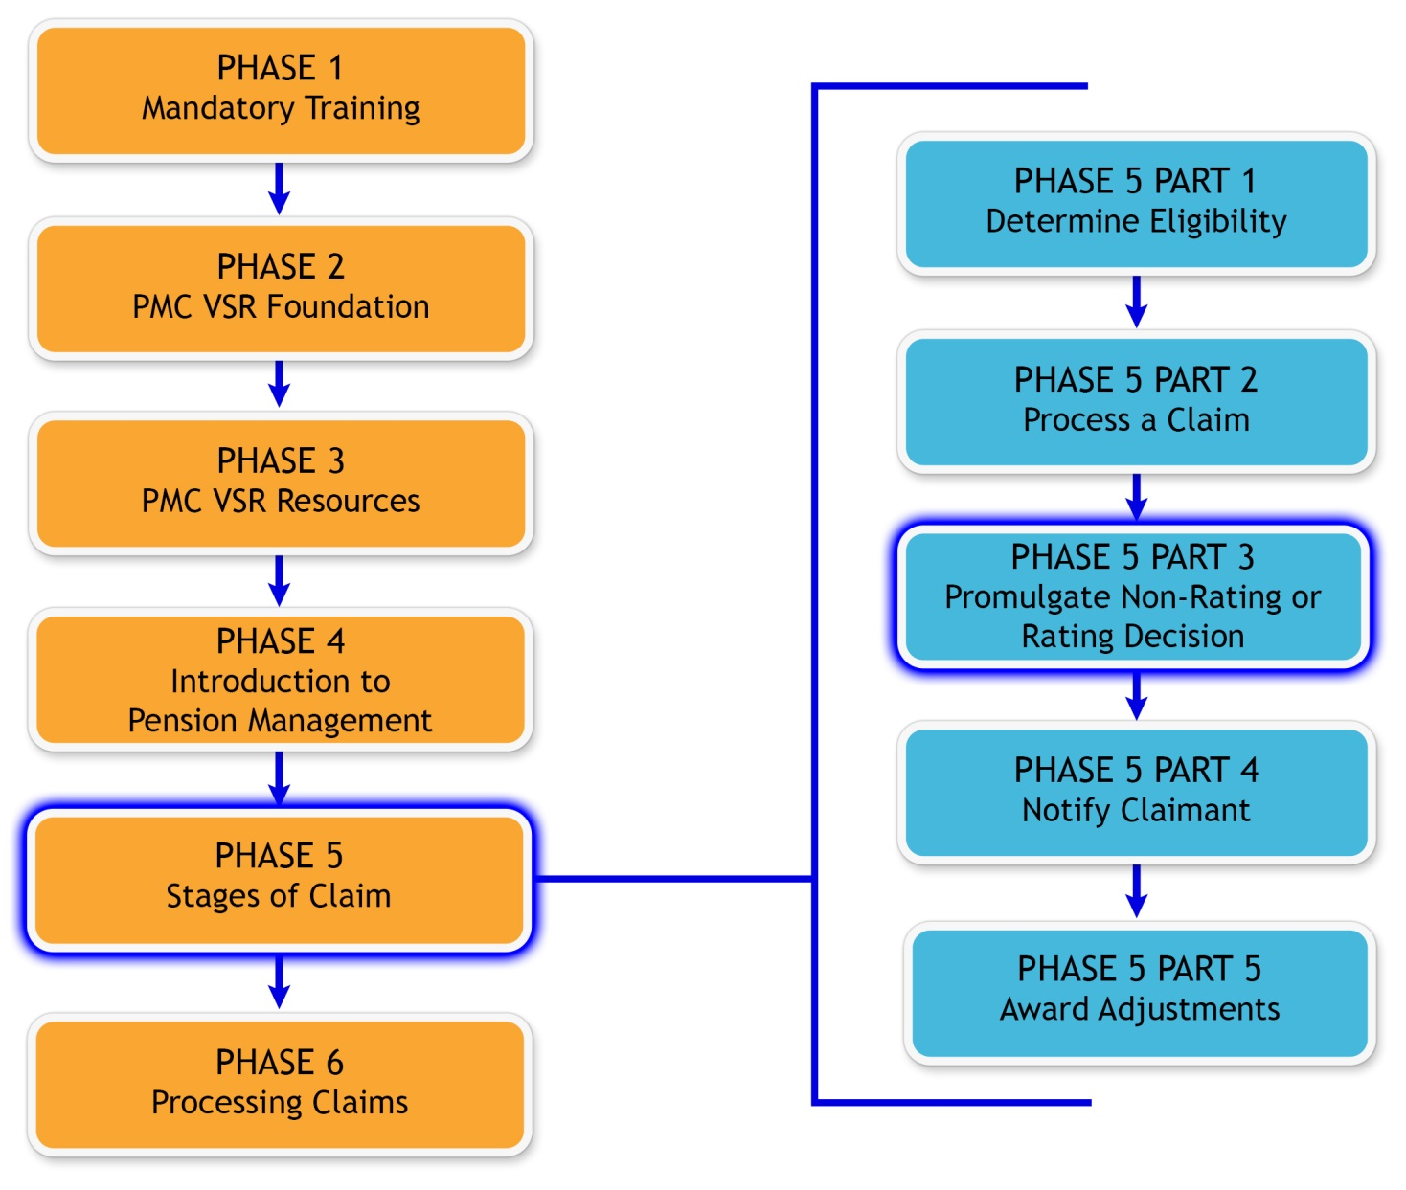
You Are Here

Slide 3
Why It Matters!
PMC VSR reviews and determines if the claim contains the information and evidence needed to determine eligibility for benefits which includes:
Reviewing a rating decision for completion and accuracy
Processing an award action in the correct system

Slide 4
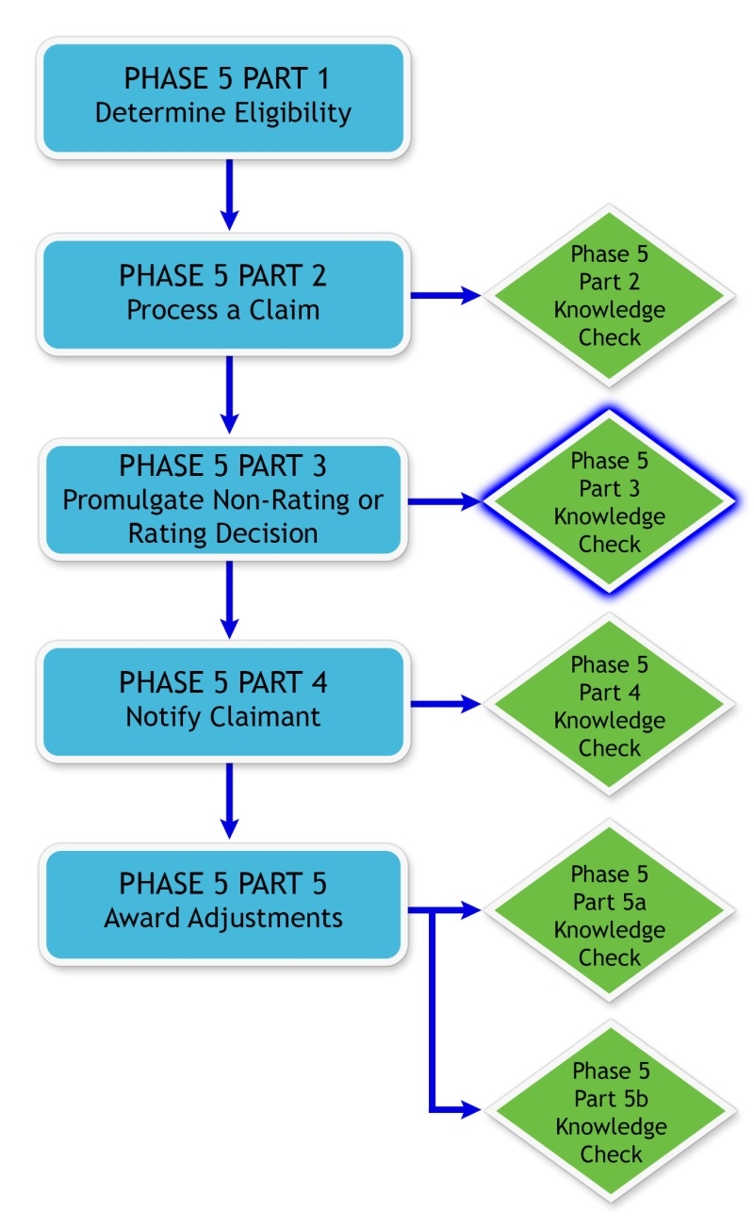
Knowledge Check

Slide 5
Knowledge Check Preparation Overview
This preparation will consist of the following:
Lesson objectives review
Partner activities
Question/answer forum

Slide 6
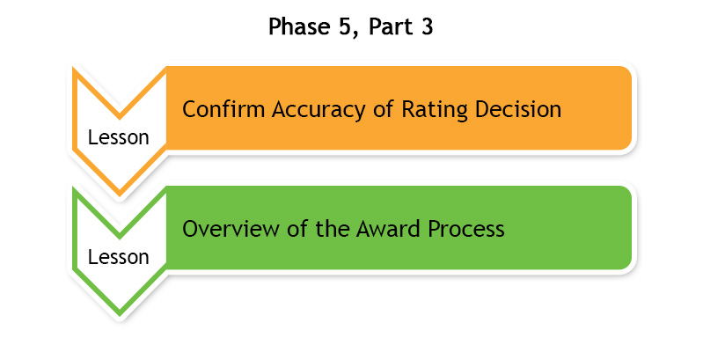
Phase 5, Part 3 Lessons

Slide 7
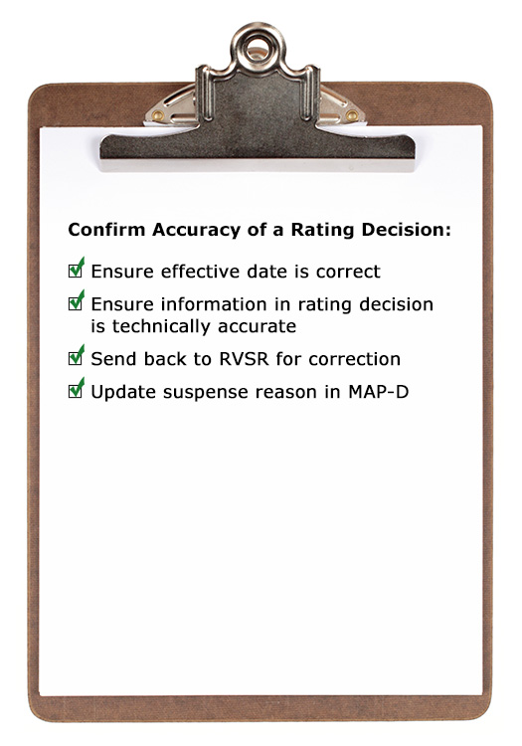
Confirm Accuracy of Rating Decision

Slide 8
Confirm Accuracy of Rating Decision Objectives
Confirm accuracy of a rating decision.
Confirm effective date is correct.
Confirm information in rating decision is technically accurate.
Complete request for corrected rating.

Slide 9
Accuracy of Rating Decision Question Writing Opportunity
Instructions:
Use Appendix C: Question and Answer Worksheet to write any questions regarding accuracy of rating decision
Questions will be answered at the end of this preparation
Time allowed: 5 minutes

Slide 10
Partner Activity—Rating Decision
Instructions:
Divide into pairs.
Review example claim in Appendix A: Example Claim.
Complete Part A of Appendix B: Phase 5, Part 3 Worksheet.
Use the job aids listed in the Part A to help answer the questions.
Be prepared to share your finished activity with the class.
Time allowed: 20 minutes

Slide 11
Partner Activity—Rating Decision Answers
What issues were sent to the RVSR for a rating decision?
Helpless Child
SMP for Veteran
What were the final decision(s) determined by the rater.
Entitlement to A&A for SMP denied
Helpless child for son granted
List any errors that need to be addressed and provide your rationale for the error.
The ITF was not listed on the rating decision so the effective date is incorrect

Slide 12
Overview of the Award Process

Slide 13
Overview of the Award Process Objectives
Describe how to prepare an award action.
Describe the responsibilities on award action for all decisions.
Describe the common steps for processing a grant of benefits.
Describe the common steps for processing a denial of benefits.
Describe the common steps for processing an award adjustment.
Describe the common steps for processing a renouncement.

Slide 14
Overview of the Award Process Question Writing Opportunity
Instructions:
Use Appendix C: Question and Answer Worksheet to write any questions regarding processing an award action
Questions will be answered at the end of this preparation
Time allowed: 5 minutes

Slide 15
Partner Activity—What’s the Award Action
Instructions:
Divide into pairs.
Review example claim in Appendix A: Example Claim
Complete Part B of Appendix B: Phase 5, Part 3 Worksheet.
Use the job aids in Part B to help answer the questions.
Be prepared to share your finished activity with the class.
Time allowed: 20 minutes

Slide 16
Partner Activity—What’s the Award Action Answers (1 of 2)
What are the decisions that need to be processed for an award action?
Veteran’s pension
SMP for Veteran
Dependent Spouse
Dependent Child—Adoption
Helpless child

Slide 17
Partner Activity—What’s the Award Action Answers (2 of 2)
For each decision listed in question 1, choose whether the award action is a grant or denial of benefit.
Veteran’s pension—Grant
SMP for Veteran—Deny
Dependent Spouse—Grant
Dependent Child—Grant
Helpless child—Grant

Slide 18
Question and Answer Forum
Instructions
Divide into groups of three or four
Review the Appendix C: Question and Answer Worksheet with your group
Mark any questions that need further clarification from the instructor
Time allowed: 10-15 minutes

Slide 19
Question and Answer Clarification

Slide 20
What’s Next?
Phase 5, Part 3 Promulgate Non-Rating or Rating Decision Knowledge Check

