Slide 1
Phase 5, Part 2: Knowledge Check Preparation
PMC VSR Advanced Core Course
Phase 5: Stages of a Claim
Part 2: Process a Claim

Slide 2
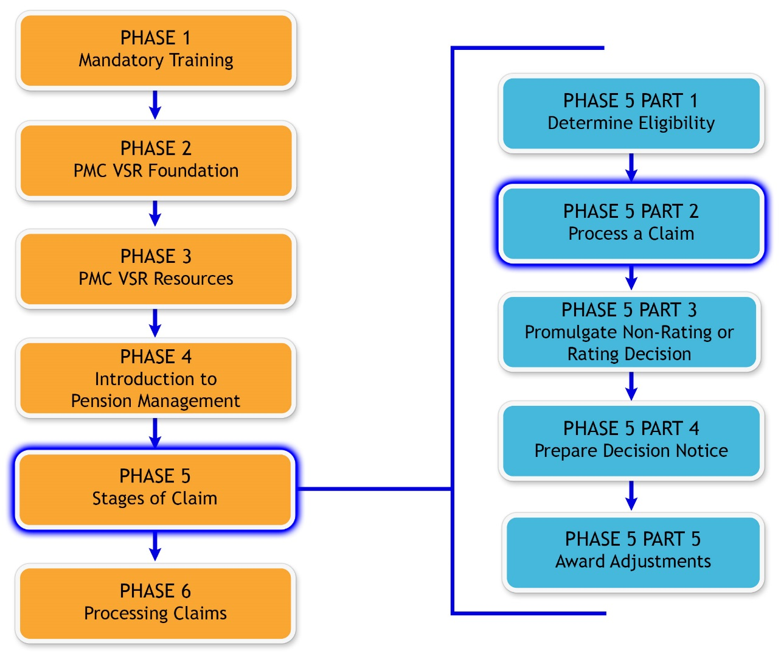
You Are Here

Slide 3
Why It Matters!
PMC VSRs review all pieces of information and evidence to determine the type of claim and how it should be processed. This includes:
Developing for information/evidence needed to fulfill duty to assist for various types of claims.
Requesting appointment of a fiduciary for an incompetency claim.

Slide 4
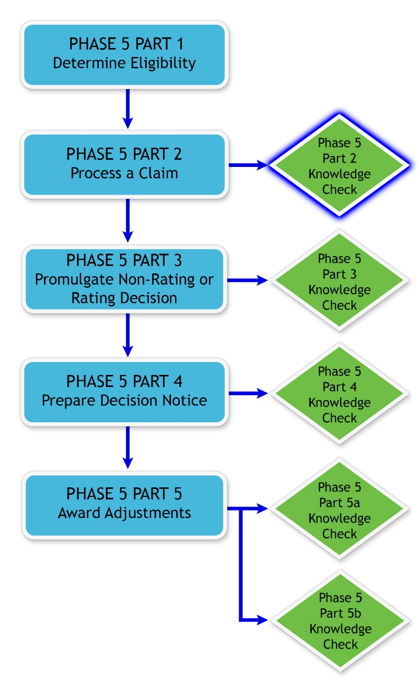
Knowledge Check

Slide 5
Knowledge Check Preparation Overview
This preparation will consist of the following:
Lesson objectives review
Partner activities
Question/answer forum

Slide 6
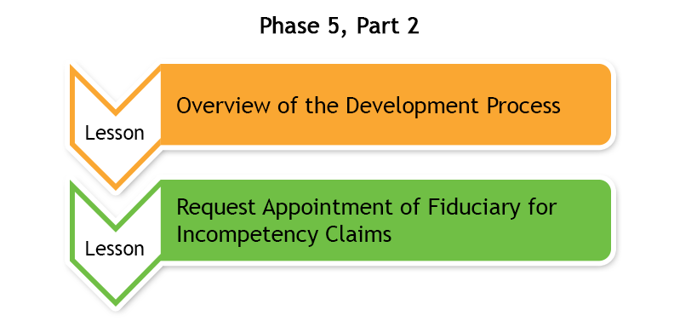
Phase 5, Part 2 Lessons

Slide 7
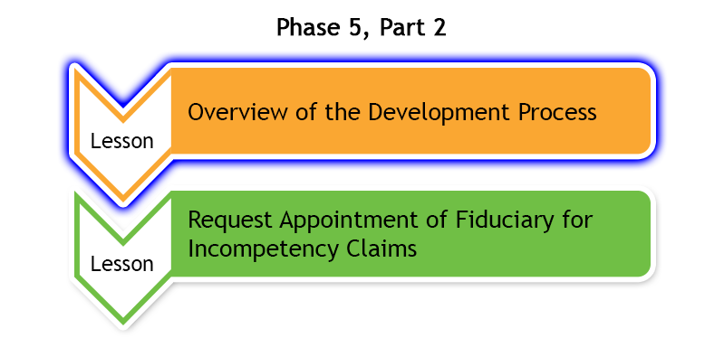
Overview of the Development Process
Develop for information/evidence needed to fulfill duty to assist.
Objectives:
  Define key terms used by PMC VSRs in development of a claim.
  Describe the common steps in development.

Slide 8
Overview of the Development Process
Question Writing Opportunity
Instructions:
  Use Appendix B: Question and Answer Worksheet to write any questions regarding overview of the development process.
  Questions will be answered at the end of this preparation.
Time allowed: 5 minutes

Slide 9
Matching Activity—Key Terms Used When
Developing a Claim
Instructions:
  Match the terms with the correct description provided in Appendix A: Part A—Key Terms Used When Developing a Claim.
  Use the Develop for Missing Information/Evidence job aid to assist in matching the terms.
  Compare your finished activity with another trainee in the class.
Time allowed: 5 minutes

Slide 10
Matching Activity—Key Terms Used When
Developing a Claim Answers (1 of 2)
Non-evidentiary facts used to substantiate the claim.
  Information
Request for documentation from state government, local government and privately held entity.
  Non-federal records
Help claimant obtain information or evidence to substantiate the claim.
  Duty to Assist
Provided by a nonexpert who has knowledge of facts or circumstances and conveys matters that can be observed.
  Competent lay evidence

Slide 11
Matching Activity—Key Terms Used When
Developing a Claim Answers (2 of 2)
Provided by a person who is qualified through education, training, or experience to offer medical diagnoses, statements, or opinions.
  Competent medical evidence
Provide a notice of any information or evidence needed to substantiate the claim.
  Duty to Notify
Request for documentation from Social Security Administration (SSA), VA Medical Centers (VAMCs), or National Personnel Records Center (NPRC).
  Federal records

Slide 12
Group Activity—What’s Your Next Step?
Instructions:
  Divide into groups of three.
  Review Claim 1, Claim 2, and Claim 3.
  Use the Develop for Missing Information/Evidence job aid.
  Complete Appendix A: Part B—What’s Your Next Step? Worksheet and decide what would be the next step in the development process.
  Be prepared to share your finished activity with other groups.
Time allowed: 15 minutes

Slide 13
Group Activity—What’s Your Next Step?
Claim 1 Answers
Based on your review, do you need to contact the claimant?
  Answer provided by instructor based on example claim selected.
What evidence is needed, if any, to continue processing the claim?
  Answer provided by instructor based on example claim selected.
If evidence needs to be requested, what is the deadline for evidence to be received?
  Answer provided by instructor based on example claim selected.

Slide 14
Group Activity—What’s Your Next Step?
Claim 2 Answers
Based on your review, do you need to contact the claimant?
  Answer provided by instructor based on example claim selected.
What evidence is needed, if any, to continue processing the claim?
  Answer provided by instructor based on example claim selected.
If evidence needs to be requested, what is the deadline for evidence to be received?
  Answer provided by instructor based on example claim selected.

Slide 15
Group Activity—What’s Your Next Step?
Claim 3 Answers
Based on your review, do you need to contact the claimant?
  Answer provided by instructor based on example claim selected.
What evidence is needed, if any, to continue processing the claim?
  Answer provided by instructor based on example claim selected.
If evidence needs to be requested, what the is deadline for evidence to be received?
  Answer provided by instructor based on example claim selected.

Slide 16
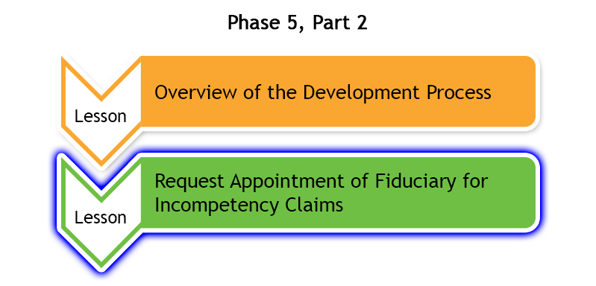
Request Appointment of Fiduciary for Incompetency Claims
You will have pension claims that indicate a beneficiary may be incompetent and fiduciary may need to be appointed
Request Appointment of Fiduciary objectives:
  Request appointment of a fiduciary for an incompetency claim.
    Recognize incompetency indicators.
    Confirm beneficiary has been proposed incompetent by the RVSR.
    Process award.
    Identify the elements of the proposed notice of incompetency rating.

Slide 17
Request Appointment of Fiduciary
Question Writing Opportunity
Instructions:
  Use Appendix B: Question and Answer Worksheet to write any questions regarding requesting appointment of a fiduciary.
  Questions will be answered at the end of this knowledge check preparation.
Time allowed: 5 minutes

Slide 18
Group Activity—Request Appointment of a
Fiduciary
Instructions:
  Divide into groups of three.
  Review Claim 4.
  Complete Appendix A: Part C—Request Appointment of a Fiduciary Worksheet using the references provided in the exercise.
  Be prepared to share your finished activity with other groups.
Time allowed: 10 minutes

Slide 19
Partner Activity—Request Appointment of a
Fiduciary Claim Answers
Does the claim indicate incompetency? Explain why or why not.
  Answer provided by instructor based on example claim selected.
Does the beneficiary have a proposed rating of incompetency?
  Answer provided by instructor based on example claim selected.
What information should you include when notifying the beneficiary of the Brady Bill?
  Answer provided by instructor based on example claim selected.
Based on the information in the claim, do you need to prepare VA Form 21-592, Request for Appointment of a Fiduciary, Custodian or Guardian? Explain why or why not.
  Answer provided by instructor based on example claim selected.

Slide 20
Question and Answer Forum
Instructions:
  Divide into groups of three or four.
  Review the Appendix B: Question and Answer Worksheet with your group.
  Mark any questions that need further clarification from the instructor.
Time allowed: 10 minutes

Slide 21

Question and Answer Clarification

Slide 22
What’s Next?
Phase 5, Part 2: Process a Claim Knowledge Check

