Slide 1
Phase 5, Part 1(c) Knowledge Check Preparation
PMC VSR Advanced Core Course
Phase 5: Stages of a Claim
Part 1: Determine Eligibility

Slide 2
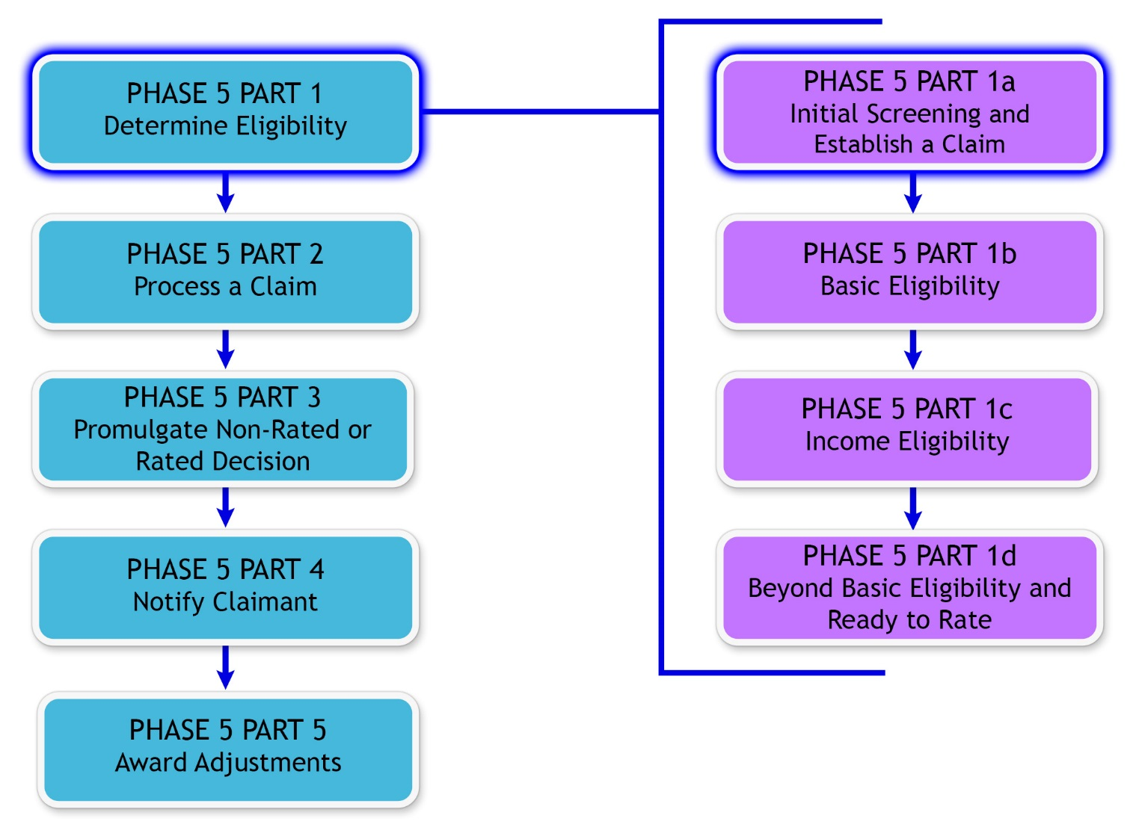
You Are Here

Slide 3
Why It Matters!
PMC VSRs are responsible for determining the income and net worth status of a claim. This includes:
Selecting the effective dates
Selecting initial year period
Determining if the income is countable
Selecting qualifying expenses
Calculating Income for VA Purposes (IVAP)
Performing upfront verification
Determining if IVAP is within Monthly Annual Pension Rate (MAPR) limit
Calculating net worth
Determining if net worth is a factor

Slide 4
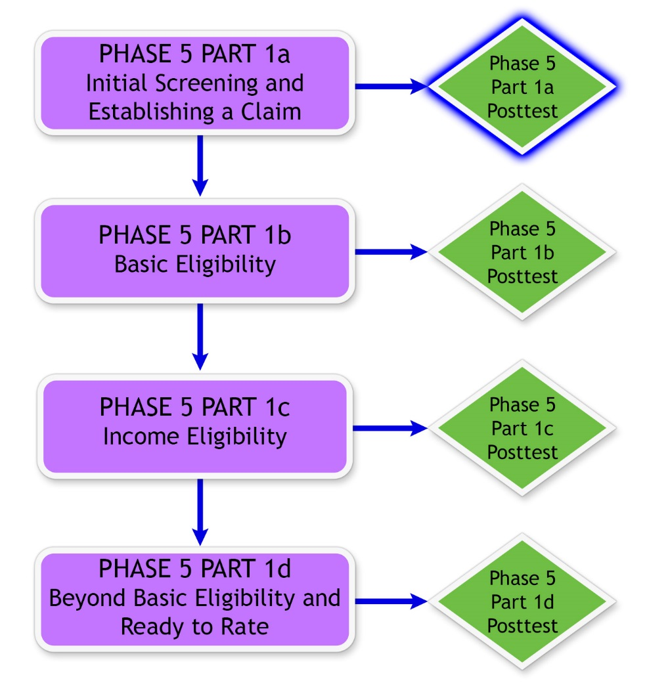
Knowledge Check

Slide 5
Knowledge Check Preparation Overview
This preparation will consist of the following:
Lesson objectives review
Partner activities
Question/answer forum

Slide 6
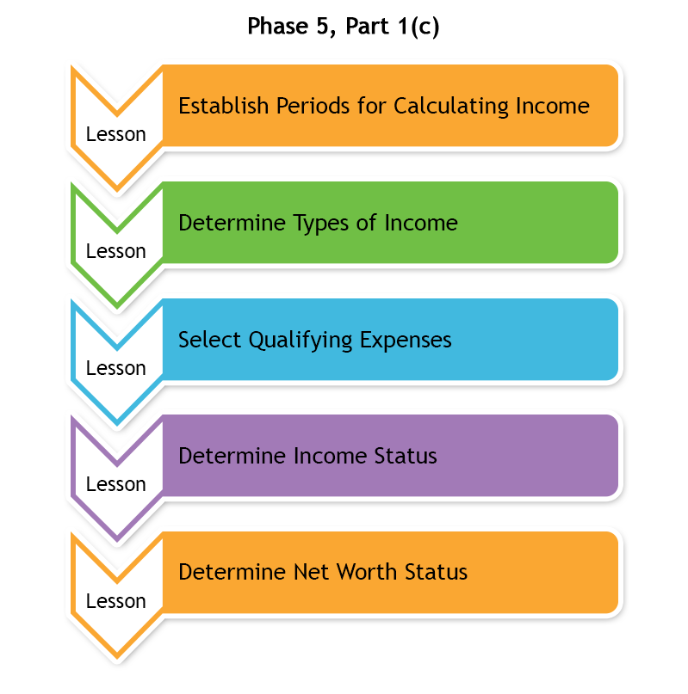
Phase 5, Part 1(c) Lessons

Slide 7
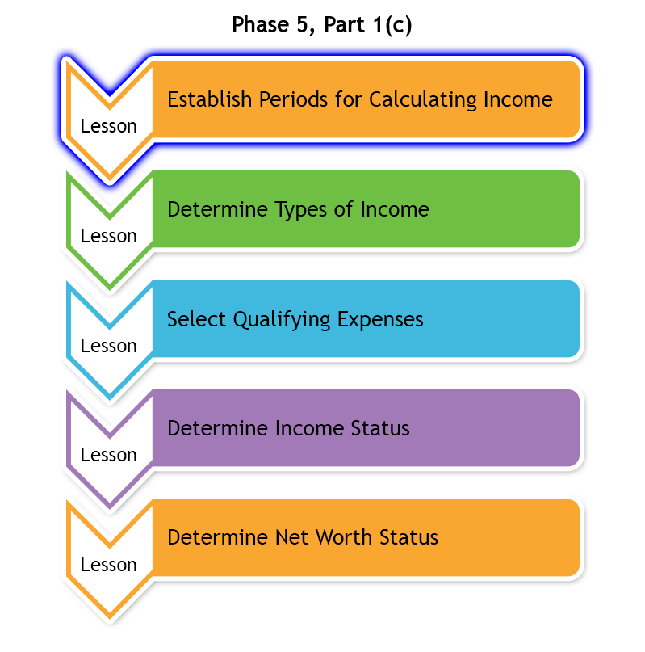
Establish Periods for Calculating Income
Selecting the correct dates for establishing the time periods is used to:
  Calculate Income for VA Purposes (IVAP)
  Determine income status
Using incorrect dates may result in errors in denying or awarding benefits

Slide 8
Establish Periods for Calculating Income Objectives
Establish periods for calculating income.
  Select the effective date.
  Derive the payment date.
  Select the dates of initial year period.
  Select the dates of the overlap period between the initial year and calendar year.
  Select the dates beginning and ending the second 12-month period.

Slide 9
Establish Periods for Calculating Income
Question Writing Opportunity
Instructions:
  Use Appendix E: Question and Answer Worksheet to write any questions regarding administrative decisions
  Questions will be answered at the end of this preparation
Time allowed: 5 minutes

Slide 10
Partner Activity—What’s the Date?
Instructions:
  Divide into pairs
  Review example claim in Appendix A: Example Claim 1
  Complete Appendix B: Part A—What’s the Date?
  Use the Initial Year job aid to help answer the questions
  Be prepared to share your finished activity with the class
Time allowed: 7-10 minutes

Slide 11
Partner Activity—What’s the Date?
Answers (1 of 2)
1. Entitlement date/effective date, beginning of initial year:
  4/02/2015

Slide 12
Partner Activity—What’s the Date?
Answers (2 of 2)
2. Provide the dates for the following periods:
  “A” period: 4/02/2015 to 12/31/2015
  End of “A” period: 12/31/2015
  Beginning of first full calendar year: 1/1/2016
  Overlap period or “B” period: 1/1/2016 to 4/30/2016
  End of initial year: 4/30/2016
  “C” period: 1/1/2016 to 12/31/2016
  End of first full calendar year: 12/31/2016
  End of second 12 months: 5/31/2017

Slide 13
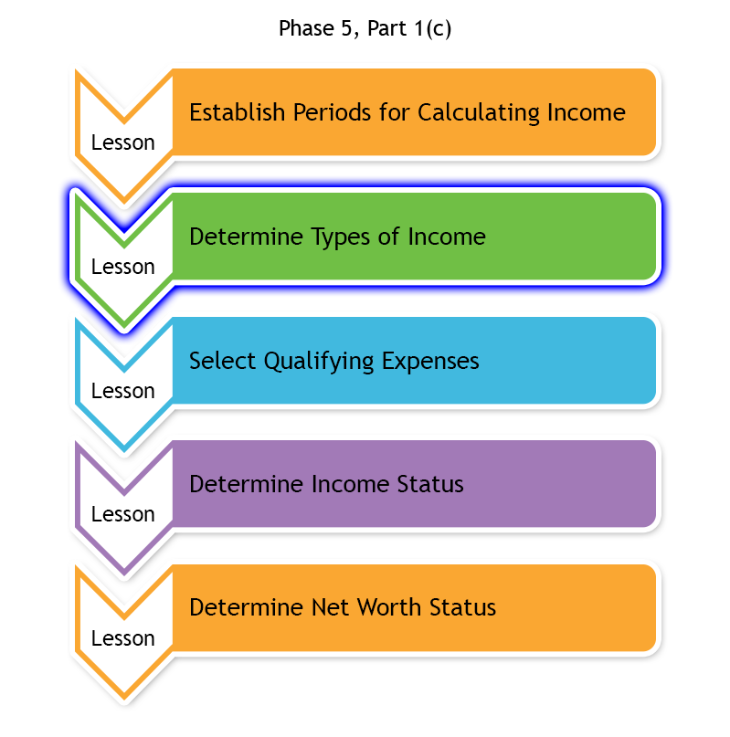
Determine Types of Income
The PMC VSR is responsible for reviewing the claim to determine if the income is countable or excluded
Income for all persons on an award is countable:
  Veteran
  Spouse/surviving spouse
  Child dependents

Slide 14
Determine Types of Income Objectives
Determine the types of income for pension purposes.
  Define income for VA purposes.
  Determine income inclusions.
  Determine income exclusions.
  Enter countable income into VBMS-A.

Slide 15
Types of Income Question
Writing Opportunity
Instructions:
  Use Appendix E: Question and Answer Worksheet to write any questions regarding types of income
  Questions will be answered at the end of this preparation
Time allowed: 5 minutes

Slide 16
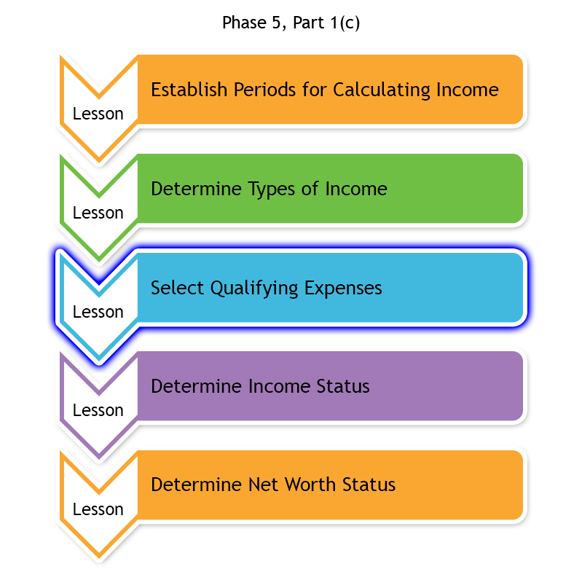
Select Qualifying Expenses
Correct calculation of claimant income affects amount of benefit for claimant
Qualifying expenses reduce claimant income; therefore, qualifying expenses may result in an increase in benefits
The PMC VSR selects expenses that qualify for deduction from income

Slide 17
Select Qualifying Expenses Objectives
Select qualifying expenses for calculating income.
  Describe the rules for allowing medical expenses as a deduction when calculating income.
  Describe the rules for allowing final expenses as a deduction when calculating income.
  Describe the rules for allowing education expenses as a deduction when calculating income.
  Determine if claimed expenses are acceptable when calculating income.
  Determine whether to develop for claimed expenses when calculating income.

Slide 18
Qualifying Expenses Question
Writing Opportunity
Instructions:
  Use Appendix E: Question and Answer Worksheet to write any questions regarding qualifying expenses
  Questions will be answered at the end of this preparation
Time allowed: 5 minutes

Slide 19
Partner Activity—Income and Expenses
Instructions:
  Divide into pairs
  Review the example claim in Appendix A: Example Claim 1
  Complete Appendix B: Part B—Income and Expenses Worksheet
  Use the job aids to help answer the questions
  Be prepared to share your finished activity with the class
Time allowed: 10 minutes

Slide 20
Partner Activity—Income and Expenses
Answers (1 of 2)
List the countable income and classification in the table.
  Refer to Appendix D: Answer Key for the countable income answers.

Slide 21
Partner Activity—Income and Expenses
Answers (2 of 2)
2. List the medical expenses in the table.
  Refer to Appendix D: Answer Key for the medical expenses answers.

Slide 22
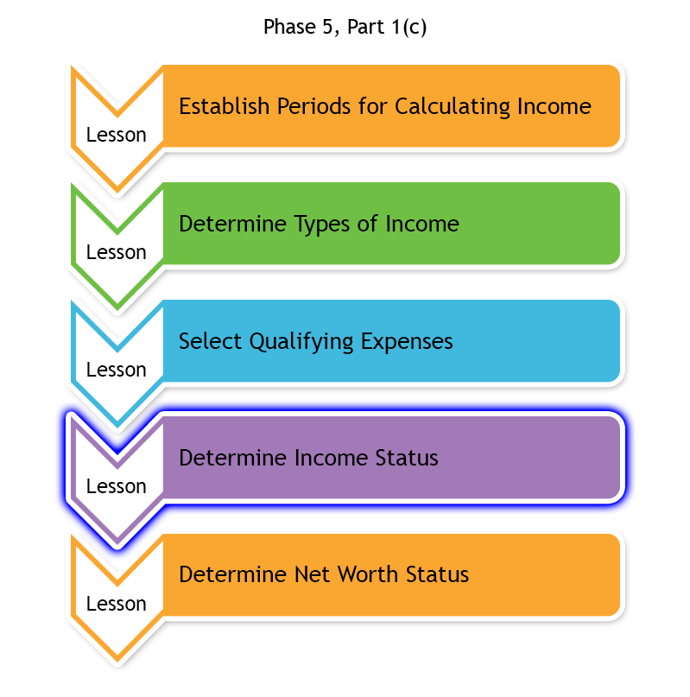
Determine Income Status
Determining income status consists of the following:
  Calculating IVAP from application
  Performing upfront verification
  Comparing IVAP with upfront verification IVAP
  Determining if IVAP is within MAPR limit

Slide 23
Determine Income Status Objectives
Determine income status.
  Calculate IVAP from application.
  Perform upfront verification.
  Determine if IVAP is within MAPR limit.

Slide 24
Income Status Question Writing Opportunity
Instructions:
  Use Appendix E: Question and Answer Worksheet to write any questions regarding income status
  Questions will be answered at the end of the Knowledge Check preparation
Time allowed: 5 minutes

Slide 25
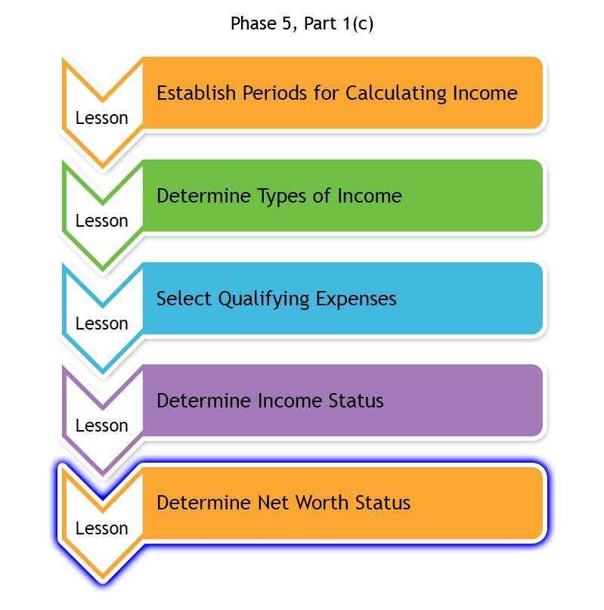
Determine Net Worth Status
Net worth for VA purposes includes all personal property owned by the claimant, except for personal effects suitable to the claimant’s reasonable mode of life
If net worth is excessive, then a formal administrative decision needs to be prepared using VA Form 21-5427, Corpus of Estate Determination

Slide 26
Determine Net Worth Status Objectives
Determine net worth status.
  Define net worth for VA purposes.
  Determine sources of net worth.
  Calculate net worth.
  Determine if net worth is a bar to benefits.

Slide 27
Net Worth Status Question
Writing Opportunity
Instructions:
  Use Appendix E: Question and Answer Worksheet to write any questions regarding net worth status
  Questions will be answered at the end of the preparation
Time allowed: 5 minutes

Slide 28
Partner Activity—Net Worth
Instructions:
  Divide into pairs
  Review example claim 2 in Appendix C: Example Claim 2
  Answer the questions in Appendix B: Part C—Net Worth Worksheet to determine whether net worth is a bar to benefits
  Use the Income and Net Worth Status job aid
  Be prepared to share your finished activity with the class
Time allowed: 20 minutes

Slide 29
Partner Activity—Net Worth
Answers (1 of 2)
Use the documents in the example claim 2, to complete the following fields on VA Form 21-5427, Corpus of Estate Determination:
  Total Amount of Estate
    $107,200.00
  Total Income
    $1,592.63
  Total Expenses
    $5,525.25

Slide 30
Partner Activity— Net Worth
Answers (2 of 2)
Do the monthly expenses exceed the claimant’s income? If so, by how much monthly?
  Yes, claimant's monthly expenses exceeds her income by $3,932.52
Based on all the evidence provided in the example claim 2, is net worth a bar to benefits?
  PMC VSR Discretion

Slide 31
Question and Answer Forum
Instructions
  Divide into groups of three or four
  Review the Appendix E: Phase 5, Part 1(c) Question and Answer Worksheet with your group
  Mark any questions that need further clarification from the instructor
Time allowed: 10 minutes

Slide 32

Question and Answer Clarification

Slide 33
What’s Next?
Phase 5, Part 1(c): Income Eligibility Knowledge Check

