Slide 1
Lesson 9: Process New or Reconsidered Claims
PMC VSR Advanced Core Course
Phase 6: Processing Claims

Slide 2
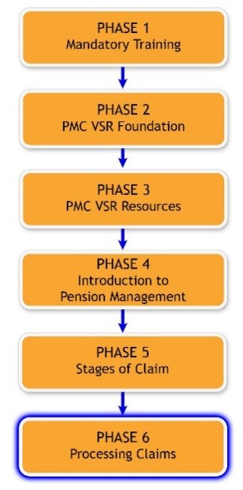
You Are Here

Slide 3
Technical Competencies
Program Benefits and Eligibility (PMC VSR)
Processing Claims (PMC VSR)
VBA Applications (PMC VSR)
Income Counting and Net Worth

Slide 4
Scenario—New or Reconsidered Claim
Mr. Jacob Danforth first applied for benefits on 06/14/2014 but is denied for excessive income in a decision notice dated 08/03/2014. On 02/21/2015, Mr. Danforth submits additional income and expense information to the VA.

Slide 5
Why it Matters!
Accurately determining whether a claim is new or a claim for reconsideration affects appeal dates as well as entitlement dates.

Slide 6
Lesson Objectives (1 of 2)
Process new or reconsidered claims.
  Recognize indicators of new or reconsidered claims.
  Confirm claim characteristics assigned by claims assistant.
  Determine if claim may be denied without development.
  Determine if evidence is sufficient to process new or reconsidered claims.
  Apply the correct development actions for the information/evidence missing from the claim.

Slide 7
Lesson Objectives (2 of 2)
  Determine entitlement to new or reconsidered claims.
  Determine if claim should be submitted to rating activity.
  Decide the award action for new or reconsidered claims.
  Prepare a decision notice for new or reconsidered claims.
  Submit the claim to the Authorizer.

Slide 8
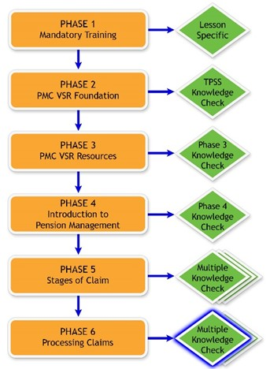
Knowledge Check

Slide 9
Distinguishing New or
Reconsidered Claims (1 of 2)
Reconsidered—submitted within 1 year of decision of denied claim (the appeal period)
New—submitted 1 year or more after decision is final for prior claim
EP Codes: 127, 137, 165, 167, 150/157, 297

Slide 10
Distinguishing New or
Reconsidered Claims (2 of 2)
PMC VSRs should do the following to distinguish between new claims or reconsidered claims:
  Confirm the EP is not for an original claim
  Check the date of decision notice, date of claim, or date of development letter of previously denied claim to determine time limits
  Look in eFolder at evidence and letters for previously denied claim

Slide 11
Activity—Distinguishing New or Reconsidered Claims
Instructions:
  Access CPKM to use M21-1 to complete the activity.
  Work in assigned group.
  Read the scenarios from the worksheet.
  Determine for each scenario whether it is a new or reconsidered claim.
  Record your answers on the worksheet provided.
  Select one person to present your group’s findings.
Time allowed: 10 min.

Slide 12
Activity—Distinguishing New or
Reconsidered Claims Answers (1 of 2)
Scenario 1
  Reconsidered
Scenario 2
  New

Slide 13
Activity—Distinguishing New or
Reconsidered Claims Answers (2 of 2)
Scenario 3
  Reconsidered
Scenario 4
  Reconsidered
Scenario 5
  New

Slide 14
Overview of Processing New or Reconsidered Claims
Many of the steps required to process new or reconsidered claims are done simultaneously by PMC VSRs in the field.
For the purpose of instruction, the steps are broken out individually.

Slide 15
Lesson Overview
Demonstration—Instructor processes a claim from start to finish with opportunities for questions.
Guided Practice—Trainees process a claim with questions and feedback/remediation.

Slide 16

Demonstration Claim 1—Process New or Reconsidered Claims
Demonstration Claim 1—
  {Name}
  {Other information}

Slide 17
Claim 1—Recognize Indicators of a
New or Reconsidered Claim
Prescribed VA forms, as needed
EP 127, 137, 165, 167, 150/157, 297

Slide 18
Claim 1—Confirm Claim Characteristics
Assigned by Claims Assistant

Slide 19
Refraining From or Discontinuing Assistance
M21-1 I.1.A.3.b (Refraining From or Discontinuing Assistance)
Lack of qualifying service, Veteran status, or legal eligibility
Claims that are inherently incredible or clearly lack merit
Request for a benefit to which the claimant is not entitled as a matter of law

Slide 20
Claim 1—Screen Claim for Lack of Eligibility
(to Determine if Claim may be
Denied without Development)

Slide 21
Claim 1—Identify Missing
Information/Evidence

Slide 22
Claim 1—Develop for
Missing Information/Evidence

Slide 23
Claim 1—Determine Entitlement to
New or Reconsidered Claims

Slide 24
Claim 1—Determine if Claim Should Be
Submitted to Rating Activity

Slide 25
Claim 1—Decide the Award Action for
New or Reconsidered Claims

Slide 26
Claim 1—Prepare a Decision Notice for
New or Reconsidered Claims

Slide 27
Claim 1—Submit the Claim to the Authorizer

Slide 28
Take Credit in ASPEN

Slide 29
Guided Practice Exercise Overview (1 of 3)
Instructions:
  Process Claim 2 from beginning to end.
  Use the job aids, references, and systems available.
  Select a partner before beginning the exercise to confer with after completing each step individually.
  Consult with instructors for assistance.
  Be prepared to discuss your results with the class.
  Take credit in ASPEN at the completion of the exercise.

Slide 30
Guided Practice Exercise Overview (2 of 3)
This exercise includes the following parts of the claim process:
  Recognize indicators of a new or reconsidered claim
  Confirm claim characteristics assigned by claims assistant
  Screen for lack of eligibility
  Identify missing information/evidence
  Develop for missing information/evidence

Slide 31
Guided Practice Exercise Overview (3 of 3)
  Determine entitlement to new or reconsidered claims
  Determine if claim should be submitted to rating activity
  Decide the award action
  Prepare a decision notice
  Submit the claim to the Authorizer

Slide 32
Guided Practice Exercise Claim 2—
Process New or Reconsidered Claims
Guided Practice Exercise Claim 2:
  {Name}
  {Other information}

Slide 33
Claim 2—Recognize Indicators of a
New or Reconsidered Claim
Instructions:
  Perform the steps to recognize indicators of the claim for Claim 2.
  Use the job aids, references, and systems available.
  Confer with your partner.
  Be prepared to discuss your results with the class.
Time allowed: 5 minutes

Slide 34
Claim 2—Confirm Claim Characteristics
Assigned by Claims Assistant
Instructions:
  Perform the steps to confirm claim characteristics assigned by claims assistant for Claim 2.
  Use the job aids, references, and systems available.
  Confer with your partner.
  Be prepared to discuss your results with the class.
Time allowed: 15 minutes

Slide 35
Claim 2—Screen Claim for Lack of Eligibility
(to Determine if Claim may be
Denied without Development)
Instructions:
  Perform the steps to screen claim for lack of eligibility for Claim 2.
  Use the job aids, references, and systems available.
  Confer with your partner.
  Be prepared to discuss your results with the class.
Time allowed: 15 minutes

Slide 36
Claim 2—Identify Missing
Information/Evidence (1 of 2)
Instructions:
  Perform the steps to identify missing information/evidence for Claim 2.
  Use the job aids, references, and systems available.
  Confer with your partner.
  Be prepared to discuss your results with the class.
Time allowed: 15 minutes

Slide 37
Claim 2—Identify Missing
Information/Evidence (2 of 2)
What information/evidence may require development for Claim 2?

Slide 38
Claim 2—Develop for Missing
Information/Evidence
Instructions:
  Perform the steps to develop for missing information/evidence for Claim 2.
  Use the job aids, references, and systems available.
  Trade development letters with your partner.
  Discuss differences in the letters.
Time allowed: 45 minutes

Slide 39
Claim 2—Determine Entitlement (1 of 2)
Instructions:
  Perform the steps to determine entitlement to benefits for Claim 2.
  Use the job aids, references, and systems available.
  Confer with your partner.
  Be prepared to discuss your results with the class.
Time allowed: 25 minutes

Slide 40
Claim 2—Determine Entitlement (2 of 2)
Is Claim 2 claimant entitled in the following areas? What evidence supports your conclusions?
  Veteran status
  Dependency
  Income and net worth, if applicable

Slide 41
Claim 2—Determine If Claim Should Be
Submitted to Rating Activity
Instructions:
  Perform the steps to determine if the claim should be submitted to rating for Claim 2.
  If so, perform the steps to submit the claim.
  Use the job aids, references, and systems available.
  Confer with your partner.
  Be prepared to discuss your results with the class.
Time allowed: 15 minutes

Slide 42
Claim 2—Decide the Award Action for
New or Reconsidered Claims
Instructions:
  Perform the steps to decide the award action for Claim 2.
  Use the job aids, references, and systems available.
  Confer with your partner.
  Be prepared to discuss your results with the class.
Time allowed: 45 minutes

Slide 43
Claim 2—Prepare a Decision Notice for New or Reconsidered Claims
Instructions:
  Perform the steps to prepare the decision notice for Claim 2.
  Use the job aids, references, and systems available.
  Confer with your partner to assess each other’s decision notice.
  Ask for guidance from the instructor if you identify discrepancies.
Time allowed: 20 minutes

Slide 44
Claim 2—Submit the Claim to the Authorizer
Instructions:
  Finalize notes for Claim 2 and save completed work in appropriate locations for review by Authorizer.
  Use the job aids, references, and systems available.
Time allowed: 15 minutes

Slide 45

Questions?

Slide 46
Lesson Summary (1 of 3)
What are the main tasks a PMC VSR must accomplish to process new or reconsidered claims?

Slide 47
Lesson Summary (2 of 3)
Recognize indicators of a new or reconsidered claim.
Confirm claim characteristics assigned by the claims assistant.
Screen claim for lack of eligibility (to determine if claim can be denied without development).
Identify missing information/evidence.
Develop for missing information/evidence.

Slide 48
Lesson Summary (3 of 3)
Determine entitlement to new or reconsidered claims.
Determine if a claim should be submitted to rating activity.
Decide the award action for new or reconsidered claims.
Prepare the decision notice for new or reconsidered claims.
Submit the claim to the Authorizer.

Slide 49
What’s Next?
Knowledge Check: Process New or Reconsidered Claims

