Slide 1
Compensation Service
November 2017
Inferred/Subordinate Issues

Slide 2
Purpose
Improve the quality and efficiency of service provided to Veterans and claimants.
Reduction of A2 quality review errors

Slide 3
Objectives
Identify commonly inferred issues
Describe situations which common inferred issues typically arise
Recognize inferred issues and identify the actions required to address the issue with 100% accuracy

Slide 4
References
38 CFR 3.310, Disabilities that are proximately due to, or aggravated by, service connected disease or injury
38 CFR 3.321, General rating considerations
38 CFR 3.324, Multiple noncompensable service connected disabilities
38 CFR 3.340, Total and permanent ratings and unemployability
38 CFR 3.350, Special monthly compensation ratings

Slide 5
M21-1, Part III, Subpart iv, 4.F.2.e, When evidence supports hypertension is/is not a complication of diabetes mellitus
M21-1, Part III, Subpart iv, 6.B.1.a, Recognizing Issues and Claims when Preparing a Rating Decision
M21-1, Part III, Subpart iv, 6,B.2, Considering subordinate issues and ancillary benefits
M21-1, Part III, Subpart iv, 6.C.3.c, Handling issues within the scope of a claim
M21-1, Part IV, Subpart ii, 2.A, Deciding Claims for Disability Compensation

Slide 6
References (continued)
M21-1, Part IV, Subpart ii, 2.F.2.k, Identifying Reasonably Raised Claims of IU
M21-1, Part IV, Subpart ii, 2.H, Special Monthly Compensation
M21-1, IX,i.3.1.a, General Information on SAH and SHA Grants
M21-1, IX,ii.2.5, Ratings for Special Purpose
M21-4, 3.03 a, STAR Checklists
M21-4, Appendix A, STAR Rating Quality Review Checklist

Slide 7
National Quality Definition of A2 Errors
An A-2 error will be cited where all subordinate/inferred issues are not addressed.
A “subordinate issue” is derived from the consideration or outcome of related issues and often shares the same fact pattern. The Veterans Court in McGrath v. Brown has stated that “An issue may not be ignored or rejected merely because the Veteran did not expressly raise the appropriate legal provision for the benefit sought.
Notes:
A list of some, but not all, subordinate issues is included in M21-1, Part III, Subpart iv, 6.B.1.d. A list of some, but not all, ancillary issues are enumerated in M21-1, Part III, Subpart iv, 6.B.1.c.

Slide 8
Subordinate and/or Ancillary Issues
Issues within the scope
Unclaimed subordinate issues
Ancillary benefits
Reasonably raised issues
Compensation entitlement issues
  Competency reviews

Slide 9
Issues within the Scope
Additional benefits for complications of the claimed condition, including those identified by the rating criteria for that condition in 38 CFR Part 4, VA Schedule for Rating Disabilities, and
Any ancillary benefit(s) or other unclaimed subordinate issue(s) not expressly raised by the claimant which are related to a claimed issue and arise as a result of the adjudication of a claimed issue.
Sympathetic reading of the claimant’s statements and/or evidence of record.
Notes:
Sympathetic reading Examples: Tinnitus not addressed during a hearing loss claim

Slide 10
Subordinate Issues
A subordinate issue is defined as: an issue that results from the consideration or outcome of related issues.
Infer only to grant entitlement
Exception: §3.324 cases

Slide 11
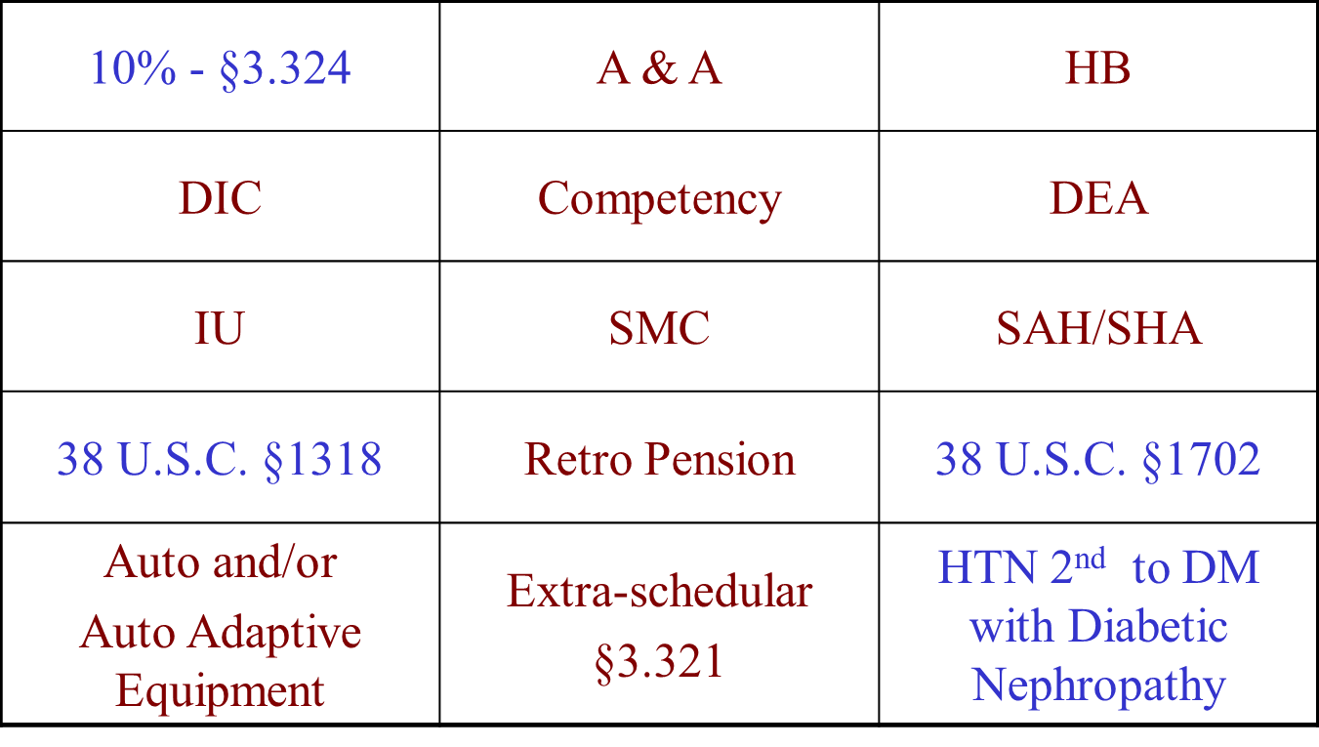
Common Subordinate/Inferred Issues

Slide 12
Subordinate Issues and Ancillary Benefits (cont.)
Other
  Surgical scars
  Radiculopathy
  Other secondary complications
  SAH, SHA, Automobile

Slide 13
Common Errors
Surgical scars resulting from treatment of SC conditions
Additional complications resulting from progression of a disease process (diabetic complications)
Competence for VA purposes

Slide 14
Discussion
What are the subordinate issues you see most frequently while working Veterans’ claims?

Slide 15
Addressing Subordinate Issues
Infer the contention
Address via rating decision
Do not defer these contentions
  Exception: TDIU should be deferred when reasonably raised. See M21-1 Part IV, Subpart ii, 2.F.2.l, Processing Reasonably Raised Claims of IU

Slide 16
Summary
Identified issues and the review process
Differentiated types of issues
Defined subordinate issues and discussed examples
Discussed unclaimed chronic disabilities
Discussed impact on quality

Slide 17
Questions
QUESTIONS?

