Slide 1
Compensation Service
November 2017
Failure to Address Claimed Issues

Slide 2
Purpose
Improvement in the quality and efficiency of service provided to Veterans and claimants
Reduction of A1 quality review errors

Slide 3
Objectives
Identify issues claimed by the Veteran.
Ensure system compliance within the VBMS contentions list.
Verify all contentions are addressed via rating decisions, notification letters, and/or administrative decisions.

Slide 4
References
38 U.S.C. 5103A, Duty to assist claimants
38 CFR 3.103, Procedural due process and appellate rights
38 CFR 3.151, Claims for disability benefits
38 CFR 3.155, How to file a claim
38 CFR 3.159, Department of Veterans Affairs assistance in developing claims
M21-1 Part III, ii.1, Initial Screening Process
M21-1 Part III, Subpart ii, 2.B.1, Application for Compensation and/or Pension, and Application for Survivors Benefits
M21-1 Part III, Subpart iv, 1.1.b, Specific Issues Requiring a Rating Decision
M21-1 Part III, Subpart iv, 6.B, Determining the Issues
M21-1 Part III, Subpart iv, 6.C, Completing the Rating Decision Narrative
M21-1 Part III, Subpart v, 2.B.1.b, Decision Notice Requirements

Slide 5
Identify Claimed Issues
Review the Veteran’s application for benefits.
Review all evidence submitted in support of the claim to identify all claimed issues.

Slide 6
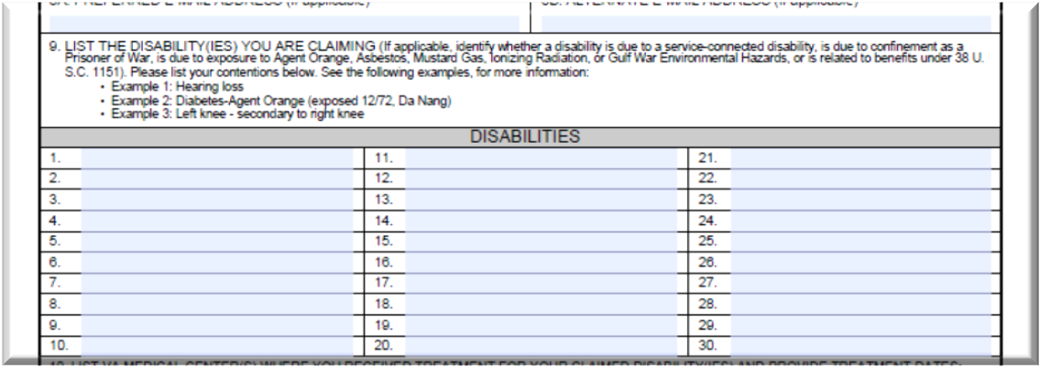
VA Form 21-526EZ
Contentions Excerpt from VA Form 21-526EZ, Application for Disability Compensation and Related Compensation Benefits
Contentions will frequently be noted on the last page of the VBMS document as a continuation of the 21-526EZ on electronically submitted applications.

Slide 7
Additional Correspondence
Claim contentions do not have to be included on the prescribed claim form when they are included in additional correspondence submitted/received at the same time as the appropriate prescribed claim form.

Slide 8
Processing Additional Correspondence
If the additional correspondence is received….
Same date as the appropriate prescribed form
Different date than the appropriate prescribed form, or
With a form not prescribed for the specific benefit requested in the additional correspondence
Then consider the additional contentions….
As part of the pending claim.
A request for application

Slide 9
What to Look for in Correspondence
Statements:
Indicating a disability or symptom was incurred in or manifested during military service.
Indicating a service connected disability has caused additional disabilities or aggravated another disability.
Relating a disability or symptoms to exposure to environmental or other hazards during military service.

Slide 10
Example Scenario
A Veteran submits a claim for an increase for SC posttraumatic stress disorder (PTSD), right and left knee patellofemoral pain syndrome, and lumbosacral strain on a VA Form 21-526EZ, Application for Disability Compensation and Related Compensation Benefits. The Veteran also submits a VA Form 21-4138, Statement in Support of Claim, at the same time as the VA Form 21-526EZ that describes the worsening of the disabilities as well as a new right hip problem caused by an altered gait related to the knee conditions.
How should the right hip problem be addressed in this scenario?

Slide 11
Answer
The right hip condition can be accepted as a claim because the VA Form 21-526EZ is the prescribed form for SC disabilities and the VA Form 21-4138 was submitted at the same time as the prescribed VA Form 21-526EZ.

Slide 12
Example 2
A Veteran submits a claim for pension on VA Form 21P-527EZ, Application for Pension. At the same time, the Veteran submits a VA Form 21-4138, Statement in Support of Claim requesting Aid & Attendance.

Slide 13
Answer
The statement on the VA Form 21-4138 can be accepted as a claim for SMP with A&A or housebound benefits because the VA Form 21P-527EZ , is a prescribed form for SMP A&A and the VA Form 21-4138 was submitted at the same time as the prescribed VA Form 21P-527EZ.

Slide 14
Example 3
A Veteran submits an original claim for SC for cervical spine strain on a VA Form 21-526EZ, Application for Disability Compensation and Related Compensation Benefits. One day later, the Veteran submits a VA Form 21-4138, Statement in Support of claim, for a claim for SC for anxiety disorder.

Slide 15
Answer
VA Form 21-4138 is not the proper prescribed form for a claim for SC.
Additionally, the VA Form 21-4138 was received at a different time than the prescribed VA Form 21-526EZ.
Since the statement pertaining to anxiety was not submitted on the proper prescribed form and did not accompany a prescribed form submitted at the same time, no claim for SC for anxiety disorder exists.

Slide 16
Answer (Continued)
The VA Form 21-4138 regarding anxiety disorder is accepted as a request for application that will be reviewed in accordance with M21-1, Part III, Subpart ii. 2.C.2.b.

Slide 17
Other Issues to Watch Out For
Individual Unemployability (M21-1 IV.ii.2.F.4.h)
Moot if schedular 100% granted, but still must be addressed as an issue.
Not moot if an additional period of potential IU eligibility prior to the schedular 100% grant.
VA Form 21-2680, Examination for Housebound Status or Permanent Need for Regular Aid and Attendance (M21-1 III.ii.2.B.1.g)
Represents a potential claim for both A&A and housebound benefits.
If A&A granted (whether SMC or SMP), no need to address housebound.
If A&A denied, decision must address issue of entitlement to housebound.

Slide 18
Other Issues (Continued)
Pension (M21-1 III.ii.2.B.1.d and III.ii.2.B.1.l)
If claim submitted on VA Form 21-526EZ, Application for Disability Compensation and Related Compensation Benefits, pension must be addressed if claimed, either by rating or administratively by the VSR, depending on the case specifics.
If pension is claimed on a prescribed form which is not a recognized or prescribed form for pension claims, consider it as a request for application.
Bilateral conditions
Multiple claimed mental conditions

Slide 19
VBMS System Compliance
VBMS Contentions List for the End Product must accurately reflect all claimed issues.

Slide 20
VBMS System Compliance
Contentions should be established by the CA upon receipt/review of mail.
All claims processors are responsible for the accuracy of the contentions in VBMS.
Accurate contentions lists assist RVSRs and VSRs downstream in the process to prevent A1 errors for missed issues.

Slide 21
Verifying All Contentions Are Addressed
Suggestions for verifying that all contentions are addressed:
Develop a consistent process.
Use Checklists and/or Job Aids.
Proofread decisions and notifications.

Slide 22
Summary
Identify issues claimed by the Veteran.
Prescribed application forms & additional correspondence received
IU, 21-2680 (A&A and HB), pension, bilateral conditions, multiple mental conditions
Ensure system compliance for VBMS contentions list.
Verify all contentions are addressed via rating decisions, notification letters, and/or administrative decisions.
Use a consistent process, checklists/job aids, proofread

Slide 23
QUESTIONS?

