Slide 1
Pension Service Training Staff
November 2017
Decision Ready Claims (DRC): PMC Claims Assistants (CAs)

Slide 2
Objectives
Discuss the Decision Ready Claims (DRC) Program
Describe Veterans Service Organization (VSO) actions for DRC
Establish DRC claims and identify DRC exclusions
Review the DRC process for Claims Assistants (CAs)
Discuss Letter Creator

Slide 3
References
General Information About the Decision Ready Claim (DRC) Initiative
M21-1, Part III, Subpart I, Chapter 3, Section C
Processing Decision Ready Claims (DRCs)
M21-1, Part III, Subpart I, Chapter 3, Section D
Decision Ready Claims Home Intranet Site
VCIP Intranet Site (Office of Business Process Integration)

Slide 4
DRC Overview
DRC Overview

Slide 5
DRC Overview
The Department of Veterans Affairs (VA) designed the Decision Ready Claim (DRC) initiative for the purposes of improving:
Claims-processing timeliness,
Claimant experience
Offering expedited decisions on certain types of claims for Compensation and Pension
Successful participation in the DRC Initiative will result in the issuance of a decision within 30 days of submission.

Slide 6
Timeline for DRC
If the activity is… | Then the timeliness target will be…
Intake processing | Within one day of receipt
Rating | Within two days of RFD Status
Award promulgation/authorization | Within three days of generation of the Rating Decision

Slide 7
DRC Claim Types
For the purpose of this initiative, certain types of Compensation and Pension claims are defined as:
Claims for Increase: Claim for disability compensation where the Veteran is currently service-connected for the condition and is requesting an increased evaluation.
Original Dependency and Indemnity Compensation (DIC): Original service-connected death claims where the Veteran’s death certificate lists at least one of his or her service-connected conditions; or he or she was rated 100% disabled due to service-connected conditions (including entitlement to Individual Unemployability) for 10 years prior to death.
These claims will be submitted to the VSO by the surviving spouse.

Slide 8
VSO Process
DRC VSO PROCESS

Slide 9
DRC Process (VSO Initial Actions) cont’d
VSO Initial Actions:
Must have access to the claimant’s electronic folder
VA Form 21-22 must be of record and signed by claimant and VSO
Electronic claims file must be available in VBMS
Must be aware of an active Intent to File (ITF)
Note: If a VSO has trouble with any of these items; they may contact the DRC Superuser (DRC Superusers are the IPC Coach staff).

Slide 10
Evidence Submission
VSOs gather and submit all evidence from claimant
(i.e. eligible surviving spouse)
VSOs will use Direct Upload and must include a DRC evidence cover sheet
VSOs utilize a checklist to ensure accuracy
Note: It is important that the VSO work with the claimant or DRC Superuser, to ensure all of the evidence is gathered upfront so that the claim is not excluded from the DRC Program.

Slide 11
VSO Checklist
VSOs are granted a review period
Vendor will provide the VSO a 72-hour timeframe to fix any deficiencies
Vendor may exclude the claim if all evidence is not re-submitted within correction timeframe
VSOs utilize and sign a checklist to ensure accuracy
DRC Program has checks and balances in place to assist the VSOs
Reference: M21-1, Part III, Subpart i.3.D.2.b

Slide 12
DRC Submission
Currently a contract vendor will review the initial submission for missing documents and necessary information
A specific note will identify the status
DRC Super Users at your station are responsible for reviewing DRC Centralized Mail Queue notes and take appropriate action

Slide 13
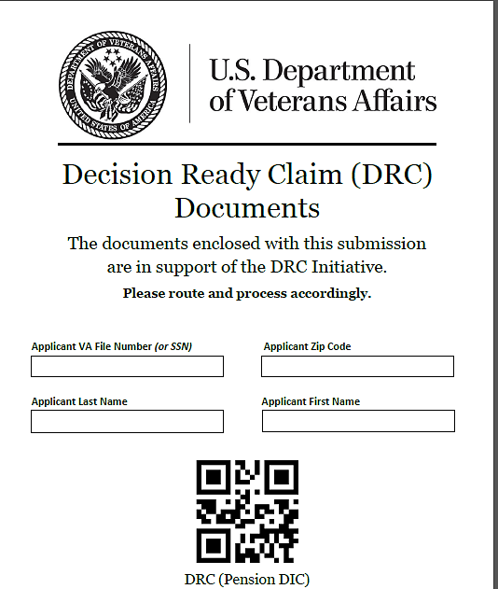
DRC Evidence Coversheet
VSOs have been instructed to use this Coversheet when submitting evidence
DRC (Pension DIC)
VSOs must submit all required evidence, and forms through the DRC Direct Upload portal
VSOs may exclude claims from the DRC DIC Process if all required evidence is not submitted upfront
Notes:
VSOs must submit all claims for DRC through the DRC Direct Upload Portal.
If claims are excluded from the DRC Program, the claims will simply go through traditional processing.

Slide 14
DRC Coversheet
This DRC Cover Sheet is different than the DRC Evidence Cover Sheet
This will accompany a DRC submission through Direct Upload

Slide 15
Establishing DRC Claims
If the DRC submission appears complete; then the scanning vendor will use the Direct Upload portal to route the DRC mail packet to the DRC Pension Queue with a status of Available in Mail Portal; then CAs and IPC Leadership (DRC Superusers) will be able to review the complete mail packets.

Slide 16
PMC DRC DIC
DIC DECISION CLAIM
AND EXCLUSIONS

Slide 17
PMC DRC DIC
For the purpose of this initiative, Pension DRC claims are defined as:
Original Dependency and Indemnity Compensation (DIC): Original service-connected death claims where the Veteran’s death certificate lists at least one of his or her service-connected conditions; or he or she was rated 100% disabled due to service-connected conditions (including entitlement to Individual Unemployability) for 10 years prior to death.
These claims will be submitted to the VSO by the surviving spouse.

Slide 18
Complete DRC Exclusion List (refer to CPKM for recent updates)
Current pending disability claim | Conditions already at scheduler maximum | Special Monthly Pension
DRC conditions on appeal | Individual Unemployability | Burial claims (unless submitted w/DIC)
DRC application submissions signed by just VSO | Pregnant Veterans | In-service death
Pre-discharge | Ch.18 and birth defect | Parents’ DIC
Incarcerated Veterans | Pension | DIC involving accrued benefits (claim or appeal pending at time of death)
Restricted Access Claims | Foreign Veterans | Stand-alone SMC
Notes:
Exclusions continue to change. Please refer to the CPKM for updates (CPKM, M21-1, Part III, subpart.iii.3.C.1.c.)

Slide 19
DRC DIC Exclusions
If the DRC Claim Type is DIC, Then exclude claims involving:
Parents’ DIC
Accrued Benefits
Burial Benefits, and/or Spousal aid and attendance and/or housebound benefits
In-Service death
Submissions received while another rating-related claim is concurrently pending (PMC example, if another claim for DIC is pending)
Note: PMCs are only able to accept burial claims that come in with a DRC eligible DIC Claim.
Notes:
For a complete list of all current exclusions from DRC DIC processing, refer to (CPKM, M21-1, Part III, subpart.iii.3.C.1.c.). We can only except burial claims that come in with a DRC eligible DIC claim.

Slide 20
Excluded Claims
If the claim meets one of the exclusion criteria, DO NOT CEST the claim or send a 5103 letter
Send a DRC Exclusion Letter using Letter Creator
Select the Re-Route button in the Centralized Mail (CM) Portal
For PMCs, Mail packets will be re-routed to the general PMC CM queue
Re-route the excluded DRC to help prioritize the CEST and RFD of DRC claims

Slide 21
DRC Super User
If the note states… | Then…
There is claim in DRC CM queue, but there isn’t a note | Super User should not take any actions
“DRC – Valid” | Super User should assign claim to a DRC CA
“DRC – VSO Correction Pending” | Super User should not take any actions
“DRC- Incomplete due to [insert missing information]” | Super User assigns mail packet to DRC CA to send DRC Exclusion Letter with the reason for exclusion identified in the note.

Slide 22
DRC Super User cont’d
If… | Then…
There is a “DRC – Please review DRC CM portal for [missing information] from VSO on [insert date]” note in the DRC assign-queue associated with a DRC claim* | Super User should check the DRC CM queue for the date indicated in the note. Once the date indicated in the note has expired, the Super User should check the DRC CM queue for the missing information mentioned in the note. Please make sure to identify mail packets using both the file number and Social Security number. If the missing information is found, the Super User should assign both packets to a DRC CA. If missing information is not found, Super User should assign the original claim to the DRC CA to send DRC Exclusion Letter with the reason for exclusion identified in the note.

Slide 23
Identify Exclusions
If… | Then…
there is already a pending rating end product (such as, an accrued benefit) | • Add the associated contentions to the already pending rating end product • Send “DRC Exclusion Letter” to the surviving spouse using Letter Creator, citing “There was already a pending rating End Product” as the exclusion reason
there is no pending rating end product AND the submission is on the exclusion list | • The CA returns the claim to the normal queue for processing • Send “DRC Exclusion Letter” to the surviving spouse using Letter Creator, citing “one or more claimed conditions is on the DRC exclusion list” as the exclusion reason

Slide 24
Establishing DRC Claims
If there is no exclusion:
Establish the appropriate EP 140 with DOC of receipt of VAF 21P-534EZ
Enter in the associated contentions
CRITICAL: Add the “Decision Ready Claim” Special Issues Indicator to one contention
Open and close a custom tracked item, labeled “DRC” to trigger the auto-RFD feature simultaneously
Notes:
After RFD, claim goes straight to the RVSR within one day.

Slide 25
Review the Timeline for DRC
If the activity is… | Then the timeliness target will be…
Intake processing | Within one day of receipt
Rating | Within two days of RFD Status
Award promulgation/authorization | Within three days of generation of the Rating Decision

Slide 26
Workload Processing for RFDs
Closing the tracked item will mark the claim as Ready for Decision
After CEST, the claim should appear in the station’s unassigned queue or daily report at your PMC
Then it will be assigned to a DRC RVSR the next day
Note: Currently, PMCs Leadership Staff will utilize current workload management reports to review, monitor, and assign the DRC workload.
Notes:
Note: Workload process may change for the PMCs as the PMCs become fully integrated into the NWQ. PMC Leadership is responsible for designated employees who will be working DRC claims.

Slide 27
PMC DRC
ADDING TRACKED ITEMS IN VBMS

Slide 28
Adding DRC Tracked Item
1. Select Tracked Items
2. Select Add Tracked Item

Slide 29
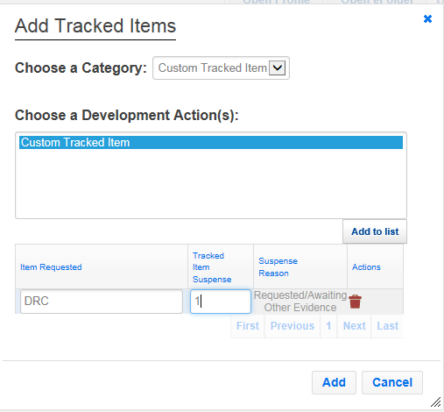
Adding DRC Tracked Item cont’d
1. Leave at Custom Tracked Item
2. Select Custom Tracked Item
3. Select Add to List
4. Type “DRC”
5. Type “1”
6. Select Add

Slide 30
Adding DRC Tracked Item cont’d
1. Select Pencil

Slide 31
Adding DRC Tracked Item cont’d
2. Select save button
1. Enter date into closed field

Slide 32
PMC Mail Portal
PMC Mail Portal

Slide 33
DRC Mail Portal
Once the packet is available in the portal; the CA reviews the packet

Slide 34
DRC Mail Portal
Best Practice: Use a note to indicate “DRC Exclusion Letter Sent” for the next CA to identify that the exclusion has already been completed.

Slide 35
DRC Mail Portal
Note: The PMC Portal is slightly different; but the functions remain the same.

Slide 36
DRC Mail Portal
Note: The PMC Portal is slightly different; but the functions remain the same.

Slide 37
Letter Creator
Letter Creator

Slide 38
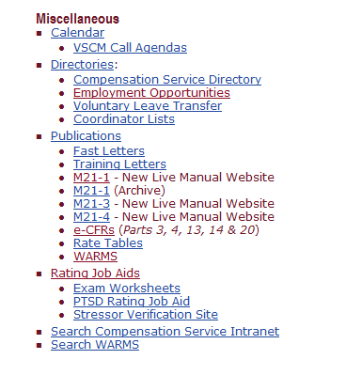
Creating a DRC Exclusion Letter
1.Proceed to Compensation Intranet Home page
2. Make sure VBMS is
active/open before
launching Letter Creator
Select Rating Job Aids
Notes:
Compensation Service Intranet Home Page: https://vbaw.vba.va.gov/bl/21/rating/rat00.htm

Slide 39
DRC Exclusion Letter cont’d
Click on the letter Creator to process a DRC Exclusion Notification
Click Letter Creator User Guide for more information on the tool
Select Letter Creator

Slide 40
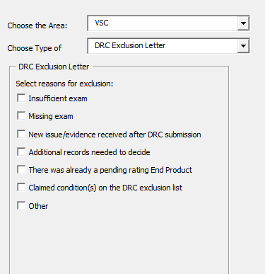
DRC Exclusion Letter
Select VSC
Select DRC
Exclusion Letter
Select Appropriate Exclusion Reason

Slide 41
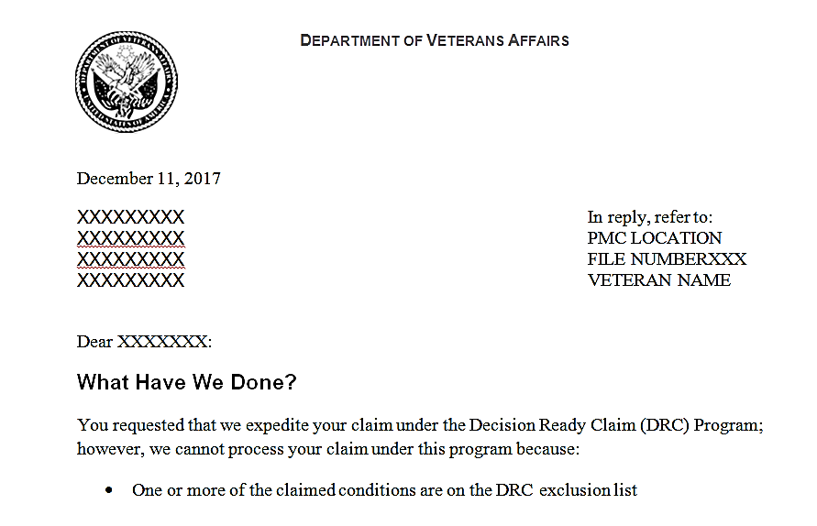
Example DRC Exclusion Letter
Name populates based on information entered into letter creator; review letter to ensure accuracy
Final decision notice should be uploaded into VBMS

Slide 42
Letter Creator Tips
Ensure VBMS is open before launching letter creator
Review letter to ensure proper claimant is addressed
DRC Exclusion Letters must be uploaded into VBMS systems

Slide 43
Important CA Reminders
Do… | Do not…
Ensure all evidence is included with DRC claim submission | Proceed to process claims in mail portal if all evidence is not included
Use Decision Ready Claim special issue | Send 5103 letters
CEST EP 140 | CEST EP400
Send DRC Exclusion Letter when applicable | Forget to upload exclusion notification letter in the electronic systems (i.e. VBMS)
Note: Always ask for assistance from your DRC Superuser (i.e. Coach Staff) if clarifications are needed.

Slide 44
Summary
DRC is an exciting new program that will begin in the PMCs effective December 11, 2017
PMCs will utilize Letter Creator to send exclusion letters
effective December 11, 2017
DRC Superuser questions can be submitted to: VCIP.VBACO@va.gov
OBPI Website: http://vbaw.vba.va.gov/OBPI/Centralized_Mail.asp
DRC Policy and Procedure Questions can be submitted to P&F: pensionpolproc.vbaco@va.gov
DRC Training Questions can be submitted to P&F: pensiontrngqual.vbaco@va.gov

Slide 45
Questions

