Slide 1
Pension Service Training Staff
November 2017
Decision Ready Claims (DRC): PMC VSR and RVSR

Slide 2
References
General Information About the Decision Ready Claim (DRC) Initiative
M21-1, Part III, Subpart I, Chapter 3, Section C
Processing Decision Ready Claims (DRCs)
M21-1, Part III, Subpart I, Chapter 3, Section D
Decision Ready Claims Home Intranet Site
Notes:
Notes: Decision Ready Claims Home Intranet Site (http://vbaw.vba.va.gov/bl/21/drc.asp)
**CPKM for DRC DIC is in the process of being updated for the Pension Management Centers (PMCs)

Slide 3
Objectives
After the training, the trainee will be able to:
Define the DRC Initiative
Describe the VSO process for DRC
Process eligible and ineligible DRC claims for DIC
Define DIC exclusions
Discuss Letter Creator for processing DRC DIC Exclusions
Notes:
All objectives will relate to the processing of original dependency and indemnity compensation (DIC) for the Pension Management centers (PMCs)

Slide 4
DRC Overview
DRC Overview

Slide 5
DRC Overview
The Department of Veterans Affairs (VA) designed the Decision Ready Claim (DRC) initiative for the purposes of improving:
Claims-processing timeliness,
Claimant experience
Offering expedited decisions on certain types of claims for Compensation and Pension
Successful participation in the DRC Initiative will result in the issuance of a decision within 30 days of submission.

Slide 6
DRC Overview cont’d
To participate in the DRC Initiative, a Veteran or eligible surviving spouse must:
Be represented by an accredited Veterans Service Organization (VSO)
Include all relevant evidence needed to render a decision for the VSO to submit into the DRC Direct Upload portal
Simultaneously submit signed claims on specific forms containing language (i.e. 21P-534EZ) satisfying the general notice requirements of 38 U.S.C.5103 for the VSO to submit into the DRC Direct Upload portal
Notes:
For purposes of DRC, all required forms must be signed or the DRC will be routed through the FDC or traditional claims process. In addition, only VSOs upload these claims into the DRC Direct Upload portal.

Slide 7
DRC Claim Types
For the purpose of this initiative, certain types of Compensation and Pension claims are defined as:
Claims for Increase: Claim for disability compensation where the Veteran is currently service-connected for the condition and is requesting an increased evaluation.
Original Dependency and Indemnity Compensation (DIC): Original service-connected death claims where the Veteran’s death certificate lists at least one of his or her service-connected conditions; or he or she was rated 100% disabled due to service-connected conditions (including entitlement to Individual Unemployability) for 10 years prior to death.
These claims will be submitted to the VSO by the surviving spouse.

Slide 8
VSO Process
DRC VSO PROCESS

Slide 9
DRC Process (VSO Initial Actions)
Veterans Service Organizations (VSOs) are a primary function of the DRC Program
VSOs must complete a few initial actions before a claim can be included in the DIC Decision Ready Claim Program
VSOs may contact the IPC Coach(es) (also known as a DRC Superuser) if the claimant’s electronic file is not accessible

Slide 10
VSO DRC DIC Process
VSO submits VA Form 21-22
VSO requests paper claims folder to be uploaded into VBMS
(if necessary)
Utilizing a checklist, VSO gathers evidence, required forms, and submits claim into DRC Direct Upload Portal if claim meets
DRC DIC Criteria
VSOs will include a DRC Evidence Coversheet and DRC Coversheet
Notes:
Note: Contract examinations will not be warranted in or authorized for DIC claims submitted under the DRC Initiative.

Slide 11
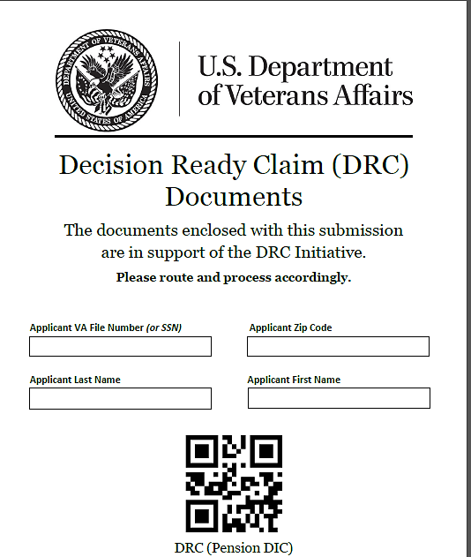
DRC Evidence Coversheet Example
VSOs have been instructed to use this Coversheet when submitting evidence
DRC (Pension DIC)
VSOs must submit all required evidence, and forms through the DRC Direct Upload portal
VSOs may exclude claims from the DRC DIC Process if all required evidence is not submitted upfront
Notes:
If claims are excluded from the DRC Program, the claims will simply go through traditional processing

Slide 12
DRC Coversheet Example
This DRC Cover Sheet is different than the DRC Evidence Cover Sheet
This will accompany a DRC submission through Direct Upload

Slide 13
VSO Checklist
DRC Program has checks and balances in place to assist the VSOs
VSOs utilize checklist to ensure accuracy
Vendor reviews all VSO submissions
Route complete DRC mail packets to DRC Mail Queue
Incomplete DRC mail packets are routed back to VSO
DRCs date of claim remains date of initial submission (regardless of if materials are returned and subsequently resubmitted
Reference: M21-1, Part III, Subpart i.3.D.2.b
Notes:
**VSOs do not submit the checklist through the Direct Upload Program**
Note: VSOs have 72 hours to correct missing elements; if corrections are not made within 72 hours claim will be routed for traditional claims processing.

Slide 14
VSO DRC DIC Process
VSO Summary:
The entire VSO Process happens behind the scenes
RVSRs and VSRs will not see any coversheets, etc.
RVSRs and VSRs will only grant DIC, promulgate, and send out letters to the claimants

Slide 15
PMC DRC DIC
DIC DECISION READY CLAIMS PROCESS

Slide 16
PMC DRC DIC Process
PMC Claims Assistant (CA)
Review the mail packets in the mail portal to ensure all evidence submitted is of record
CA may send DRC DIC exclusion letter through Letter Creator
if unable to process DRC DIC claim,
c. CA may send DRC DIC claim to RVSR
establishes appropriate end product, along with DRC special issue indicator, and triggers auto-RFD (simultaneously)
1-day tracked item suspense
Reference: For more information on the DRC Direct Upload portal, see the VSO Direct Upload/DRC User Guide.
Notes:
PMCs will utilize Letter Creator to send exclusion letters at this time; more information will be forthcoming
Reference: For more information on the DRC Direct Upload portal, see the VSO Direct Upload/DRC User Guide.

Slide 17
PMC DRC DIC Process cont’d
3. RVSR will rate the DIC issue
RVSRs may grant DIC
RVSR may partial grant and send to VSR for development and/or exclusion
RVSR may determine that an exclusion exists
VSR will promulgate and send to authorization
VSRs may promulgate claim and send the standard DIC notification letter
VSR may complete development on deferrals
VSR may send the DRC DIC exclusion letter at the request of the RVSR
Notes:
PMCs will utilize Letter Creator to send exclusion letters at this time; more information will be forthcoming

Slide 18
Timeline for DRC
If the activity is… | Then the timeliness target will be…
Intake processing | Within one day of receipt
Rating | Within two days of RFD Status
Award promulgation/authorization | Within three days of generation of the Rating Decision
Notes:
Note: For Award promulgation/authorization: this is inclusive of the 48-hour VSO review period afforded under M21-1, Part I, 3.B.3.b.

Slide 19
DIC Exclusions
DIC Exclusions

Slide 20
DRC DIC Exclusions
Applicable PMC DIC Exclusions
Survivors Pension
Special Monthly Pension and special monthly compensation for DIC
Claims involving non-Veteran and non-surviving spouse beneficiaries (i.e. helpless child, Survivors Pension, etc.)
In-Service death claims
Submissions received while another rating-related claim is concurrently pending (PMC example, if another claim for DIC is pending)
Notes:
For a complete list of all current exclusions from DRC DIC processing, refer to (CPKM, M21-1, Part III, subpart.iii.3.C.1.c.)

Slide 21
DRC DIC Exclusions
There are a lot of claim types excluded from DRC Processing
Refer to the CPKM for a complete and most updated list
Review Jurisdiction Exclusions
Review Claimant Exclusions
Review Development Exclusions
Reference: CPKM, M21-1, Part III, subpart.iii.i.3.C.1.c.
Notes:
For a complete list of all current exclusions from DRC DIC processing, refer to (CPKM, M21-1, Part III, subpart.iii.3.C.1.c.)

Slide 22
RVSR – DRC TIPS
RVSR: DIC DECISION READY CLAIMS TIPS

Slide 23
RVSR – Issuing a Decision on a DRC
If the DRC submission… | Then…
Contains sufficient evidence to grant DIC | Complete Rating Decision and grant DIC Route claim to VSR to completed decision notice
Warrants a partial grant (for the PMCs partial grants should be rare) | RVSR should grant the claim and update the special issue indicator Append the Decision Ready Claim-Partial Deferred special issue indicator to the contention Direct the claim to the VSR/authorization activity for development and to send DRC Exclusion Letter (M21-1, Part III, Subpart I, 3.D.3.b)
Does not contain sufficient evidence and RVSR cannot make a decision (i.e. grant DIC at all) | RVSR should update the special issue indicator (DRC) RVSR should prepare a deferral in accordance with standard procedures Append the Decision Ready Claim-Deferred special issue to contention, and route the claim to the development activity (VSR) for additional processing and to send DRC Exclusion Letter (M21-1, Part III, Subpart I, 3.D.3.b)
Notes:
Note: Upon assignment of a DRC in Ready for Decision status, the rating activity must review the claim submission and all associated evidence to ensure that immediate preparation of a rating decision, to include a partial rating decision, is possible and appropriate. (CPKM, M21-1, III.i.3.D.4.a)

Slide 24
VSR – DRC DIC
VSR: Actions to take on DIC Decision Ready Claims

Slide 25
VSR Actions
If Claim IS Rated AND Processed as a DIC Decision Ready Claim:
The VSR should follow standard promulgation or authorization procedures
VSR will send DIC notification letters as normal
VSR will send DRC Exclusion Letters through Letter Creator if directed
There are no special notification requirements if the claim can be processed through the DRC program
Notes:
Note: Use the Letter Creator tool to send DRC Exclusion Letters.

Slide 26
VSR Excluded Actions
If RVSR excludes claim from the DRC program:
VSR ensures the system is updated appropriately
VSR completes any necessary development
VSR sends a “DRC Exclusion Letter”
PMCs will utilize Letter Creator to send exclusion letters
Note: More information on Letter Creator is located on the Compensation Service Intranet page.
Notes:
VSRs should only send DRC Exclusion letters if directed.

Slide 27
VSR Development
Eligible DRC Claims DO NOT require up-front development.
Only develop if the RVSR directs development on a deferral
Should be rare for PMC DRC DIC claims
Standard 5103 should NEVER be sent.

Slide 28
Systems Compliance
All employees are responsible for ensuring that the appropriate DRC special issue indicator is added to one contention:
Decision Ready Claim
Decision Ready Claim – Deferred
Decision Ready Claim – Partial Deferred
Note: There is no special issue for claims excluded from the DRC program.
Notes:
All employees should review systems compliance in accordance with CPKM.

Slide 29
Letter Creator
Letter Creator

Slide 30
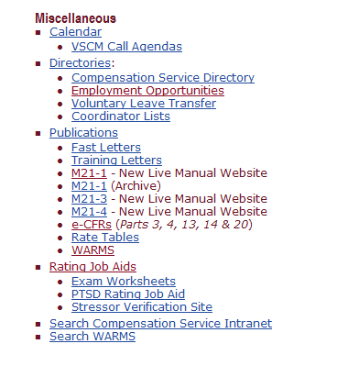
Creating a DRC Exclusion Letter
1.Proceed to Compensation Intranet Home page
2. Make sure VBMS is
active/open before
launching Letter Creator
Select Rating Job Aids
Notes:
Compensation Service Intranet Home Page: https://vbaw.vba.va.gov/bl/21/rating/rat00.htm

Slide 31
DRC Exclusion Letter cont’d
Click on the letter Creator to process a DRC Exclusion Notification
Click Letter Creator User Guide for more information on the tool
Select Letter Creator

Slide 32
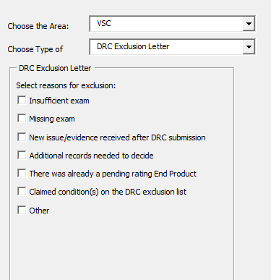
DRC Exclusion Letter
Select VSC
Select DRC
Exclusion Letter
Select Appropriate Exclusion Reason

Slide 33
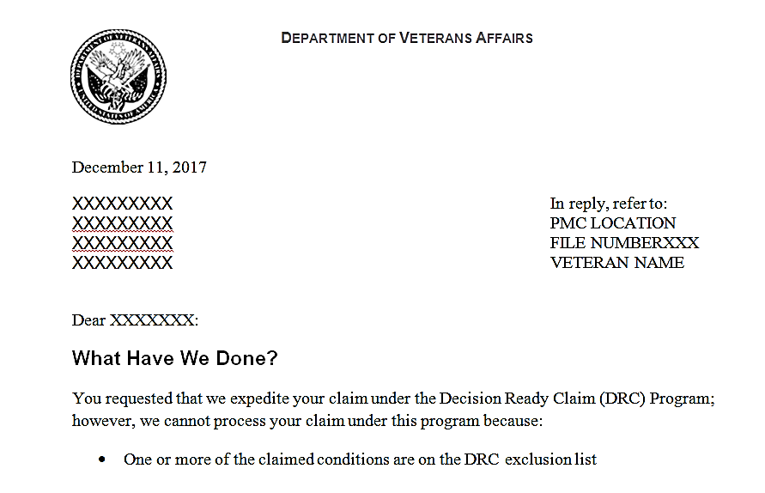
Example DRC Exclusion Letter
Name populates based on information entered; review letter for accuracy
Decision notice must be uploaded in VBMS after review activity

Slide 34
Letter Creator Tips
Ensure VBMS is open before launching letter creator
Review letter to ensure proper claimant is addressed
DRC Exclusion Letters must be uploaded into VBMS systems

Slide 35
Summary
DRC is an exciting new program that will begin in the PMCs effective December 11, 2017
DRC Policy and Procedure Questions can be submitted to P&F: pensionpolproc.vbaco@va.gov
DRC Training Questions can be submitted to P&F: pensiontrngqual.vbaco@va.gov

Slide 36
Questions

