Slide 1
Pre-Discharge Benefits Delivery at Discharge (BDD) – In-Service Rating
Compensation Service
November 2018

Slide 2
Objectives
Understand the Pre-discharge Benefits Delivery at Discharge (BDD) in-service rating guidance

Slide 3
References
38 CFR Part 4 – Schedule for Rating Disabilities
M21-1, Part III, Subpart i, 2, A - General Information on Pre-Discharge Claims
M21-1, Part III, Subpart i, 2, B - Division of Responsibilities for Processing Benefits Delivery at Discharge (BDD) and BDD Excluded Claims
M21-1, Part III, Subpart i, 2, C - Ancillary Benefits and Other Issues Involving Pre-Discharge Claims

Slide 4
In-Service Rating
Pre-discharge BDD claims shifted from completing the rating decision after the service members’ (SM) discharge from active duty to requiring that the rating decision be completed while the SM is still on active duty.
The purpose of this training is to inform the audience of the current BDD in-service rating decision process.

Slide 5
In-Service Rating
The BDD rating decision will be completed while the SM is still on active duty.
This will allow for:
completion of all necessary development required to rate a claim prior to discharge
insufficient examinations to be identified and corrected
service verification, award generation/authorization, and decision notification to begin the day after discharge pending

Slide 6
Benefits of In-Service Rating
The SM to receive a decision on their claim as close to discharge as possible
Greatly decrease the overall average number of days pending for the pre-discharge claim inventory

Slide 7
BDD vs. BDD Excluded
Claims received on or after October 1, 2017, within 180 days prior to discharge, are identified as Benefits Delivery at Discharge (BDD) claims or BDD excluded claims.
Days prior to separation claim is submitted | 90-180 days | 1-89 days
Claim identity | BDD | BDD Excluded

Slide 8
National Work Queue (NWQ)
National Work Queue (NWQ) will route the BDD claim to regional offices nationally for review for ready for decision (RFD) status as soon as all examinations have been completed or all tracked items have expired.
NOTE: This will occur while the SM is still on active duty, therefore deferral for service verification should not occur.

Slide 9
Jurisdiction
BDD claims that are made ready for decision are routed to regional offices nationally based on capacity
BDD excluded claims will be rated at the Regional Office of Jurisdiction (ROJ).
If an intake site receives a BDD-excluded claim 10 or fewer days before the discharge date that, cannot be processed in VBMS, follow instructions in M21-1III.i.2.B.3.g

Slide 10
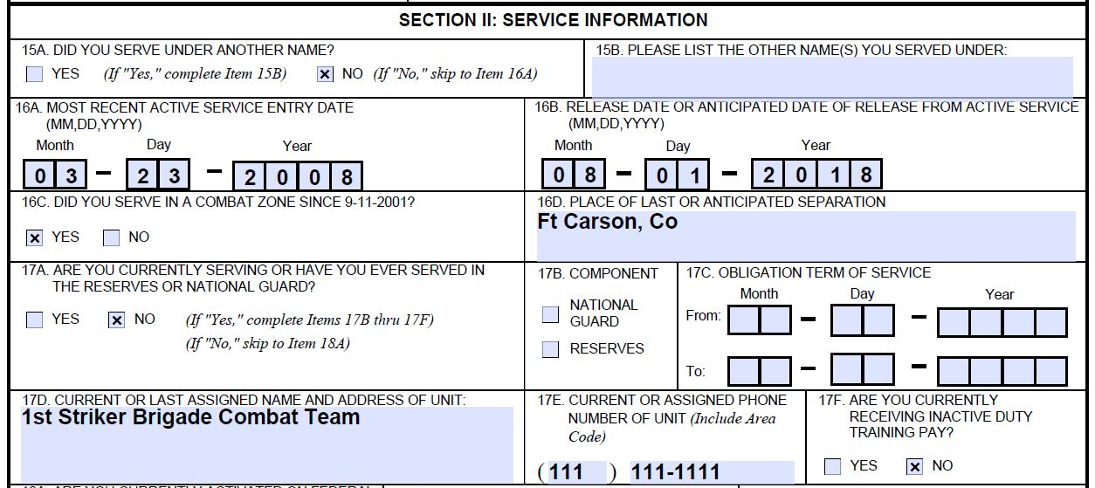
In-Service Rating Guidance
Rating decision will be completed while the SM is still on active duty
The RVSR will utilize a future effective date for the grant of benefits
All current rating requirements will remain the same except that partial rating decisions will not be allowed for the In-Service Ratings.

Slide 11
In-Service Rating Guidance (Cont.)
RVSR must:
ensure the SMs reported separation date is still accurate
Remember the effective date entered into VBMS-R will be a future effective date.
Do not defer the claim for service verification prior to completing the in-service draft rating!
take into account that an examination was conducted in-service
This can have an effect on the evidence required for service-connection (SC).
A diagnosis of a chronic disability on an in-service VA examination is a diagnosed disability while on active duty.
A Pre-discharge claim is filed by the claimant while still on active duty; therefore, inherently has in-service symptoms/complaints.

Slide 12
Rating Decision Procedures
When completing rating decisions for BDD claims, the rater must verify that all development required has been completed
If not fully ready to rate, defer the claim for evidence required.
No contentions on a BDD claim may be deferred on an in-service rating (i.e. no partial in-service rating decisions).

Slide 13
Rating Introduction Paragraph
Replace the language in the introduction paragraph with the below text:
The records reflect that you are a veteran of the [service era] Era. You served in the [branch of service] from [MM/DD/YYYY] to [MM/DD/YYYY] and for the current period of service beginning on [MM/DD/YYYY]. You filed an original disability claim that was received on [MM/DD/YYYY]. Based on a review of the evidence listed below, we have made the following decision(s) on your claim.
Please Note: The determination of entitlement to VA benefits is contingent upon your discharge from service and upon having the requisite character of service. We will review all evidence of record upon discharge to ensure the information provided in this decision is accurate. This rating decision will only be corrected, if necessary, based on the final review after your discharge.

Slide 14
Finalizing the BDD Rating Decision
Rate the claim as normal with consideration given to the fact that the rating decision is being conducted while the SM is still on active duty so a future effective date would be assigned.
Finalize the rating decision.
Add a bookmark stating, “DRAFT: Rating document should not be released until after the award is authorized.”

Slide 15
VSO Review
If the Veteran selected a Veterans Service Organization (VSO) as their power of attorney (POA)
ensure the completed rating decision is available for review by the appropriate VSO for a minimum of two days, and
send an email to the VSO notifying them that the rating is in the eFolder for their review

Slide 16
Questions

