Slide 1
Compliance Survey Referrals and Processing

Slide 2
Overview of Today’s Training
Who performs a Compliance Survey?
What is a Compliance Survey Referral?
What should you do if you receive a Referral?
Examples
Recap & Reminders
Questions

Slide 3
Lesson Objective
At the end of this lesson, you will be able to:
Using available references, define and recognize a compliance survey referral
Using available references, correctly process compliance survey referrals

Slide 4
What is a Compliance Survey Referral?
Compliance Survey (CS) Referrals are corrections to claims resulting from the Compliance survey after the review of the education benefits records at the school or OJT Training establishment. These corrections may result in the overpayment or underpayment to the school or to the beneficiaries.
The corrections are then sent to the Education Division for processing by one of the following pathways:
VAONCE
COMPLIANCE MAILBOX - (VAVBASTL/RO/COMPSRV (COMPSRV.VBASTL@VA.GOV))

Slide 5
Who Performs a Compliance Survey
ECSS- Education Compliance Survey Specialist ELR- Education Liaison Representative
ECSSs and ELRs are VA employees of the Compliance & Liaison Team. The Division Chief is Marie George, Chief Education Liaison Officer (CELO). The Team consists of Education Liaison Representatives and Compliance Survey Specialist assigned to 18 states within our region.
The out-based staff are assigned to each state so you will receive referrals from any of these Compliance Survey Specialist within our assigned area.

Slide 6
Who Performs a Compliance Survey-Continued
SAA – State Approving Agent
This is a contract partner with the VA assigned to do Compliance Surveys.
A full listing of the SAAs can be found on their website:
http://www.nasaa-vetseducation.com/Contacts.aspx
http://www.nasaa-vetseducation.com/Contacts.aspx

Slide 7
Recognizing Compliance Surveys
Compliance referrals submitted through VA-ONCE will be identified by the standard remark “Compliance Survey Referral”. Upon completion of award, the VCE should send the overpayment or underpayment amounts to the email address of the ECCS as provided.
For purposes of workload management, supplemental end products should be changed for compliance survey referrals to a 4 as a third digit modifier, i.e. 354, 254, 214, etc.
When a VCE or SVCE identifies the amended VA Form 22-1999 or 22-1999B as a compliance survey referral, he/she will change the TIMS document type to COMPL.

Slide 8
Processing Compliance Surveys
Amendments or changes submitted through VA-ONCE or on a template will be processed in the same manner as all other amended VA Form 22-1999 or 22-1999B submissions with the following exceptions:
The VCE should complete the CS VCE Form and email it to the ECSS who submitted the referral. On the response, the VCE should report how much each debt is, i.e. tuition debt, housing debt, books and supplies debt, etc. The VCE should capture the response template into the TIMS file.

Slide 9
Processing Compliance Surveys (Cont’d)
VCEs should suppress the LTS (Chapter 33) or BDN (other benefits) generated letter and prepare an appropriate award letter which informs the claimant of the reason for the overpayment (or additional award).
VCE should capture the letter(s) into TIMS and label as appropriate.

Slide 10
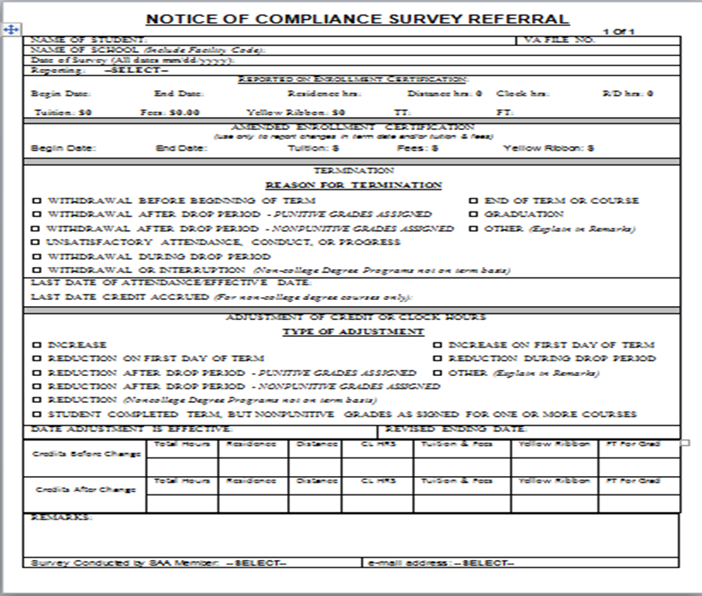
Compliance Survey Referral Form

Slide 11
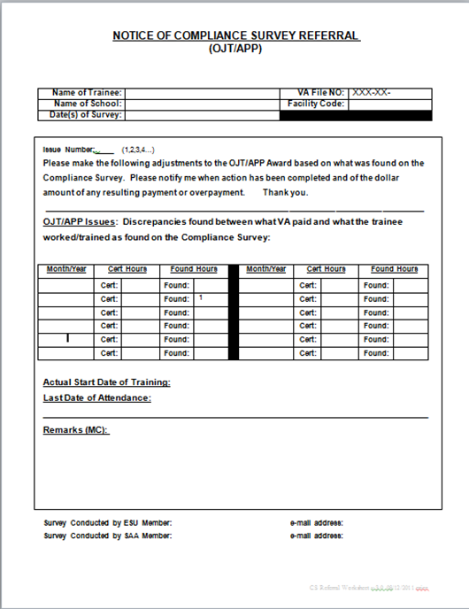
Compliance Survey Referral Form (OJT/APP)

Slide 12
VA Once Certification with Compliance Survey Remark

Slide 13
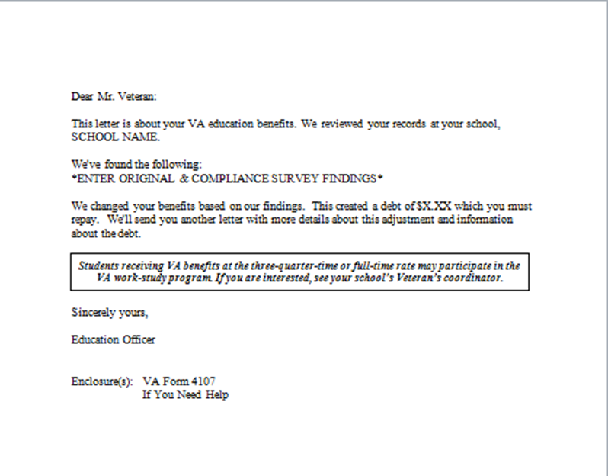
Compliance Survey Adjustment Letter Debt Owed

Slide 14
Compliance Survey Adjustment Letter Payment Due

Slide 15
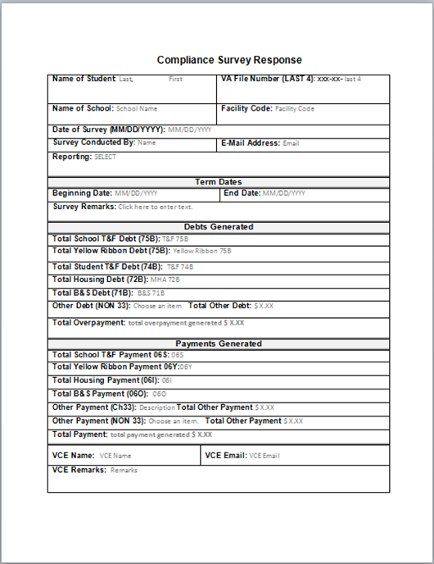
Compliance Survey Response VCE Form

Slide 16
Recap & Reminders
It is important to remember that the SAAs are external customers, so encryption must be removed and VA guidelines regarding PII must be followed.
Responding to the Compliance Mailbox allows the person managing the mailbox to close out the referral and archive the responses.
Capturing the email response into TIMS provides documentation in case a response is not received or is lost. This minimizes emails to request responses from both the SAA and the Compliance Mailbox.

Slide 17
Lesson References
Procedural Advisory: Compliance Survey Corrections- February 17, 2017
M22-4
Title 38, United States Code, §3693

Slide 18
Summary
You have completed this lesson. You should be able to:
Using available references, define and recognize a compliance survey referral.
Using available references, correctly adjudicate compliance survey referrals.

Slide 19
Questions?

Slide 20
TMS Assessment and Survey
The assessment and survey have been assigned to you in TMS
The questions are based on the information you learned today
You should be able to complete the assessment and survey within one half hour
Be sure to complete both the assessment and the survey in TMS to receive credit for this training

