Slide 1
Introduction to Gynecological & Breast Conditions Rating Schedule Changes
Compensation Service
May 2018

Slide 2
Objectives
Review updates and changes to rating schedule for gynecological body system
Focus on important considerations due to changes
Evaluate gynecological conditions with 80% or higher accuracy in 12 scenarios

Slide 3
References
38 CFR 4.116 Schedule of Ratings – Gynecological Conditions and Disorders of the Breast
M21-1 Part III, Subpart iv, Chapter 4, Section J – Disabilities of the Gynecological System and Breast
M21-1 Part III, Subpart iv, Chapter 3, Section A – Examination Request Overview
May 13, 2018, is the effective date of the law change for the Gynecological and Breast Conditions VASRD section.

Slide 4
Review of Updates And Changes
4

Slide 5
7610 Diagnosis Text Change
7610 diagnosis text changes
From “Vulva, disease or injury of (including vulvovaginitis)”
To “Vulva or clitoris, disease or injury of (including vulvovaginitis)”

Slide 6
7615 New Note
Note states that for the purpose of disability evaluation, the disease, injury, or adhesions of the ovaries resulting in ovarian dysfunction affecting the menstrual cycle, such as dysmenorrhea and secondary amenorrhea, shall be rated under diagnostic code 7615.

Slide 7
7619 New Note
Directs a 30% in cases where
one ovary removal is SC, and
there is absence or nonfunctioning of the other ovary unrelated to service.

Slide 8
7621 – Pelvic Organ Prolapse
Former 7622 & 7623 are now rated under 7621 criteria
30% and 50% are no longer available under this code
Whether one or multiple organs are prolapsed, only one evaluation will be granted under 7621
If there are additional residuals such as urinary incontinence, impairment of sphincter control, or skin conditions related to the prolapse, separate evaluations may be assigned under the appropriate body system(s)

Slide 9
7621 Pelvic Organ Prolapse Example
Veteran has prolapse with urinary incontinence, impairment of sphincter control, and localized dermatitis. Evaluations would be assigned under:
7621: pelvic organ prolapse
7517: urinary incontinence
7332: impairment of sphincter control
7806: localized dermatitis

Slide 10
Neoplasms
7627 – Malignant neoplasms, gynecological system
7628 – Benign neoplasms, gynecological system
- now separated -
7630 – Malignant neoplasms of the breast
7631 – Benign neoplasms of the breast

Slide 11
7632 – FSAD
Formerly rated under 7699 – 7611, Female Sexual Arousal Disorder now has a dedicated diagnostic code – 7632.
If FSAD is diagnosed by a mental health care provider or examiner, you will now be required to verify diagnosis by appropriate medical provider in the records or request a Gyn DBQ to confirm the diagnosis.
For evaluation purposes a noncompensable evaluation will be assigned
Don’t forget to infer and grant SMC – K!

Slide 12
Important Considerations

Slide 13
Which Criteria Apply?
(Not Liberalizing Legislation)
What date did the claim come in?
Does the Veteran warrant a higher evaluation under historical criteria?
Do they qualify for an increase under the new criteria?
Is there an intent to file (ITF) to consider?
Is the date entitlement arose based on increase shown in medical records the applicable effective date?
When was the Veteran released from active duty? Should the effective date be RAD+1?
May 13, 2018, Gynecological and Breast Conditions Rating Schedule Change

Slide 14
DBQs
Does the DBQ or exam of record give information needed for current criteria?
Did you check the DBQ for issues within scope of the expressly claimed condition?

Slide 15
Resources Available: VBMS
VBMS updates – watch the VBMS Release Information and User Guides page for updates to support Rating Schedule Revisions

Slide 16
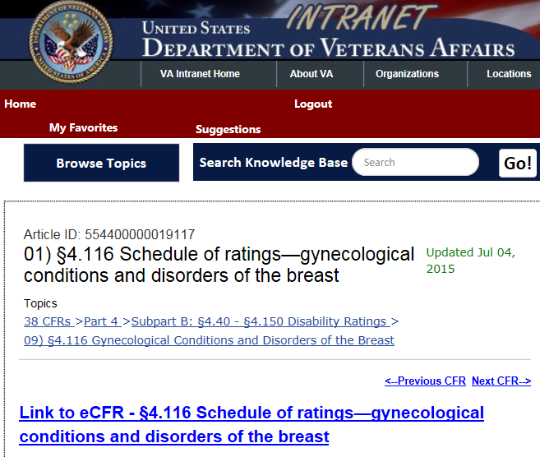
Historical Rating Schedules, Available in Knowledge Management Portal
Scroll down to

Slide 17
Practice & Evaluate

Slide 18
Scenario 1
Veteran has incomplete uterine prolapse. There are no other symptoms noted on exam. This was opined to be related to surgical complications of pregnancy during her military service and can be service-connected.
What diagnostic code would be used in the current rating schedule?
7621
What evaluation would be granted?
10%

Slide 19
Scenario 2
Veteran had a unilateral oophorectomy for ovarian torsion prior to joining service. During her time in the military, the Veteran developed a large ovarian cyst and required an oophorectomy removing her 2nd ovary. She was recently released from service and has claimed SC for ovary removal.
There is entitlement to SC for ovary removal. Yes
If yes, what would the DC be? 7619
What would the evaluation be? 30%
Are there any other considerations? SMC K

Slide 20
Scenario 3a
Veteran with PTSD has claimed increased evaluation.
She has a diagnosis of Female Sexual Arousal Disorder, which the DBQ associates with the PTSD. Private treatment records from a medical doctor show a diagnosis of FSAD.
In addition to evaluating the PTSD based on current symptoms, what Gynecological System related actions need to be taken?
Grant FSAD under DC 7632 at 0%
Grant SMC K for LOU of a creative organ

Slide 21
Scenario 3b
Veteran with PTSD has claimed increased evaluation.
She has a diagnosis of Female Sexual Arousal Disorder, which the DBQ associates with the PTSD. This time, there are no private treatment records showing a diagnosis of FSAD, only the mental health exam.
In addition to evaluating the PTSD based on current symptoms, what Gynecological System related actions need to be taken?
Request a Gynecological DBQ

Slide 22
Scenario 3c
Veteran with Diabetes Mellitus, type II has claimed increased evaluation. The DM DBQ gives a diagnosis of Female Sexual Arousal Disorder, which the DBQ associates with the DM II. There are no private treatment records showing a diagnosis of FSAD, only the DM II exam.
What Gynecological System related actions need to be taken?
Request a Gynecological DBQ

Slide 23
Scenario 4
Male Veteran has claimed SC for breast cancer.
During active duty Veteran developed lumps in his breast tissue. VA examination has opined that the lumps found during service are related to the current diagnosis of breast cancer. Examination diagnosed him with malignant neoplasm of the breast. He has undergone surgical intervention and chemotherapy treatment is planned to continue for another 3 months from the time you are reviewing the claim.
What DC should be used? 7630
Grant what evaluation? 100%
Should there be a future exam? Yes, for 6 mo post tx end
Is SMC K warranted? No, because it’s a male Veteran

Slide 24
Scenario 5
Female Veteran developed uterine fibroids and had surgical treatment during service. She has had ongoing issues with abnormal bleeding, nausea and vomiting, and additional surgery. She receives continuous treatment that is currently controlling symptoms and has claimed service connection.
What diagnostic code would be used to grant SC? DC 7628-7613
What evaluation would be established? 10%
Are there additional considerations? No

Slide 25
Scenario 6
Veteran is evaluated at 30% under DC 7622 for uterine displacement with continuous menstrual disturbances. She has claimed an increased evaluation for this condition.
Medical records show complete uterine prolapse. There are menstrual disturbances of record consistent with what was seen on the examinations and evidence prior to the initial rating decision.
What diagnostic codes will you consider?
Historical 7622 and current 7621
Based on current symptoms, is a reduction warranted?
No!

Slide 26
Remember
Remember the gynecological and breast conditions law change, effective May 13, 2018.

Slide 27
Scenario 7
Let’s look at another version of scenario 6… Veteran previously granted SC from March 21, 2015 for uterine prolapse under 7621 at 30% based on incomplete prolapse.
June 5, 2018, she requested an increased evaluation and submitted records dated January 12, 2018, showing complete uterine prolapse as well as urinary incontinence requiring changing of absorbent materials 4 times per day.
Is 7622 still the appropriate DC? No
What evaluation would be appropriate? 50%
Should historical or current evaluation criteria be used? Historical
What is the correct effective date? 01/12/18

Slide 28
Scenario 8
Veteran submits a claim for increase in a gynecological condition on April 30, 2018. Medical evidence shows that she met criteria for an increased evaluation under the new law from August 2017; there is no increase warranted under historical criteria. There is no ITF of record. You are reviewing the claim May 20, 2018.
What is the correct effective date?
May 13, 2018 (the date of the law change)

Slide 29
Scenario 9
Veteran submits a claim for SC on October 1, 2018. Records show that she has had the condition since January 4, 2017, and she was released from active duty on September 15, 2018.
What is the correct effective date?
September 16, 2018 (RAD+1)

Slide 30
Scenario 10
Veteran was SC for endometrial cancer on March 6, 2015. She underwent treatment and records show remission from September 3, 2016. February 26, 2018, radiology found active gynecological cancer which had metastasized to two additional sites in her lungs. She submitted a claim for increase May 9, 2018.
What are the appropriate diagnostic codes and evaluations?
Gynecological cancer DC 7627 at 100%, lung cancer DC 6819 at 100%
What other benefits should be granted?
SMC S
What is the appropriate effective date of increase?
02/26/2018, date entitlement arose

Slide 31
Scenario 11
Veteran submits a claim for SC for depression and sexual dysfunction on May 2, 2018. Medical evidence from a DBQ dated June 15, 2018, shows that there is a diagnosis of major depressive disorder related to service with symptoms justifying a 50% evaluation. Sexual dysfunction, not diagnosable as FSAD, is mentioned. An ITF is of record from November 3, 2017.
What is the correct rating action?
Grant major depressive disorder at 50%
What is the correct effective date?
11/03/2017

Slide 32
Scenario 12
Claim for increase was received June 22, 2018. Medical evidence shows that criteria for increased evaluation were not met as of July 5, 2018; however, at an exam July 30, 2018, criteria for increased evaluation were present.
What is the correct effective date?
July 30, 2018, the date entitlement arose

Slide 33
Conclusion

Slide 34
Questions

